Slide 1
Through - life Engineering Services Technology Strategy for UK Aerospace
Balaji Srimoolanathan
Strategy Manager
06/12/2017

Slide 2
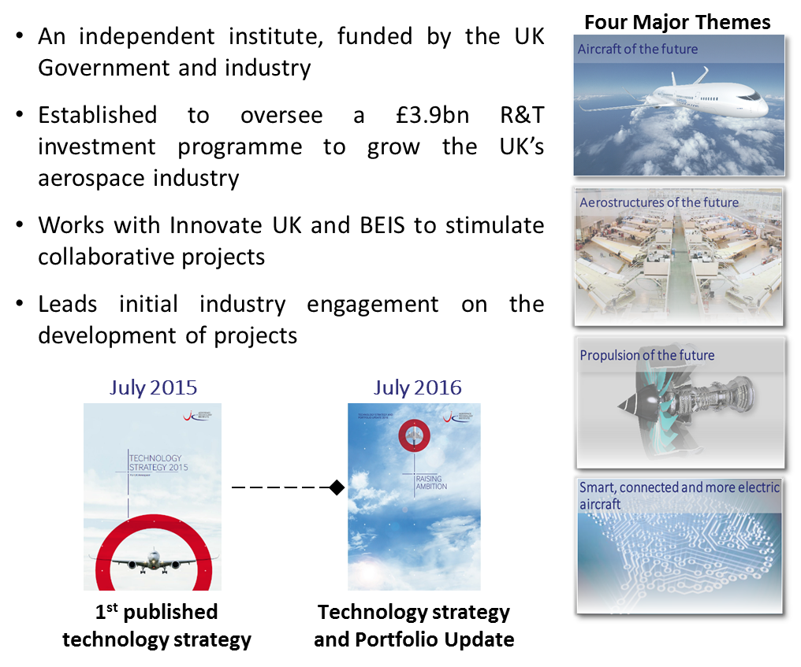
The ATI
1st published technology strategy
Technology strategy and Portfolio Update

Slide 3



Headline ATI Portfolio Statistics
Projects developed in the last 2 years…
WILL HELP TO SECURE OR GROW
UK HIGH VALUE JOBS
100
INDIVIDUAL PROPOSALS
40,000
…are adding to an extensive technology portfolio
70% SUCCESS RATE AT SR1
ATI PROJECTS ON CONTRACT: 196
TOTAL VALUE: £1.7BN; GRANTS OF £923M
60% SUCCESS RATE AT SR2
208 UNIQUE ORGANISATIONS
109 SME’s DIRECTLY CONTRACTED
WITH MANY MORE SMEs SUBCONTRACTED
Source: ATI Analysis of Innovate UK Public Data (1st November 2017)
Note: SMEs are defined as having 250 or fewer employees in the UK
27/10/2017

Slide 4
Key ATI Portfolio Statistics
ATI funding by value stream in line with UK aerospace sector turnover.
Largest focus in portfolio on cost reduction and fuel efficiency projects
Funding for exploit projects (5-10 years) has increased over the past months.
>50% of the partners participating are SMEs, receiving >£40m of grant funding
Source: ATI Analysis of Innovate UK Public Data (1st October 2017)
Note: SMEs are defined as having 250 or fewer employees in the UK
27/10/2017

Slide 5
ATI TES STRATEGY

Slide 6
Introduction to TES
“Through-life Engineering Services” (TES) comprise the design, creation and in-service sustainment of complex engineering products with a focus on their entire life cycle, using high-quality information to maximise their availability, predictability and reliability at the lowest possible through-life cost.

Slide 7


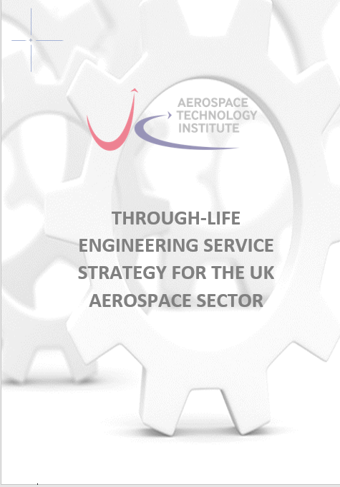
ATI TES Strategy Development
The ATI set out to develop a complete view of Through Life Engineering Services (TES) capabilities and technologies in the UK aerospace sector to inform its technology strategy - to ensure the UK is well positioned to take advantage of the opportunities in through-life services that are enabled by technology and to understand the opportunities for R&D.
Sector wide ATI TES survey launched in Feb/March 2017
Focussing on sector state of play in TES, key drivers and challenges, current gaps and technology requirements.
Over 112 survey responses with 30+ complete and detailed responses.
Industry stakeholder group established to provide inputs to strategy.
Workshop with Industry participants held in April 2017
Attendees from over 15 different organisations including Rolls Royce, BAE Systems, Leonardo, Thales, Marshalls, Boeing, Airbus, Academia and others.
Workshop provided inputs to roadmap developments for knowledge requirements, tools and technologies.
Published in October 2017 and accessible to UK industry participants.

Slide 8
Implications of TES to Product Life-Cycle Stages
Through-life engineering services may yield benefits across the life-cycle of a product

Slide 9
Roadmap for evolution
Several near- term opportunities can be addressed through supply chain companies capturing product performance / operational knowledge to improve product design and reliability.
Leveraging design for service capability, the mid-term presents an opportunity for primes, OEM’s and higher tier companies to partner with supply chain companies to deliver integrated service offerings, sharing know-how, risks and benefits into the supply chain.
Leveraging the partnerships, the industry can then execute and deliver more cost effective, customer centric service business models.

Slide 10
TES Framework
Using insights gathered from the sector, the ATI has created a framework for understanding the technologies and capabilities required to deliver potential service offerings. It enables companies to assess where they are on their servitisation journey from a knowledge, tools and technology perspective.

Slide 11
Knowledge Requirements
Service knowledge enables organisations to make physical or operational changes to products or assets in response to awareness of their current condition. Knowledge is generated by monitoring, diagnostic and prognostic technologies, and decision support systems.

Slide 12
Tools and Standards
Tools and Standards underpin decision frameworks and are the backbone of technology platforms used to deliver through-life services. Through-life data architectures, decision optimisation tools, uncertainty models, and degradation/deterioration models were identified as near-term priorities for the UK, as were common data and interoperability standards

Slide 13
Technology Requirements
A range of technologies have been identified as essential to enable the transition to through-life services. These range from in-situ repair to self-healing, along with digital technologies such as data aggregation and analysis platforms.

Slide 14
Other TES Technology Themes
Prognostics - going beyond component level monitoring and aircraft level reasoning for prognostics
Electronics degradation assessment and modelling - developing degradation models to predict remaining useful life (RUL)
Secure sensor network for monitoring data collection - cyber-secure sensor networks
Science of compound degradation - model and database development focusing on difficult metals, composites and polymers
Health assessment and life prediction using NDT techniques and advanced signal processing
In-situ delivery focusing on miniaturisation of degradation assessment, borescope system development, robotic manipulators, repair and residual stress and incipient health assessment
Integrated life study at design stage (e.g. CAD module) focusing on attribute trade-off, usage modelling, degradation model integration with design parameters and morphing of CAD for visualisation
Digital Twin at component, sub-system and system levels for life study including PLM, networked PLM, new data model for service and integration with a deterioration database
17/10/2017

Slide 15
Other TES Technology Themes
Design for Through-life and No Fault Found, focusing on CAD modules for life studies, new materials and machines that never die
Methods to minimise incipient damage/defects in manufacturing to extend life by reducing residual stress, micro cracks, thermal damage and through compound in-service degradation science
Accurate health assessment including part/system sanctioning and self-health assessment technologies
Prediction capability for remaining useful life (RUL) at component, sub-system and system level
Life extension analysis including repair and re-manufacturing assessments, fatigue enhancement, mechanical vaccine at component, sub-system and system levels
Self-engineering systems for zero-maintenance including self-repair and self-healing technologies
Metal and composite repair technologies especially for novel materials and new components that cannot be repaired today. For metallic, inspection and deposition technologies to relieve stress, and the capability to machine and re-inspect.

Slide 16
Other TES R&T Challenges
Analysis of surface quality and life including interface design for life and high performance, and maintaining ultra-precision features over time.
Reducing energy/environment footprint through-life including analysis on reduce material consumption.
Modelling usage scenarios including Load modelling and Environmental modelling (to understand the relation between the environment and component features.

Slide 17
Summary
The ATI TES technology strategy identifies a clear need to:
Consolidate existing UK industrial know-how on through-life services by creating a services knowledge platform, accessible to UK OEMs, supply chain companies and MROs, to spread knowledge and understanding of TES principles.
Create a technology architecture for TES, integrating design, manufacturing and aftermarket activities, including tools, standards and technologies identified, to support sector capability development for advanced through-life service provision.
Next Steps for the ATI
The ATI TES strategy identifies the opportunities of transitioning to through-life engineering services, and the technologies and capabilities required to enable the transition. The Institute will continue to work with the sector to disseminate the strategy and to encourage the sector to shape and submit relevant TES technology projects.

Slide 18
THANK YOU

