Slide 1
Future-proofing UK Composite Manufacturing
Manufacturing 2075
6th December 2017
Cranfield University
Cranfield
Giuseppe Dell’Anno, Chief Engineer
Notes:
I have here a few slides to provide you with a peek into the future and give you an outlook on what composite manufacturing might look like in the decades to come
Before I delve into the details of it, let me give you an overview of the NCC for those who are not familiar with who we are

Slide 2
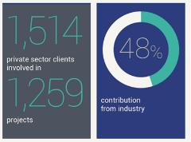
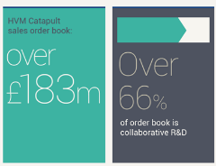
The High Value Manufacturing Catapult
The HVM Catapult is the catalyst for the growth and success of UK advanced manufacturing
We help turn ideas into commercial applications by addressing the gap between technology concept and commercialisation
Engaged with manufacturing businesses of all sizes and from all sectors
Notes:
The whole Catapult initiative has been established a few years ago to address the gap between technology concept and commercialisation
Performance from last year’s report

Slide 3
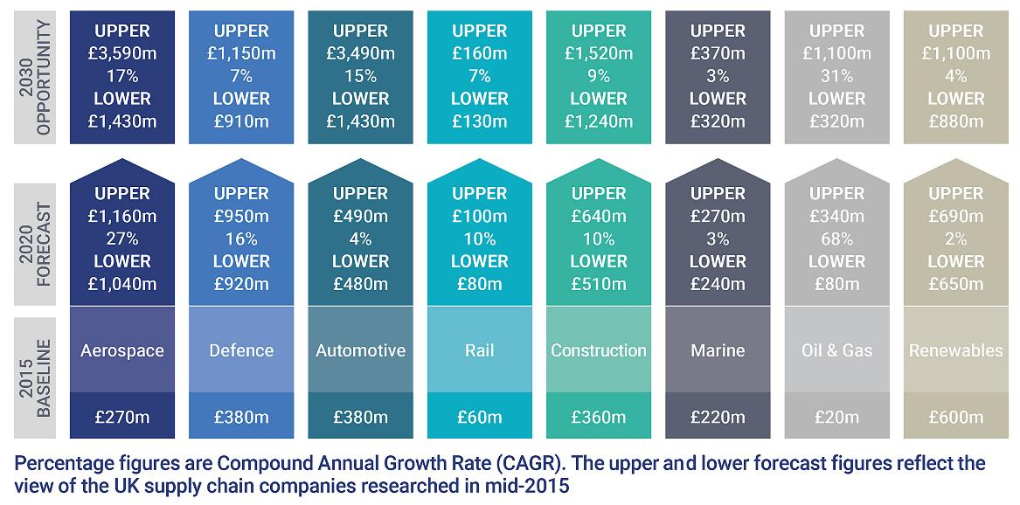
The UK Composites Opportunity
£12.5bn
12% CAGR
2020
£4.7bn
15% CAGR
UK Total
2015
£2.3bn
Notes:
Composite Leadership Forum report
£2bn of product 2015
To £4,7 bn in 2020
To 12.5 bn in 2030
All possible but not going happen by itself
And that’s is where we come in…..

Slide 4
The NCC Mission
To accelerate the growth of UK industrial output by enabling design and manufacturing enterprises to deliver winning solutions in the application of composites
Technology
to Industry
Research
Product
NCC Focus
Align Research with Industry needs
Notes:
Bridging the Valley of Death

Slide 5
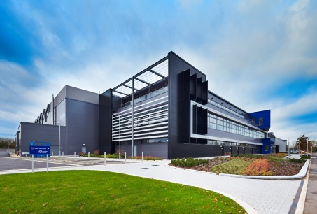
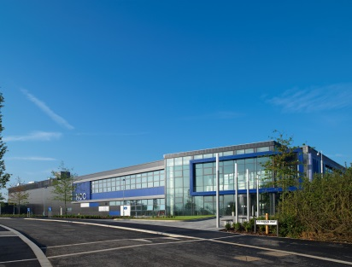
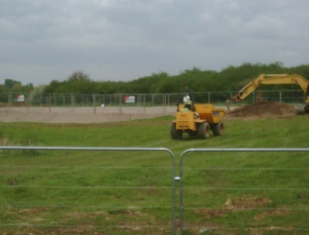
The NCC journey
An open access centre led by industry, used by industry, hosted by University of Bristol
£12.5bn
12% CAGR
2020
£4.7bn
15% CAGR
UK Total
2015
£2.3bn
>200 Customers
~300Staff
£ 22m
Catapult funds have enabled 25% year-on-year growth
2009
2011
2017
2030
Notes:
2009 strategy – money for a centre to help with commercialisation
Competition – UoB and SW
Open in 2011 … envisaged as £5m turnover and max of 50 staff we have grown to around 300 staff and our turnover last year was £22m
Due to the acceleration funding that came from Government when it formed the catapults
Catapult funding enables capability growth ahead of industrial demand so knowledge is ready for them

Slide 6
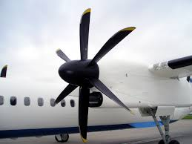
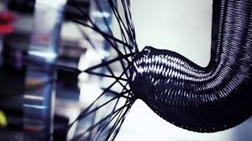
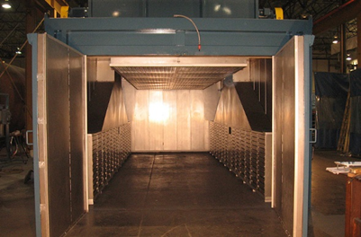
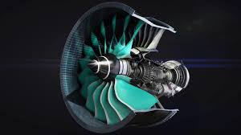
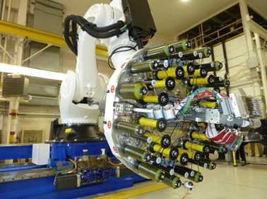
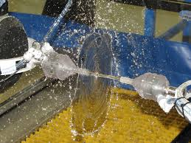
The NCC journey
Planned expansion
£12.5bn
12% CAGR
Thermoplastic composites, over-moulding, advanced braiding, tension fibre placement
2020
£4.7bn
15% CAGR
UK Total
2015
£2.3bn
Automated Dry-fibre pilot line, curing oven, large scale resin infusion
High rate AFP & ATL technologies, Net-shape performs, automated quality assurance
2009
2011
2017
2030
Notes:
£37m grant to procure 10 pieces of equipment
Seeing a transition from prepeg materials and autoclave curing to new materials (TP) and OoA processes to met high rates, low waste and high repeatability that the auto sector demands.

Slide 7
The NCC journey
Large Structures Centre
Future possibilities?
NCM Programme
£12.5bn
12% CAGR
People & Innovation Centre
Multi Materials
Beyond CF Programme
2020
£4.7bn
15% CAGR
UK Total
2015
£2.3bn
Smart Materials
Institute
Sustainability Centre
Adv. Composites Design & Simulation Institute
2009
2011
2017
2030

Slide 8
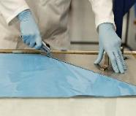
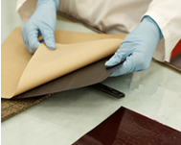
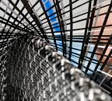
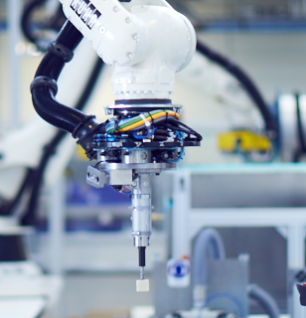
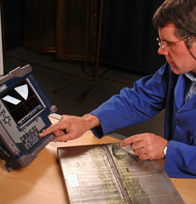
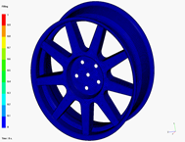
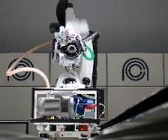
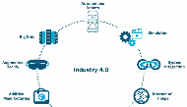
Fuelling the Revolution for Composites Manufacturing
Increasing:
Productivity
Repeatability
Reliability
Hand Cutting
Manual Lay-up
Braiding & 3-D Weaving
Press Moulding
Local Reinforcement
In Process Inspection
Manual Quality Checks
Curing
Process Simulation
Automated Lay-up
Automated Preforming
Digital Manufacturing
Notes:
What is the driver behind this?
Effectively it’s a step change in manufacturing technologies
The operators are stepping further and further back from the workbench

Slide 9
UK Manufacturing of Composites – Political & Market View*
Increasing demand for large components aerospace, wind, construction…
Processes and costs that suit increased manufacturing rates 10⁵/y not 10²/y
Automated manufacture
Reducing cost and time to market design → certification → in service
Growing the UK skills/expertise to compete with the world supply chains
Digital Manufacturing
The Challenges
*Courtesy of Prof Mike Hinton, Research and Technology Partnerships, High Value Manufacturing Catapult
Notes:
The strategy must articulate around Digital Manufacturing…

Slide 10
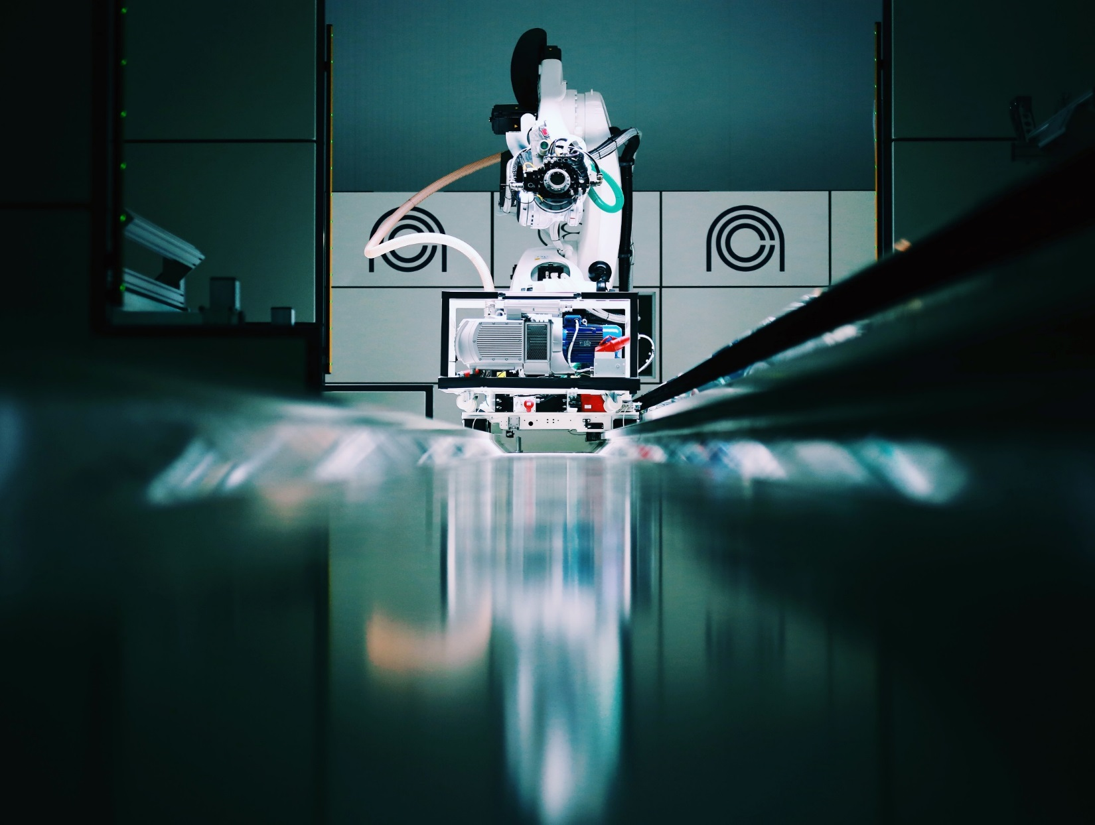
Digital for Composites
Process Intelligence
Data Handling
Connected Systems
Notes:
Digital –buzz word today: what does it mean for composites? The key is to work out how to integrate live design parameters and physical processes to improve both product and process.

Slide 11
Digital for Composites
Process Intelligence
Data Handling
Connected Systems
NCC Lead
NCC Access
Notes:
The NCC focuses on composite process intelligence while we use the expertise of other Catapult centres to create the integrated framework.
E.g. The MTC (manufacturing technology centre) leads the digital technology – the means for connecting systems – we utilise these and tailor them to composites needs

Slide 12
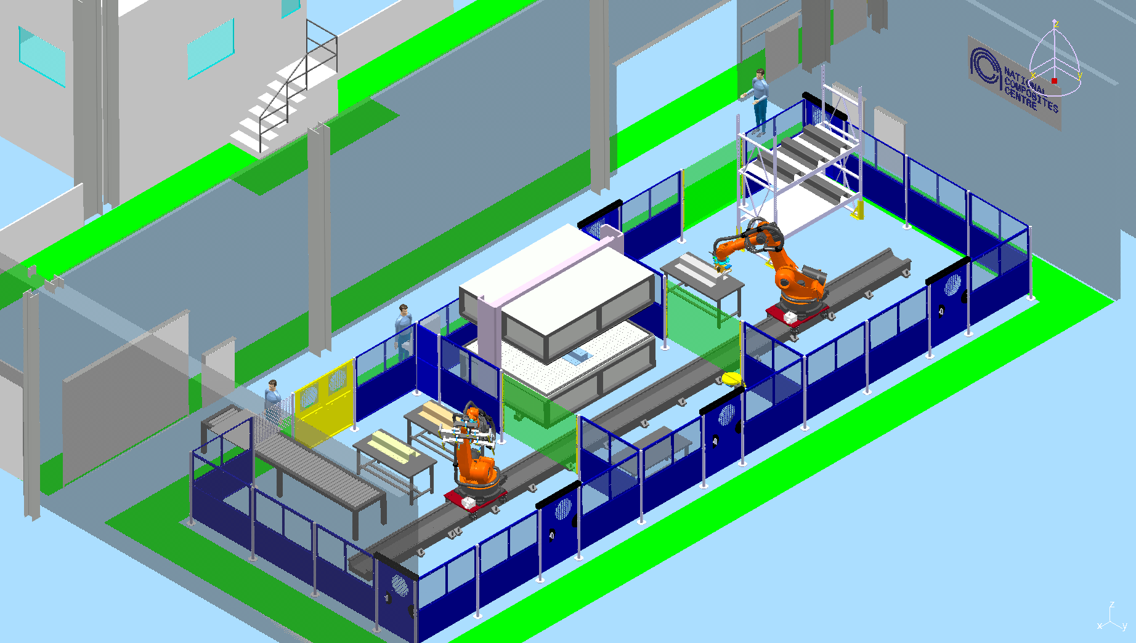
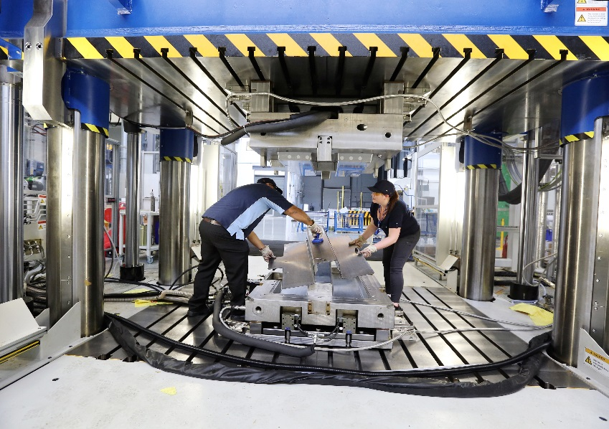
What is Industry 4.0? Why should we be interested?
What?
Industry 4.0 identifies the current trend of automation and data exchange in manufacturing technologies. It defines the use of Cyber-Physical Systems in industry.
Why?
Provides tools to digitise the ‘black-art’ aspects of composites
Artificial Intelligence can help us learn from and improve our designs and processes
Digitised and intelligent production offers a greater return on investment of knowledge
Notes:
Cyber-physical in the sense that the system still revolve around experimental artefacts manufacturing, with digital-computational elements supporting it

Slide 13
How should we do it?
4 Key Enablers
Highly integrated systems (enabling processes to be customised)
Digital simulation linked to real world processes (Digital Twin)
Internet of things connecting processes to generate large amounts of data to learn from
Artificial Intelligence to make decisions automatically
Challenges
Requires accessible industrial IT infrastructure
You need composites experts to build and train the digital tools
Expected benefits
Speed
Repeatability
Part complexity
Notes:
Speed: Reduced cycle times in all automated processes, not just for simple parts
Repeatability: Improved part quality and less external factors dependency
Part complexity: Automated processes tolerant of design complexity, and reduced amount of manufacturing constraints applied to a design

Slide 14
Composite Technologies Comparison
Prepreg hand laminating (baseline)
5 out of 10 in speed
3 out of 10 in repeatability
10 out of 10 design complexity (size of the bubble)
Holy Grail
Prepreg Hand Layup
Speed
Repeatability
Notes:
So… which of the current process can benefit from this and how?
The holy grail process is shown for reference in green (10/10/10)

Slide 15
Composite Technologies Comparison
Prepreg hand laminating (baseline)
Automated Tape Laying
Automated Preforming
Automated Fibre Placement
Braiding
Resin Transfer Moulding
Liquid Resin Infusion
High Pressure RTM
Compression Moulding
Injection Overmoulding
Injection overmoulding
Compression moulding
Holy Grail
HP-RTM
Prepreg hand layup
Automated preforming
ATL
Speed
RTM
Braiding
AFP
Liquid resin infusion
Repeatability
Notes:
Now the other processes can be added

Slide 16
Composite Technologies Comparison
Prepreg hand laminating (baseline)
Automated Tape Laying
Automated Preforming
Automated Fibre Placement
Braiding
Resin Transfer Moulding
Liquid Resin Infusion
High Pressure RTM
Compression Moulding
Injection Overmoulding
Holy Grail
Prepreg hand layup
Automated preforming
ATL
Speed
Braiding
AFP
Repeatability
Notes:
It makes sense to take out the preform-driven technologies (on the basis that preforming is the bottle neck, the greatest challenge, and our current solutions are not competitive
i.e. automation has made us 15 times faster in preforming (2 hours to 8 minutes, based on the omega panel we made at the NCC when we commissioned the HPRTM), but we need to use digital to get the 8 minutes to 1 minute (so 120 time faster that the baseline) – i.e. for people like JLR to adopt composites as a technology

Slide 17
Speed vs. Complexity vs. Repeatability
Increase part complexity by:
Digitising the human worker to allow manual tasks to be performed with high levels of traceability and repeatability
Reduce cycle times by:
Automating manual processes, and automating the decision making in existing automated processes
Improve part quality and repeatability by:
Integrating systems together and using intelligent process control to identify problems and implement real-time solutions
Instrumented worker
Speed
Surrogate modelling
Repeatability
Machine learning
Notes:
Improve design complexity: Instrumented hand tools used to inform operator when optimum process parameters are met such as laminate temperature and pressure applied by hand
Improve quality and cycle time: Surrogate model used to implement Read/Decide/Act loop for resin transfer moulding of a component which has been highly characterised by digital simulations
Improve quality and repeatability: Using artificial intelligence to check for laminate quality automatically in the preforming cell based on photographs taken mid-process cycle. The decision is made automatically and in real-time
Let’s have a look at these strategies one by one

Slide 18
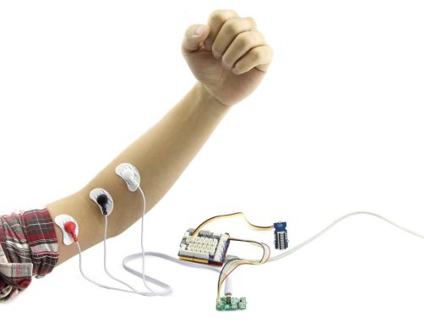
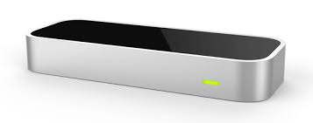
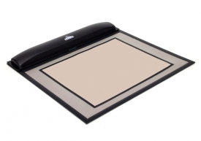
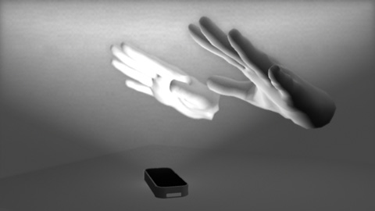
Complexity: Instrumented Worker
The concept involves applying sensors to a manual task
An experimental set-up:
Leap Motion: tracks hand movements (locational data)
Camera: captures general movement data
Electromyography (EMG) sensors: capture muscular effort
Pressure mat: captures additional pressure data from the tooling
All the above is complemented by data captured from sensor-enabled hand tools
An EMG sensor
Leap Motion sensor
A Tekscan pressure sensor
Notes:
Involves embracing the fact that we are never going to replace a human, and find ways to address the flaws in their performance
Digital coach for the manual worker

Slide 19
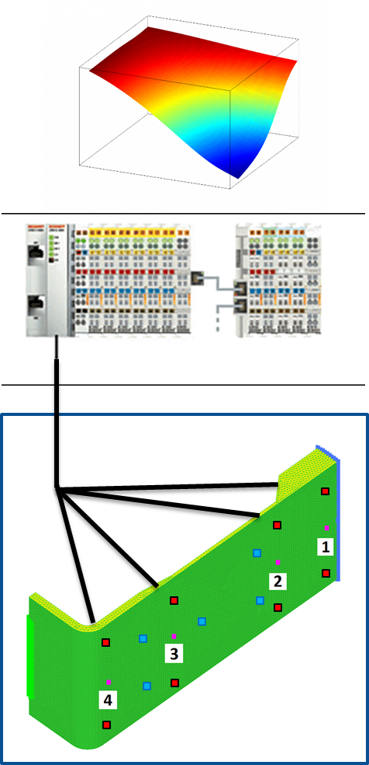
Speed: Surrogate Modelling
Sensors positioned around tool indicate the progression of the resin flow-front
Simulations are used to create a surrogate model, stored on the PLC
The PLC controls the resin inlet and vacuum ports based on the surrogate model
Data generated during manufacture is fed into a machine learning algorithm to improve the surrogate model
Learn
Teach
Capture
Decide
Act
Read
Define
Interrogate
Notes:
Surrogate model: loads of preliminary testing to experimentally validate points across a surface which is then used by the integrated system to identify the optimal position once a set of variables are defined
1) Data is stored in a database in a logical and easily retrievable manner
2) The data is interrogated to identify process patterns and relationships. This is augmented with digital process simulation so that skilled composites engineers can extract learning.
3) The lessons learned are then captured as decisions or scenario plans that can be loaded onto a control PLC in an automated system
1) Data is read from a wide array of in-process sensors relaying information such as temperature, pressure, power and position
2) The data is used to establish what is happening during the process and decisions are made on how to proceed – enabling mitigation scenarios to be selected
3) The decision and associated process data is actioned by the controlling PLC as part of the automated process

Slide 20
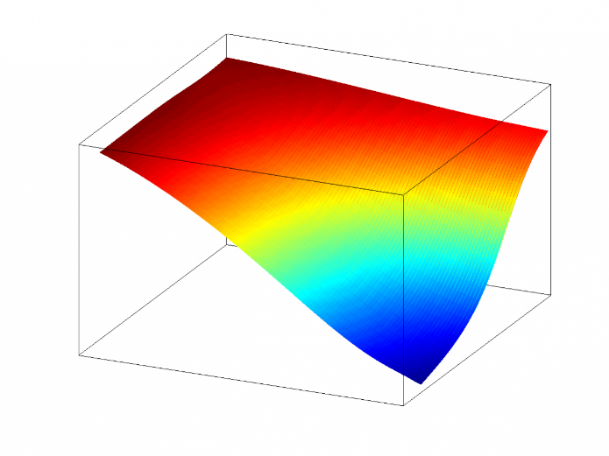
Speed: Surrogate Modelling
Notes:
We have started to move the first steps in this direction by simulating multiple realistic scenarios for a resing impregnation process and account for the process variability due to different race tracking conditions

Slide 21
Repeatability: Machine Learning applied to composites
Machine learning seeks to generate insight and value from data
Neural networks mimic the structure of a biological brain to learn connections between data features
So far applications in composites have been limited
Problem: Can we make a learning algorithm to classify ‘preforms’ as good or bad based on how frayed their edges are?
Test: The classifier performs extremely well in this limited problem
99+% accuracy on test set
97.5% accuracy achieved on validation set
Further work would increase generality and improve robustness:
Changing network architecture (e.g. increasing number of layers) to cope with more realistic data
Introducing more training samples into the data set
GOOD
BAD
Correctly classified examples
Base images for training set
Notes:
Our smart phones already use deep learning techniques to recognise our faces, voices and fingerprints.
Used a simplified representation of a preform (50 x 50 pixel black and white image) and irregular protruding lines around the edges to depict frayed fibres
A neural network system (Tensorflow - Google) trained on 8000 images
Sounds easy but it’s mindbogglingly complicated: the network has about 2.2M parameters!

Slide 22
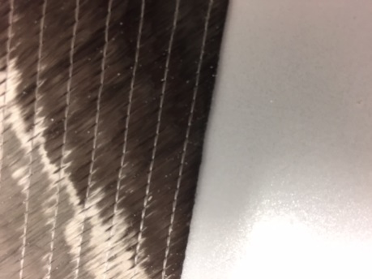
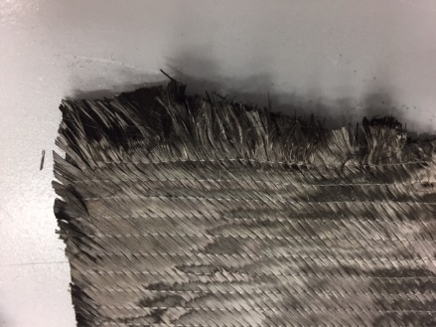
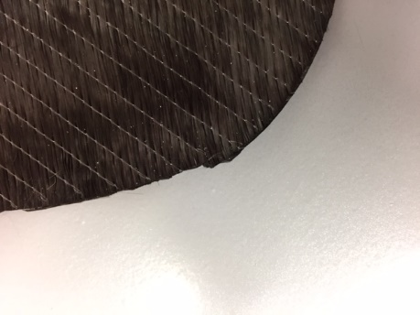
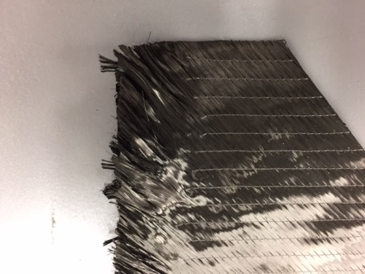
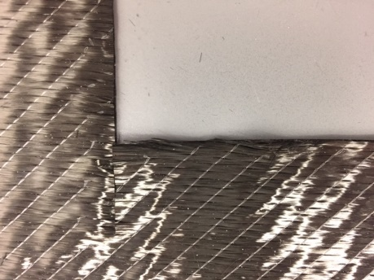
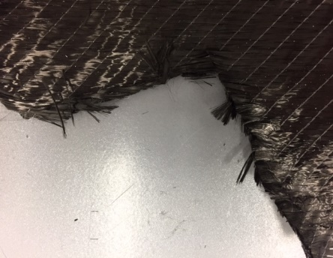
Repeatability: Machine Learning applied to composites
GOOD
BAD
Dry fibre plies photographed before and after handling and classified as ‘good’ or ‘bad’
Problem kept as a binary edge classifier
A neural network was trained on ~15,000 images (data augmentation was used on a base set of around 50 images)
Reasonable accuracy of around 80% on the test set was achieved
Performance could be improved by acquiring more data and refining the acquisition methodology
Next? Defect identification, NDT scans, process data
Base images for training set (real data)
Notes:
More work is needed to increase expertise and develop proper products with market appeal:
Quality and quantity of data.
Benchmarking (against human performance and alternative machine performance)

Slide 23
Manufacturing in a suit?
Notes:
Is this the future?
Manufacturing in a suit rather than in workshop overalls?
The feeling is that we will not avoid getting our hands dirty just yet, but we will certainly have more smart tools which will get covered in resins as well as our hands…

Slide 24
Thank you
for your attention!
Further information from: giuseppe.dellanno@nccuk.com
The material presented was produced by Dr Simon Astwood.
www.nccuk.com | 0117 3707 600 | enquiries@nccuk.com | @NCCUKinfo | @NCCUKComms

Slide 25
The NCC 5-year plan: Focussing on Digital Twin & Analytics
In 2022 the NCC will…
“…demonstrate automated manufacturing processes that improve themselves based on live process data”
The long-term objectives of this are to…
Improve component quality & repeatability
Reduce cycle times
Enable the manufacture of complex components
To enable ATI programs to benefit by Q2 2019 we should…
Enable all new equipment to gather process monitoring data
Facilitate machine decision making in equipment control architecture
Establish which process parameters are likely to benefit from in-process adaption
Notes:
Part of the ATI capability expansion programme
But what does this mean and how are we going to implement it?

