Slide 1
Forensic MSc Programme
Professor Andrew J. Shortland
Cranfield Forensic Institute
Thursday 7 June 2018

Slide 2
Cranfield Defence and Security campus

Slide 3
Cranfield University

Slide 4
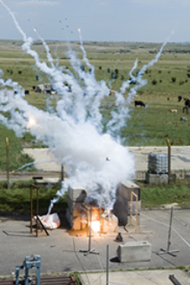
Research
Programmes reflect the strengths and expertise of the staff
Age at time of death,
Species discrimination from bone fragments,
CO threats,
Advanced X-ray imaging,
Location, excavation and recovery,
DNA recovery from cartridge cases,
Art fraud and illicit antiquities,
Explosive and drug detection,
Pigment and paint analysis,
Impact and trauma biomechanics,
OSINT, HUMINT, attack the network,
Digital investigations.
For many of the MSc projects, students will become a research team member.

Slide 5
Educational Courses
Short Courses include:
Conflict Archaeology.
Forensic Archaeology and Anthropology.
Counter IED.
Analytical Techniques in Forensic Science.
Courtroom Skills.
Engineering Failures and Accidents.
Fire and Explosion Investigations.
Firearms Investigations.
Forensic modular master’s
programme

Slide 6
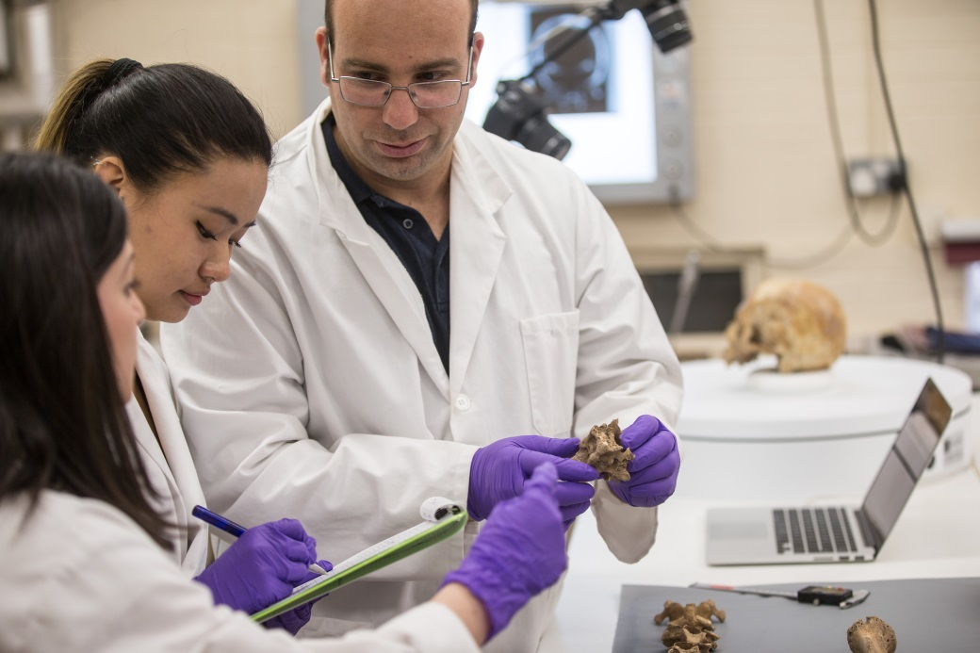
Course history
Forensic Computing MSc
First intake 1998/9
Forensic Engineering and Science MSc
First intake 1998/9
Forensic Archaeology and Anthropology MSc
First intake 2006/7.

Slide 7
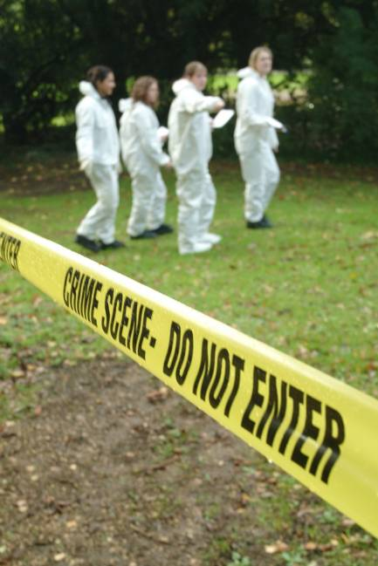
A modular forensic MSc programme
First ran in 2009/10
Science-based course
Ideally suited to those with a non-forensic first degree
Six themes:
Digital Forensics,
Forensic Archaeology and Anthropology,
Forensic Engineering and Science,
Forensic Ballistics,
Forensic Investigation,
Forensic Explosives and Explosion Investigations.
Which one are you interested in?

Slide 8
Course structure
Introductory studies (1 week)
Pre-course reading.
Introductory studies.
Assessed modules are:
mostly 10 credits,
120 credits,
one week (except AT, FCF),
some common,
first set foundation for later role specific modules.
Private study.
Examinations.
Research project.
80 credits
Part-time students up to three years.
Assessed modules
Block 1
Exams… then Christmas break
Assessed modules
Block 2
Exams… then Easter break
Research Project

Slide 9
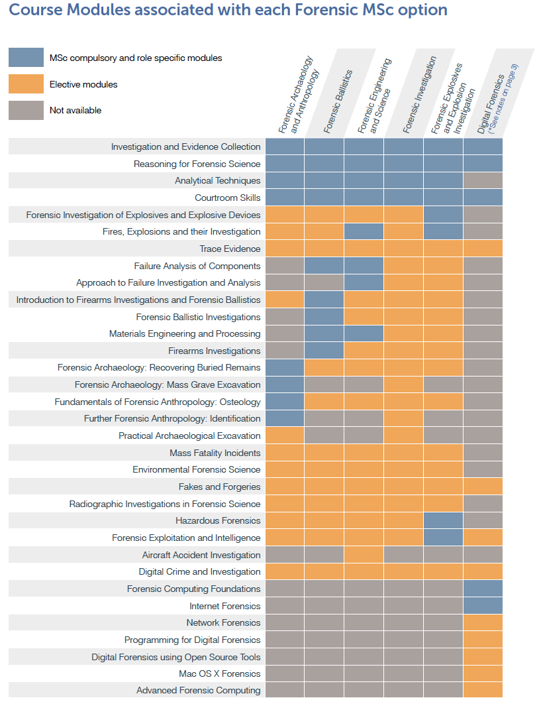
Modules

Slide 10
Modules

Slide 11
Assessment
Wide spectrum of assessment types
Taught modules include:
Individual and group presentations;
Laboratory reports and expert witness statements;
Crime scene exercises and archaeological excavations;
Written, oral & practical examinations;
Research project of 20,000 word thesis or shorter paper;
Oral examination;
Continuous assessment.

Slide 12
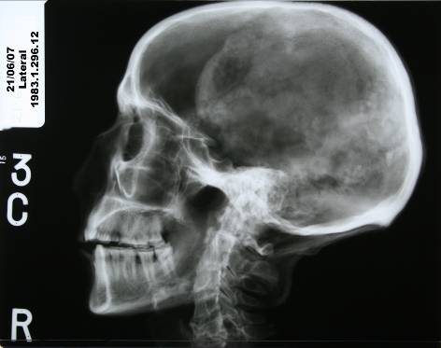
Research projects
Blast Mitigation Materials
Study of Human Hair
Small Scale Fragmentation of Cast Iron
Analysis of Matches Used in Arson
Blood Pattern Analysis on Shoes From Kicking
Frequency of Paint Fragments on the Clothing
Isotope ratios for IEDs
DNA preservation in heated bone and bone marrow
The effects of different size firearms on skull bones
Preservation of Rwandan genocide victims
Determining the position of the source of blood stains
Anthropological analysis of skeletal remains
The application of modern fire investigation techniques
Forensic ballistics investigation
Shotgun safety study
Soft tissue strength under dynamic loads.

Slide 13
Forensic Science Society accreditation
All five themes have been formally accredited:
MSc Forensic Archaeology and Anthropology,
MSc Forensic Ballistics,
MSc Forensic Engineering and Science,
MSc Forensic Explosives and Explosion Investigations,
MSc Forensic Investigation,
Accredited by GCHQ:
MSc Digital Forensics.

Slide 14
Social
Officers’ Mess
Mess Dinners
Outings
Mess Bar
Very cheap rooms
Clubs
Other events
Sporting
Gym
Stables
Swimming Pool
Golf course
Sporting clubs
Shooting
Celebratory
Graduation
Firework display
Red Arrows
Working
Secure
Ranges
Armoury
Laboratories
Libraries

Slide 15
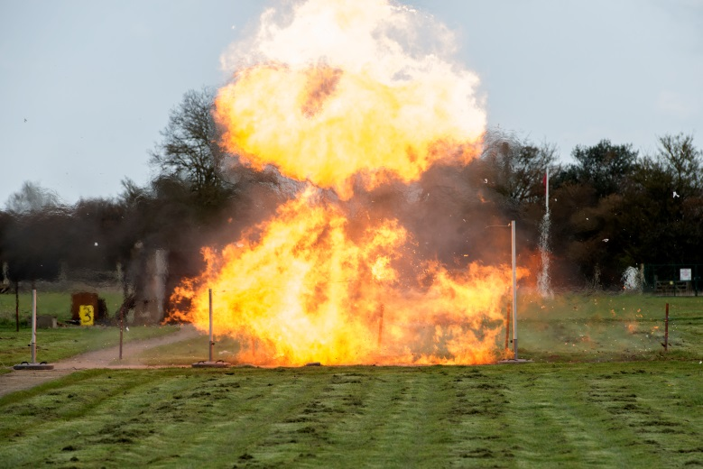
Highlights
No undergraduates,
International student body,
Large and secure site,
Unique Facilities including:
Armoury and ranges,
Explosives,
Experimental burials.
Flexible courses with large module choice,
Operational, research active staff.

Slide 16
Our analytical forensic facility
We have attracted a significant financial investment to build a new forensic laboratory
Available for research, case work and teaching
State-of-the-art equipment including a CT scanner, spectroscopic microscopes and interactive viewing.

Slide 17
Key people
Cranfield Forensic Institute
Professor Andrew Shortland
Professor David Lane
Professor Keith Rogers
Forensic Science & Engineering
Dr Jon Painter
Forensic Archaeology
Dr Karl Harrison
Forensic Anthropology
Dr Nick Marquez-Grant
Forensic Ballistics
Dr James Shackel
Forensic Explosions & Explosives
Steve Johnson
Digital Forensics
Dr Sarah Morris

