Slide 1
Manufacturing 2075: Rethinking the role of digital in manufacturing
Dr Nick Wright
Digital Catapult

Slide 2
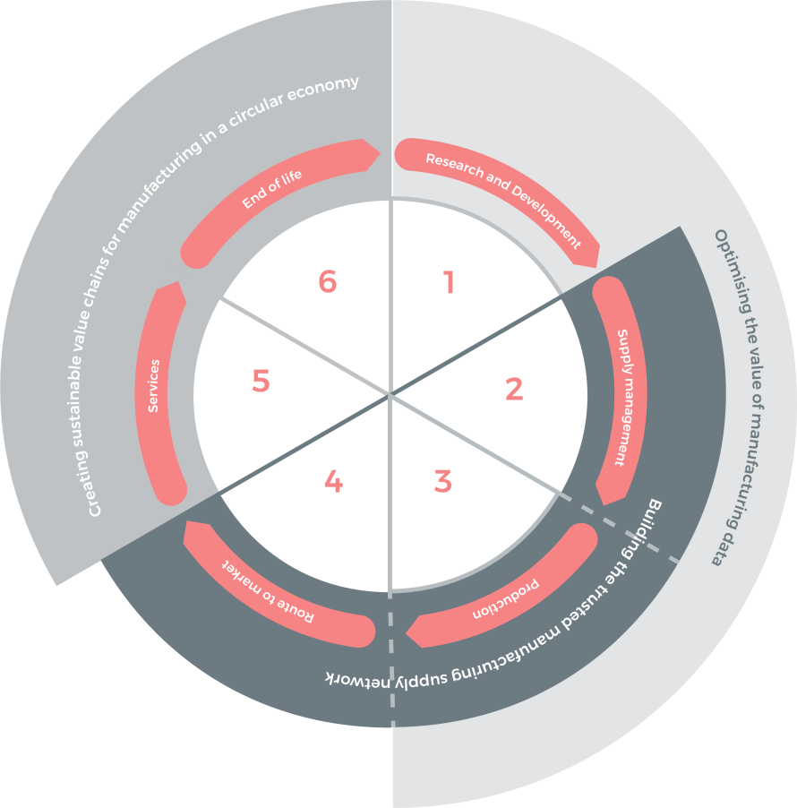
Manufacturing 2075: Rethinking the role of digital in manufacturing
Opportunities for digital across every aspect of the product cycle
4th industrial revolution has largely focused on improving production processes
Manufacturing companies are ultimately driven by revenue and profit
Digital Catapult aims to help unlock the value of advanced digital technology in three areas of opportunity
Notes:
I4 focuses on solving todays challenges, and many of the case studies have focussed on improving production processes
Digital Catapult is creating an environment to help unlock the value of technology in new huge areas of opportunity in the manufacturing sector
Manufacturing companies do much more than simply make things.
Ultimately they’re required to make money
Digital Catapult is placed to help established manufacturers exploit this opportunity as well as encouraging new disruptors to the market

Slide 3
Manufacturing 2075: Rethinking the role of digital in manufacturing
Digital Catapult creates an environment to help established manufacturers exploit this opportunity and encourage new disruptors to the market
Notes:
I4 focuses on solving todays challenges, and many of the case studies have focussed on improving production processes
Digital Catapult is creating an environment to help unlock the value of technology in new huge areas of opportunity in the manufacturing sector
Manufacturing companies do much more than simply make things.
Ultimately they’re required to make money
Digital Catapult is placed to help established manufacturers exploit this opportunity as well as encouraging new disruptors to the market

Slide 4
Manufacturing 2075: Rethinking the role of digital in manufacturing
Sustainability
powered by
Future Networks
Notes:
How many people here have a reusable water bottle or coffee cup?
Blue planet had an impact to change consumer habits based on new information - and many brands/companies made announcements saying they were changing the way they made their products as a response to consumers
Did you know avocado production requires something called migratory beekeeping which involves shipping bees in trucks to supplement native bees with pollination of plants?
Does knowing this change anything about your view of avocados?
We think this will become a huge opportunity for future manufacturing applications
Take airlines - at some point the impact of a particular plane will impact decisions on who to fly with
It already impacts the car you buy
It won’t be long until data around circular economy deep into the manufacturing supply chain is valuable for sales in all tiers of the supply chain
Using digital technology in the circular economy has the potential to help us make better decisions about resource use, design out waste, provide added value for business, and proceed along a secure route to environmental sustainability for future generations. For the UK, the circular economy could drive £10 billion profit and 4.5% GHG reduction
Sustainability is at the heart of national and global policy across almost every industry at present. The adoption of new innovative technological interventions in particular supported by Future Networks such as 5G and LPWAN will be critical for improvements

Slide 5
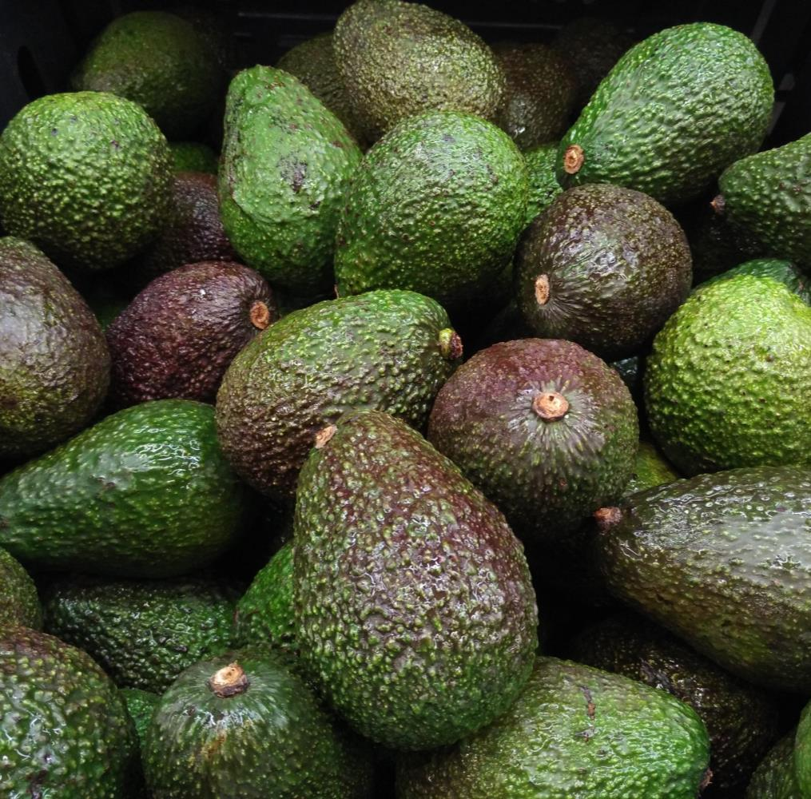
Manufacturing 2075: Rethinking the role of digital in manufacturing
Consumer trends
Data-driven information is changing the demand for products in food & drink and consumer packaged goods
Automotive impact
UK automotive industry leading with 97% of the vehicle being recycled, reused or recovered
Value of sustainability data
We predict that data associated with environmental impact and the circular economy will become more valuable
Competitive advantage
Manufacturers that make this data available to the customers and end users will gain an advantage over the competition
Notes:
How many people here have a reusable water bottle or coffee cup?
Blue planet had an impact to change consumer habits based on new information - and many brands/companies made announcements saying they were changing the way they made their products as a response to consumers
Did you know avocado production requires something called migratory beekeeping which involves shipping bees in trucks to supplement native bees with pollination of plants?
Does knowing this change anything about your view of avocados?
We think this will become a huge opportunity for future manufacturing applications
Take airlines - at some point the impact of a particular plane will impact decisions on who to fly with
It already impacts the car you buy
It won’t be long until data around circular economy deep into the manufacturing supply chain is valuable for sales in all tiers of the supply chain
Using digital technology in the circular economy has the potential to help us make better decisions about resource use, design out waste, provide added value for business, and proceed along a secure route to environmental sustainability for future generations. For the UK, the circular economy could drive £10 billion profit and 4.5% GHG reduction
Sustainability is at the heart of national and global policy across almost every industry at present. The adoption of new innovative technological interventions in particular supported by Future Networks such as 5G and LPWAN will be critical for improvements

Slide 6
Manufacturing 2075: Rethinking the role of digital in manufacturing
Cost of data collection
Average cost of IoT modules is now below $10 and trending towards $3
Sensor cost is now below $0.5
Cost of computing will drop to $0.01/GFLOP in 2020
Future Networks
5G, Low Power Wide Area Networks, Bluetooth Low Energy and Ultra Wide Band are strategic connectivity enablers to drive value from sustainability data
£10 billion growth for the UK
Applications of digital technology within the circular economy is predicted to add £10bn to the UK economy and reduce GHG emission by 4.5%¹
1. Next Manufacturing Revolution
Notes:
How many people here have a reusable water bottle or coffee cup?
Blue planet had an impact to change consumer habits based on new information - and many brands/companies made announcements saying they were changing the way they made their products as a response to consumers
Did you know avocado production requires something called migratory beekeeping which involves shipping bees in trucks to supplement native bees with pollination of plants?
Does knowing this change anything about your view of avocados?
We think this will become a huge opportunity for future manufacturing applications
Take airlines - at some point the impact of a particular plane will impact decisions on who to fly with
It already impacts the car you buy
It won’t be long until data around circular economy deep into the manufacturing supply chain is valuable for sales in all tiers of the supply chain
Using digital technology in the circular economy has the potential to help us make better decisions about resource use, design out waste, provide added value for business, and proceed along a secure route to environmental sustainability for future generations. For the UK, the circular economy could drive £10 billion profit and 4.5% GHG reduction
Sustainability is at the heart of national and global policy across almost every industry at present. The adoption of new innovative technological interventions in particular supported by Future Networks such as 5G and LPWAN will be critical for improvements

Slide 7
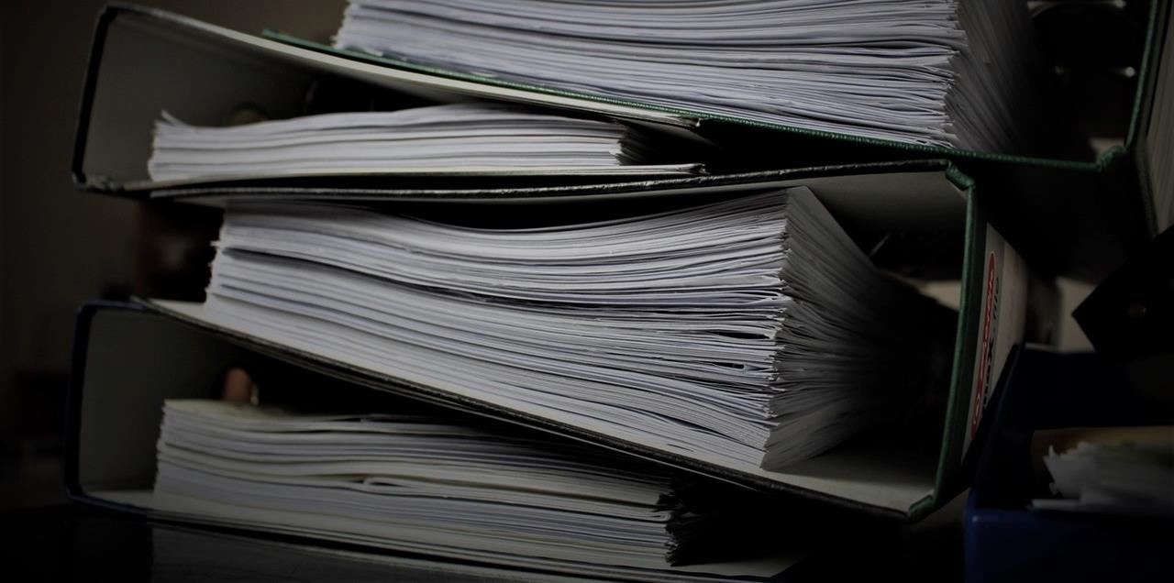
Manufacturing 2075: Rethinking the role of digital in manufacturing
Trust
powered by
Distributed Ledger Technology

Slide 8
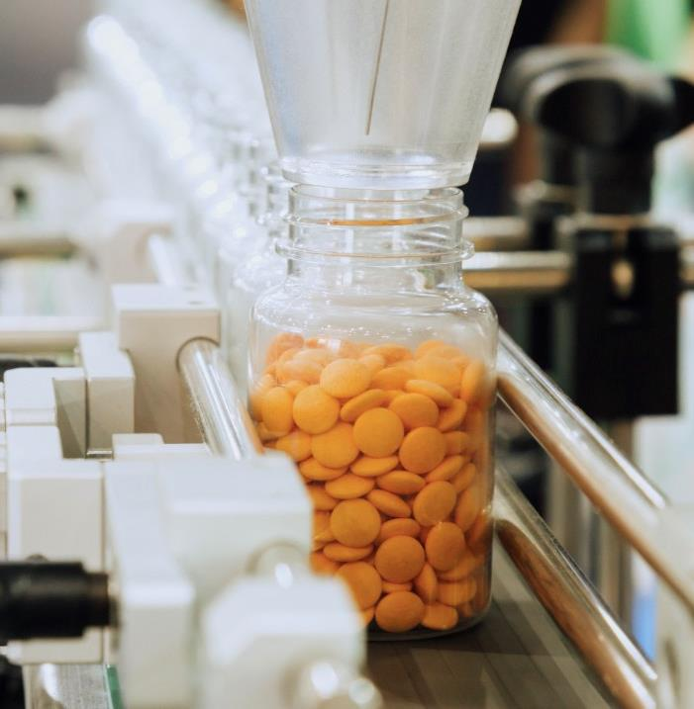
Manufacturing 2075: Rethinking the role of digital in manufacturing
Paperwork builds trust
In aerospace, the A350 presented nearly 700 documents for type certificate, with many thousands more in the supply chain
Counterfeit supply chains
Up to 15% of the aerospace supply chain is thought to be counterfeit¹
1% - 30% of all drugs in circulation are counterfeit²
Security of data
Majority of documentation is available in electronic form, but it is possible to manipulate
Databases
A single database for all data across the supply chain, would make sense, but nobody would trust it!
Fighting counterfeit pharmaceuticals, PWC
Department of Defense
Notes:
I4 focuses on solving todays challenges, and many of the case studies have focussed on improving production processes
Digital Catapult is creating an environment to help unlock the value of technology in new huge areas of opportunity in the manufacturing sector
Manufacturing companies do much more than simply make things.
Ultimately they’re required to make money
Digital Catapult is placed to help established manufacturers exploit this opportunity as well as encouraging new disruptors to the market

Slide 9
Manufacturing 2075: Rethinking the role of digital in manufacturing
Distributed Ledger Technology
Aims to split the database open and make it secure
Smart ledgers are estimated to contribute over £500m to this alone
UK Capability
The UK has over 260 DLT companies that are not exclusively aligned to financial services
Early adopters could uncover significant advantages
£30 billion growth for the UK
By innovating and developing service driven supply chains that could create over 500k jobs
Reducing supply chain barriers could increase global GDP by nearly 5% and trade by 15%²
135
5G – Relevant academic projects
39
Academic institutions leading or participating
29
Local authorities
57
Companies
Pulling together: Strengthening the UK’s supply chains (CBI)
World WEF 2013, Enabling Trade Valuing Growth Opportunities
Notes:
I4 focuses on solving todays challenges, and many of the case studies have focussed on improving production processes
Digital Catapult is creating an environment to help unlock the value of technology in new huge areas of opportunity in the manufacturing sector
Manufacturing companies do much more than simply make things.
Ultimately they’re required to make money
Digital Catapult is placed to help established manufacturers exploit this opportunity as well as encouraging new disruptors to the market

Slide 10
Manufacturing 2075: Rethinking the role of digital in manufacturing
Optimisation
powered by
Artificial Intelligence

Slide 11
Manufacturing 2075: Rethinking the role of digital in manufacturing
Product performance
Leading-edge, modern buildings are routinely found using up to 3.5 times more energy than their design had allowed for¹
Availability of data
Building management systems have evolved using IoT and analytics, making them critical to building performance
Improperly configured BMS are believed to account for 20% of building energy usage²
Optimise the use of data
Opportunity to use rich data sets produced in running buildings to advance generative design for future design and in ongoing operation of the building to improve energy consumption
Building Data Exchange
Advanced Sensors and Controls for Building Applications:
Notes:
Imagine you invest a fortune in something new and cutting edge and find it doesn’t perform
You’d take it back
But you can’t do that with a building
Leading-edge, modern buildings are routinely found using up to 3.5 times more energy than their design had allowed for
Building management systems have evolved using IoT and analytics but not made enough of an impact
Modern Artificial Intelligence & Machine Learning (AI & ML) techniques have a number of different applications that can unlock new value out of data gathered in production by linking it back into other aspects of the value chain such as design and engineering.
AI is no single technique and our modern perspective on AI has shifted from rules based code to dynamic processing which uses vast quantities of data to classify details of a model system.
Within construction this could be using BMS data to influence cutting edge generative design or for
BMS systems are a critical component to managing energy demand. Improperly configured BMS systems are believed to account for 20% of building energy usage, or approximately 8% of total energy usage in the United States
However this technology capability sits outside the manufacturing supply chain
Only 2% of around 1000 UK AI companies have applications in manufacturing
in the UK, AI is predicted to contribute £199bn to the manufacturing supply chain over next decade
If we are to unlock this value, we need to attract this capability, providing rich data sets gathered using legacy and next generation sensing technology and IoT solutions

Slide 12
Manufacturing 2075: Rethinking the role of digital in manufacturing
Artificial Intelligence & Machine Learning
AI is no single technique and our modern perspective on AI has shifted from rules based code to dynamic processing which uses vast quantities of data to classify details of a model system
UK Capability
Types of people and company exist outside the manufacturing ecosystem
Out of around 1000 UK AI companies, only 2% have applications in the manufacturing sector
£199 billion opportunity for UK manufacturing
The value at stake to the UK economy between 2017 and 2027
This represents 43% of the of the benefits in Made Smarter
Notes:
Imagine you invest a fortune in something new and cutting edge and find it doesn’t perform
You’d take it back
But you can’t do that with a building
Leading-edge, modern buildings are routinely found using up to 3.5 times more energy than their design had allowed for
Building management systems have evolved using IoT and analytics but not made enough of an impact
Modern Artificial Intelligence & Machine Learning (AI & ML) techniques have a number of different applications that can unlock new value out of data gathered in production by linking it back into other aspects of the value chain such as design and engineering.
AI is no single technique and our modern perspective on AI has shifted from rules based code to dynamic processing which uses vast quantities of data to classify details of a model system.
Within construction this could be using BMS data to influence cutting edge generative design or for
However this technology capability sits outside the manufacturing supply chain
Only 2% of around 1000 UK AI companies have applications in manufacturing
in the UK, AI is predicted to contribute £199bn to the manufacturing supply chain over next decade
If we are to unlock this value, we need to attract this capability, providing rich data sets gathered using legacy and next generation sensing technology and IoT solutions

Slide 13
Manufacturing 2075: Rethinking the role of digital in manufacturing
Capability
Accelerating these ideas and unlock value for UK manufacturing sits in the tech ecosystem
Funding
Tech in the UK is stronger than ever, having received over £5 billion in venture capital funding since 2016. More than France, Germany and Sweden combined
Opportunities
Many tech companies don’t realise the opportunity that awaits them in the manufacturing sector
Collaborate
Digital Catapult has developed a network of over 12,000 startups and scaleups, having worked directly with over 2,500
Notes:
Businesses of all sizes – accelerating growth for small businesses and helping large organisation untap new innovative solutions
Investors and accelerators – introducing the investment community to talented early-stage businesses
Research and academia – working with academic researchers to increase impact

Slide 14
Manufacturing 2075: Rethinking the role of digital in manufacturing
Future Networks Lab
DLT Field Labs
MI Sprints
The Future Networks Lab is a unique facility to develop, test and innovate with the world’s leading future networks technologies in a product-agnostic environment.
DLT Field Labs provide an opportunity for companies to work together to develop, deploy and test DLT applications in real world (and close to real world) environments.
MI Sprints help organisations adopt AI by facilitating low-risk, high impact AI proof of concept (PoC) projects between large organisations and AI startups
Notes:
Something about disruptive
Companies think about the consumer

Slide 15
Manufacturing 2075: Rethinking the role of digital in manufacturing
We can’t do this on our own – partnerships and collaboration are vital to be able to deliver the potential of advanced digital technology in the manufacturing sector

Slide 16
Thank you
Digital Catapult
www.digicatapult.org.uk
info@digicatapult.org.uk

