Slide 1
Future Manufacturing Research
Katie Daniel, EPSRC
7 December 2016

Slide 2
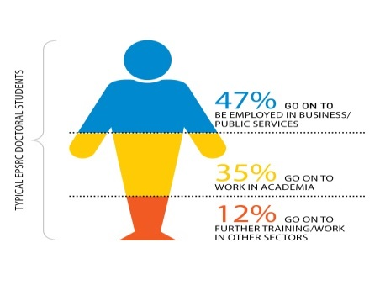
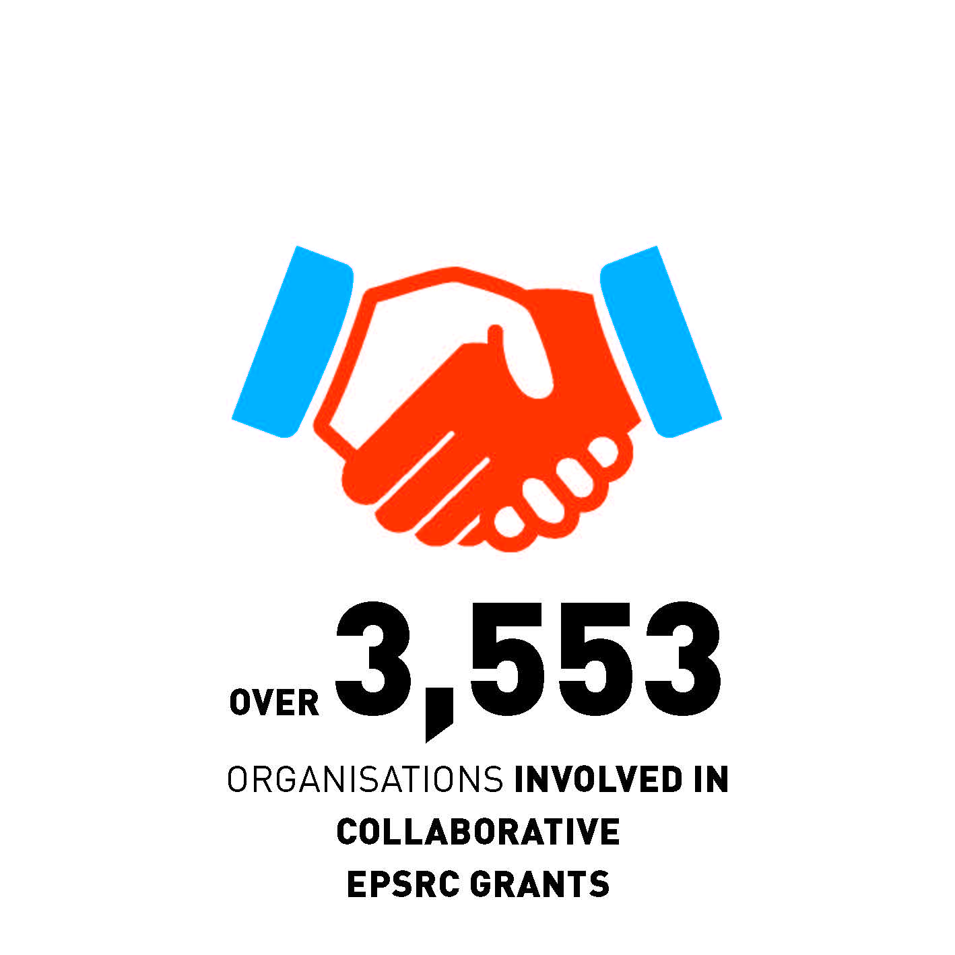
EPSRC - Key facts
Notes:
Note: 44% of portfolio is multidisciplinary but if we exclude fellowships and training and just consider our research portfolio the figure rises to 54%. 6,000 researchers supported includes Principal Investigators and Co-Investigators on research grants (training grants are not included). Data as of 1 April 2015.

Slide 3
EPSRC Strategic Vision
For the UK to be the best place in the world to research, discover and innovate
Research and Discover
Research and Innovate
Notes:
EPSRC is at the heart of discovery and innovation.
We invest in long-term, fundamental engineering and physical sciences research and training in the UK.
Committed to excellence and impact, we support the talented scientists, engineers and postgraduate research students who through their research, discover new knowledge, explore new ways of thinking and drive innovation.
Our research ranges from physics, chemistry and mathematics to materials, computing and engineering.
Our research provides underpinning knowledge that informs other fields such as the life and medical sciences.
Our research places the UK as a leading global research nation. It saves lives, creates prosperity, protects the environment and inspires future generations.

Slide 4
Research & Discover
EPSRC research portfolio
Emerging Technology
Quantum Technologies
Graphene

Slide 5
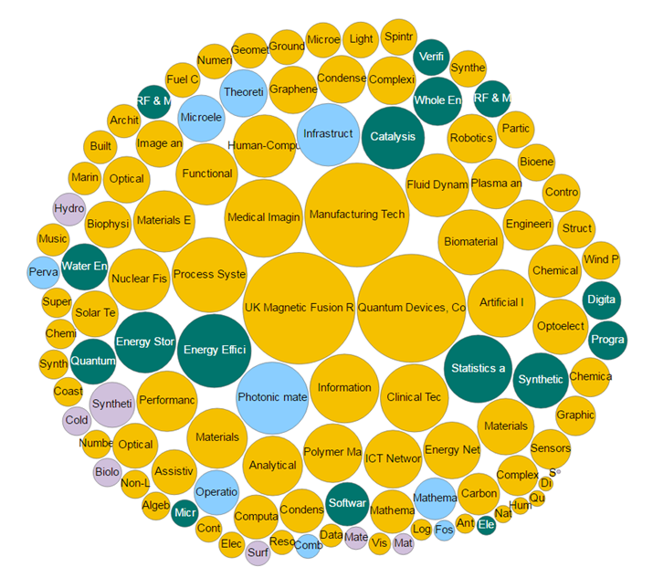
Our Portfolio

Slide 6
Research & Innovate
Role of the Manufacturing the Future theme to support:
Underpinning science, design, production, fabrication, systems and services research.
Manufacturing research to the stage where applications can be developed by companies or
Flagship investments:
8 Future Manufacturing Hubs
4 Centres for Innovative Manufacturing.

Slide 7
Future Manufacturing Hubs - 2016
Hub | Director and Location
Future Continuous Manufacturing and Advanced Crystallisation (CMAC) Research Hub | Professor Alastair Florence, University of Strathclyde
EPSRC Future Advanced Metrology Hub | Professor Jane Jiang, University of Huddersfield
The Future Composites Manufacturing Hub | Professor Andrew Long, University of Nottingham
Future Compound Semiconductor Manufacturing Hub | Professor Peter Smowton, Cardiff University
Future Manufacturing Hub in Targeted Healthcare | Professor Nigel Titchener-Hooker, University College London
EPSRC Future Manufacturing Hub in Manufacture using Advanced Powders and Processes | Professor Iain Todd, University of Sheffield

Slide 8
Existing Hubs and CIMs
Hub / CIM | Director and Location
Future Liquid Metals Engineering (LiME) Hub | Professor Zhongyun Fan, Brunel University London
The Future Photonics Hub | Professor David Payne, University of Southampton
EPSRC CIM in Medical Devices | Professor John Fisher, University of Leeds
EPSRC CIM in Laser-based Production Processes | Professor Duncan Hand, Heriot-Watt University
EPSRC CIM in Large-area Electronics | Professor Chris Rider, University of Cambridge
EPSRC CIM in Food | Professor Tim Foster, University of Nottingham

Slide 9
Our Visions for Manufacturing
21stC Products
Digital Manufacturing
New Industrial Systems
Sustainable Industries

Slide 10
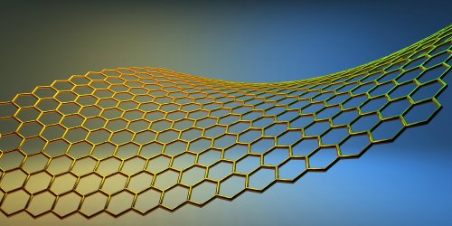
21st Century Products
Products that are unimaginable today
May be ‘smart’, multi-functional or enhance our well-being. They could:
Result from the discovery of new materials
Control physical phenomena
Use biological processes in novel ways
Research can ensure the manufacturing process is integrated in the discovery, design and development of these new products.

Slide 11
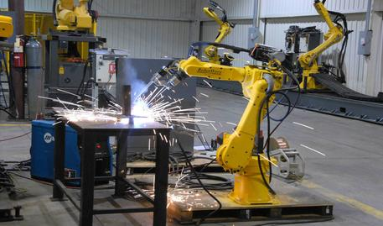
Digital Manufacturing
Use of advanced ICT to improve the integration of design, manufacturing and services:
Optimisation of the design process
Simulation and visualisation of processes
Fast and responsive control and connectivity of manufacturing systems and their supply chains.
Intelligent factories will be characterised by IT-driven production that is highly automated, and in some cases completely autonomous.

Slide 12
Sustainable Industries
Manufacturing that meets the needs of the present without compromising the ability of future generations to meet their own needs.
This is a future where we:
Are resource efficient and energy resilient
Have transitioned to a circular economy
Are far less reliant on fossil fuels and scarce natural resources

Slide 13
New Industrial Systems
Resources
21st C Products
Digital
New approaches to manufacturing
Brings together our other visions
Vision to anchor more of the manufacturing value chain in the UK
Local, bespoke

Slide 14
Summary
EPSRC’s goals:
Research and Discover
Research and Innovate
We have identified visions for the future - but not specified what research is required.
Must be prepared to support the next ‘emerging technologies’ or ‘big ideas’.

Slide 15
Thank you for your attention!

