Slide 1
Global manufacturing: the next 100 years Manufacturing 2075 conference Cranfield University, December 7 2016
Peter Marsh
Founder, Made Here Now, and author of
The New Industrial Revolution
www.petermarsh.eu www.madeherenow.com
Twitter:@petermarsh307
Notes:
0

Slide 2
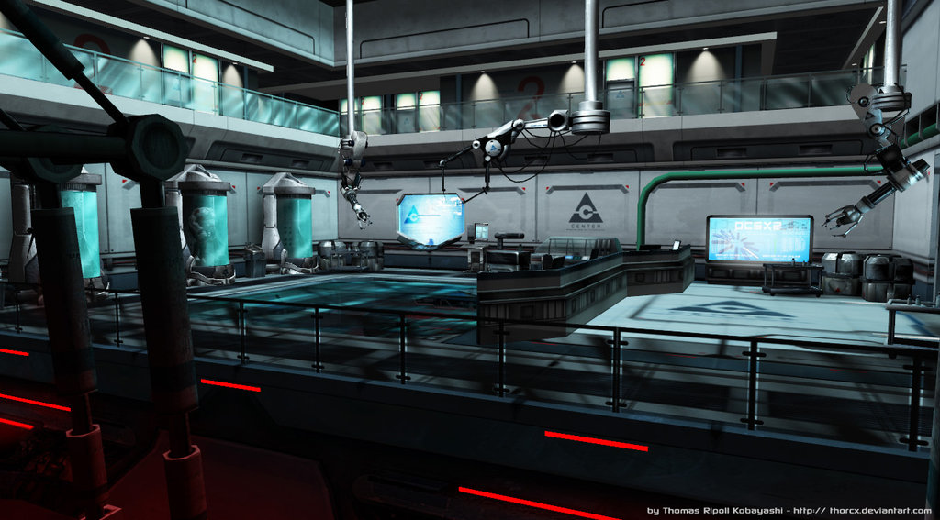
2116: more intelligence, more products, fewer people

Slide 3
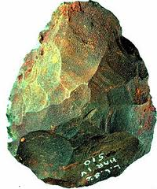

Slide 4
1800-CHINA
1860-UK
1900-US
2016-CHINA

Slide 5
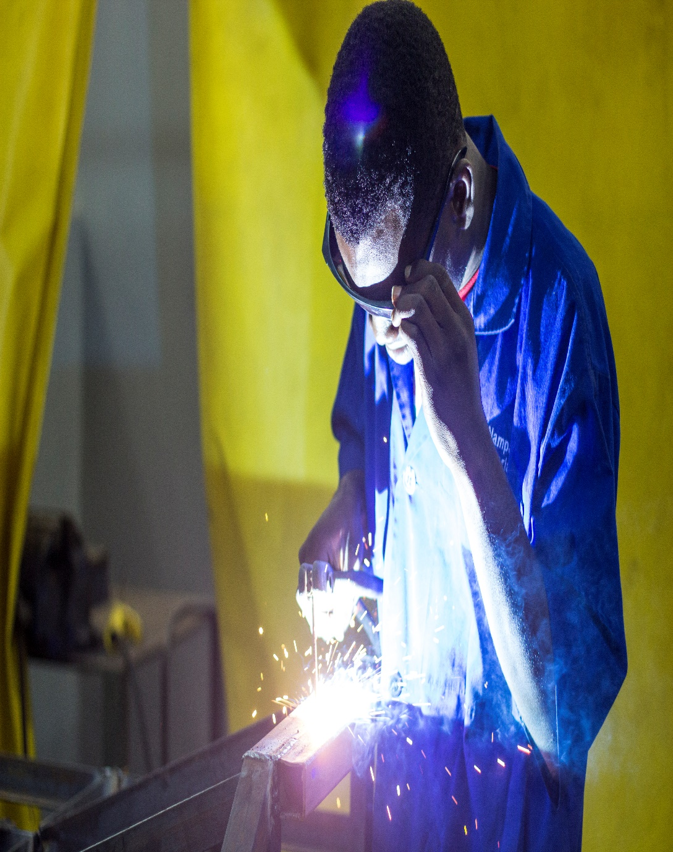
2116 – Africa’s turn?

Slide 6
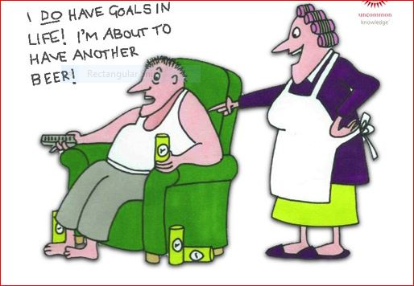

Slide 9
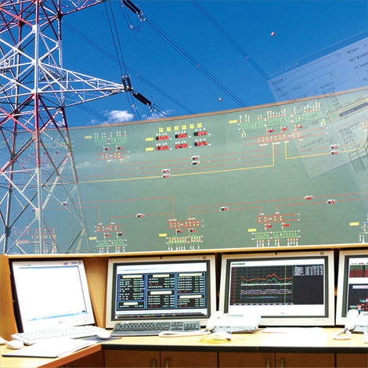
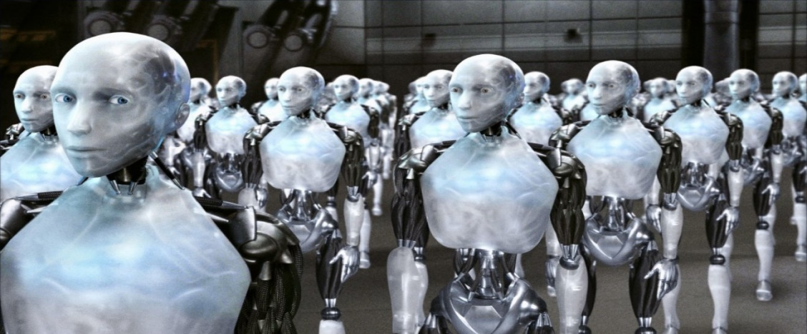
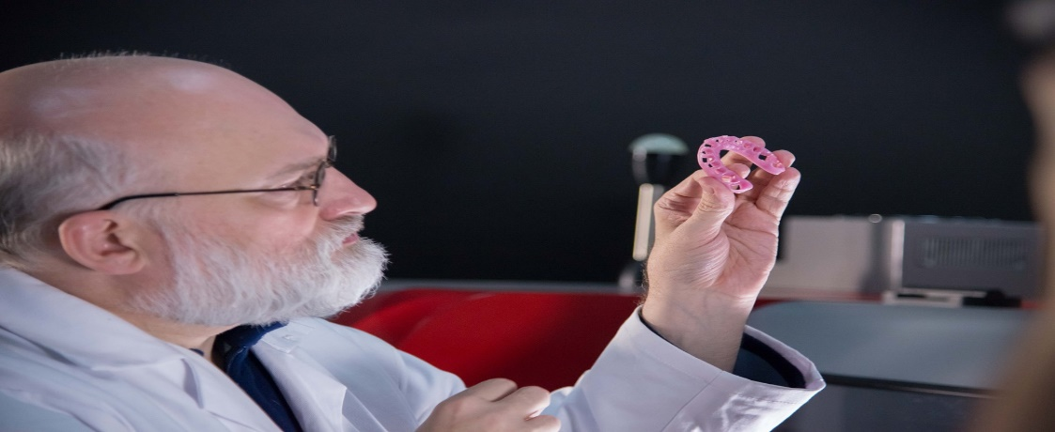
21st century industry
DIGITAL TECHNOLOGY
CONNECTIONS
CREATIVITY
CUSTOMISATION

Slide 10
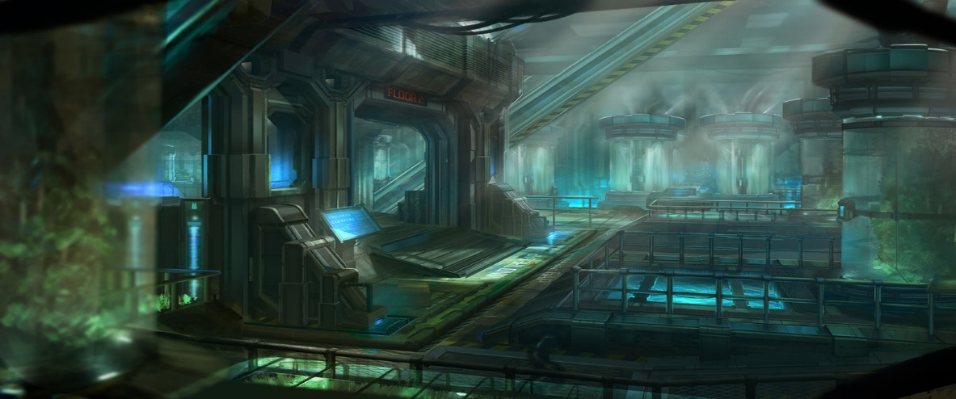
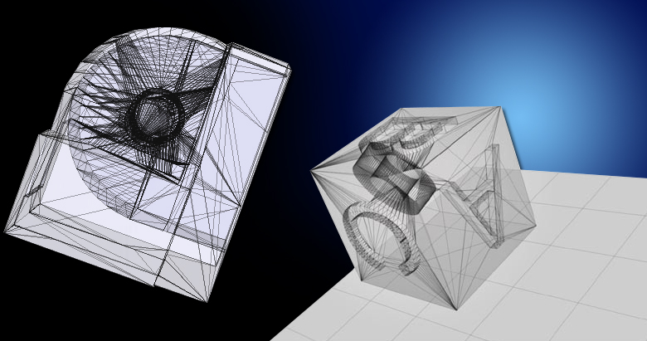
What next century will look like
BIO-ELECTRONICS
BIO-MACHINE INTELLIGENCE
DEMAND, MAKE
GLOBAL ECOSYSTEMS

Slide 11
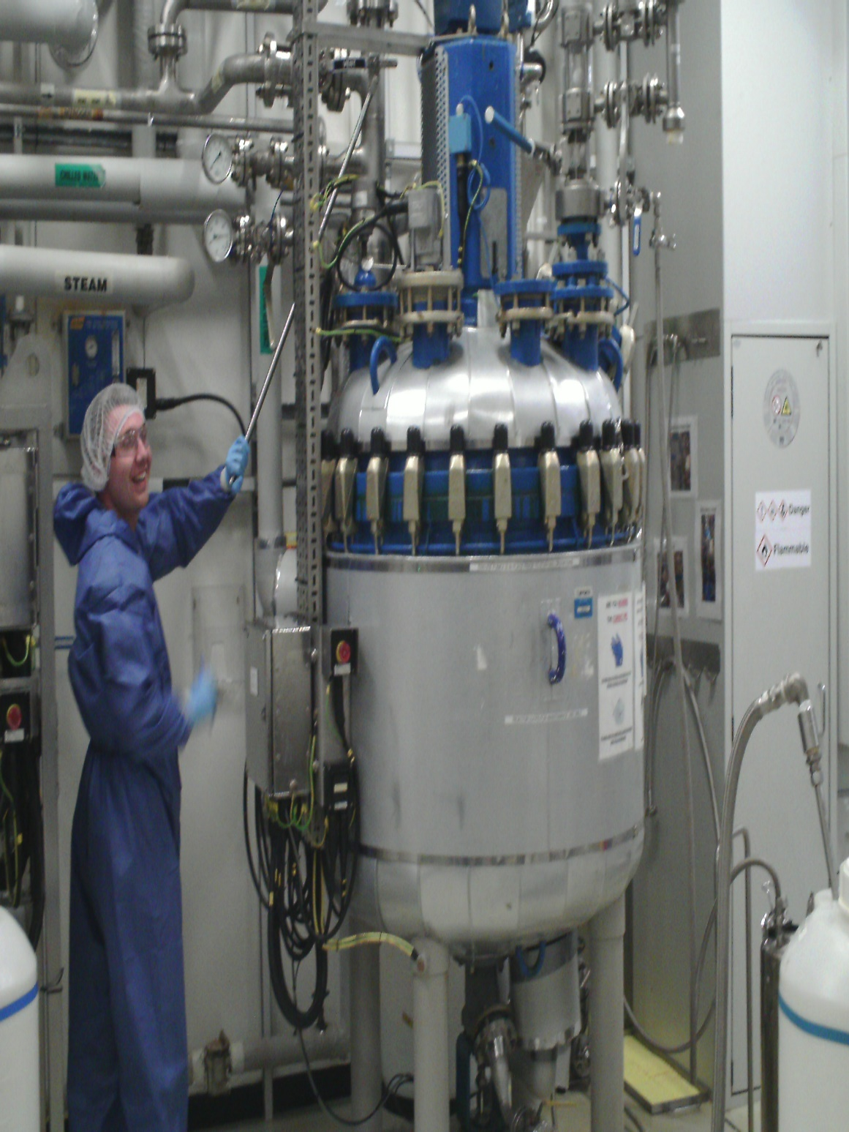

Slide 12
Dawn of the biochip

Slide 13
Engineering life with synthetic biology

Slide 14
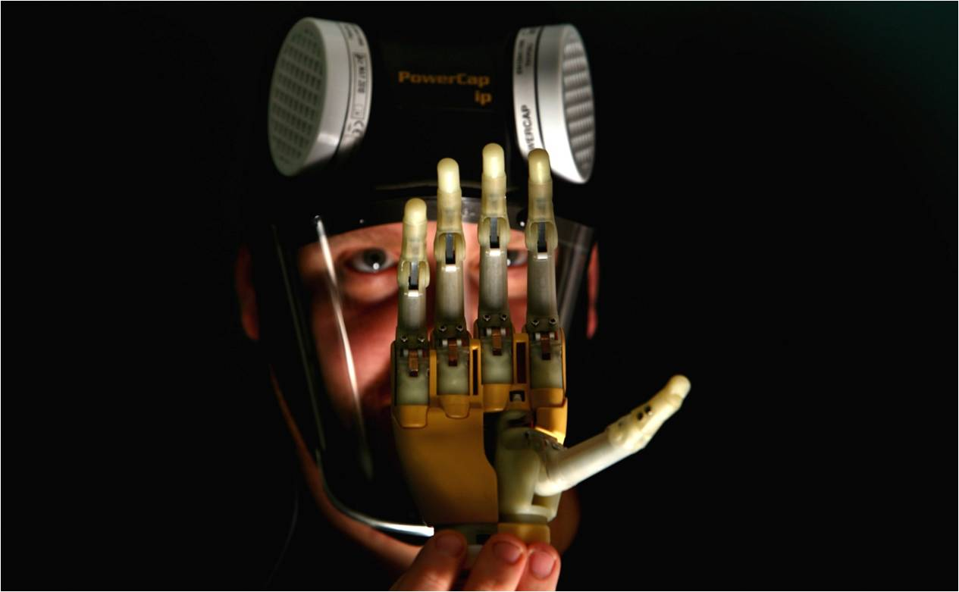
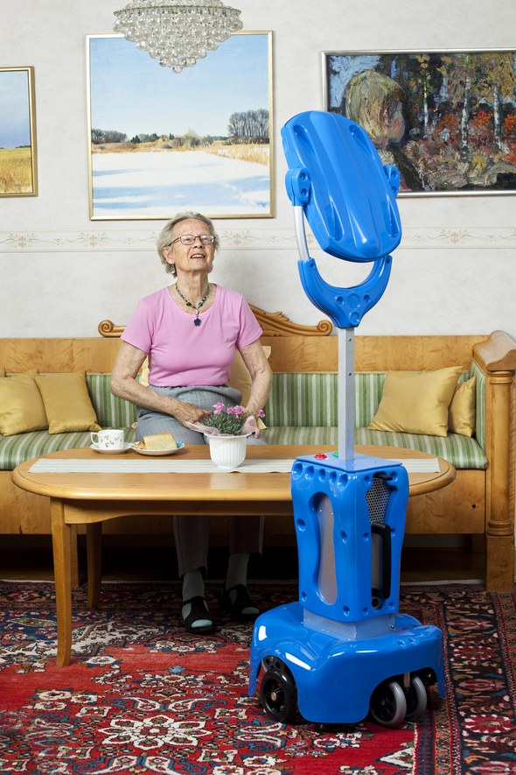

Slide 15
LAL (Limulus amebocyte lysate) ke to human health – Sothic Bioscience in Ireland

Slide 16
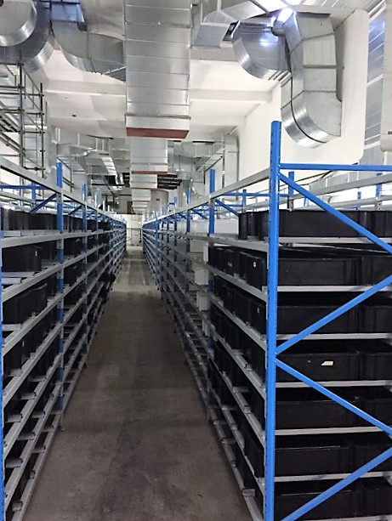

Slide 17
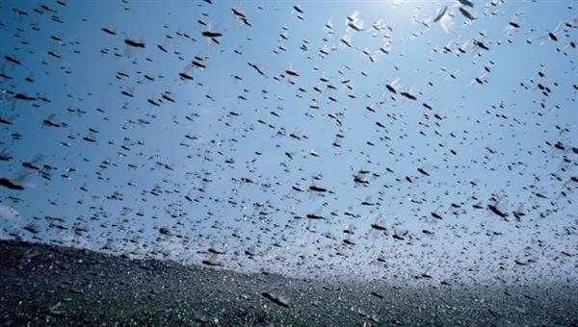
Large-scale sensing in the air

Slide 18
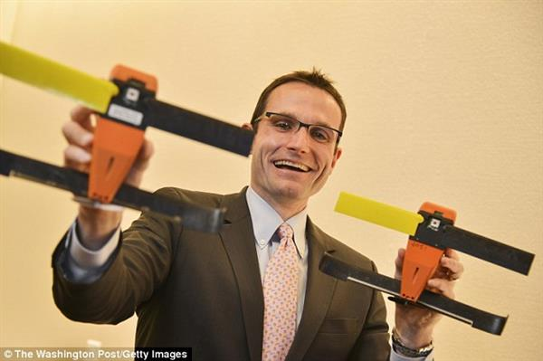

Slide 19
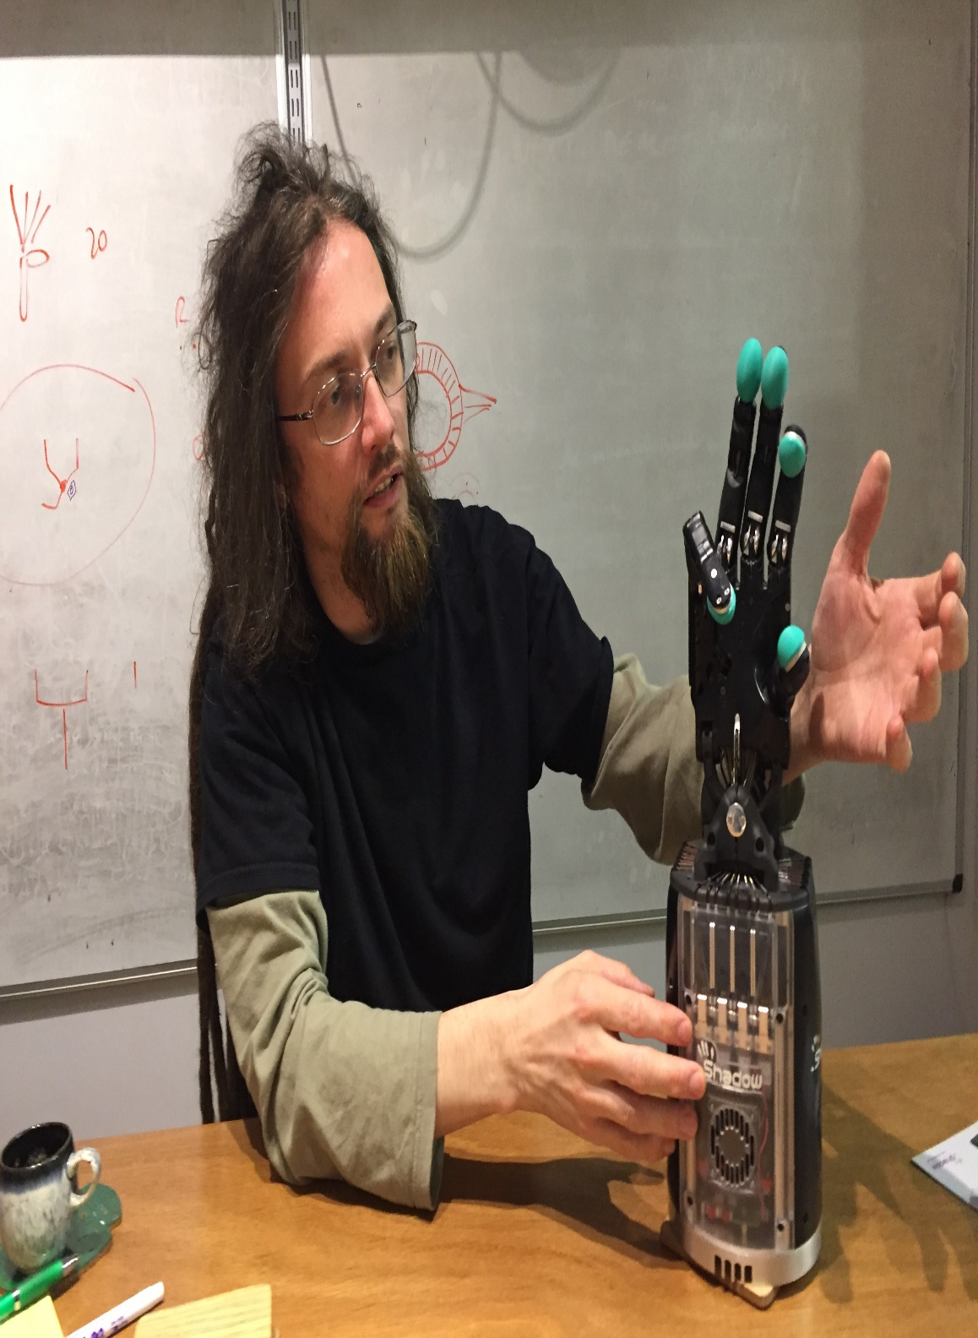
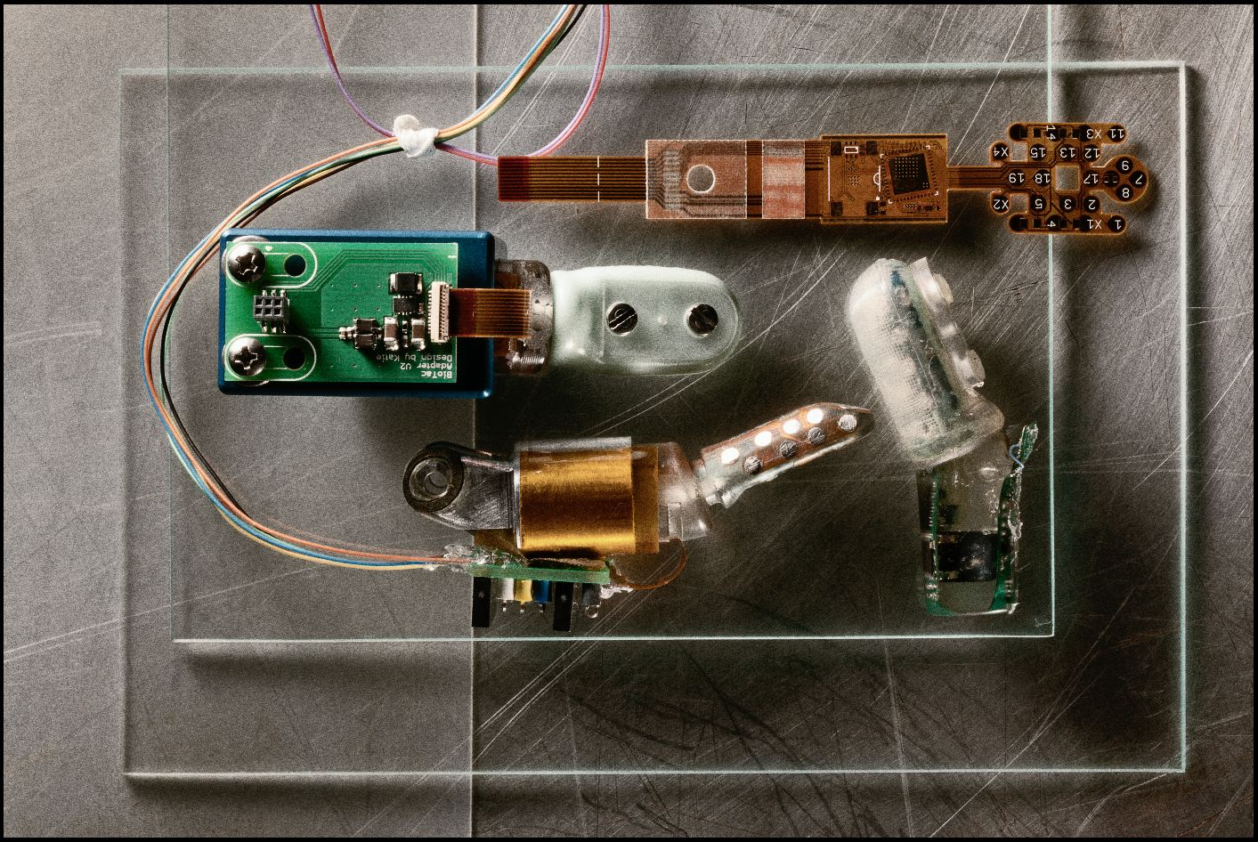

Slide 20
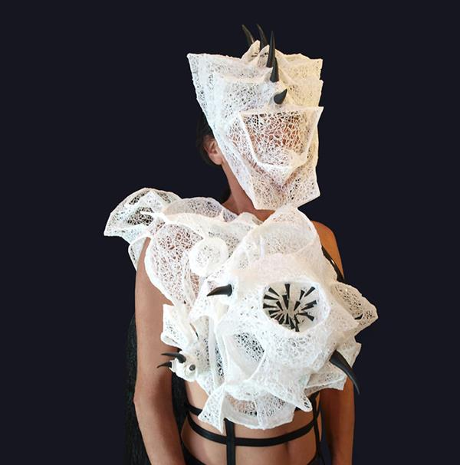
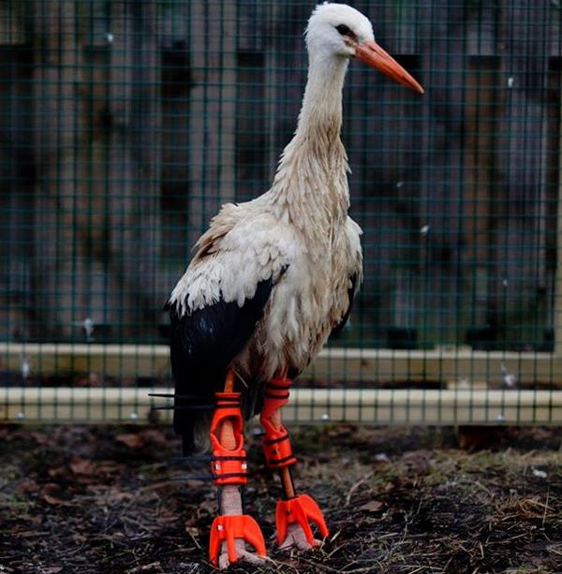

Slide 23
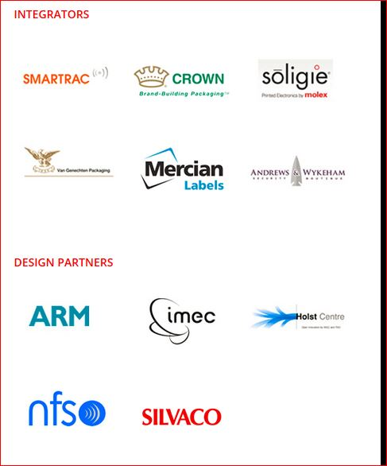
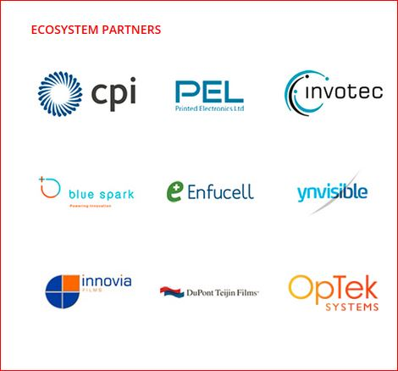

Slide 24
