Slide 1
Manufacturing in France
Eloïse Martin
MSc in Engineering and Management of Manufacturing Systems
March 7th, 2017
Notes:
Hi everybody, today I am going to tackle the subject of Manufacturing in France.

Slide 2
Manufacturing Industry in France
10% of French GDP since 2010
Sources: http://donnees.banquemondiale.org ; http://www.entreprises.gouv.fr
Notes:
During 10 years, the proportion of Manufacturing industry in the French GDP has been declining by about 4%.
Since 2010, this proportion is not declining anymore, but is stagnating around 10% of GDP.
In the following presentation, I am going to highlight the reasons why the French manufacturing Industry remains strong, but I will also cover some important issues that are still currently faced. I will finally put forward some ways to improve.
http://www.entreprises.gouv.fr/files/files/directions_services/etudes-et-statistiques/Chiffres_cles/Industrie/2016-Chiffres-cles-industrie.pdf
Good - comparison with other sectors ?
But stable

Slide 3
What do you know about France’s Manufacturing ?
…Aeronautics & Aerospace
2nd exporter at global scale
16% share in world exports
(USA: 40%)
180,000 employees in Aeronautics
Sources: http://www.trademap.org; https://www.gifas.asso.fr, 2015
Notes:
First of all, I strongly noticed that today, when I ask a non-French student about Manufacturing in France, I hear very often about Aeronautics, about Airbus. If Airbus’ head office is in France, this is basically a European company. In Aeronautics however, France is currently the 2nd exporter at global scale. It ranks 2nd after the USA, in 2015, with 16% of market share in aerospace products exports. Moreover, it also employs 180,000 workers, number that reaches 350,000 if we include all the sub-contractors and all the sectors of space, defense and security. So yes, consequently, it is fair to say that France is a major player of the global Aeronautics Industry.
http://www.latribune.fr/entreprises-finance/industrie/aeronautique-defense/l-aeronautique-le-principal-atout-de-la-france-a-l-exportation-478236.html
http://lekiosque.finances.gouv.fr/fichiers/Etudes/tableaux/EE_34.pdf
http://www.blog-emploi.com/emploi-aeronautique/
https://www.gifas.asso.fr
http://www.worldstopexports.com/aerospace-exports-by-country/
http://www.trademap.org

Slide 4
Key manufacturing sectors
French Industry is strong !
Source: http://www.entreprises.gouv.fr, 2015
Notes:
However, if we consider the French key manufacturing sectors, we can notice that Materials of Transport represent only 10% of them. The major sectors are rather Chemistry, Pharmaceuticals, Food-processing industry, Repairs, or again Electronics. Moreover, all these sectors are characterised by French companies that are now famous worldwide. And if there is one thing to remember from all of this, it is that French Manufacturing does not only rely on one particular sector, but on many ones. Sectors are very well balanced, and THIS is what makes the French Manufacturing Industry strong.
http://www.entreprises.gouv.fr/files/files/directions_services/etudes-et-statistiques/Chiffres_cles/Industrie/2016-Chiffres-cles-industrie.pdf
Strong industry becasue sectors very well balance
Logo, company
Some figures ?

Slide 5
Micro, Small and Medium-sized Manufacturing companies…
… 99% of French manufacturing companies, at the heart of the economic fabric !
235,000
3 Million
870 Billion Euros
Source: https://www.insee.fr, 2014
Notes:
I have been talking about famous companies, now let’s have a look at the range of manufacturing companies. It can be observed that 99% of Manufacturing companies are micro, small and medium-sized companies. These companies employ half of the industrial workers, contribute to 40% of the turnover, and realise 25% of exports. But what is even more important to me is that these companies are innovation champions.
On the one hand, it is true that, for now, most of the French Small and Medium-sized companies spend money for R&D in services and not industrial activities, on the contrary to intermediate and big companies. But on the other hand, actually, it depends a lot on the manufacturing sectors considered. In 2010, in automotive and aerospace, big companies are contributing the most to R&D spending, whereas in textile, wood or paper sectors, more than half spending of R&D is the fact of the SME. The micro, small and medium-sized companies have a high potential of job creation and innovations, and THIS give them a strategic place within the French economy, as it is written : at the heart of the economic fabric.
https://www.insee.fr/fr/statistiques/2015835#tableau-tableau
https://www.insee.fr/fr/statistiques/2518228#graphique-Figure1
https://cache.media.enseignementsup-recherche.gouv.fr/file/2013/80/9/NI_13_01_PME_acteurs_meconnus_de_la_recherche_241809.pdf
Prove 88%....=> turnover of small industries…+ employment etc
Manufacturing = 85% of industry
870 Billion whose 37% at export

Slide 6
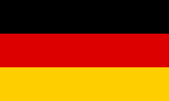
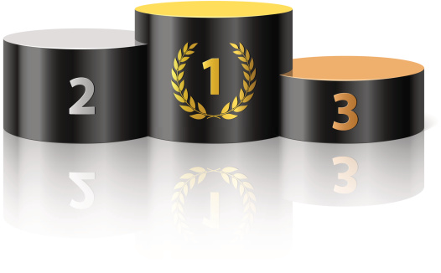
World merchandise trade
One of the leading exporters and importers in 2015
8th global exporter
6th global importer
7%
17%
6%
9%
17%
7%
Trading partners
Sources: http://lekiosque.finances.gouv.fr, 2016, https://www.wto.org, 2015
Notes:
I should also add that France is a leader exporter, ranking 8th in 2015 in world merchandise trade ranking, and also a leader importer, ranking 6th at global scale in the same ranking. French trade partners are essentially European, Germany, Spain and Italy being the main ones. But China and the United States are also major partners.
http://lekiosque.finances.gouv.fr/fichiers/Etudes/tableaux/apercu.pdf
https://www.wto.org/english/res_e/statis_e/wts2016_e/wts2016_e.pdf
Trade contract / alliance ?

Slide 7
What about Manufacturing in the EU ?
14%
Sources: http://www.entreprises.gouv.fr; https://stats.oecd.org, 2015
Notes:
So, now that we got an overview of Manufacturing key strengths in France, let’s compare a bit France’s contribution to the EU’s Manufacturing with other EU countries. First, it is clear that Germany positions itself as a leader regarding European Manufacturing, while the French contribution is quite similar to Italy, Spain and the UK. But, it is also clear that the 10% proportion of Manufacturing of the French GDP stated previously, is under the European Union’s mean, around 14%.
http://www.entreprises.gouv.fr/files/files/directions_services/etudes-et-statistiques/Chiffres_cles/Industrie/2016-Chiffres-cles-industrie.pdf
Recheck figures on OECD : https://stats.oecd.org/index.aspx?queryid=60702

Slide 8
Global Manufacturing Competitiveness Ranking
A downward trend in French competitivity appears
Current Competitiveness Index |  |  | Forecasted Index
Country | 2016 Rank | 2013 Rank | Country | 2020 Rank
Australia | 21 | 16 | Netherlands | 21
France | 22 | 25 | Australia | 22
Czech Republic | 23 | 19 | Brazil | 23
Finland | 24 | - | Finland | 24
Spain | 25 | 33 | South Africa | 25
Belgium | 26 | 27 | France | 26
Source: Deloitte Global Manufacturing Competitiveness Index, 2016 edition
Notes:
Now let’s have a look at the global scale. Since 2013, France moved up by 3 places in the Deloitte Global Manufacturing Competitiveness Index, rising from 25th to 22nd. But, a downward trend is appearing by 5 years, when France would rank 26th.
Deloitte Global Manufacturing Competitiveness Index, édition 2016
Why France is competitive in industry ?

Slide 9
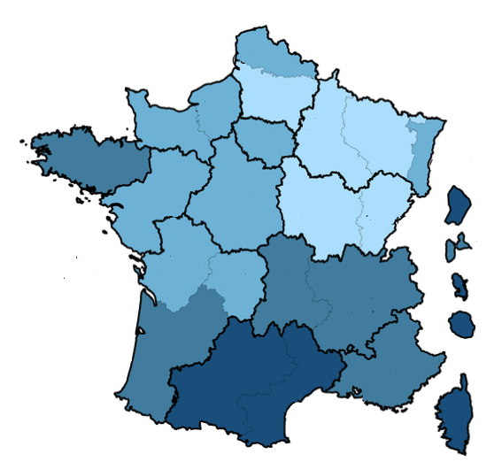
Focus on geographical distribution
Industrial activities are unevenly settled and declining
Employment in Industry average annual growth rate (2014-2015)
< -2 %
-2 to -1 %
Size of companies
-1 to 0 %
> 0%
Regional distribution of industrial employees (2015)
0 - 5 %
6 % - 10 %
> 10 %
Sources: http://www.entreprises.gouv.fr; http://www.acoss.fr
Notes:
Moreover, to this forecasted decline in Manufacturing competitiveness, can be added that industrial activities in France are quite uneven and also in decline.
-First, the employment in industry is overall declining everywhere in France, and especially in Northern France because of a lower growth of population.
-Then, the distribution of employees working in industry is also uneven, some areas being much more active than others.
-Finally, if large companies have an overall great weight in all regions, it is particularly the case within big cities, and in some historical industrial areas. The medium-sized companies weigh more strongly in the northern regions. Micro-companies weigh more in the South and in the French overseas departments.
http://www.entreprises.gouv.fr/files/files/directions_services/etudes-et-statistiques/Chiffres_cles/Industrie/2016-Chiffres-cles-industrie.pdf
http://www.acoss.fr/files/Publications/Acoss_Stat/Acoss_Stat_237.pdf
https://www.insee.fr/fr/statistiques/1281379
Reasons of differences between north and south ? Unemployment, growth rate, industries, what happened, maybe % and not numbers

Slide 10
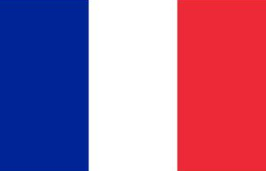
Challenges for French productivity
Economists notice a labour productivity growth rate slowdown
Investment in NICTs (2009)
Investment in robotics (2014, robot density)
Working population skills (2013)
16%
31%
125 units
290 units
Ranked 21st out of 24
countries in literacy
Sources: http://www.oecd.org; https://www.conference-board.org; http://www.ifr.org
Notes:
Finally, as another decline, we can also notice a slowdown in labour productivity growth that is now occurring for 40 years.
So the main reasons that have been raised to explain the current French unhooking in Manufacturing are multiple.
-First, there is a real delay in investment in New Information and Communication Technologies. In 2009, the French one was almost half of the US one.
-Secondly, a lack of investment in robotics. Germany was, in 2014, much more advanced with 290 units robot density.
-Finally, missing working skills is a strong issue, as a ranking from OECD stated in 2013.
http://www.oecd.org/std/productivity-stats/oecd-compendium-of-productivity-indicators-22252126.htm
https://www.conference-board.org/data/economydatabase/index.cfm?id=25667
https://data.oecd.org/fr/ict/investissement-dans-les-tic.htm
http://www.strategie.gouv.fr/publications/comprendre-ralentissement-de-productivite-France
https://www.oecd.org/fr/competences/piaac/SkillsOutlook_2013_French_eBook.pdf
http://www.ifr.org/news/ifr-press-release/survey-13-million-industrial-robots-to-enter-service-by-2018-799/
Figure to support comparison in robotics and investment in NTIC : ICT investment is defined as the acquisition of equipment and computer software that is used in production for more than one year. ICT has three components: information technology equipment (computers and related hardware); communications equipment; and software. Software includes acquisition of pre-packaged software, customised software and software developed in-house. This indicator is measured as a percentage of total non-residential gross fixed capital formation.
The productivity slowdown observed in recent years has occurred at a time of rapid technological change, increasing participation of firms and countries in global value chains (GVCs), and rising education levels in the labour force, all of which are generally associated with higher productivity growth. These seemingly contradictory facts have revived the debate on whether the productivity slowdown is a transitional phenomenon, a longer term condition or a function of mis-measurement.
Yet, the slowdown in productivity growth is not a recent phenomenon. Indeed, it is a common feature among advanced economies, and underlying long-term trends suggest that the slowdown predates both the crisis and the current technological wave which has created the digitalised economy.
The robotic density figure is a key performance indicator for gauging the current degree of automation within the international markets: For example, the average global robotic density in producing industries lies at 66 robot units per 10,000 employees.
Number of multipurpose industrial robots per 10,000 employees in the manufacturing industry.
Labor Productivity (measured as GDP per Person Employed and GDP per Hour Worked)

Slide 11
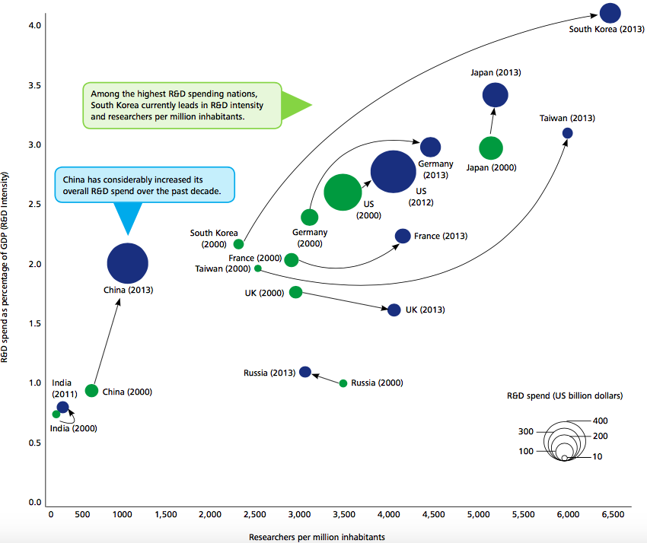
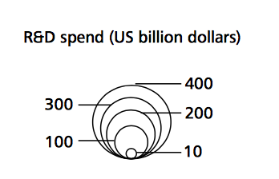
Investment in innovation and R&D : hope for future ?
R&D % of GDP (from 2000 to 2013)
4.0
South Korea
Japan
3%
Germany
4,250 researchers per million inhabitants
2.3% R&D (% of GDP)
US (2012)
China
Ranks 5th
France
2%
UK
Ranks 6th
1%
India (2011)
0%
Researchers per million inhabitants
0
1000
2000
3000
4000
5000
6000
Source: Deloitte Global Manufacturing Competitiveness Index, 2016 edition
Notes:
But in spite of all this, there is something that is very promising for France. Many studies show that a real key strength of French Manufacturing today, at global scale, is its ability to invest in innovation and Research and Development. In 2013, France ranked 5th with more than 4,000 researchers per million inhabitants, and ranked 6th with more than 2% of R&D in GDP. And it seems that this trend is rather upward.
Deloitte Touche Tohmatsu Limited et US Council on Competitiveness, Global Manufacturing Competitiveness Index, édition 2016
https://www2.deloitte.com/content/dam/Deloitte/global/Documents/Manufacturing/gx-global-mfg-competitiveness-index-2016.pdf
Re-do graph, no text, 2 first point are the most important, in a box on the graph , in the title, « hope for future » good
Blue and yellow ?

Slide 12
Conclusion
Manufacturing Industry is robust, but declining and facing several challenges
Obsolescence of skills
Late investment in technologies
Low rotation rate of companies (many old small ones)
Developing manufacturing?
Diversifying technological offer
2000 companies supported in 2016
5 Billion € at stake
Supporting companies financially and humanely
Encouraging innovation in private sectors
Source: http://www.gouvernement.fr
Notes:
So, as a conclusion, I want to insist on the fact that the French Industry IS robust.
But some challenges remain, such as : fighting against the obsolescence of skills, the late investment in technologies, or the low rotation rate of companies.
In order to develop manufacturing, France is currently focusing on diversifying its technological offer, with popular techniques as 3D printing, augmented reality and many others. Within the framework of the project well known as “Industry of Future” launched in 2013, a call for projects has already been launched in 2015 and technological platforms have been set-up in 2016, the objective being still now to test new experimental technologies. And it is really necessary : for example, according to a recent study based on 150 intermediate and big companies, only 10% of French industries had set up an IoT strategy in the end of 2015.
Also, companies must more than ever be supported financially and humanely. At the end of 2016, 2000 middle sized and intermediate companies have received a personalised diagnosis already. Moreover, more than 5 billion euros have been put forward by the government to push industrial companies to take part in this movement, in the form of loan or tax advantage. Training is also essential, and it also goes through an essential improvement of the educative system.
Finally, a last way of improvement consists in encouraging innovation in private sectors. As we noticed during the presentation, there are many small companies in France that are very promising, but that face a strong lack of support from private investors to grow, on the contrary to countries as Germany or the UK. Yet, they are more than ready to invest in R&D and to contribute to revitalise French Manufacturing.
https://www.oecd.org/fr/competences/piaac/SkillsOutlook_2013_French_eBook.pdf
http://stats.oecd.org/Index.aspx?DataSetCode=TENURE_AVE&Lang=fr#
http://www.oecd.org/fr/presse/investir-dans-la-recherche-de-maniere-plus-judicieuse-stimulerait-l-innovation-en-france.htm
https://www.pac-online.com/iot-quelle-r-alit-pour-le-secteur-industriel-en-france
http://www.gouvernement.fr/action/la-nouvelle-france-industrielle
Chat are th
Key message = Mnufacturing is significant bu declining for years, disparity between regions, government slow, late investment in new technologies
How to rebalance industry between north and south ?
How can we build industry, emplyment ?
Public/Private sectors, link to slow investment in new technologies
But robust industry base across multiple sectors
Graph of professionnal mobility
Initiatives of government to improve manufacturing industry and research ?
What does it mean to me ? What is wrong, what is going down, own opinion
What are the insights in future ? What will happen next ?
Summary

