Slide 1
Colombia Manufacturing: A land of Transformation
Javier R. Amaya, MSc Engineering and Management of Manufacturing Systems
March 7th 2017

Slide 2
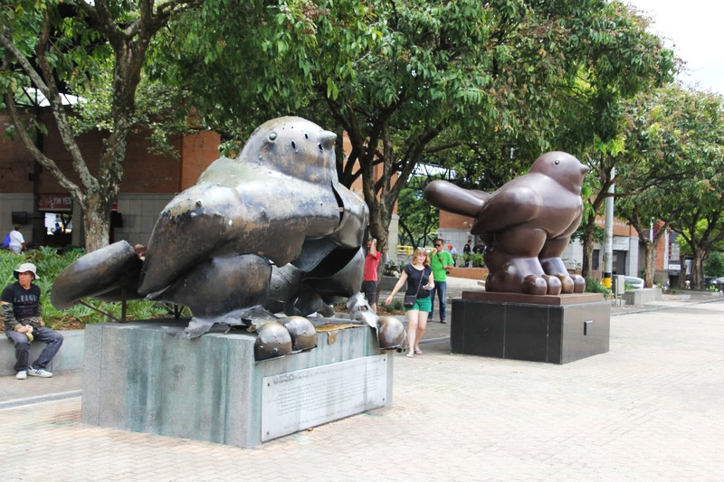
TRANSFORMATION
Notes:
Picture of Destroyed and Restaured birds
restauation
Bad associations with Colombia Destroyed and reconstructed (as the birds)

Slide 3
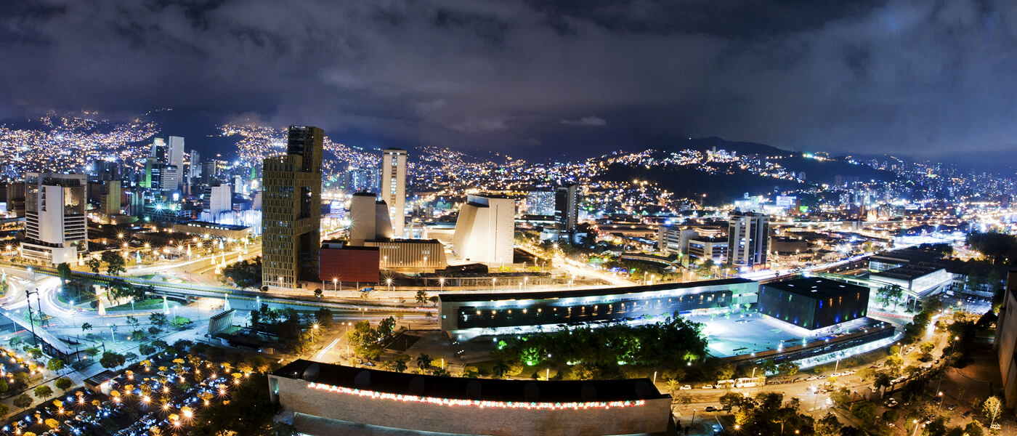
Cosmopolitan Cities: Lee Kuan Yew World City Prize 2016
Notes:
achievements and contributions to the creation of liveable, innovative and sustainable urban communities around the world.
for displaying foresight, good governance and innovation in tackling the many urban challenges faced, to bring about social, economic and environmental benefits in a holistic way to their communities.

Slide 4
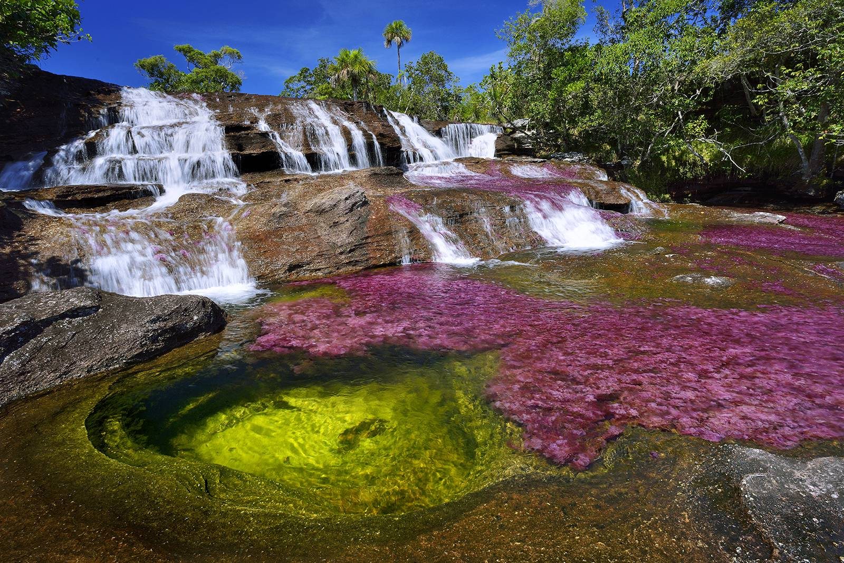
Amazing Natural Landscape: Most beautiful river in the world

Slide 5
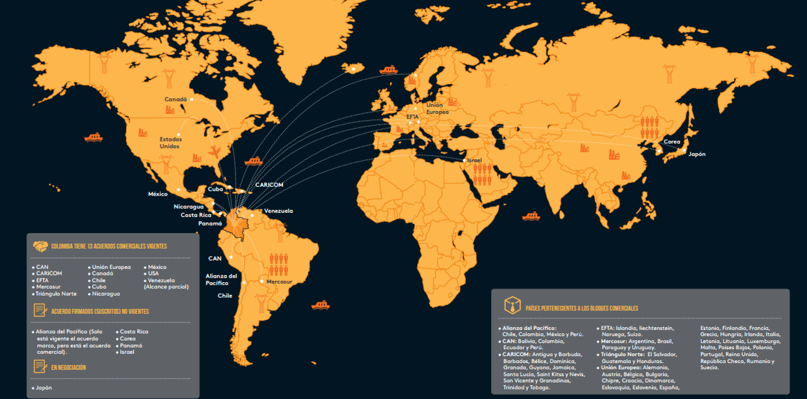
Colombia: Strategic Location and Agreements
Pacific Alliance:
  Colombia
  Chile
  Mexico
  Peru
Japan
Korea
Israel
CAN (Customs Union between Bolivia, Colombia and Ecuador)
Mercosur
Caribbean Community (Caricom)
Group of 3(G3) – Colombia, Mexico, and Venezuela
European Free Trade Association (EFTA)
The US Colombia Free Trade Agreement
ANDI. & Colombia, A.N. de E., 2015. Estrategia para una nueva industrialización, Bogota.
Notes:
Netflix Series
What and Where?
Strategic location has drive our commercial policy

Slide 6
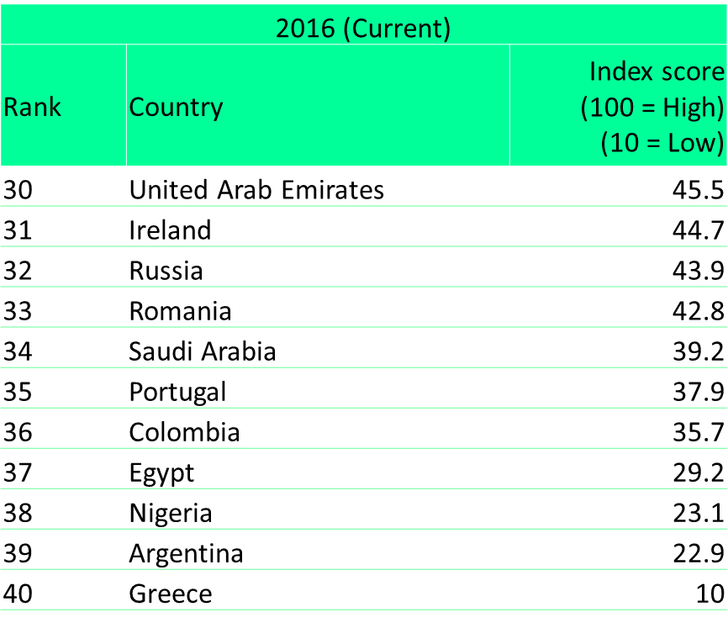
Deloitte Manufacturing Competitive Index
Deloitte, 2016. Global Manufacturing Competitiveness Index, London.

Slide 7
Current State: Colombia and the Region-GDP Comparison
COUNTRIES | 2016p |  |  | 2017p
 | IMF | Wold Bank | Latin American Consensus | IMF | Wold Bank | Latin American Consensus
Argentina | -1.8 | -0.5 | -1.5 | 2.7 | 3.1 | 3.2
Brazil | -3.3 | -4.0 | -3.2 | 0.5 | -0.2 | 1.1
Chile | 1.7 | 1.9 | 1.6 | 2.0 | 2.1 | 2.2
Colombia | 2.2 | 2.5 | 2.2 | 2.7 | 3.0 | 2.8
Ecuador | -2.3 | -4.0 | -2.3 | -2.7 | -4.0 | 0.8
Mexico | 2.1 | 2.5 | 2.1 | 2.3 | 2.8 | 2.4
Perú | 3.7 | 3.5 | 3.7 | 4.1 | 3.5 | 4.2
Venezuela | -10.0 | -10.1 | -10.1 | -4.5 | -3.4 | -2.6
Data Source: http://data.worldbank.org/indicator/NY.GDP.MKTP.CD
Notes:
Make more manufacturing related
The GDP per capita has doubled over the last decade, going from USD 5.826 in 2000 to USD 10.350 in 2012.

Slide 8
Current State: Colombia and the Region-GDP Comparison
Colombia and Peru show the greatest growth rate in the region
COUNTRIES | 2016p |  |  | 2017p
 | IMF | Wold Bank | Latin American Consensus | IFM | Wold Bank | Latin American Consensus
Argentina | -1.8 | -0.5 | -1.5 | 2.7 | 3.1 | 3.2
Brasil | -3.3 | -4.0 | -3.2 | 0.5 | -0.2 | 1.1
Chile | 1.7 | 1.9 | 1.6 | 2.0 | 2.1 | 2.2
Colombia | 2.2 | 2.5 | 2.2 | 2.7 | 3.0 | 2.8
Ecuador | -2.3 | -4.0 | -2.3 | -2.7 | -4.0 | 0.8
Mexico | 2.1 | 2.5 | 2.1 | 2.3 | 2.8 | 2.4
Perú | 3.7 | 3.5 | 3.7 | 4.1 | 3.5 | 4.2
Venezuela | -10.0 | -10.1 | -10.1 | -4.5 | -3.4 | -2.6
Other Countries show negative variation
Data Source: http://data.worldbank.org/indicator/NY.GDP.MKTP.CD
Notes:
Make more manufacturing related

Slide 9
Manufacturing Industry in Colombia
Manufacturing Industry in Colombia
12.2% of total GDP, 4th most representative productive activity of the Colombian economy
US $ 7,033 million, ranking as the 2nd sector with higher exports in 2015 and representing 19.7% of total Colombian exports.
Metalworking
Automotive
Defence
Fashion
Biotechnology
Food and Beverage
DANE, 2016.
Source: FMI Ocutubre 2016, World Bank, Global Economic Prospects, June 2015, Latin American Consensus Forecasts, September 2016
From: Mincomercio Industria y Turismo

Slide 10
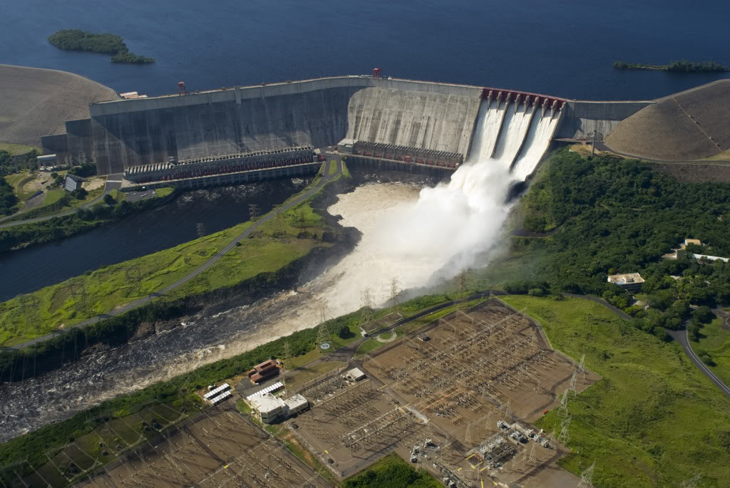
Drivers: Electricity Price and Renewable Sources
ANDI. & Colombia, A.N. de E., 2015. Estrategia para una nueva industrialización, Bogota.
Notes:
Highlight the price of electricity and Hydroelectric power.. Around 64%
Wages in the industrial sector in Colombia are the second lowest in Latin America(IMD World Competitiveness
Yearbook, 2015). Wages are 24% lower than the Latin American average and 71% lower than those on the
continent.

Slide 11
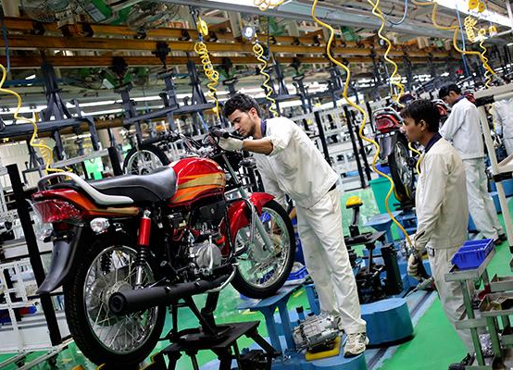

Automotive Industry and Metalworking
Distribution platform to Central & South America
Notes:
Hero Motorcop, an Honda Brand
Consolidated as the Second largest producer of motorcycles in the region, just after brazil with more than 660 thousands units

Slide 12








Automotive Industry and Metalworking
USD 200 million in its industrial FTZ to construct a stamping /cutting and folding plant
USD 240 million in new Plant in Cartagena
Plant produce 20% of Colombia’s Steel consumption
Joint Venture to increase battery production.
Open a plant in Colombia to cater for the market in the Americas
The world invest in Colombia: Automotive Sector. ProColombia
Source: http://www.investincolombia.com.co/sectors/manufacturing/automotive.html
The world invest in Colombia: Metalworking Sector. ProColombia
Source: http://www.investincolombia.com.co/sectors/manufacturing/metalworking.html
Notes:
4th gratest producer of vehicles in Latin America, with more than 130.000 unites assembled per year. Acolfa 2015

Slide 13

FASHION INDUSTRY
Image from Colombian Brand: Agua Bendita Website:
http://aguabendita.com/wild-orchestra/
Notes:
Young women

Slide 14
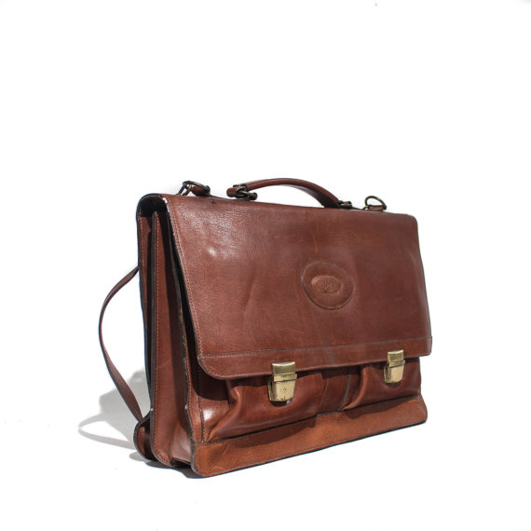
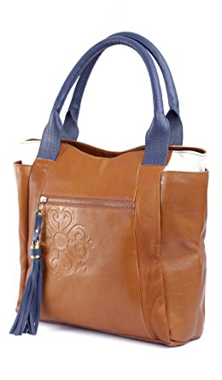
Fashion Industry: Textiles, Leather Goods and Footwear
100 years of experience
Suppliers
23%
Commerce
54%
Manufacturing 23%
6500 Enterprises
46% National Market share
5% of the country’s exports
Source DANE 2015
Notes:
Textiles and apparel in Colombia is a blossoming industry with more than 100 years of experience and a consolidated production chain. The sector represents 7.5% of the manufacturing GDP, and 3% of total national GDP. It represents 5% of the country’s exports. DANE, 2015
Colombia moda

Slide 15
Fashion Industry: Textiles, Leather Goods and Footwear
Priority sector for the country, driven by the Productive Transformation Program*
7.5 % Manufacturing GDP
Notes:
The I in Industry is missing

Slide 16
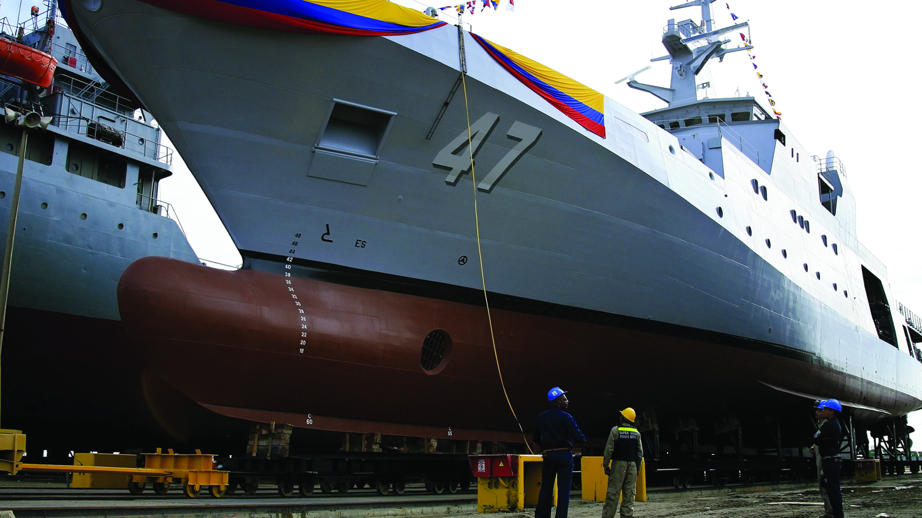
Defence Industry
Source: DANE – DIAN. Elaboración DNP – DDE. *Incluye exportadores privados y Sector Defensa
Departamento Nacional de Planeación, May 2016 CUARTO ENCUENTRO DE LA INDUSTRIA DE SEGURIDAD Y DEFENSA
Notes:
GSED
Since 2014 Lightship, dredges
Main ships: Tugboat
"Free On Board", is a term in international commercial law specifying at what point respective obligations, costs, and risk involved in the delivery of goods shift from the seller to the buyer.
Ecuador, Brasil and the US.

Slide 17

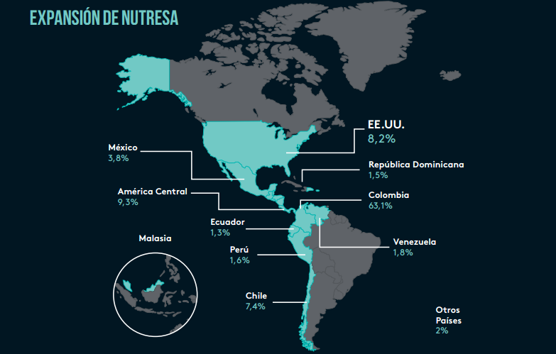

Food and Beverage
Food Variety
From:ANDI. & Colombia, A.N. de E., 2015. Estrategia para una nueva industrialización, Bogota.
Notes:
Stable sector, continuous grow
Present in more than 14 coutntries 11% industrial production
Exports in 2014 214 Million Dollars According to ANDI

Slide 18

Biotechnology: Development Opportunities
Red Biotechnology:
Ex. Gardedam: Therapies for Parkinson
Green Biotechnology:
Ex. Bioallpa: Microorganism for bio fertilizers and waste composite
White Biotechnology:
Ex. Satech: Waste Treatment technologies
High Biodiversity Potential to be used in Biotechnology
By 2032, high value-added products resulting from the sustainable use of biodiversity.
Government has designed a policy to foster the right economic, technical, institutional and legal conditions
Based on http://www.investincolombia.com.co/sectors/manufacturing/biotechnology.html
Notes:
2nd most biodiverse country in the world, only after brazil.
Megabiodiversity
Biodeversity richness and healthcare industry success to enhance Biotechnology:
By 2032, Colombia seeks to be recognized as a leader in the development, production and export of high value-added products resulting from the sustainable use of biodiversity.
Government has designed a policy to foster the right economic, technical, institutional and legal conditions that will attract public and private resources for the development of companies and sustainable products which also use biotechnology-base applications

Slide 19

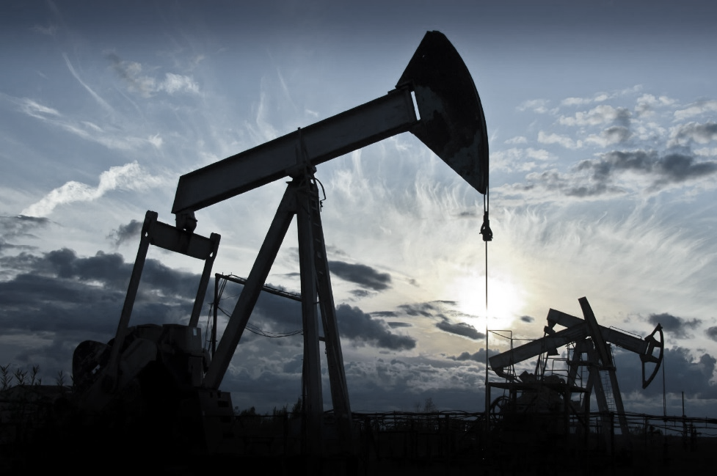
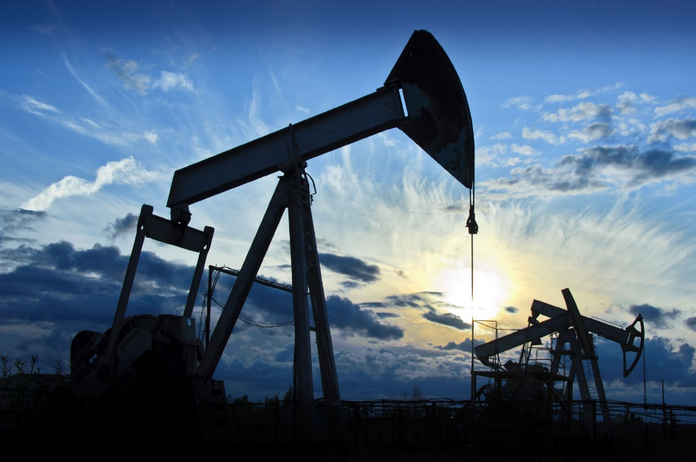
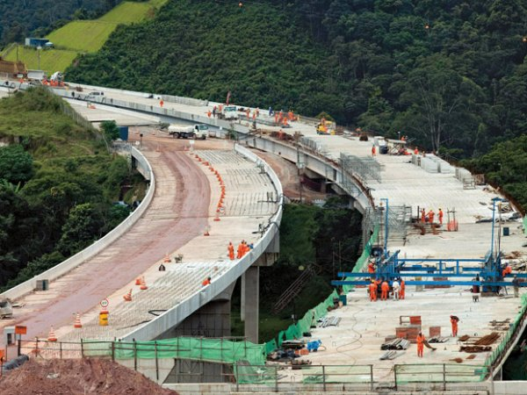
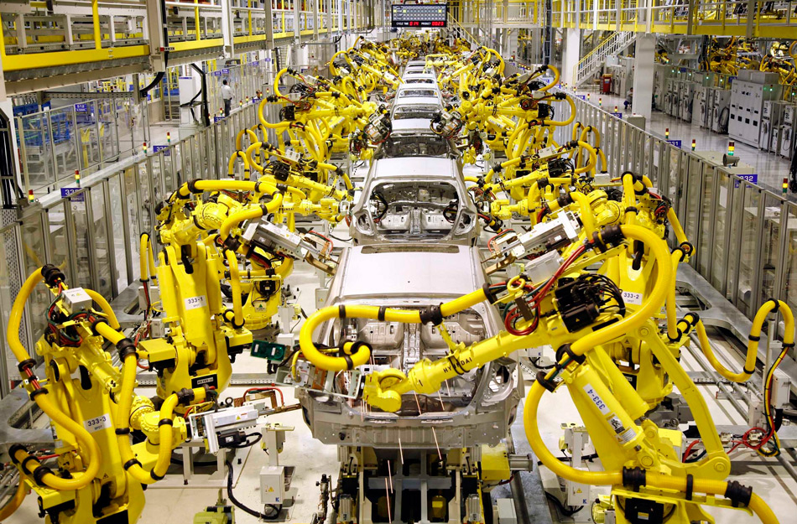
Future challenges
Get over dependency on Oil & Gas sector
Infrastructure
R&D. Be ready for Incoming technologies: IoT
Colombia is investing USD 500 million per annum in science and innovation. Not enough yet.
Notes:
industrial production 22% - Oil and Gas
Crisis affects growth of other sectors
Roads that connects the rural area with the operation hubs
RD. IoT
My personal opinion is … potentiate the current industrial machines
Globalization Vs Nationalism
adapt to the geopolitical transformation
Change the colors of the pictures and remove globalization

Slide 20
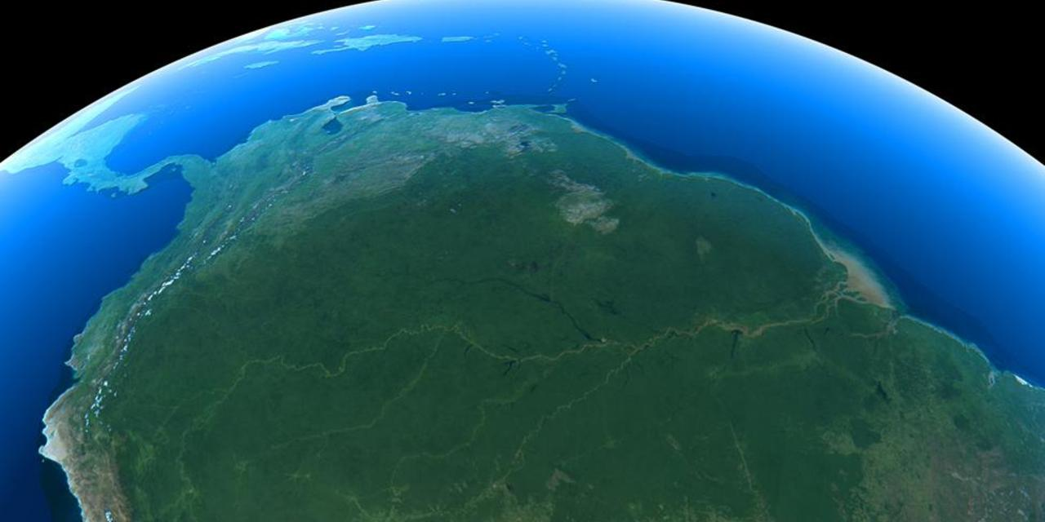
Challenges: Sustainability
Image Source BBC Website:http://www.bbc.com/future/story/20130226-amazon-lungs-of-the-planet
Notes:
Rainforest
Planet lungs
Responsibility for protecting it for future generations
Create policies that nurture industry but protect this natural treasure

Slide 21
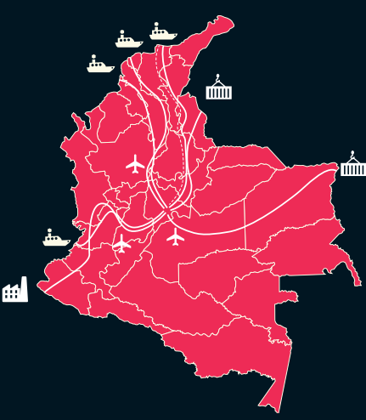
Why Colombia?
13 trade agreements
Ranked 1st Easiest Latin-American country to do business
Geographical Location
Increasing Foreign Direct Investment
Competitive Costs
Potential access to 1500 million habitants
Skilled Labour force
Government support
Attractive Domestic market
PEACE
Notes:
10 reasons
Set a business in 11 days
Access to central and south america

Slide 22





Acknowledgments

Slide 23
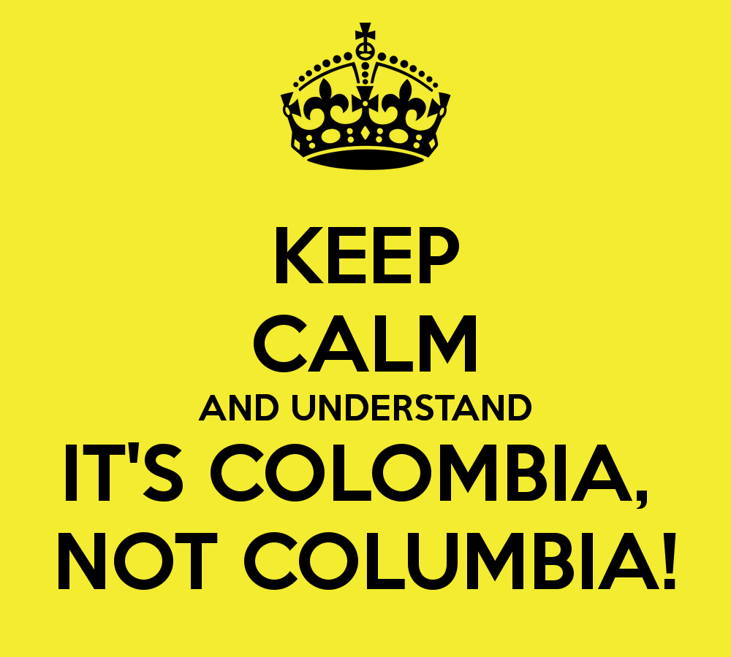
THANK YOU!
Notes:
Maybe something like a fast hook… Colombia not Columbia ( howing a picture)
Best airport in South Amarica
Happiest Country in the world

Slide 24
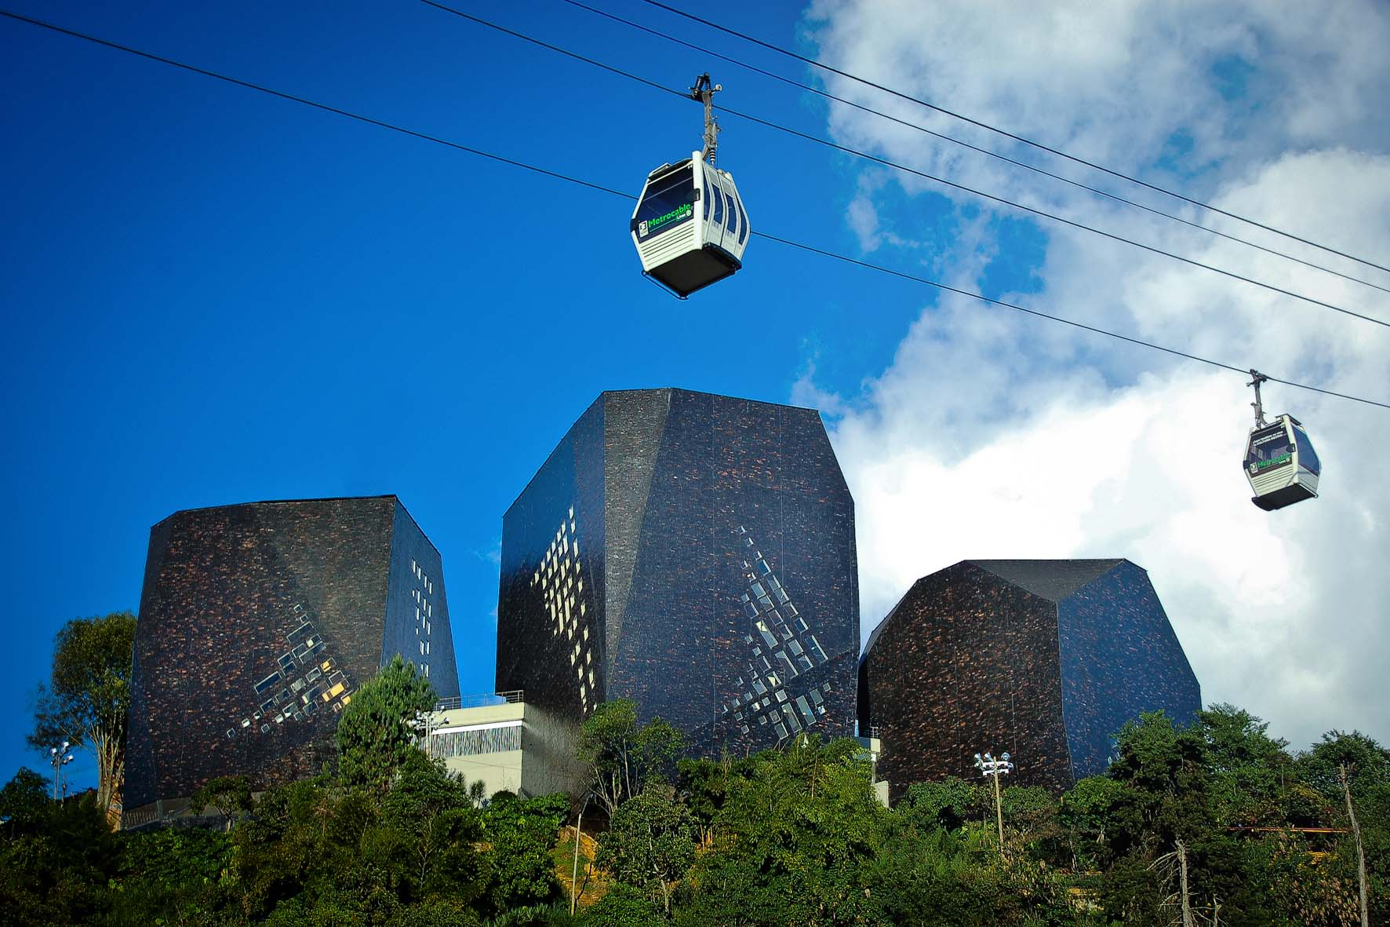
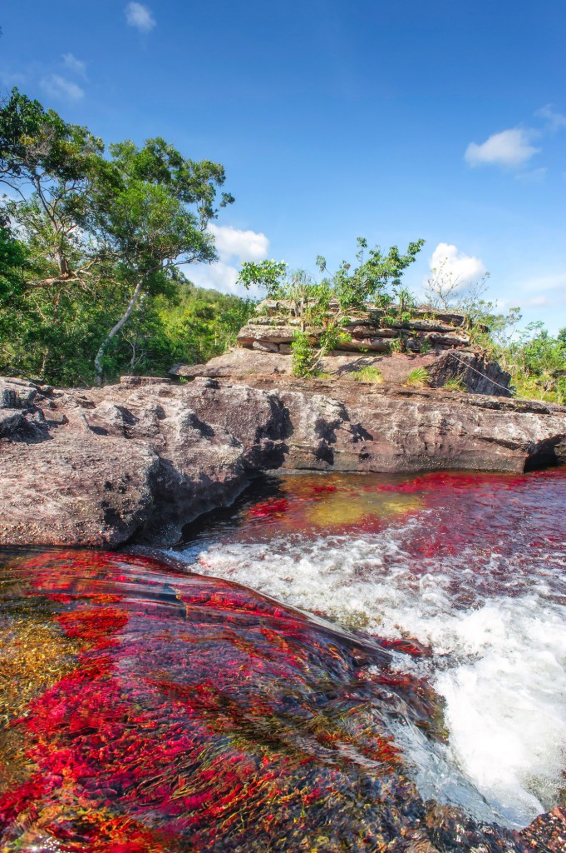
Notes:
Bogota has South America’s largest network of bicycle routes: over 300km stretching from slum areas and suburbs to the city centre.
(Source: Danish Architecture Centre, 2014)

Slide 25
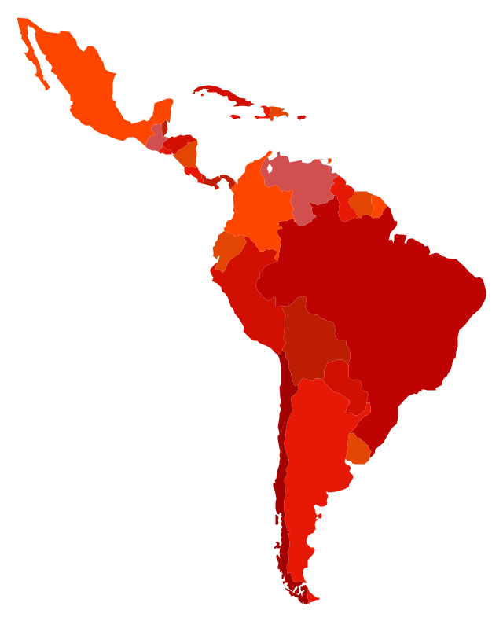
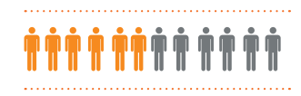
Conclusions
“TOP REFORMER”
5-8 years, according to World Bank
2nd
Flexible market
Strategic Geolocation
Easy access to Central & South-America
13 AGREEMENTS
1st and 6th
for investor protection in Latin-America and the world respectively
1.500 million habitants

Slide 26
