Slide 1
Manufacturing in Romania
Andrei Ionașcu, MSc Aerospace Materials
7th March 2017

Slide 2
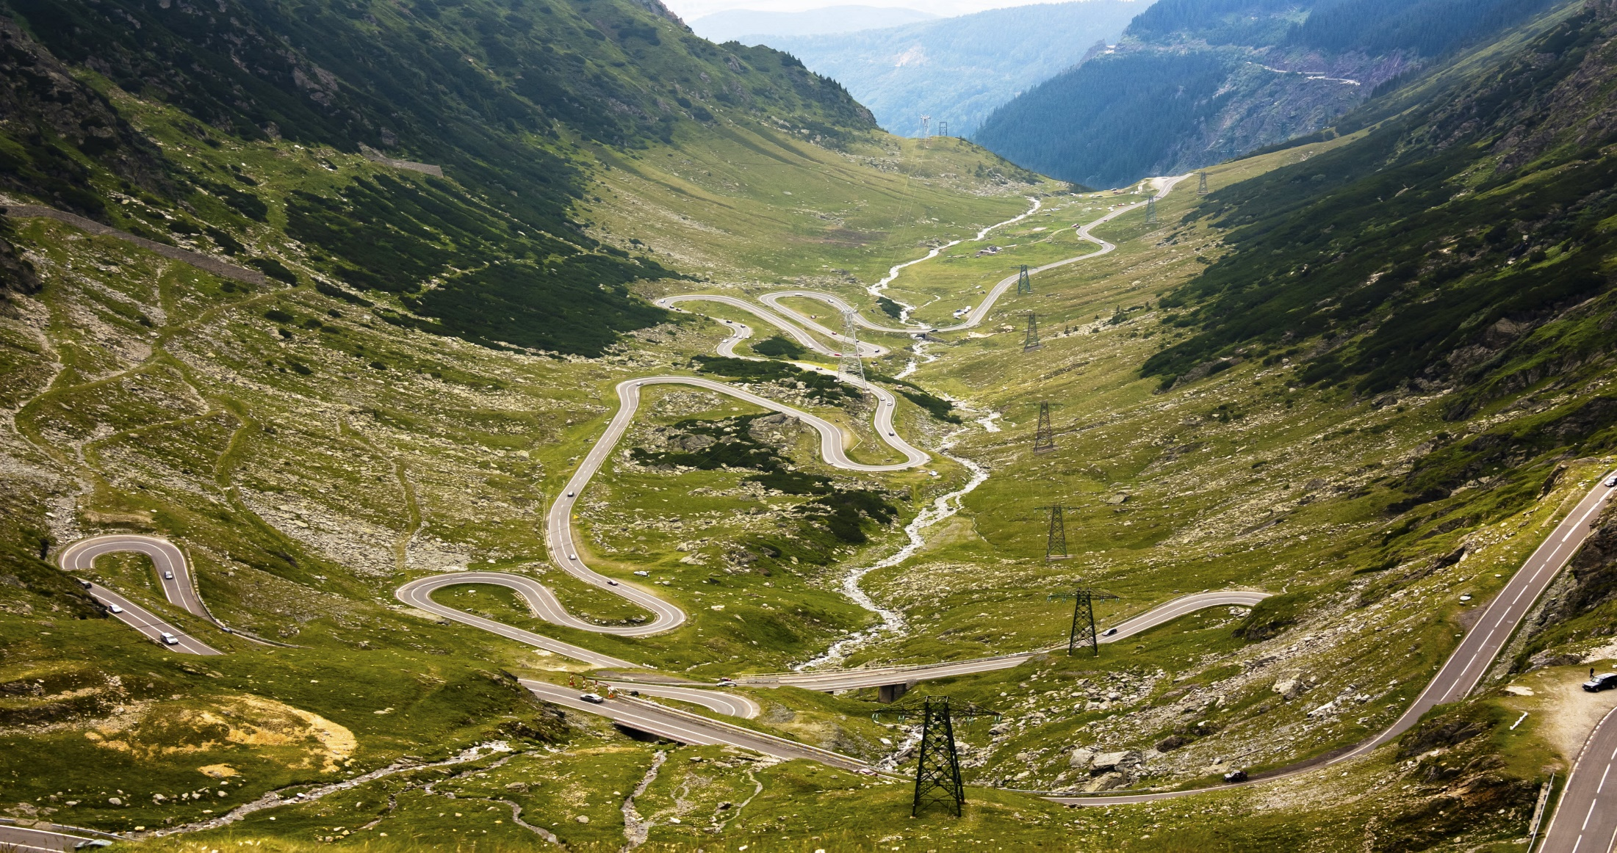
Romania
Transfăgărășan Road

Slide 3
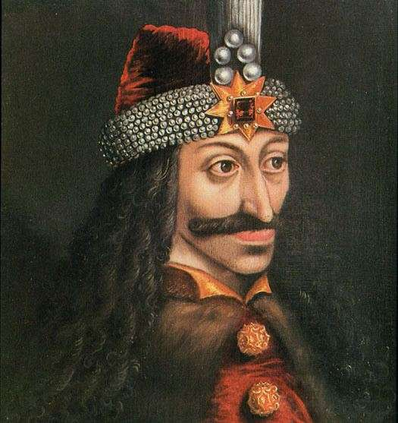
Romania
Vlad the Impaler (1448; 1456-1462; 1476)

Slide 4
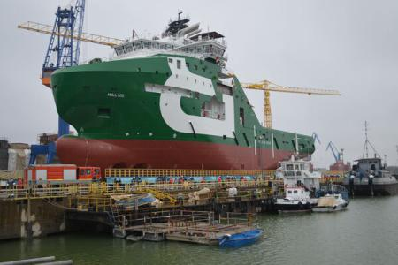
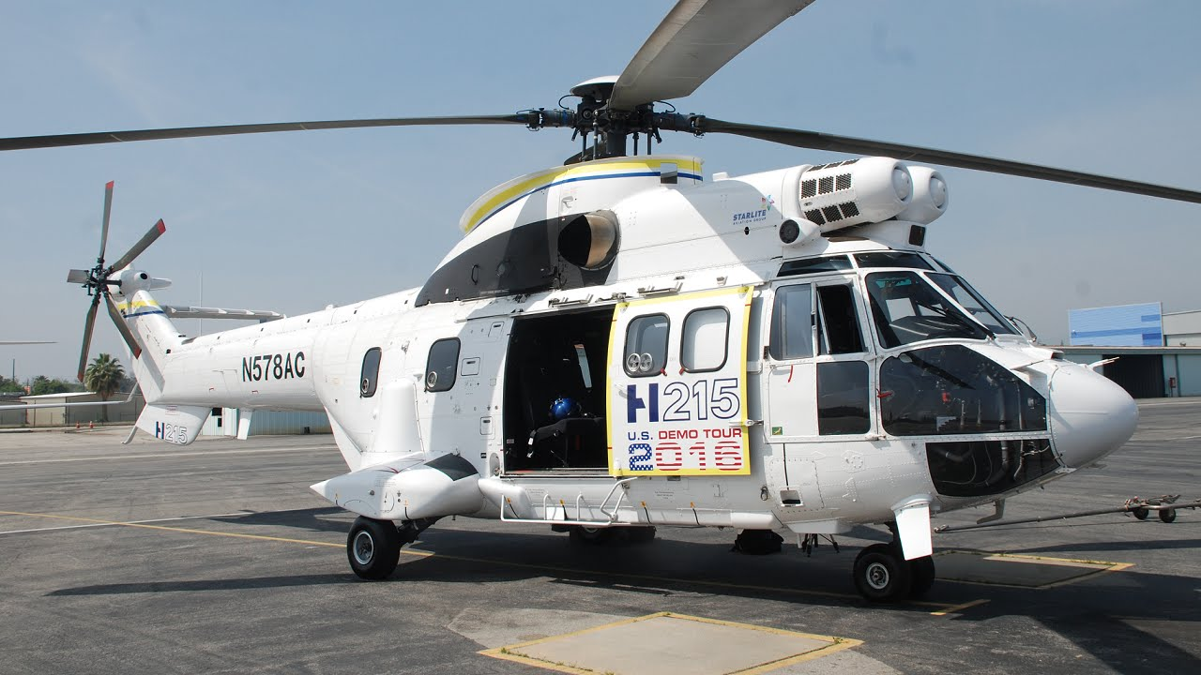
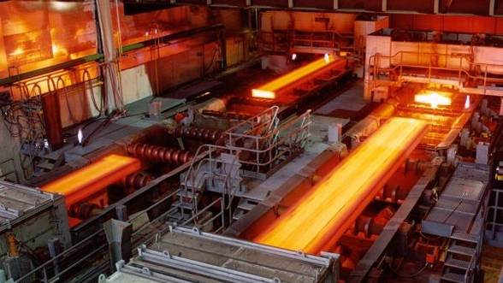
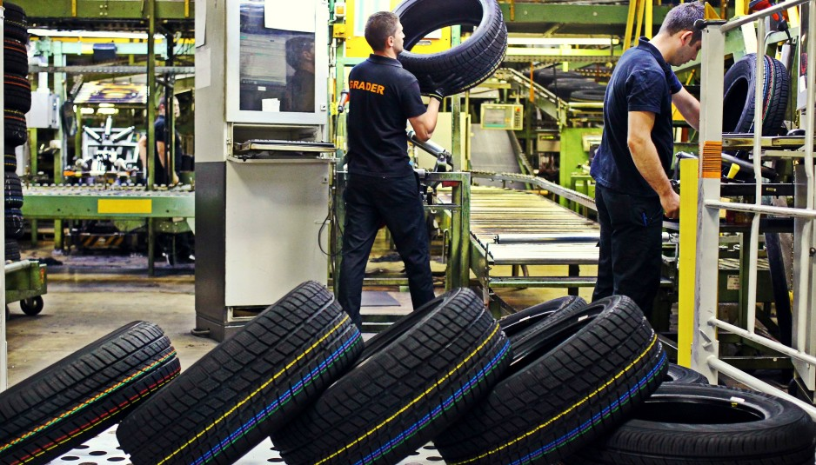
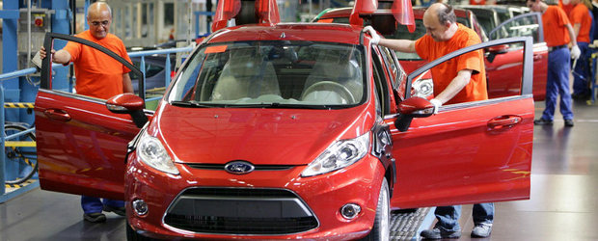
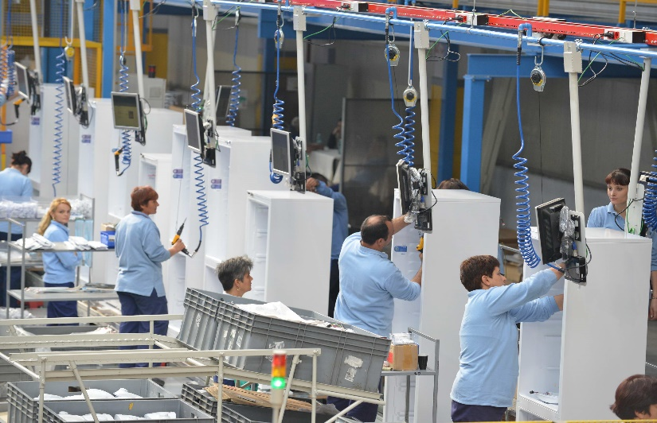
Romania

Slide 5
Romania`s Manufacturing History
Important Years in Romania`s Manufacturing History
1951-1974
Romania`s gross industrial output increased at an average annual rate of 13%
Nicolae Ceaușescu founded branches of heavy industry, including the machine-tool, automotive, shipbuilding, electric diesel locomotives and petrochemical ones
1967-1989
1989-2000
Industry’s contribution to the GDP went down from 40% to 26.1% and employment from 36.9% to 23.3%
2016
The industrial production represents 81% of that recorded at the end of the communist period
Coat of Arms of the Socialist Republic of Romania
Sources:
https://en.wikipedia.org/wiki/Socialist_Republic_of_Romania

Slide 6
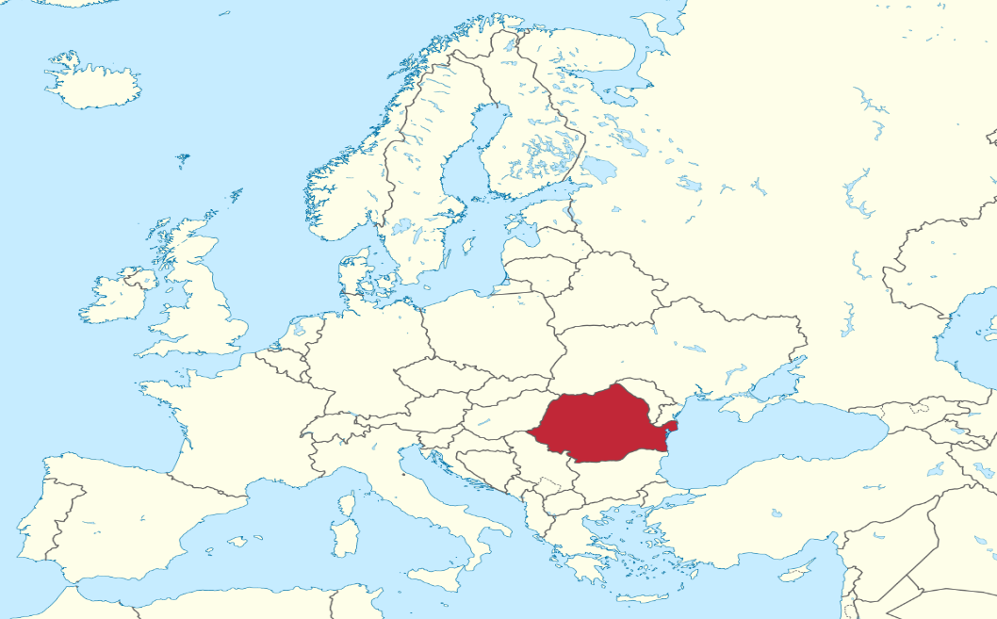
Why Romania?
Attractive location
Highly skilled professionals, with very good knowledge of foreign languages
2nd lowest net annual average wages in the EU ($5,884)¹
One of the lowest corporate tax rates in Europe (16%)²
No taxation on reinvested profit²
3rd fastest Internet connection in the world and 1st in Europe³
Sources:
Reinis Fischer: Average Salary in European Union 2016
European Commission: Taxation and Customs Union
Internet Society: Global Internet Report 2015

Slide 7
Global Manufacturing Competitiveness Ranking
2016
Rank | Country | Index Score
1 | China | 100.0
2 | United States | 99.5
3 | Germany | 93.9
31 | Ireland | 44.7
32 | Russia | 43.9
33 | Romania | 42.8
34 | Saudi Arabia | 39.2
35 | Portugal | 37.9
2020 (Projected)
Rank | Country | Index Score
1 | United States | 100.0
2 | China | 93.5
3 | Germany | 90.8
26 | France | 49.1
27 | Spain | 48.4
28 | Romania | 45.9
29 | Belgium | 45.8
30 | Italy | 45.0
Sources:
Deloitte: 2016 Global Manufacturing Competitiveness Index.

Slide 8
GDP Ranking
Romania has the 52nd highest GDP in the world
Manufacturing represents 4.2% of Romania’s GDP
Regarding the GDP per capita, Romania can be compared to countries like Russia, Mexico, Turkey and Brazil
Country | GDP |  | GDP per capita
 | USD Billions | Ranking | USD | Ranking
United States | 18,037 | 1 | 56,116 | 8
China | 11,008 | 2 | 8,028 | 74
Japan | 4,123 | 3 | 32,477 | 25
Czech Republic | 185 | 49 | 17,548 | 39
Kazakhstan | 184 | 50 | 10,510 | 60
Iraq | 180 | 51 | 4,944 | 93
Romania | 178 | 52 | 8,973 | 69
New Zealand | 174 | 53 | 37,808 | 22
Algeria | 167 | 54 | 4,206 | 100
Qatar | 165 | 55 | 73,653 | 5
Sources:
http://www.tradingeconomics.com

Slide 9
Important Manufacturing Sectors
Sources:
The Importance of the Manufacturing Sector in the Romanian Economy (Herman, E., 9th International Conference Interdisciplinarity in Engineering, 2015, Romania)

Slide 10
The Automotive Industry in Romania
1st
Dacia is Romania`s top company by revenue ($4.6bn) and exports (7.3%)
3rd
Dacia is the 3rd largest company in Romania in terms of employees (14,229)
5th
Dacia is the 5th best-selling car brand in France (5.48% market share)
92%
Cars produced by Dacia and exported in Europe
Sources:
Romanian Government: Parc Auto Romania
https://www.dacia.ro

Slide 11
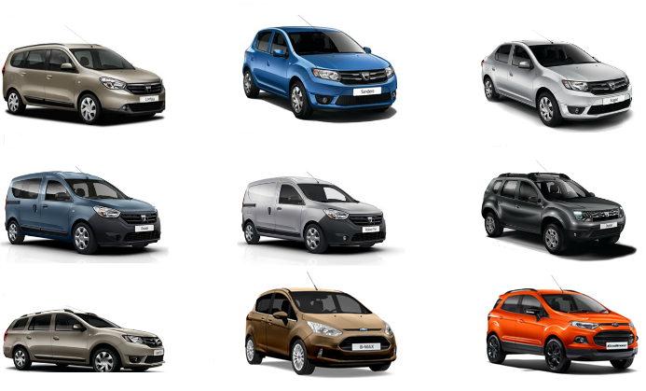
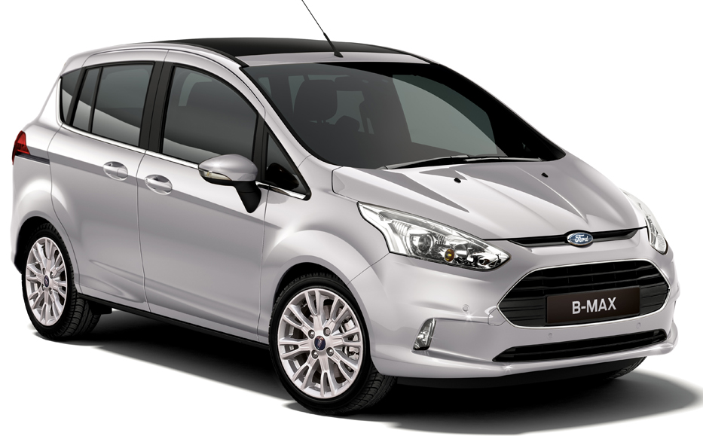
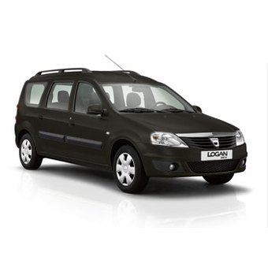
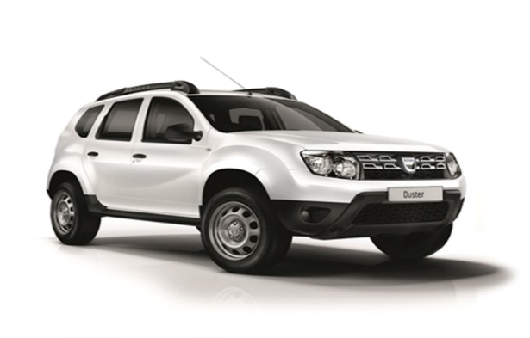
The Automotive Industry in Romania
Lodgy
Sandero
Logan
Dokker
Dokker
Van
B-Max
Logan
MCV
Duster
EcoSport

Slide 12
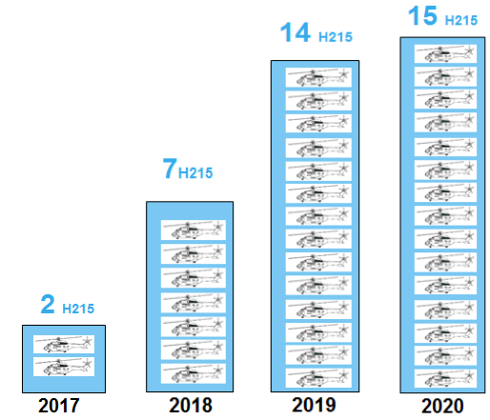
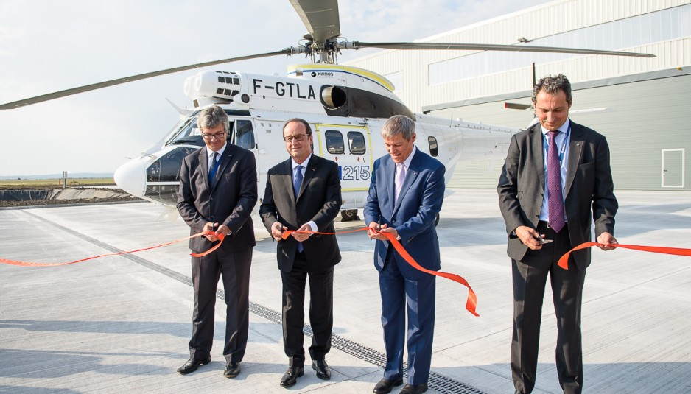
Opportunities in the Aerospace Industry
In September 2016, Airbus Helicopters opened at Braşov a plant to produce the new H215 model
$60m investment ($5.9m from the local government)
350 new jobs
First H215 helicopter to be ready in 2017
The plant`s development phase will end in 2019
Production will gradually increase until 2020
Sources:
Airbus Helicopters Romania Leaflet

Slide 13
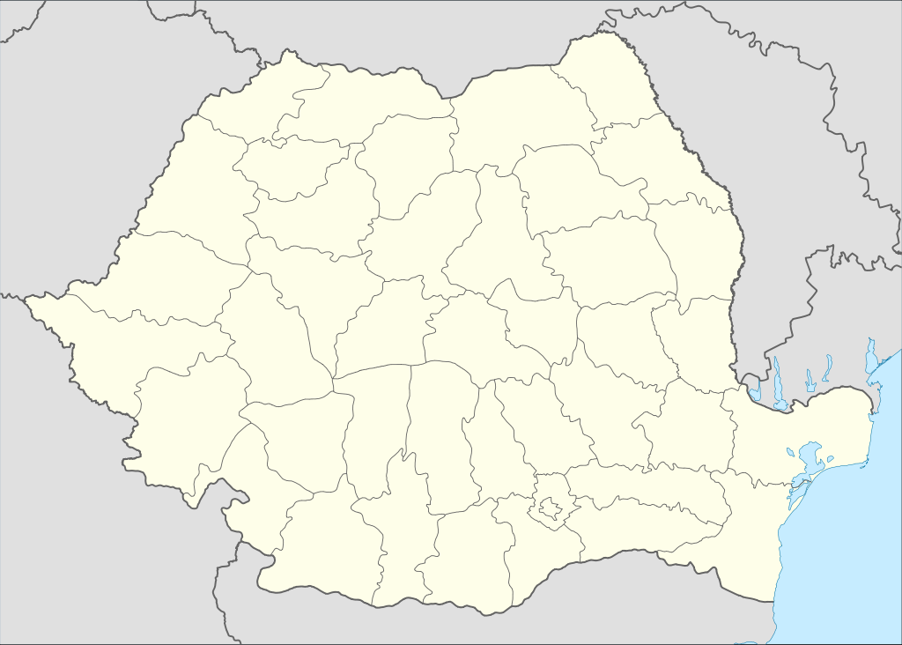
Research in Romania
Romania has the 2nd lowest GERD as a percent of GDP from the 28 member countries of the EU¹
Renault Technologie Roumanie in Titu is the only centre of automotive engineering in South-Eastern Europe²
Biggest Renault engineering centre outside France²
Dacia factory (Mioveni)
Renault research centre (Titu)
Design office (Bucharest)
Sources:
1. European Commission: Gross Domestic Expenditure on R&D (GERD)
2. Groupe Renault: http://www.gruprenault.ro/despre-noi/unde-facem-lucrurile-sa-se-intample/titu

Slide 14
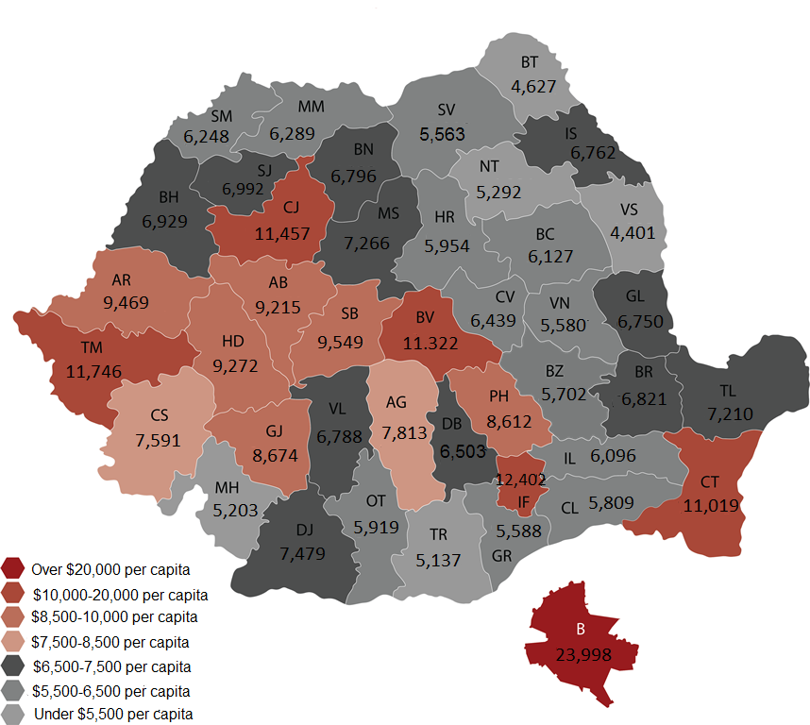
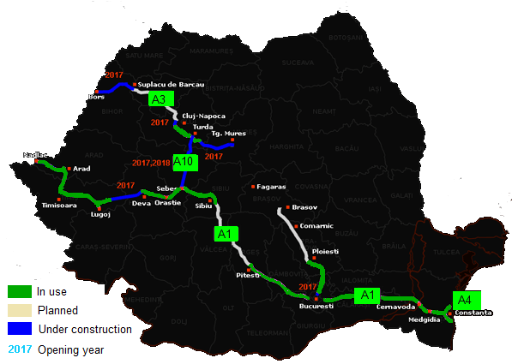
Future perspectives
GDP per capita in Bucharest and Romania`s 41 counties
Romania`s road infrastructure
Sources:
Comisia Naţională de Prognoză : PIB-ul pe cap de locuitor în 2016 (euro)

Slide 15
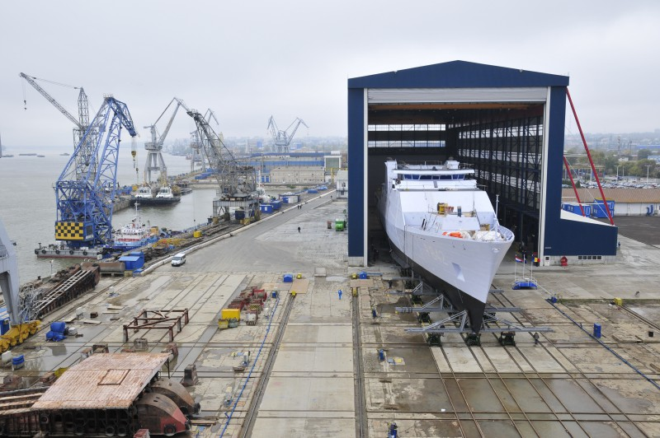
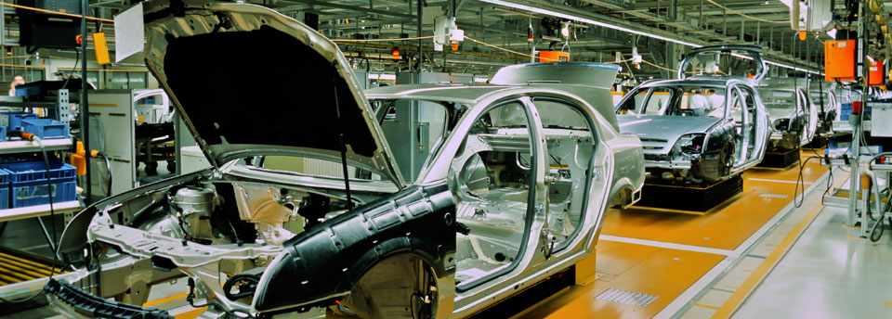
Challenges and conclusions
Challenges:
Improve sales on the local market
Attract companies to invest in poor regions
Improve road infrastructure
Increase investments in R&D
Conclusions:
Huge differences between regions
Romania has become an attractive location for manufacturing companies
Romania is becoming a key player in the European and global manufacturing sector

