Slide 1
Manufacturing in Nigeria: Opportunities for Investment
Omo Oleghe, PhD Researcher
Oluwaseyi Omoloso, MSc Student
7 March, 2017

Slide 2
Did You Know?
RANK | Developing Countries | Global GDP Ranking | GDP per Capita global Ranking
1 | China | 2 | 72
2 | India | 7 | 139
3 | Nigeria | 23 | 124
4 | Egypt | 31 | 114
5 | Thailand | 27 | 85
Nigeria has the highest GDP in Africa- 481 billion dollars
And has the 23rd highest GDP in the world
The 7th most populous country in the world has a GDP per Capita which is ranked 124th in the world.
Agriculture and Manufacturing saw highest growth in banking credit in 2016 in Nigeria
Sources
The World Bank: 2015 GDP Ranking. http://data.worldbank.org/data-catalog/GDP-ranking-table
2. The World Bank: 2015 GDP per capita (current US$). http://data.worldbank.org/indicator/NY.GDP.PCAP.CD

Slide 3
GDP comparison over the years and between countries
Source: worldbank.org
Source: worldbank.org

Slide 4
Global Manufacturing Competitiveness Ranking
2016 Competitiveness Ranking |  |  | 2020 Competitiveness Ranking
 |  | 2020
RANK | COUNTRY | ↓ ↑ ↔ | RANK | COUNTRY
1 | China | 1↑ | 1 | United States
2 | United States | 1↓ | 2 | China
3 | Germany | ↔ | 3 | Germany
4 | Japan | ↔ | 4 | Japan
5 | South Korea | 6↑ | 5 | India
11 | India | 1↓ | 11 | Singapore
12 | Switzerland | 6↑ | 12 | Vietnam
13 | Sweden | 4↑ | 13 | Malaysia
14 | Thailand | ↔ | 14 | Thailand
15 | Poland | 4↑ | 15 | Indonesia
21 | Australia | 1↓ | 21 | Netherlands
22 | France | 1↓ | 22 | Australia
23 | Czech Republic | 6↑ | 23 | Brazil
24 | Finland | ↔ | 24 | Finland
25 | Spain | 2↑ | 25 | South Africa
36 | Colombia | 1↓ | 36 | Saudi Arabia
37 | Egypt | ↔ | 37 | Egypt
38 | Nigeria | ↔ | 38 | Nigeria
39 | Argentina | ↔ | 39 | Argentina
40 | Greece | ↔ | 40 | Greece
Nigeria ranks the 38th country on the table
3rd in Africa, behind South Africa and Egypt
Position forecasted to remain unchanged till 2020? – We disagree. Why?
Sources.
1. Deloitte and US Council on Competitiveness: 2016 Global Manufacturing Competitiveness Index.

Slide 5
Assessment of Manufacturing in Nigeria
Strengths
Abundant raw materials
Large market and labour
Weaknesses
Weak infrastructures
Low industrial skills
Unaffordable finance
Opportunities
Manufacturing hub for region
Diversification of Nigeria’s exports
Manufacturing with cheap labor
Bi-lateral trade agreements
Threats
Increasing global competition
Trade policies
Source: NBS
Source: Nigeria Industrial Revolution Plan

Slide 6
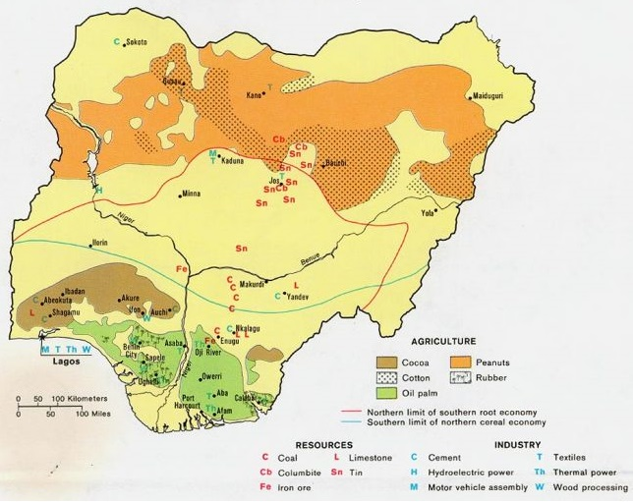
Major Raw Materials and Industries by Region
Strength lies in Agriculture
Largest cassava producer in the world,
3rd Largest Producer of Groundnut and
4th Largest producer of Cocoa in the world
Agricultural sector growth of an average of 3.5% annually since 2015
Government driving investments in agricultural production and processing
Source: www.fortuneofafrica.com

Slide 7
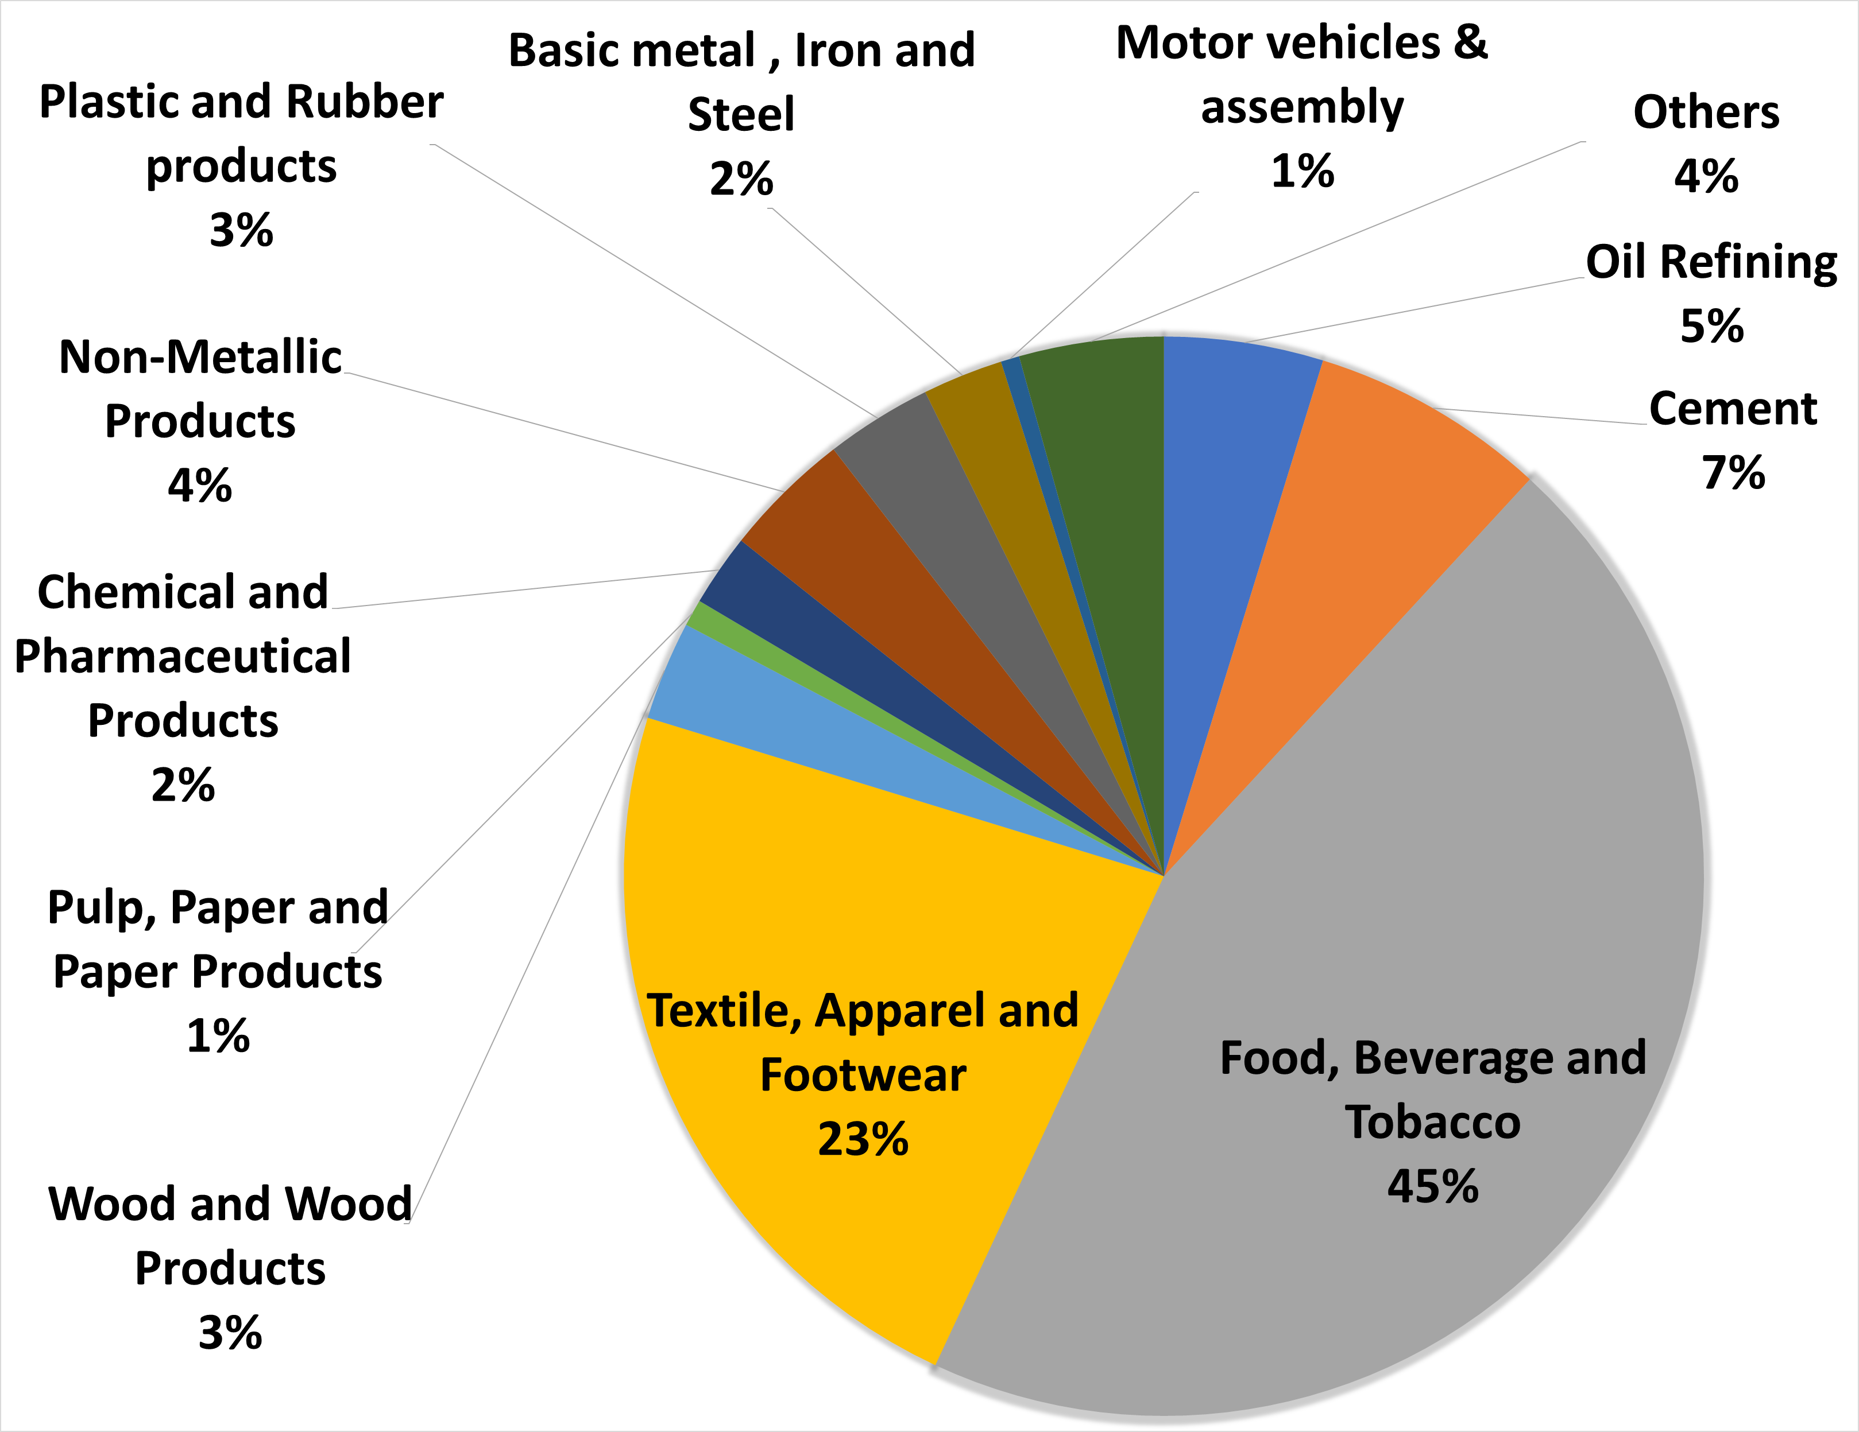
Dominant Manufacturing Sectors
Indorama group has increased its investments from $2 billion to $4 Billion in petrochemicals
This will improve the output in:
  Plastics and Rubber sub sectors
  Chemical and Pharmaceutical Products
The Nigerian government is targeting $5bn in mining investments over the next 10 years
Notes:
the core investor in Petrochemicals in Nigeria , The Indorama group aims to build Africa’s largest petrochemical hub in Nigeria.

Slide 8
Consumer products-related manufacturing investments
Population and high consumer expenditure have led to increased manufacturing investments of consumer related products
Source: World Bank
Notes:
Consumer spending in nominal terms

Slide 9
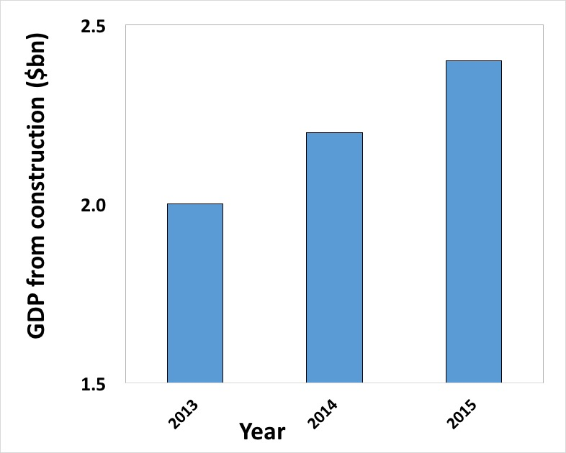
Infrastructure-related Manufacturing Investments
Construction and real estate boom has led to an increase in cement and steel production, as well as building materials
Source: tradingeconomics.com

Slide 10
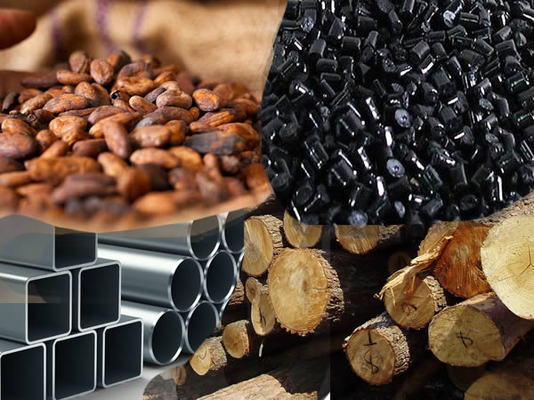
Manufacturing Incentives in Nigeria
Local raw materials utilization: 30% tax concession for 5 years for minimum local content
Export: 10% tax concessions for 5 years for exporting at least 6% of products
Import: Duty waivers and rebates on machinery, spare parts and raw materials
Engineering: 10% tax concession for engineering companies
Mining: Three-year tax holiday, as well as exemptions on import duties for mining equipment
pic: punchng.com

Slide 11
Future outlook of Manufacturing in Nigeria
Growth of retail trade will generate increased orders for manufactured consumer goods
pic: jetlinking.blogspot.com
Vision 2020: placing Nigeria among the 20 largest economies in the world by 2020.
Encourage local content
Incentives and opportunities for investment will encourage both local and foreign investors

