Slide 1
Global Manufacturing Student Think Tank
Manufacturing in Spain
Toni Galeote Perramon
MSc in Global Product Development and Management
Guillermo García del Valle Martínez
MSc in Aserospace Materials
7th March 2017

Slide 2
Desperation, anger grows for Spanish youth, with 51 percent unemployed
07/06/2012
Spain’s recovery boosts labour market
23/04/2014
Back from the brink: Spain emerges as a model for Europe
25/03/2015
Latest Europe rescue aims to prop up Spain
11/06/2012
S&P cuts Spain credit rating to near junk
11/10/2012
Growth up, joblessness falling – is Spain’s crisis finally over?
26/03/2015
Spain to ask for bailout next month
15/10/2012
How Spain fixed its economy
04/08/2015
Spain unemployment hits record high
Rate soared to a new record of 27.2% in the first quarter of 2013.
25/04/2013
Spain jobless rate falls to 7-year low of 18.6 percent
26/01/2017
However…
Notes:
2008. Big world crisis. And how was Spain doing? If you didn’t hear it, just look at these newspapers. Let me just highlight 3 main problems

Slide 3
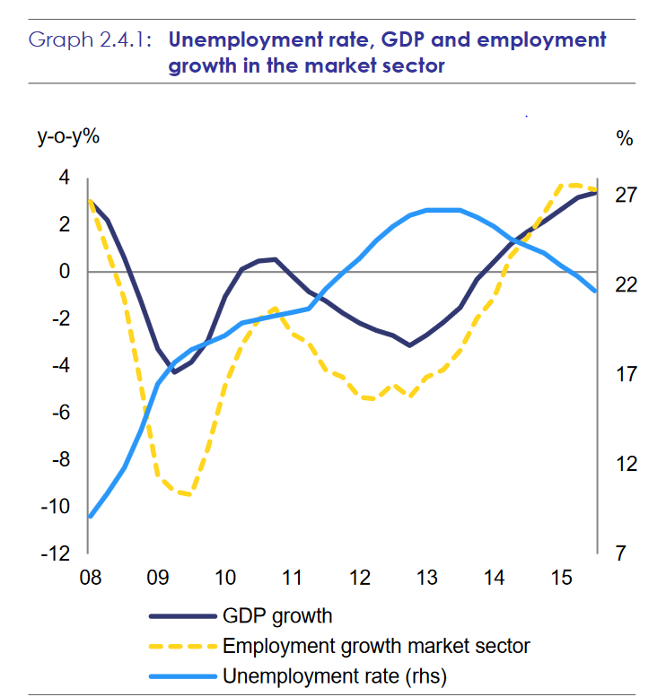
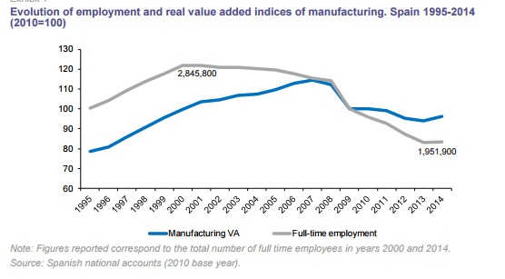
Macroeconomic data
What is the relation between employment and real value added in manufacturing?
How has Spain’s GDP evolved in the last years?
Notes:
The employment rate has decreased more dramatically than the VA, therefore we can say that the productivity has increased

Slide 4
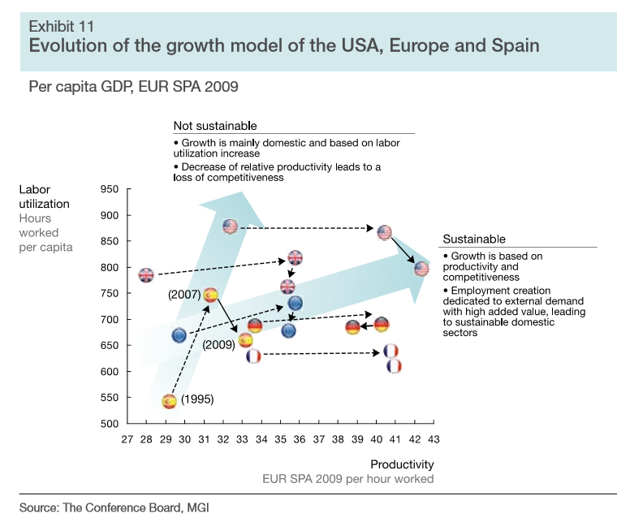
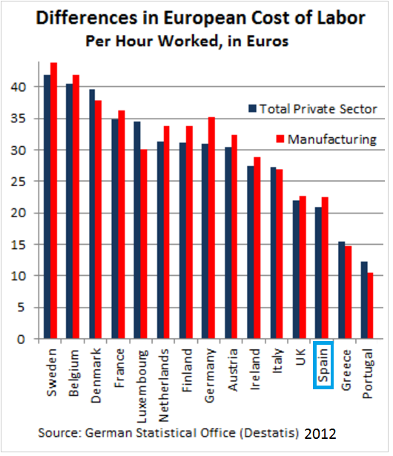
Manufacturing in Spain
Moving towards a Sustainable Growth direction, based on:
Productivity and competitiveness
Employment creation
Low labour cost of young educated people
Notes:
Evolution of the growth model following a non sustainable path due to boom in costruction industry

Slide 5
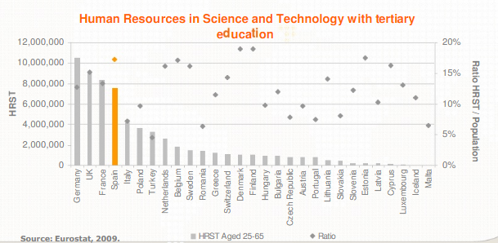
Education
Human Resources in Science and Technology with tertiary education
High rate of tertiary educated people
In STEM disciplines:
3rd best ratio in Europe
4th in numbers in Europe

Slide 6
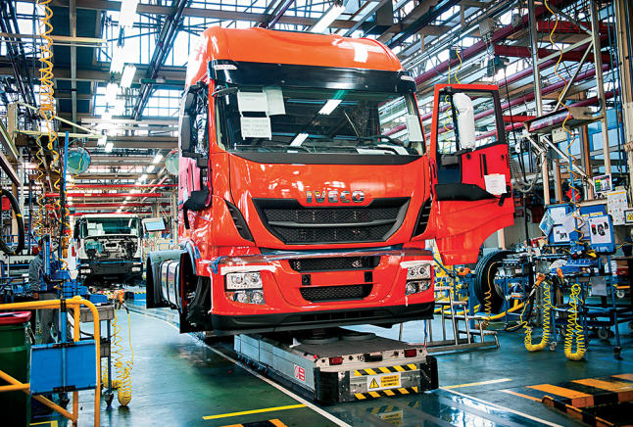
Key sectors of Spain’s industry

Slide 7
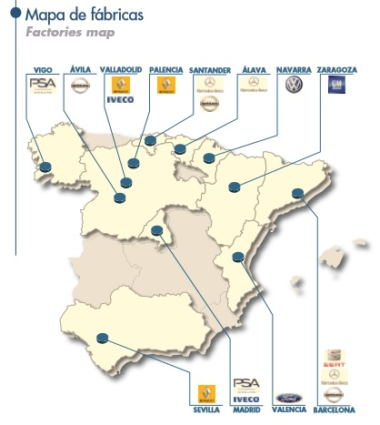
Keys to success:
Relatively low cost labour
High productivity
Export focus
Automotive industry
2nd car manufacturer in Europe, 8th worldwide
1st industrial vehicle manufacturer in Europe
High robotization: 56.4% of all robots in Spain
Export focus
+1000 companies, from SMEs to international groups, in the components industry
Source → Annual report 2015. Asociación Española de Fabricantes de Automóviles y Camiones.
Notes:
2.8 million vehicles in 2016.
56.4% of all robots in Spain’s industry are in the automotive industry.
83% of vehicles are shipped abroad

Slide 8
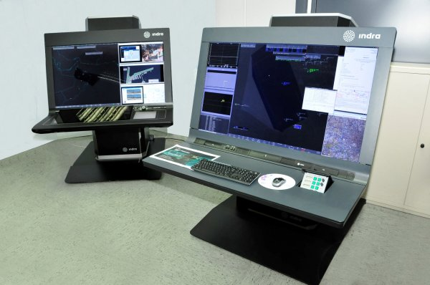
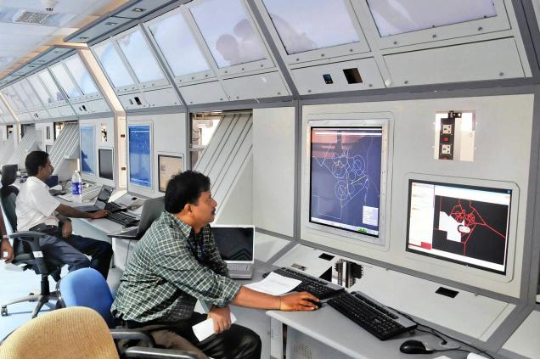
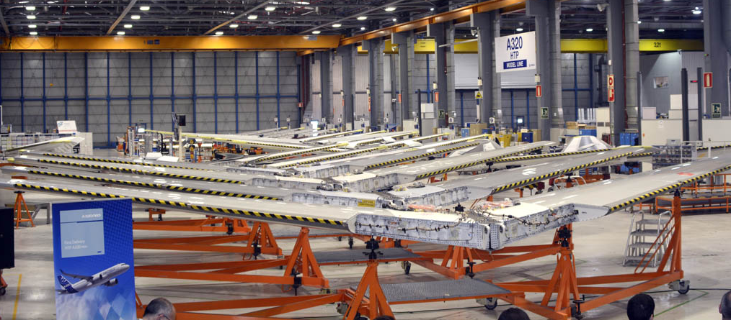
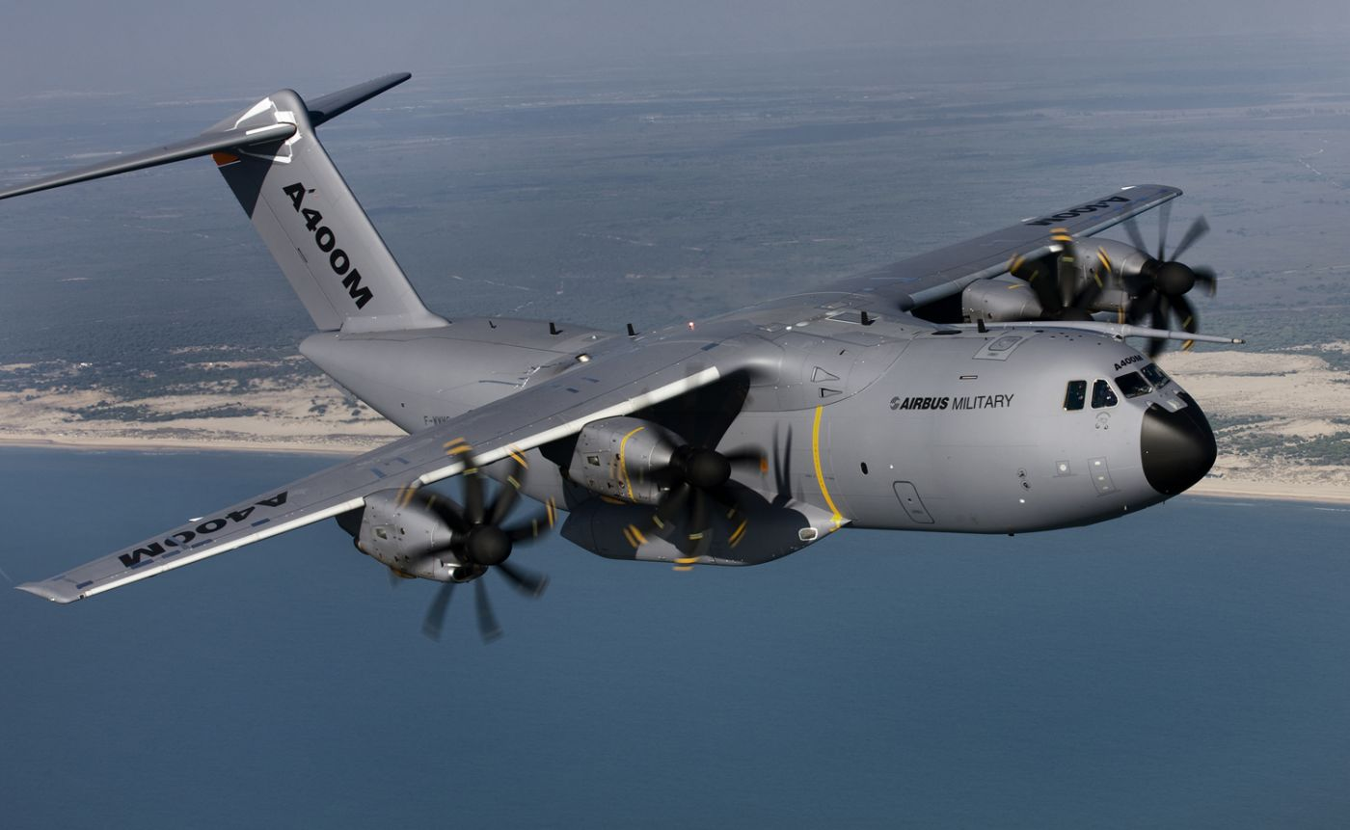
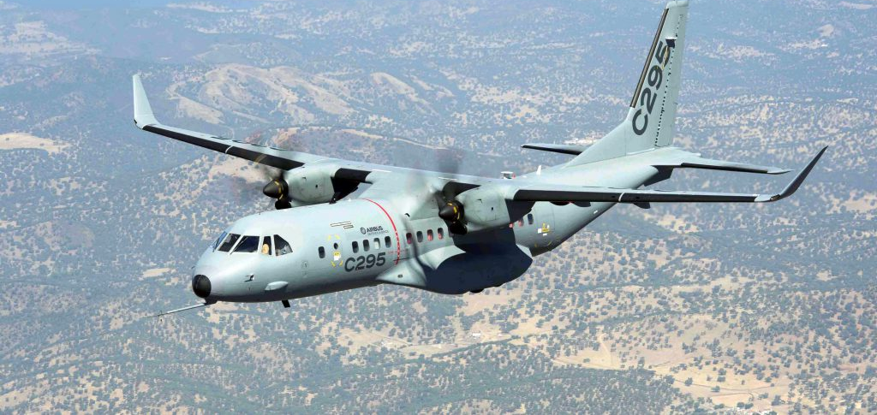
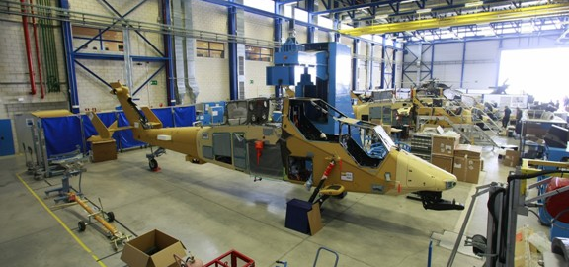
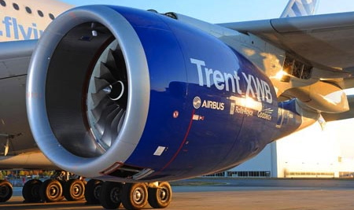
Aerospace industry
5.8% of industrial GDP in 2015
Fifth in Europe in terms of turnover and employment
Exports 84% of turnover
High growth rates
Participation in international programs
3 out of 5 flights in the world use Spanish software for landing
Source → Spain: Business opportunities in aerospace. Invest in Spain. ICEX. Gobierno de España.
Notes:
Figures: 9700 million euros turnover in 2015. 54400 employees in 2015. 100% turnover growth in last decade. 3.2% in 2015. Programs for Airbus and Boeing.
To comment: final assembly line for A400M military transport by Airbus Defence and Space in Seville, Andalusia.
Companies leaders in:
Military Transport Aircraft – A400m, CASA 225, CASA 295 (Airbus Defence and Space). Also helicopters NH90 and commercial (Horizontal tail planes for all Airbus commercial)
Low pressure turbine engines – ITP, part of Rolls Royce.
Air Traffic Management systems (3 out of 5 flights in the world use Spanish software for landing)
Leading companies in: aerostructures, space applications, composite manufacturing and the Boeing Research and Technology Europe.

Slide 9
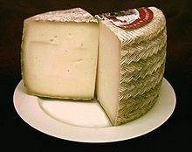
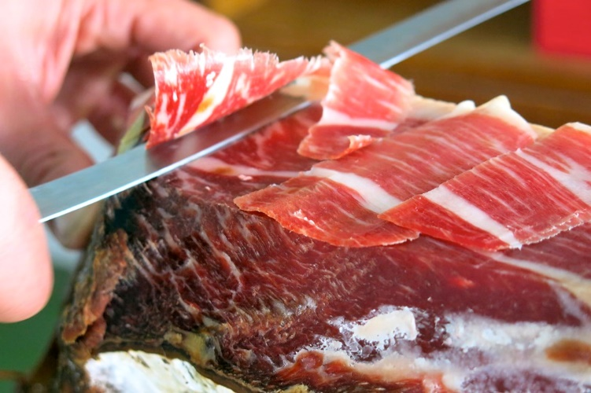
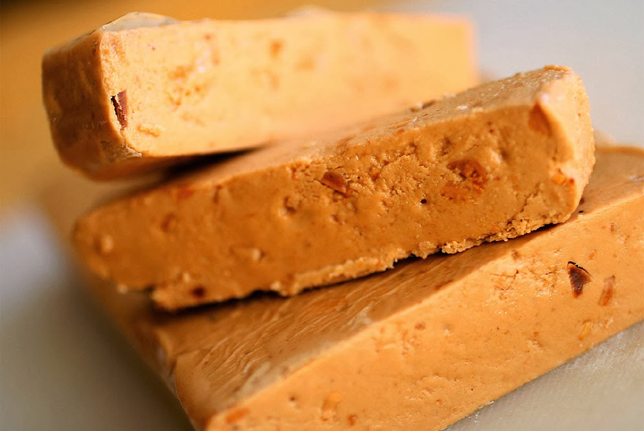
Wine, agro and food industry
4th biggest food industry in Europe
21% of all industry employees
Steady growth
World’s biggest producer of olive oil and wine
Abundance of products and beverages with quality seals (Protected Designation of Origin)
Source → FIAB (Federación Española de Industrias de Alimentación y Bebidas)
Notes:
500.000 employees in 2015.
Steady growth even during the crisis: 2% annual growth, compared with a -0.45 of the general economy and a -1.8 in the manufacturing sector.
Largest EU producer of citrus fruits, peaches, apricots and strawberries
Such as, for example, Rioja or Sherry Wines, Iberian Ham, Manchego Cheese, Virgin Olive Oil or Turron de Jijona.

Slide 10
Biotech and pharma industry
Second country with the highest number of biotechnology-related companies in the world, only behind the United States (OECD data)
10.35% GPD in 2014
330% turnover growth 2008-1014
Strong Government support
World leader in organ transplants
Pharma sector accounts for:
20% of total R&D in Spain
Highest productivity sector
Highest export propensity
Source → Biotechnology sector in Spain (September 2016 edition). Invest in Spain. ICEX. Gobierno de España.
Notes:
Notes: GPD figure with equal digits to tourism, a pillar of Spanish economy.
Government aid programmes, such as (?)
Growth:
PHARMA: 20% of total R&D expenditure, and 50% of R&D employees. Export propensity of 78%.
http://www.biospain2016.org/biotechnology-in-spain
http://www.investinspain.org/invest/wcm/idc/groups/public/documents/documento/mde2/njy2/~edisp/doc2016666751.pdf
https://www.scribd.com/document/80087918/Invest-in-Spain-Business-opportunities-in-Biotechnology-Pharmacy-and-Life-Sciences
.(1) Data from OECD (Organisation for Economic Co-operation and Development)

Slide 11
Strengths and weaknesses of Spain’s manufacturing sector

Slide 12
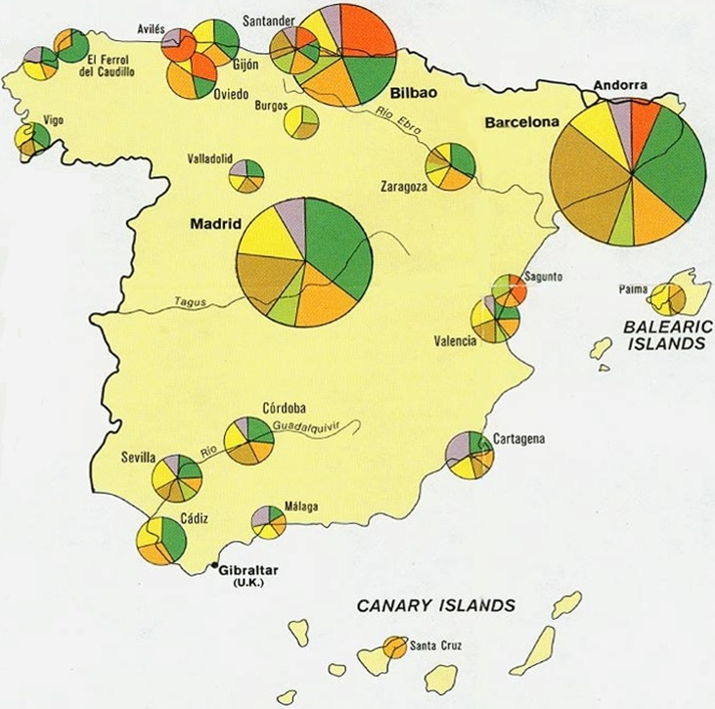
Aspects that need further improvement
Dominance of SMEs
Unbalance North/South and
coast/interior
Potential to improve investment in R&D

Slide 13
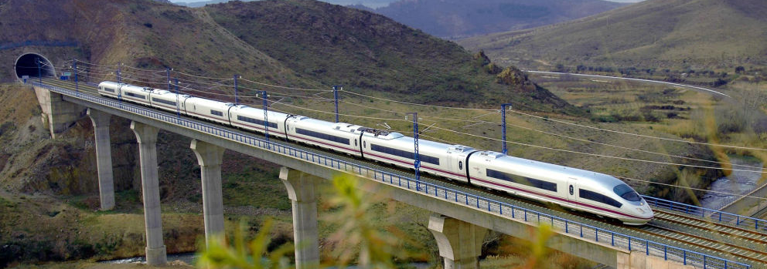
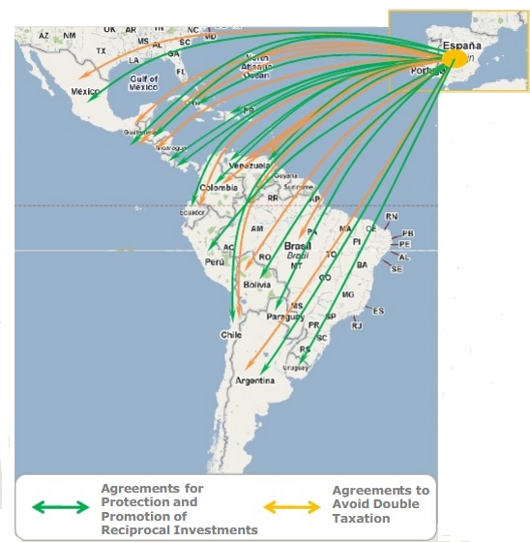
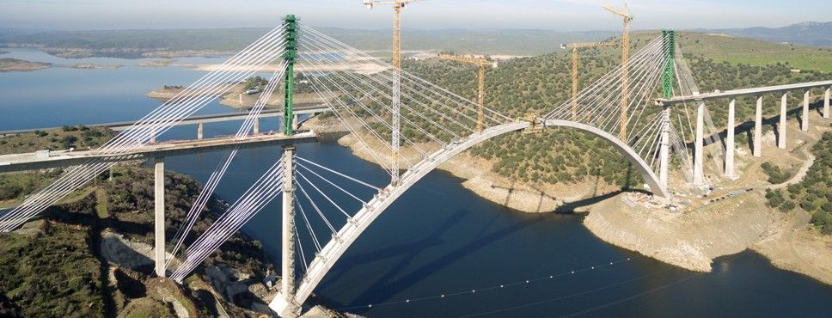
Key strengths
Language
Market size - Bridge to Latin America
First-class infrastructure
Low labour cost
Highly educated population
Human Resources in Science and Technology with tertiary education
Notes:
Second most spoken language in the world.
EU – a market of 500 million people, but also the bridge between Europe and Latin America, for historical reasons and, of course, the language.
Infrastructure: second biggest HSR network in the world. In the 2012–13 edition of the Global Competitiveness Report Spain was listed 10th in the world in terms of first-class infrastructure. It is the 5th EU country with best infrastructure and ahead of countries like Japan or the United States. Port of Valencia is the busiest seaport in the Mediterranean basin. 40% of air traffic EU-South America goes through Madrid.

Slide 14
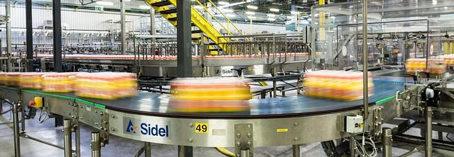
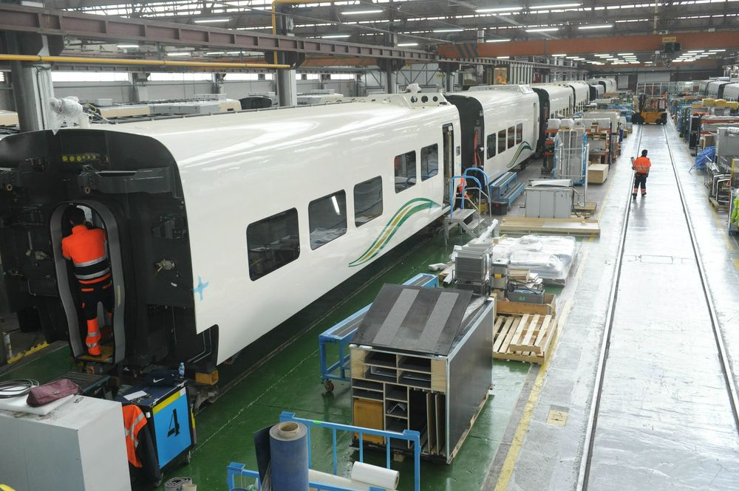
What can we expect in the future?
Keys for the success of Spanish manufacture
Relatively low cost and highly skilled labour
Investment in high productivity sectors
Export focus
Sectorial strategies
Focus on productivity increase and robotization
Cluster development strategy
Protected Designations of Origin
Future actions
Spanish Bioeconomy Strategy 2030 Horizon
Aerospace Sector Competitiveness Program
R&D projects
Notes:
Finally as future actions, spain has started some initiatives like the Spanish Bioeconomy Strategy 2030 Horizon
FUTURO: Estrategia espanola de bioeconomia 2030.
http://bioeconomia.agripa.org/download-doc/102163
‘Promoting the generation of know-how and its use in developing and applying derived technologies, via collaboration within the science and technology system and Spanish public and private bodies’

Slide 15
Manufacturing in Spain
Thank you for your attention
Global Manufacturing Student Think Tank
Notes:
And, of course, it astounding quality of life/lifestyle. 2nd in the world according to the HSBC expat survey
https://expatexplorer.hsbc.com/survey/country/spain

Slide 16
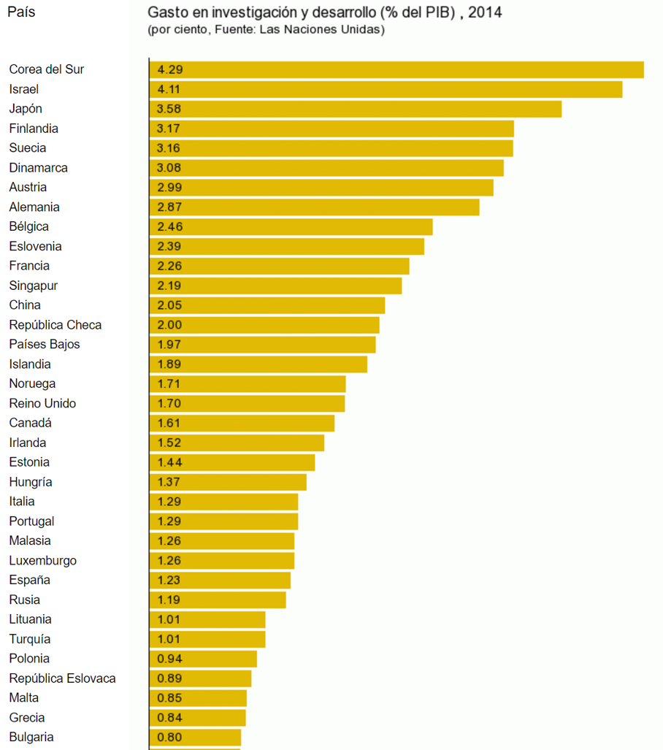
Quick Stats
1st industrial vehicle manufacturer in Europe
3 out of 5 flights in the world use Sapnish software for landing
4th biggest food industry in Europe
World’s biggest producer of olive oil and wine
2nd with the highest number of biotechnology-related companies in the world

