Slide 1
Manufacturing in Indonesia
Patriot Silitonga
MSc Aerospace Manufacturing
7th March 2017

Slide 2
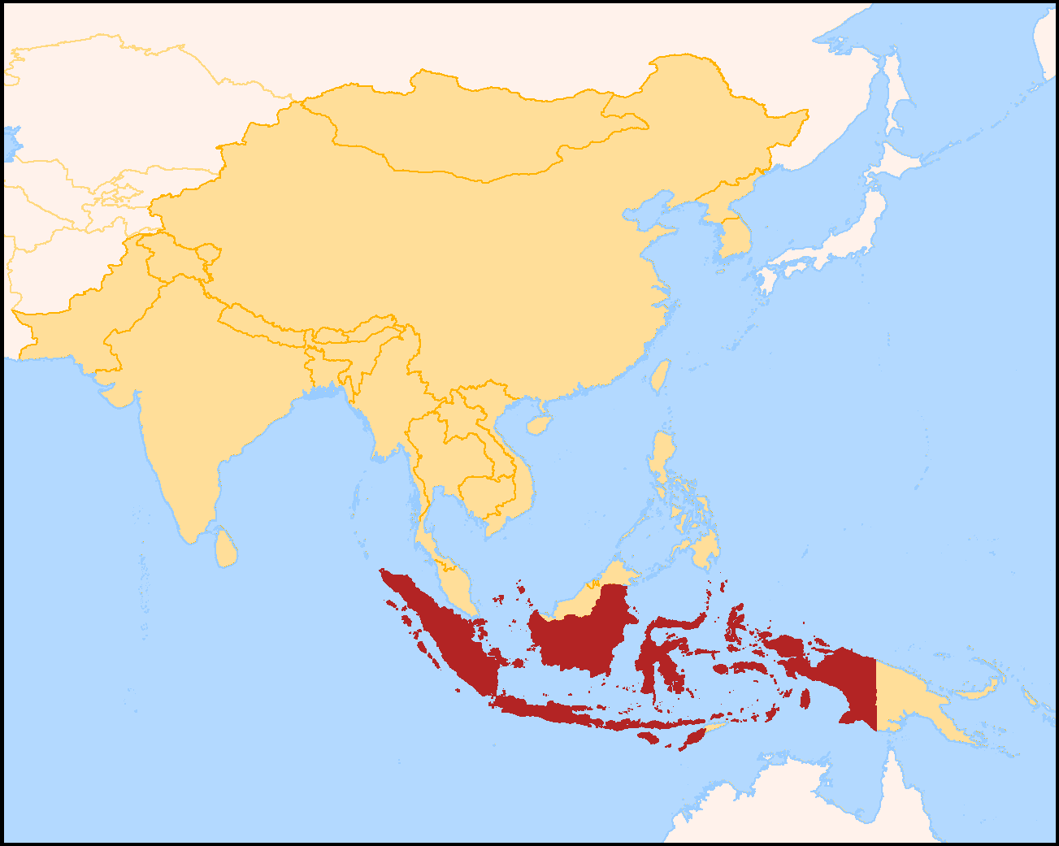
Indonesia
Between
2 Oceans &
2 Continents
17.000 beautiful islands
4th most populous Country
“258 Million”
Source:
http://www.fao.org/nr/water/aquastat/countries_regions/IDN/
http://touristexpedition.com/diving-in-raja-ampat-islands-papua-indonesia/
http://travelnoire.com/tag/bali/
http://www.shuhadaholidays.com/
https://sp2010.bps.go.id/ (graph)

Slide 3
Economy of Indonesia
16th
Position on World’s GDP
0.94
Trillion USD
116th
Position for GDP per capita
5.3%
Average GDP Growth
for 2012-2016
Source:
http://statisticstimes.com/
https://www.bps.go.id/index.php/publikasi/4238
IMF, World Economic Outlook, 2016

Slide 4
Global Manufacturing Competitiveness Index
2016 Current
Rank | Country | Index Score
1 | China | 100.00
2 | United States | 99.50
3 | Germany | 93.90
4 | Japan | 80.40
5 | South Korea | 76.70
6 | United Kingdom | 75.80
7 | Taiwan | 72.90
8 | Mexico | 69.50
9 | Canada | 68.70
10 | Singapore | 68.40
11 | India | 67.20
12 | Switzerland | 63.60
13 | Sweden | 62.10
14 | Thailand | 60.40
15 | Poland | 59.10
16 | Turkey | 59.00
17 | Malaysia | 59.00
18 | Vietnam | 56.50
19 | Indonesia | 55.80
20 | Netherlands | 55.70
2020 (Projected)
Rank | Country | Index Score
1 | United States | 100.00
2 | China | 93.50
3 | Germany | 90.80
4 | Japan | 78.00
5 | India | 77.50
6 | South Korea | 77.00
7 | Mexico | 75.90
8 | United Kingdom | 73.80
9 | Taiwan | 72.10
10 | Canada | 68.10
11 | Singapore | 67.60
12 | Vietnam | 65.50
13 | Malaysia | 62.10
14 | Thailand | 62.00
15 | Indonesia | 61.90
16 | Poland | 61.90
17 | Turkey | 60.80
18 | Sweden | 59.70
19 | Switzerland | 59.10
20 | Czech Republic | 57.40
Rank 15th In 2020
MITI–V
Malaysia, India
Thailand, Indonesia, Vietnam
Country | Malaysia | India | Thailand | Indonesia | Vietnam
2020 (projected) rank | 13 | 5 | 14 | 15 | 12
Difference | 4 | 6 | - | 4 | 6
2016 (current) rank | 17 | 11 | 14 | 19 | 18
Source:
Delloite and US council on Competitiveness :2016 Global Manufacturing Competitiveness Index

Slide 5
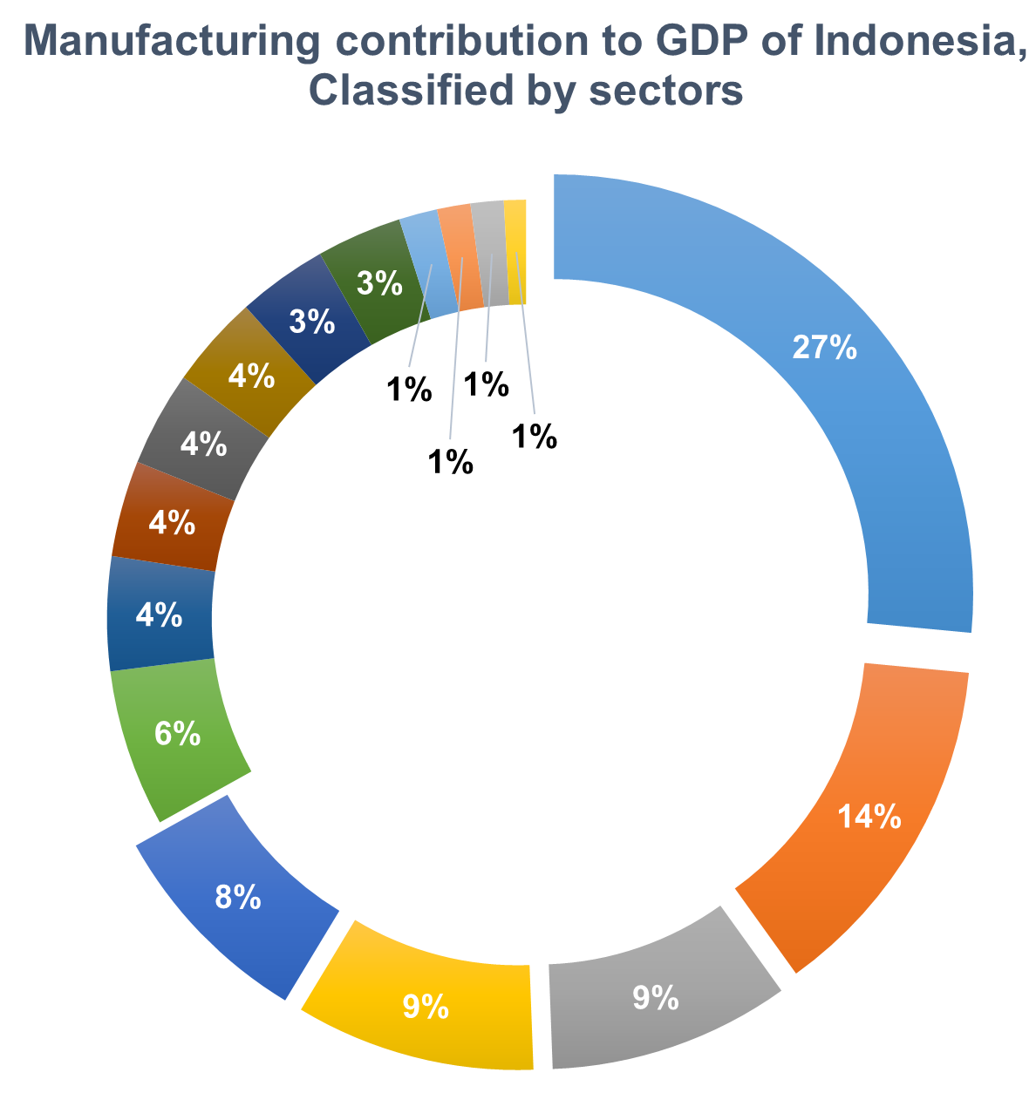
Manufacturing Contribution to GDP
Manufacturing contribution is 21% for Indonesia’s GDP,
about 197 Billion USD, for 2012 – 2016*
33.5%
Other manufacturing sectors
27%
Food & Beverages
8%
Chemical, Botanical, & Pharmaceuticals
14%
Coal & Petroleum Products
9.2%
Computers, Optical, &
Electronics Devices
9.3%
Transport Equipment
Source:
Central Bureau of Statistics – Indonesia
*Q1 & Q2 2016

Slide 6
Indonesia’s Manufacturing Overview
Food, Beverages & Pharmaceutical
One of Indonesian industrial development priorities
2nd Most Attractive country in SEA by cost and quality consideration
largest in Domestic & Foreign Direct Investment with total (USD) 9.4 Billion in 2016
Major companies:
Source:
The Investment Coordinating Board of the Republic of Indonesia
Badan Pusat Statistik: Manufacturing Industrial Indicator
Understanding ASEAN: The manufacturing opportunity: McKinsey&Company (2014)

Slide 7
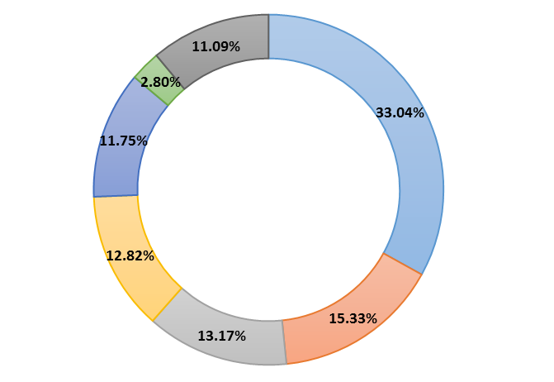
Indonesia’s Manufacturing Overview
17th Largest Auto-manufacturer,
2nd in Southeast Asian
Dominated by Domestic market
Biggest Southeast Asian Market
Domestic Automotive Sales by Brand 2010 - 2015
Others*
Flat sales for Auto in 2015
Source:
http://www.gaikindo.or.id/domestic-auto-market-by-brand-2013-2014/
http://www.gaikindo.or.id/domestic-auto-market-production-2015/

Slide 8
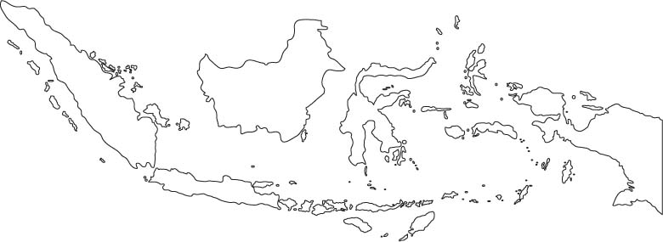
Key Challenges
22.3%
8.2%
6.4%
58.3%
1.8%
3%
Uneven GDP distribution, too centralized in Java island followed by Sumatera island
Indonesia stated as Lower Middle Income country by GDP per capita
Source:
http://www.worldatlas.com/webimage/countrys/asia/outline/idout.htm
https://www.bps.go.id/index.php/publikasi/4238
http://www.oecd.org/eco/surveys/indonesia-2016-OECD-economic-survey-overview-english.pdf

Slide 9
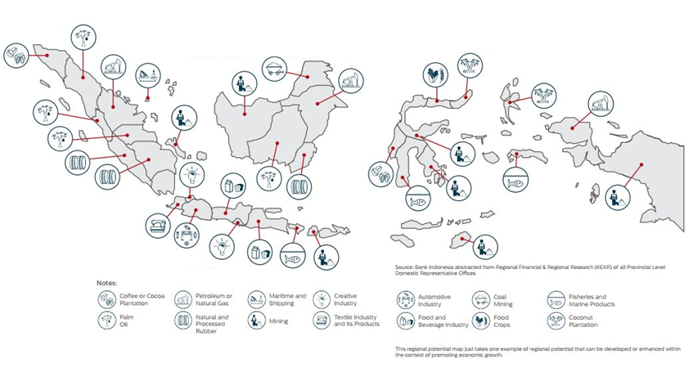
Downstream-centric empowerment
Palm Oil | Geothermal | Tin | Cacao
1st | 3rd | 2nd | 3rd
World’s #1 Exporter | 40% of world reserve | 65.000 ton/ year | 770,000 ton/ year
Source:
Central Bank of Indonesia Annual Meeting 2016
Expand local industries capabilities
Manufactured finished goods, not only raw materials
Push productivity & increasing job opportunities
Source:
Investment Coordinating Board (BKPM), compared to Q2 – 2015
Central Bank of Indonesia Annual Meeting 2016: Optimizing potential, Strengthening Resilience
Kuliah Umum: Menteri Koordinator Bidang Kemaritiman 2017 (ITB dan Masa Depan Indonesia)
http://www.worldatlas.com/articles

Slide 10
Infrastructures improvement plan
2015 – 2019
three main sectors
Infrastructure’s Target for 2017
Roads
Railways
Port & Dock
Connectivity
Basic Infrastructure
Water Resistance
815 Km
550 Km
55 ports
Bus Station
Airports
Bridges
Infrastructure investment needs estimated around USD 369.2 Billion
3 New Stations
13 New Airports
9 Km
Source:
PPP Infrastructure Projects Plan in Indonesia (2015),National Development Planning Agency
Nielsen: Indonesian Market waiting for the wave (2017)

Slide 11
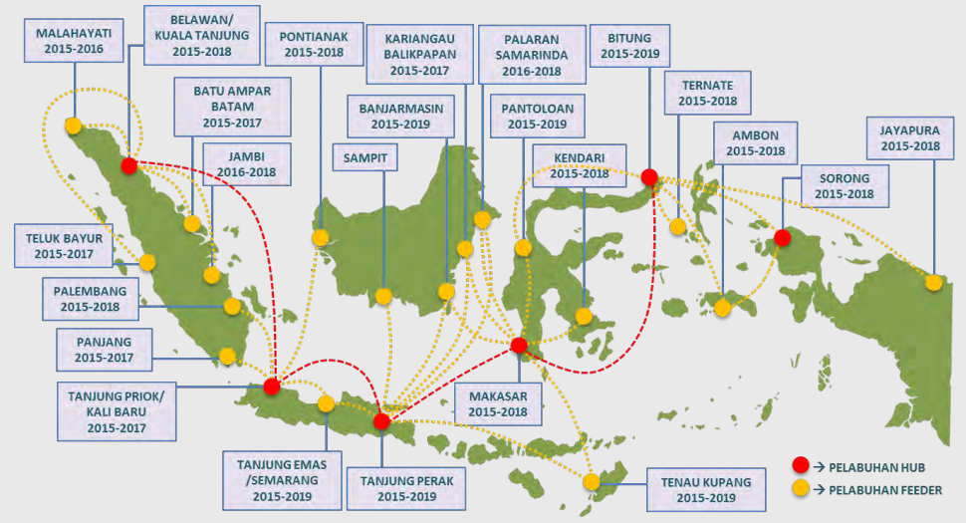
Sea Toll Program
“Indonesia as world’s maritime shafts in 2045”
Reliable Port
Frequent & Scheduled, sea & air travel
Effective inland access to support logistics transportation
http://www.bappenas.go.id
2015 – 2019:
24 Strategic port in support of Sea Toll
Source:
http://www.bappenas.go.id/files/Pengembangan%20Tol%20Laut%20Dalam%20RPJMN%202015-2019%20Dan%20Implementasi%202015.pdf
http://nusantarainitiative.com/wp-content/uploads/2016/02/150915-Buku-Tol-Laut-bappenas.pdf

Slide 12
Resources & Investments
2015:
256 Millions Total Population
15 years and over : 186.1 millions
Economically active : 122.4
Employed : 114.8 millions
Unemployed : 7.6 millions
2016
2017
Target 2019
Ease of doing businesses
40th
106th
91st
Time spent on procedures
1,566 days
132 days
Low quality labor force
Slow job growth 2% in manufacturing sector
Access to up-skilling and re-skilling is limited
Cost
6,700 USD
5,100 USD
Top 10 most Improved nations worldwide with regard to ease of doing businesses
Cheap Labor
Increasing investment in education
Government employment programs
Source:
ADB papers on Indonesia: analysis of trends and challenges in the Indonesian Labor Market
http://www.oecd.org/eco/surveys/indonesia-2016-OECD-economic-survey-overview-english.pdf
http://www.thejakartapost.com/news/2016/10/27/its-getting-easier-to-do-business-in-indonesia-report.html
http://www.doingbusiness.org/rankings

Slide 13
Conclusion
Emerging Country & stated as one of MITI-V
Huge Domestic Market & Highly - Potential Human Resources
Waiting “The next wave” on Food, Pharmaceutical & Transportation sectors
VISION to expand Manufacturing Industries

Slide 14
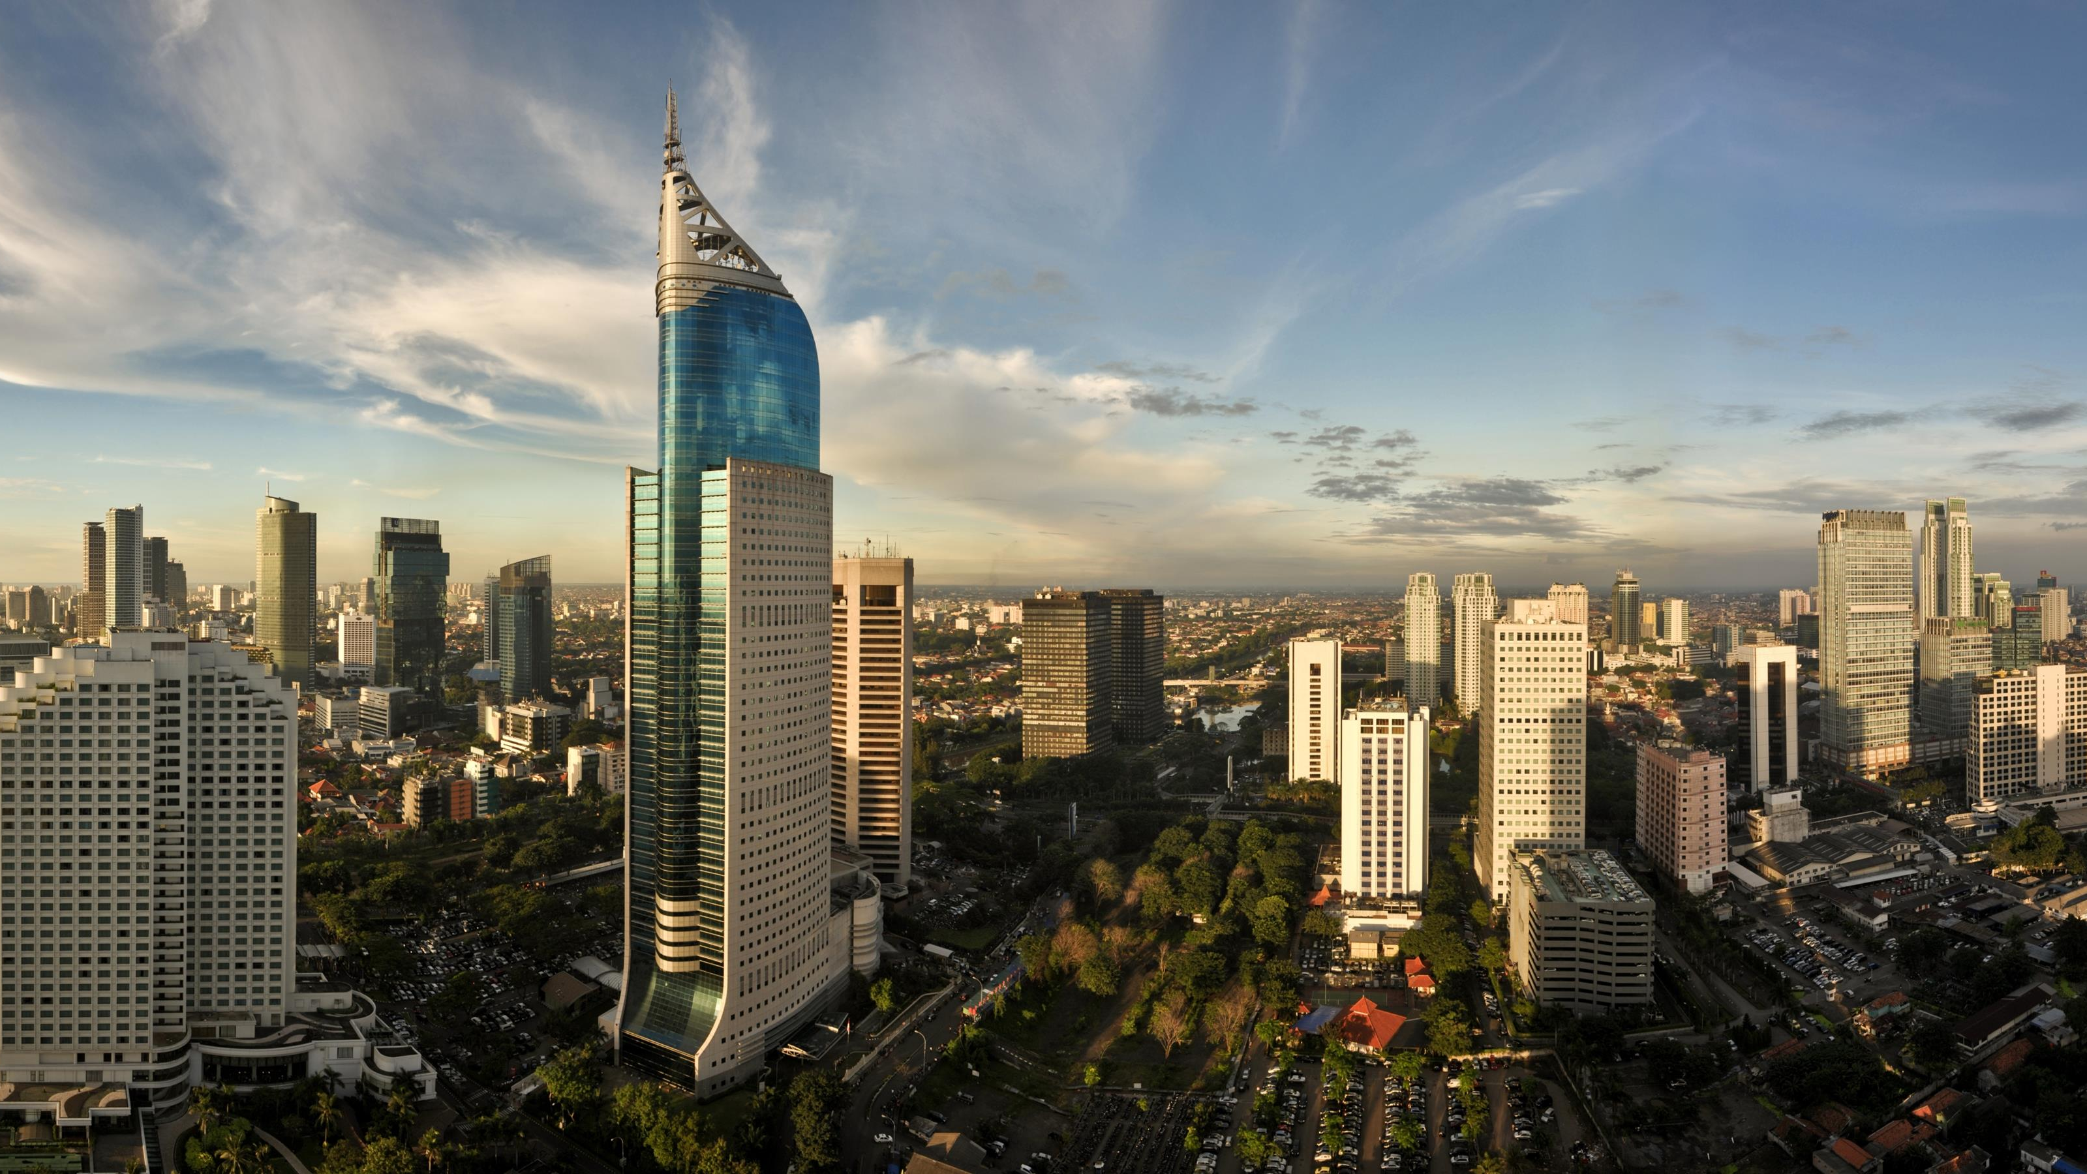
Thank You
Patriot Silitonga
MSc Aerospace Manufacturing
7th March 2017
Source:
https://www.agoda.com/city/jakarta-id.html

