Slide 1
Manufacturing in Denmark
Johnny Oliveira Moeller
MSc Engineering and Management of Manufacturing Systems
March 7th, 2017

Slide 3
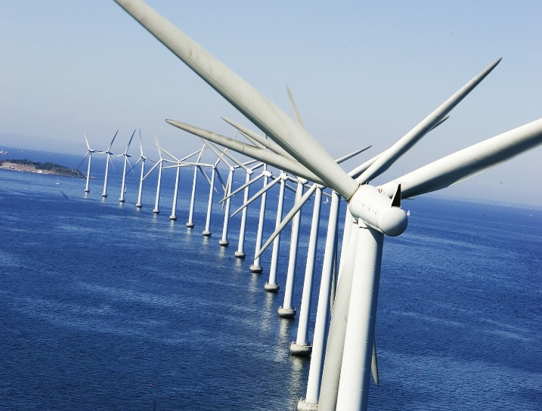
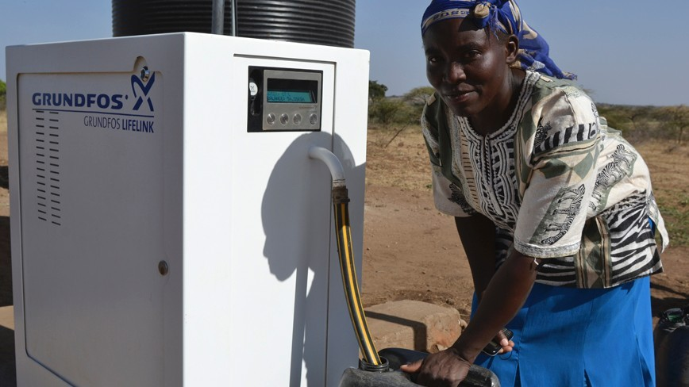
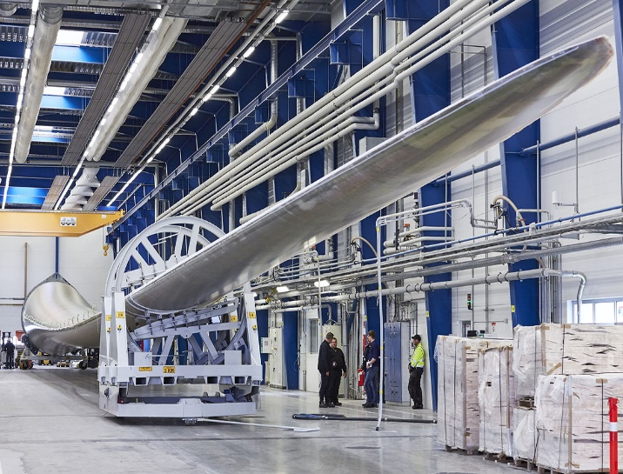
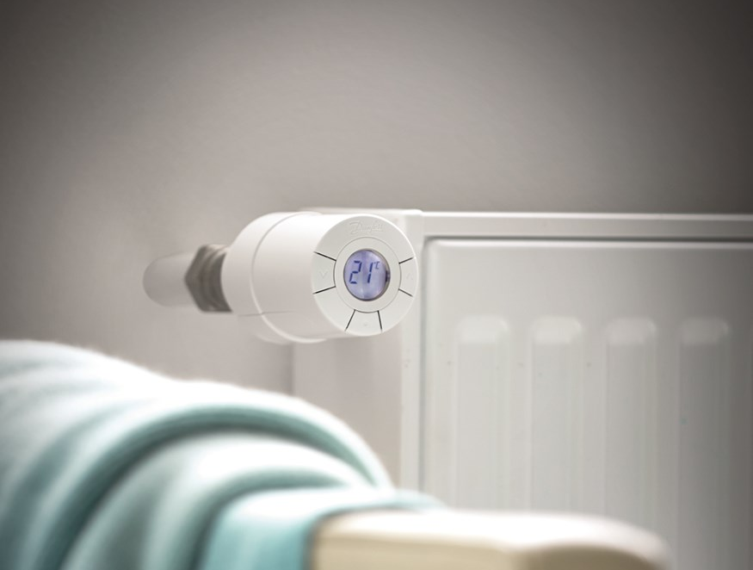
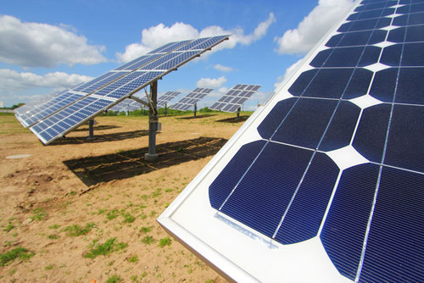
Denmark – State of Green
Sources: Arcon-Sunmark; Politiken.dk; Grundfos; LM Wind Power; Danfoss & Linak

Slide 4
Denmark – State of Green
Wind Energy
Energy Efficiency
Water
Heating & Cooling
Sources: Respective companies

Slide 5
Important Manufacturing Sectors
Source: Statistics Denmark
Notes:
Source: http://www.statistikbanken.dk/OMS5 (Industrial turnover (non-seasonally adjusted) (2010=100) by turnover, industry (DB07) and time (2016M12)

Slide 6
Manufacturing in Denmark (% of GDP)
Estimated GDP of £223bn
GDP per capita is £39,000
Export of energy technology amounted to 11.1% of the total Danish export of goods in 2015.
Sources: World Bank, OECD & State of Green

Slide 7
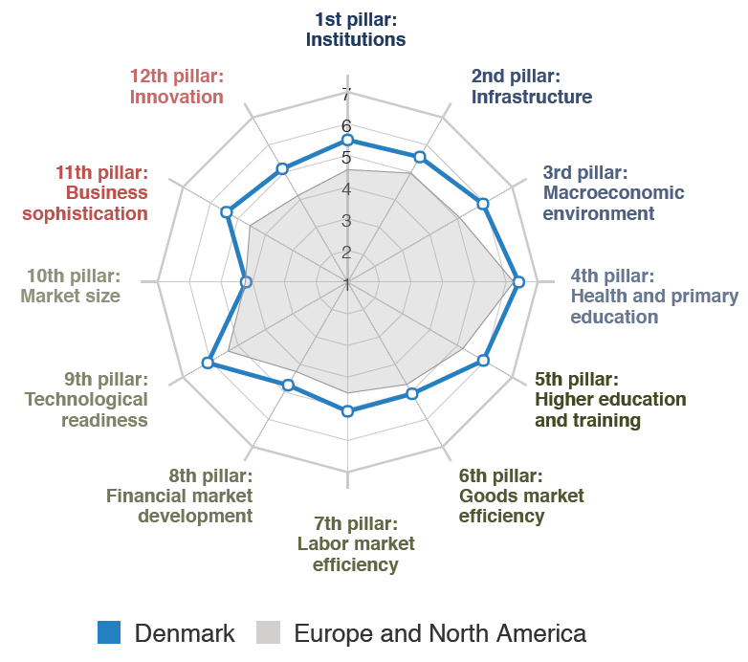
Competitiveness Ranking
Ranked as the 12th most competitive economy out of 138 countries
Problematic factors of doing business are:
Tax rates
Tax regulations
Restrictive labor regulations
Access to financing
Source: World Economic Forum

Slide 8
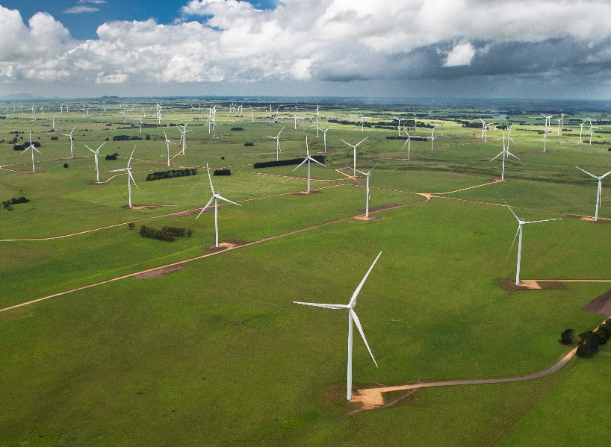
The Worlds Wind Energy Hub
Largest share of wind energy integrated in the grid worldwide (42.1%)
Biggest wind energy sector in the world
Wind energy sector consists of +500 companies
+30,000 people employed
Worldwide presence – manufacturing and R&D
Industry revenue +£10bn
+60% of production exported (+£5.5bn)
Sources: Danish Wind Industry Association & State of Green

Slide 9
Denmark – The Supplier Hub
Every link of the supply chain is represented in Denmark
Always adapting to the changing landscape and remained competitive
Moving towards system suppliers – as known from the automotive industry
The Danish wind industry is becoming more professional
Sources: Danish Wind Industry Association, State of Green & The European Wind Energy Association

Slide 10
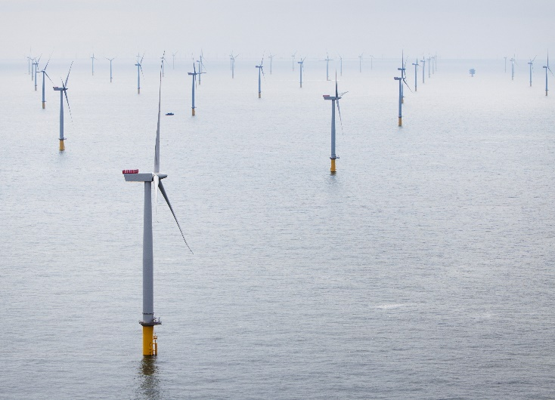
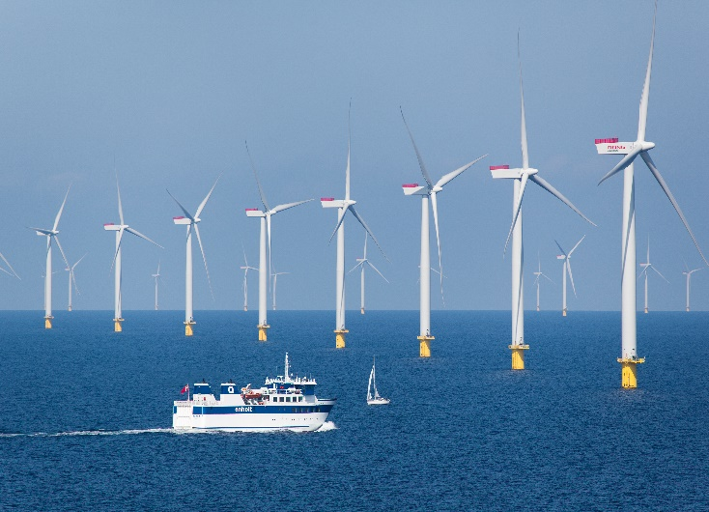
The Danish Footprint
Anholt 400 MW (DK, 2013)
Danish Deliveries
Developer and operator
Wind turbines
Wind turbine installation
Substation installation
Substation design
Substation manufacturer
Export cable design
Export cable manufacturing
Export cable installation
Substructure main constructor
Substructure design
Monopiles and transition piece
Monopiles and transition piece installation
Grouting
Logistics
Geophysical investigations
Environmental Impact Assessment
Project finance
London Array 630 MW (UK, 2016)
Danish Deliveries
Developer and operator
Wind turbines
Wind turbine installation
Substructure installation
Substructure main constructor
Substructure design
Design of substation foundation
Monopiles and transition piece
Grouting
Logistics
Monitoring of wind, waves and currents
Project finance
Source: State of Green

Slide 11
The Road to Success
Long and continuous focus on Levelized Cost of Energy (LOCE)
Result of investments, work and commitment of innovative companies
Supported by world leading research and knowledge institutions
Maturity of the Danish supplier hub
Increased use of system suppliers form development partners for next generations of wind turbines
Source: LM Wind Power

Slide 12
Future Innovation
Strong political willingness to invest in R&D
Lack of sufficient output from R&D input
Difficult to access capital for investments
Source: OECD
Notes:
Source: OECD (2017), Gross domestic spending on R&D (indicator). doi: 10.1787/d8b068b4-en (Accessed on 19 February 2017)

Slide 13
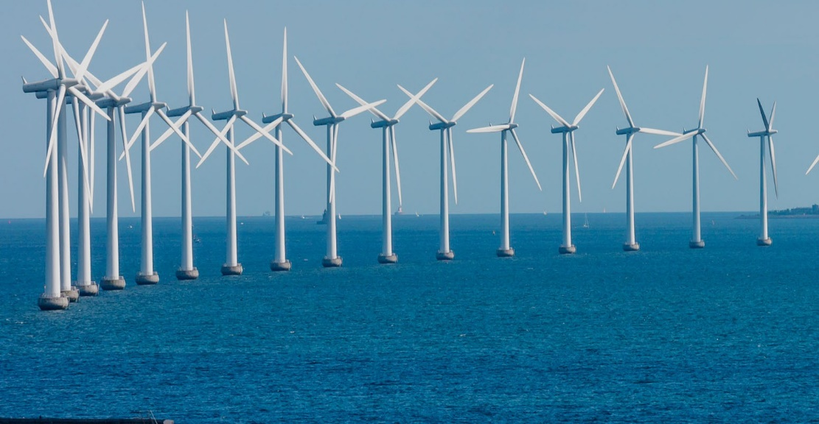
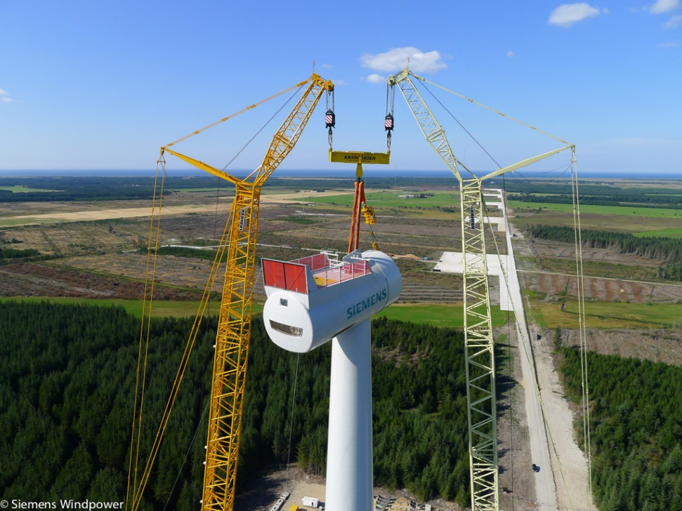
Future Perspective and Conclusion
Future Perspective
Increased use of automation
Embracing the new manufacturing paradigm
Development of industry clusters
Conclusion
Wind energy makes a perfect example of how it can be done
Invest in research and collaboration with industry
Knowledge sharing within industry

Slide 14
Acknowledgements

