Slide 1
Italian Manufacturing: between innovation and export
Francesco Moretti, Engineering and Management of Manufacturing Systems MSc student
March 7th, 2017

Slide 2
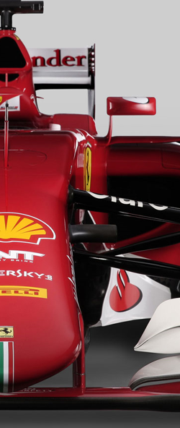
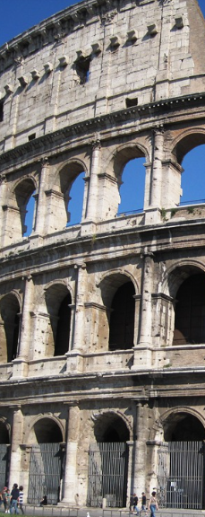

Slide 3
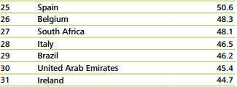
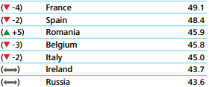
Global Manufacturing Competitiveness Ranking
Source: Deloitte and US Council on Competitiveness, 2016 Global Manufacturing Competitiveness Index.

Slide 4
The Italian economy
An overview
Global GDP Ranking | Economy | (million of US dollars)
1 | U.S.S | 180,36,648
2 | China | 11,007,721
3 | Japan | 4,123,258
4 | Germany | 3,363,447
5 | U.K. | 2,858,003
6 | France | 2,418,836
7 | India | 2,095,398
8 | Italy | 1,821,497
9 | Brazil | 1,774,725
10 | Canada | 1,550,537
8th economy in the world
4th economy in the EU
Source: Ministero dello Sviluppo Economico; World Economic Bank, 2015
Notes:
World Economic Bank (2017) World DataBank, World Development Indicators. Accessible at http://databank.worldbank.org/data/reports.aspx?source=2&country=ITA#

Slide 5
The Italian economy
An overview
8th economy in the world
4th economy in the EU
Industry represents the 15% of the GDP
It employs 30% of the total workforce
World 6th manufacturing country
SME are the key players, most of them family owned enterprises
Source: Ministero dello Sviluppo Economico; World Economic Bank, 2015
Notes:
Anom (2017) http://beforeitsnews.com/science-and-technology/2014/11/the-solidsmack-weekend-reader-week-45-2730908.html
https://rctom.hbs.org/submission/a-stitch-in-time-saves-nine-hms-journey-to-becoming-a-sustainable-brand/

Slide 6
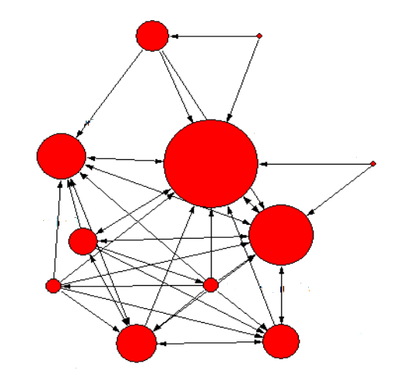
The power of manufacturing
The economic core
Utilities
Mining
83.2 % of the trade goods comes from manufacturing
72.1 % of the total investments in R&D comes from manufacturing
Considering the relationships with other economic areas, the manufacturing contribution to GDP rises up almost 23%
Other services
Manufacturing
Agriculture
Building
Commerce
Finance
Telecommunication
High profitability 1 euro invested 1.83 euro earned
Finance
Business services
Source: Confindustria, 18/04/2016, Number16-4

Slide 7
Manufacturing represents 88% of production
The 4As: Fashion, Food, Furniture, Mechanical Engineering
Important sectors:
metallurgy and fabricated metal products 14%
machinery and equipment 12%
food, drink and tobacco 10%
rubber and plastics products and non-metallic mineral products 9%
textile, clothing and leather 8 %
transport equipment 7%;
other manufacturing, repair and installation of machinery and equipment 7%.
Source: http://www.tradingeconomics.com/italy/industrial-production

Slide 8
Manufacturing SMEs
SMEs represent 99 % of Italian companies
Highest number of firms across the EU, 3.8 million of SMEs
Employ almost 80% of the labour force
Clustered in industrial districts
High quality products and niche markets
Source: European SBA Fact Sheet, 2015; Osservatorio Nazionale Distretti Italiani, Rapporto 2015; ISTAT, Struttura e Competitività del Sistema delle Imprese Industriali e dei Servizi, 2013.

Slide 9
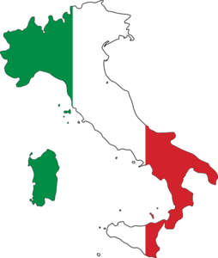
Import & export
Outside the EU
China 7.7%
Russia 2.9%
Turkey 2.0 %
Within the EU
Germany 16.2 %
France 8.8 %
Netherlands 5.4 %
IMPORT
Percentage of the world commercial manufactured goods
Export |  |  | Import
Rank | Country | % | Rank | Country | %
1 | China | 16.4 | 1 | U.S.A. | 12.5
2 | Germany | 9.8 | 2 | China | 7.8
3 | U.S.A. | 7.9 | 3 | Germany | 7.3
4 | Japan | 4.5 | 4 | U.K. | 3.9
5 | Republic of Korea | 4.1 | 5 | Hong Kong | 3.6
6 | France | 3.7 | 6 | France | 4.3
7 | Netherlands | 3.5 | 7 | Japan | 3.9
8 | Italy | 3.5 | 8 | Netherlands | 2.9
9 | U.K. | 3.1 | 9 | Canada | 2.8
10 | Belgium | 3.0 | 10 | Messico | 2.3
11 | Singapore | 2.7 | 11 | Italy | 3.1
Outside the EU
U.S.A 8.8 %
China 2.6%
Turkey 2.3%
EXPORT
Within the EU
Germany 12.8%
France 10.7 %
U.K. 5.4 %
Source: Confindustria: Scenari Industriali,2015.

Slide 10
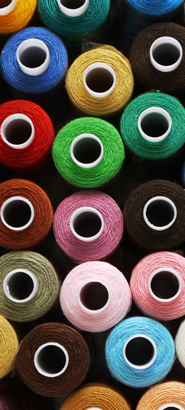
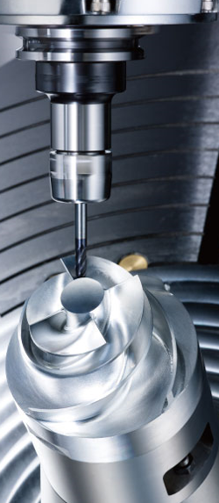
Export
The world ranking manufacturing
2nd in textile, leather, and clothing
4th in jewellery
5th in furniture
6th in machinery and equipment
Source: Confindustria: Scenari Industriali, 2015.

Slide 11
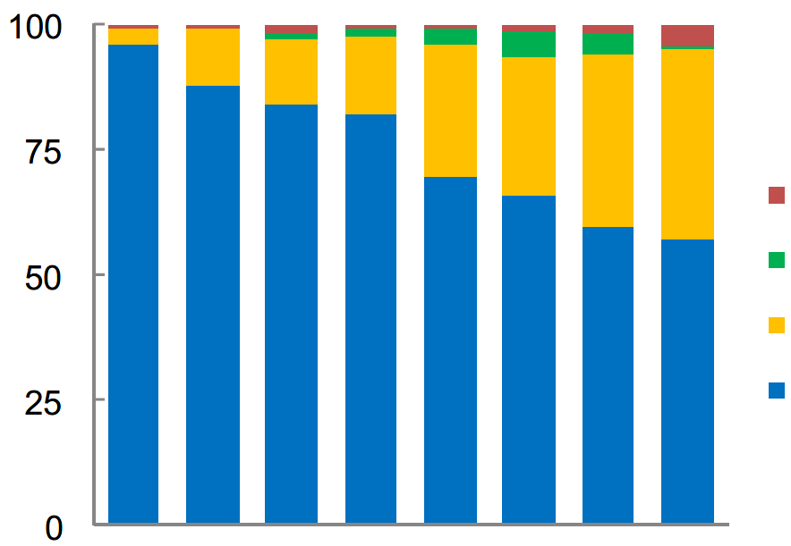
Export
The role of manufacturing
Export (%)
Machinery and equipment 15.6%
Motorcars 5.1%
Pharma goods 4.5%
Clothing 3.9 %
Chemicals 3.2%
Plastic goods 2.8%
Mining 2.4%
Leather goods 2.4%
Metal products 2.3%
Footwear 2.3%
Furniture 2.2%
Mining
Agriculture
Services
Manufacturing
Japan
Korea
ITALY
France
Spain
U.S.A.
U.K
Germany
Source: Ministero dello Sviluppo Economico; Confindustria, 18/04/2016, Number16-4

Slide 12
Innovation
An overview
 | Product innovation* | Process innovation*
Germany | 44 | 31
Italy | 32 | 35
France | 28 | 28
Spain | 14 | 19
U.K. | 28 | 17
#2 in the EU for robot density
Among the top 5 non-U.S. hosts for additive manufacturing technologies
Home to some of Europe’s most environmentally efficient manufacturing systems, even if there are still issues to overcome
* number of innovative companies / total number of companies in the sector (2012) **Spending in R&D or innovation / profit
 | R&D expense** | Other expenses in innovation**
Germany | 3.2 | 2.2
France | 2.8 | 0.6
Italy | 1.0 | 0.9
Spain | 1.0 | 0.4
U.K. | 0.6 | 0.6
Low investments in R&D compared to EU countries
Source: Confindustria: Scenari Industriali, 2015.
Source: Italian Trade Agency and FEDERMACCHINE
Notes:
Confindustria Centro Studi (November, 2015) PRODUZIONE E COMMERCIO: COME CAMBIA LA GLOBALIZZAZIONE. LA MANIFATTURA ITALIANA RIPARTE SU BUONE BASI

Slide 13
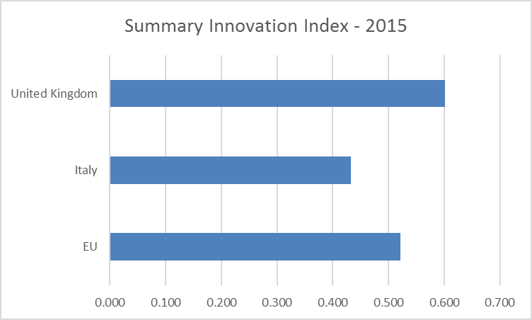
Innovation
European context
Source: https://ec.europa.eu/growth/industry/competitiveness/reports/ms-competitiveness-report_en

Slide 14
Manufacturing role in innovation
R&D expenses (%)
72.1 % of the total investments in R&D comes from manufacturing
Innovation trigger in process, product, and organisation
Learning-by-doing approach
Green technolgies chosen by 22% of the companies
Lack of a common policy
Fragmented reality
Only 10.6% of innovative companies cooperated with national operators (2013)
Low cooperation with universities and research centres
Others
Utilities
Services
Manufacturing
Germany
ITALY
Finland
Swedish
France
Spain
U.K.
Source: Confindustria, 18/04/2016, Number16-4.

Slide 15
Which are the obstacles to development?
Corruption
Mafia
Southern Issue
Political Instability
Financial Crisis
Graduates Emigration

Slide 16
The southern issue
Industrial Districts
Due to historical events
75% of the nation’s wealth was produced in the north regions (2014)
High unemployment and low per capita income in the south

Slide 17
A continuous emigration
5.7%
7.3%
Engineers* 24%
Interpreters* 17%
Economists* 15 %
11.3%
*Graduates that found a job in a foreign country within 1 year after their graduation
Italy has the lowest rate of graduates aged between 30 and 35 in the EU
27,000 high school graduates and 24,000 university graduates left Italy in 2015
Low university attraction: only 7% of students from abroad
12%
16.7%
15%
Source: IlSole24Ore, 2016

Slide 18
Future challenges
A new industrial policy of innovation
Increase the investments in R&D
Develop an innovation network
Long term vision
Internationalisation
Sustainability

Slide 19
Acknowledgements

