Slide 1
Manufacturing in the U.K.
Tom Leigh
Global Product Development and Management MSc Student
Tuesday 7th March 2017

Slide 2
The United Kingdom
63.1m
Population
84% England
8% Scotland
5% Wales
3% Northern Ireland
6th
6th largest National Economy by GDP.
9th
9th largest National Economy by PPP.
15th
15th most human population dense country.
74.5%
Record high employment rate.
Top 5 Import Partners
Germany
China
United States
Netherlands
France
Top 5 Export Partners
United States
Germany
Switzerland
China
France
5th
9th
Sources: The World Factbook, CNN Money, Office for National Statistics and gov.uk
Notes:
$2.76trn GDP
5th Import $663Bn – Cars, Crude Oil and Computers
9th Export $472Bn – Cars, Gold and Gas Turbines

Slide 3
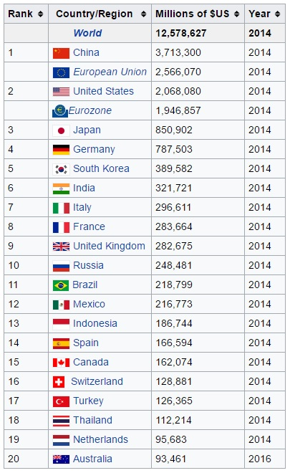
What does Manufacturing in the U.K. look like?
9th Highest Global Value of Manufacturing
10% of UK GDP
54% of UK Exports
69% of UK’s
R & D Expenditure
15% of all Business Investment in the UK
23 Universities offering 52 Manufacturing Courses
2.2% of World Manufacturing Value
2.6 million UK Jobs
Sources: World Bank Group and gov.uk
Sources: UCAS, Office for National Statistics and gov.uk

Slide 4
What is Manufactured in the U.K.?
35% Other
7% Machinery
7% Computer Equipment
4% Chemicals
3% Textiles
3% Electrical
1% Petroleum
16% Food, Drink & Tobacco
13% Transport
8% Pharmaceutical Products
11% Basic Metals
8% Wood and Paper
9% Plastics
Sources: House of Commons Manufacturing Statistics Briefing Paper
Notes:
Metals – Australian firm Wolf Minerals

Slide 5
Who Manufacturers in the U.K.?
133k
133,000 registered U.K. manufacturing companies.
5.2%
5.2% of all U.K. companies are manufacturing businesses.
57%
SME’s contribute 57% of U.K. manufacturing value.
1% of companies based in U.K. are foreign-owned.
1%
29%
Foreign-owned companies contribute 29% of GVA.
Sources: Forbes – Global 2000, CNN Money, Guardian and Office for National Statistic

Slide 6
Why Manufacture in the U.K.?
High-skilled workforce.
High working condition standards.
6th in Global Manufacturing Competitive Index.
Low volume
High quality
6th
Short lead-times to mainland Europe.
2nd in European Manufacturing Competitive Index.
2nd
Well-established airports and docks.
Continually invest in advanced manufacturing technologies.
Sources: Guardian, Make it British and Deloitte
Notes:
High-skilled

Slide 7
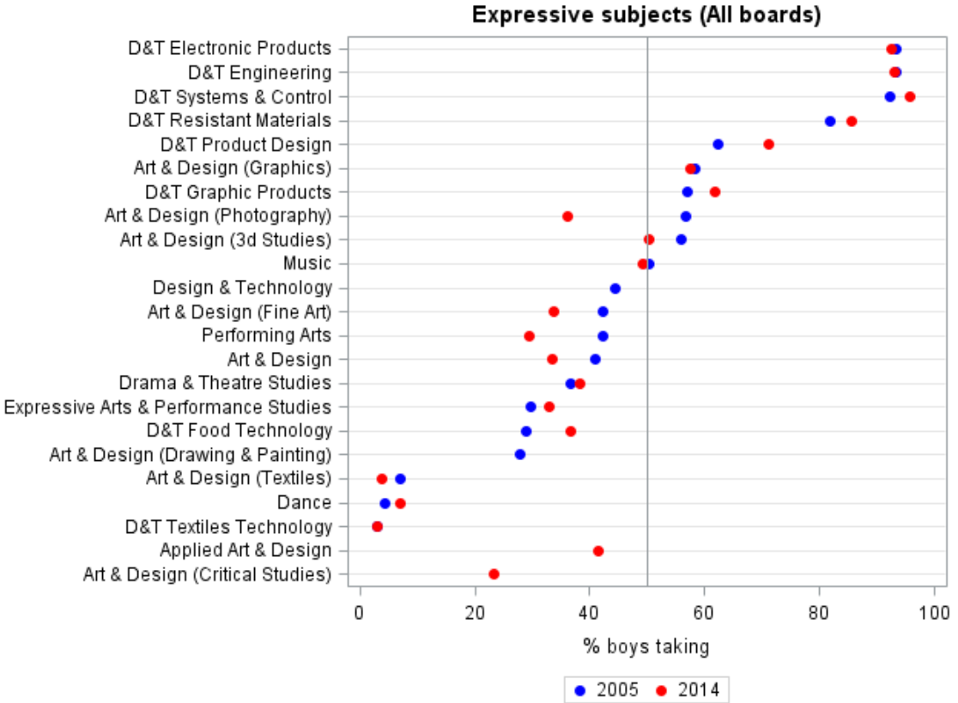
Where could U.K. Manufacturing Improve?
Gender Equality
91%
9%
9% of all engineers in the U.K. are FEMALE.
This is the LOWEST of any European nation.
Companies are 15% more likely to perform better if they are gender diverse.
15%
Sources: Women in Engineering Society
Source: Cambridge Assessment Research Report
Notes:
http://www.engineeringuk.com/research/at-a-glance-2017

Slide 8
What Manufacturing Initiatives are there in the U.K.?
Source of information on British-made brands and UK manufacturing.
2,473 industrial and 636 academic collaborations.
Provide centres for academia and industry to meet.
Designed to transform UK’s innovation capability into growth.
Independent company.
Predominantly supports SMEs.
Provided 2,851 SME’s with facilities and latest technologies
Helps companies to find skills already based in the U.K.
Collaboration of industrial leading associations.
Determine which technology developments will drive growth.
Connect and help innovators launch and succeed.
Committed £1.8Bn, added £11.5Bn. Added 55,000 jobs.
Building a connected network.
Establishes U.K. based support for manufacturing businesses.
Back 7 manufacturing R & D centres.
7 industrial areas of collaboration.
Sources: Catapult, Innovate UK and gov.uk
Sources: Make it British, Reshoring UK and gov.uk
Notes:
Catapult - https://catapult.org.uk
Innovate - https://www.gov.uk/government/organisations/innovate-uk
Reshore - http://www.reshoringuk.co.uk

Slide 9
U.K. Manufacturing in the News
£20m investment in the Sheffield based AMRC.
PM to meet Carlos Tavares to oversee Peugeot acquisition of Vauxhall.
7,000 jobs secured at Sunderland plant.
Fastest GDP growth out of G7 nations in 2016.
£50m investment into composite technology centre.
What does it mean for U.K. manufacturing?
Sources: Boeing, BBC and McLaren
Sources: The Financial Times and Office for National Statistics
Notes:
https://www.ft.com/topics/themes/UK_manufacturing
Boeing
Nissan

Slide 10
Plans for The Future of U.K. Manufacturing
F.B.M.I.
A.M.R.C.
M.I.S.
Advanced Manufacturing Research Centre
Modern Industrial Strategy
Future of British Manufacturing Initiative
5 Research Areas:
Machining
Integrated Manufacturing
Composite Materials
Structural Testing
Design and Prototyping
3 Research Categories:
Generic Research
Specific Research
Innovative Projects
Proposed in January 2017
New sector deals
Create high-skilled, high-paid jobs
Build on Britain’s strengths
Tackle underlying weaknesses
Create conditions for manufacturing businesses to emerge and grow
Keep the U.K. competitive
Response to Industry 4.0
Several key partners
Hands on approach
Provide agile product development platform.
The Steps
Take readiness assessment
Attend an event
Fast track
National F.o.M.T. Event
Sources: BBC, AMRC, gov.uk and Future if British Manufacturing Initiative
Notes:
AMRC - http://www.amrc.co.uk
Modern Industrial Strategy - https://www.gov.uk/government/news/pm-unveils-plans-for-a-modern-industrial-strategy-fit-for-global-britain
Future of British Manufacturing Initiative - http://www.futureofbritishmanufacturing.com

Slide 11
Summary
High quality manufacturing nation
Produce a large variety of products
Diverse range of manufacturing companies
Manufacturing initiatives
Areas to improve
Prosperous future
Notes:
Doing well
Large variety of products
Strengths
Areas of improvement
The future 8th in 2020 Global Competitiveness Index

