Slide 1
Global Manufacturing Student think tank day
7th March 2017

Slide 2
Global Manufacturing Student Think Tank
Agenda of the day
2.00 – 3.00 pm: Keynote Talks
Dr Stephen Fox, VTT, Finland: “Sustainable production taxonomy: the varying potential of different manufacturing distributions to improve the sustainability of production”
Mr John Patsavellas, Altro Ltd, UK: “Zooming in – Zooming out: A perspective from a 20-year career in Manufacturing Businesses”
3.00 – 5.30 pm: Student presentations on Manufacturing around the globe and debate
Tom Leigh: UK Francesco Moretti: Italy Johnny Moeller: Denmark Patriot Silitonga: Indonesia Guillermmo del Valle Martinez and Toni Haleote Perramon: Spain
Q&A session A Q&A session B
5.30 pm: Event Closing: Prof Rajkumar Roy
Omo Oleghe and Oluwaseyi Omoloso: Nigeria Andrei Ionascu: Romania Javier Amaya Silva: Colombia Eloise Martin: France Vats Kshitij: India

Slide 3
How to participate in the debate
Use
#mfgthinktank and @cranfielduni
to join the conversation, ask questions and share your opinion!

Slide 4
Keynote talks
Dr. Stephen Fox, VTT, Finland
Twenty-five years' industry experience as an apprentice, craftsman, manager and director.
Fifteen years of experience carrying out scientific research, development, and innovation work.
Research in:
in socio-technical systems for breaking down barriers to people manufacturing their own prosperity in regions without industrial infrastructure

Slide 5
Keynote talks
Mr. John Patsavellas, Altro Ltd, UK
Board member of Altro Ltd. and president of the European Resilient Flooring Manufacturers Institute
Studied Mechanical Engineering University of Huddersfield (Hons),
MSc in manufacturing systems and management from the University of Bradford
MBA from the University of Kingston.
Worked in several industries as diverse as food, pharmaceuticals, fashion, printing and building products. He has worked around the world, managing, buying, moving and building factories and deploying advanced technologies.
Led the Altro team to win the 2014 Manufacturing Excellence award for innovation in products and services.
Member of the All-Party Parliamentary Manufacturing Group (APMG) and a member of the IET’s Manufacturing Policy Panel and the IET’s Production and Design Sector.

Slide 6
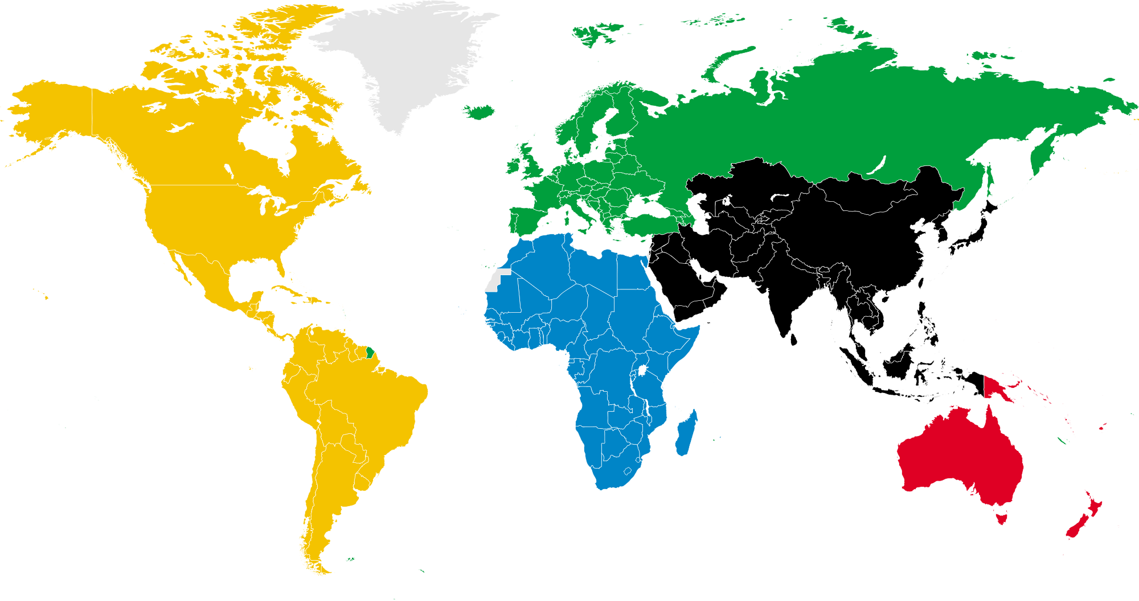
Student think tank presentations
#mfgthinktank @cranfielduni

Slide 7
Manufacturing in the UK
#mfgthinktank @cranfielduni

Slide 8
Manufacturing in Italy
#mfgthinktank @cranfielduni

Slide 9
Manufacturing in Denmark
#mfgthinktank @cranfielduni

Slide 10
Manufacturing in Indonesia
#mfgthinktank @cranfielduni

Slide 11
Manufacturing in Spain
#mfgthinktank @cranfielduni

Slide 12
Student think tank: debate
#mfgthinktank @cranfielduni

Slide 13
Manufacturing in Nigeria
#mfgthinktank @cranfielduni

Slide 14
Manufacturing in Romania
#mfgthinktank @cranfielduni

Slide 15
Manufacturing in Colombia
#mfgthinktank @cranfielduni

Slide 16
Manufacturing in France
#mfgthinktank @cranfielduni

Slide 17
Manufacturing in India
#mfgthinktank @cranfielduni

Slide 18
Student think tank: debate
#mfgthinktank @cranfielduni

