Slide 1
Zooming in
Zooming out
A perspective from a 20 year career in Manufacturing Businesses

Slide 2
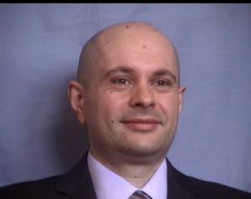
John Patsavellas Beng (Hons), MSc, MBA
Manufacturing & Technical Director
Altro Ltd
Letchworth Garden City, Hertfordshire
follow me on twitter
@john_pats

Slide 3
To many executives, manufacturing and the production function is a necessary nuisance- it soaks up capital in facilities and inventories, it resists changes in products and schedules, its quality is never as good as it should be, and its people are unsophisticated, tedious, detail-oriented and unexciting. This makes for an unreceptive climate for major innovations in factory technology and contributes to the blind spot syndrome.
W. Skinner

Slide 4
Curiosity may have killed the cat but it got me in the board room.
The best engineers = Curiosity “freaks”

Slide 5
Engineering – Manufacturing – Operations – Supply Chain
It’s all about:
Excellent
EXECUTION

Slide 6
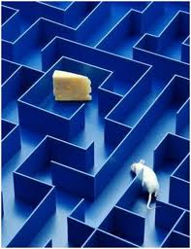
You are not a mouse!

Slide 7
Certainty
Uncertainty
Significance
Connection/Love
Growth
Contribution

Slide 8
Why
How
What

Slide 9
Your needs
How you are feeling now + Your Beliefs
Your Emotions (energy
fuel)
Your actions (Behaviour)
WHY
FILTER
FUEL
ACTION

Slide 10
No matter what job you have in life, your success will be determined 5% by your academic credentials, 15% by your professional experiences, and 80% by your communication skills

Slide 11
How do you become an expert/master?
Good Instruction
Deliberate Practice
Opportunities for Reflection & Fine Tuning
10 years of Marginal Gains

Slide 12
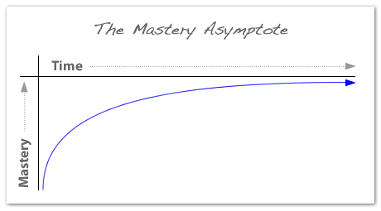
Mastery is an Asymptote

Slide 13
On the road to Mastery: Desire (for your why) Outweighs any skill level
“If you don’t have the love of doing it in the first place, you’ll never put the effort in to compete at the highest level” Sir Steve Redgrave

Slide 14
MOTIVATION
MASTERY
(5% + 15%)
AUTONOMY (+80%)
PURPOSE (your WHY)

Slide 15
In this year’s chess tournament there are 999 competitors. The tournament follows the “knock-out” rule which means that the losing player out of every pair gets knocked out of the competition, whilst the winning player moves to the next round. Given the above facts, how many pair-games must take place before the winner of the tournament is announced?

Slide 16
In this year’s chess tournament there are 999 competitors. The tournament follows the “knock-out” rule which means that the losing player out of every pair gets knocked out of the competition, whilst the winning player moves to the next round. Given the above facts, how many pair-games must take place for all the losing players to get knocked out of the competition?

Slide 17
COMPETENCIES –
CAN DO
HIGH LEVEL OF NUMERACY – IT - LITERACY
MANAGING RISK & CHANGE
MANAGING RELATIONSHIPS WITH PEOPLE
WHERE TO OBTAIN-EVALUATE-USE INFO
ABILITY TO MAKE BEST OF YOUR CREATIVITY
KNOWING HOW TO GET THINGS DONE
UNDERSTANDING SCIENTIFIC METHODS OF PROOF
MANAGING PERSONAL & FINANCIAL LIFE

Slide 18
LISTS - LISTS - LISTS
Create a daily to-do list for your course-work / job
Prioritise & rank on importance

Slide 19
Things That Matter
Things You Can Control
Focus here

Slide 20
LISTS - LISTS - LISTS
Create a daily to-do list for your course-work / job
Prioritise & rank on importance 1-2-3-4…
Cross out everything from no 3 down

Slide 21
Several months ago I was asked by a group of industrial engineers to offer an opinion as to why so few industrial engineers were moving up to the top of their companies. My answer was that perhaps a technical point of view cut them off from top management, just as the jargon and hocus-pocus of manufacturing often kept top management from understanding the factory. In their isolation, they could gain only a severely limited sense of market needs and of corporate competitive strategy
W. Skinner

Slide 22
Vision
(10-30 years vividly described unifying goal)
What we want to achieve
Purpose
(Reason for being)
Strategy
(The plan)
Lean Sigma initiatives
Automation technology
New Capabilities in Design
New Capabilities in Production
New Capabilities in Skills
New Products
New Markets
Industry 4.0
How we are going to do it
Core Ideology – Why we exist
Values
(What is important for us)

Slide 23
Market Sectors & Segments focus
Order Qualifiers
Order Winners
Capability building

Slide 24
Don’t let someone else’s opinion of you become your reality
Never let a bad day make you feel like you have a bad life
It’s never too late to be what you might have been
If opportunity doesn’t knock build a door
Begin each day with a grateful heart

