Slide 1
Global Manufacturing – India
Kshitij Vats
7th March 2017

Slide 2
7th Largest country- Geographically
2nd Largest populations- 1.2 Billion
5th Largest Economy in the World
8th Fastest growing Economy in the World
GDP- $2.46 trillion

Slide 3
Indian Manufacturing compared to the world
Manufacturing Competitive Index and Economic output
Global Manufacturing Competitive Index (Year 2016)
Manufacturing Economic output( year 2016)
Change in Manufacturing sector (Year 2005-2016)
2016 (Current)
Rank | Country | Index Score (100= High) (10= Low)
1 | China | 100
2 | United States | 99.5
3 | Germany | 93.9
4 | Japan | 80.4
5 | South Korea | 76.7
6 | United Kingdom | 75.8
7 | Taiwan | 72.9
8 | Mexico | 69.5
9 | Canada | 68.7
10 | Singapore | 68.4
11 | India | 67.2
12 | Switzerland | 63.6
13 | Sweden | 62.1
14 | Thailand | 60.4
15 | Poland | 59.1
Ranking | Countries | Economic output(%)
1 | USA | 19.3
2 | China | 18.41
3 | Japan | 10.89
4 | Germany | 6.93
5 | South Korea | 4.01
6 | Italy | 2.69
7 | United Kingdom | 2.54
8 | France | 2.46
9 | India | 2.31
10 | Mexico | 1.81
11 | Brazil | 2
12 | Canada | 2
13 | Spain | 2
14 | Russia | 2
15 | Turkey | 2
 | Others | 18.65
Countries | Increase/ Decrease in the manufacturing sectors (%)
USA | -3.29
Japan | -1.4
Italy | -1.19
United Kingdom | -0.84
France | -0.83
Canada | -0.64
Spain | -0.59
Germany | -0.54
Brazil | -0.27
Mexico | -0.13
Russia | -0.12
Turkey | 0.18
India | 0.71
South Korea | 0.9
China | 8.44
Source: Deloitte Global Manufacturing Index, The Manufacturers Organisation

Slide 4
Indian Manufacturing
Manufacturing companies in India

Slide 5
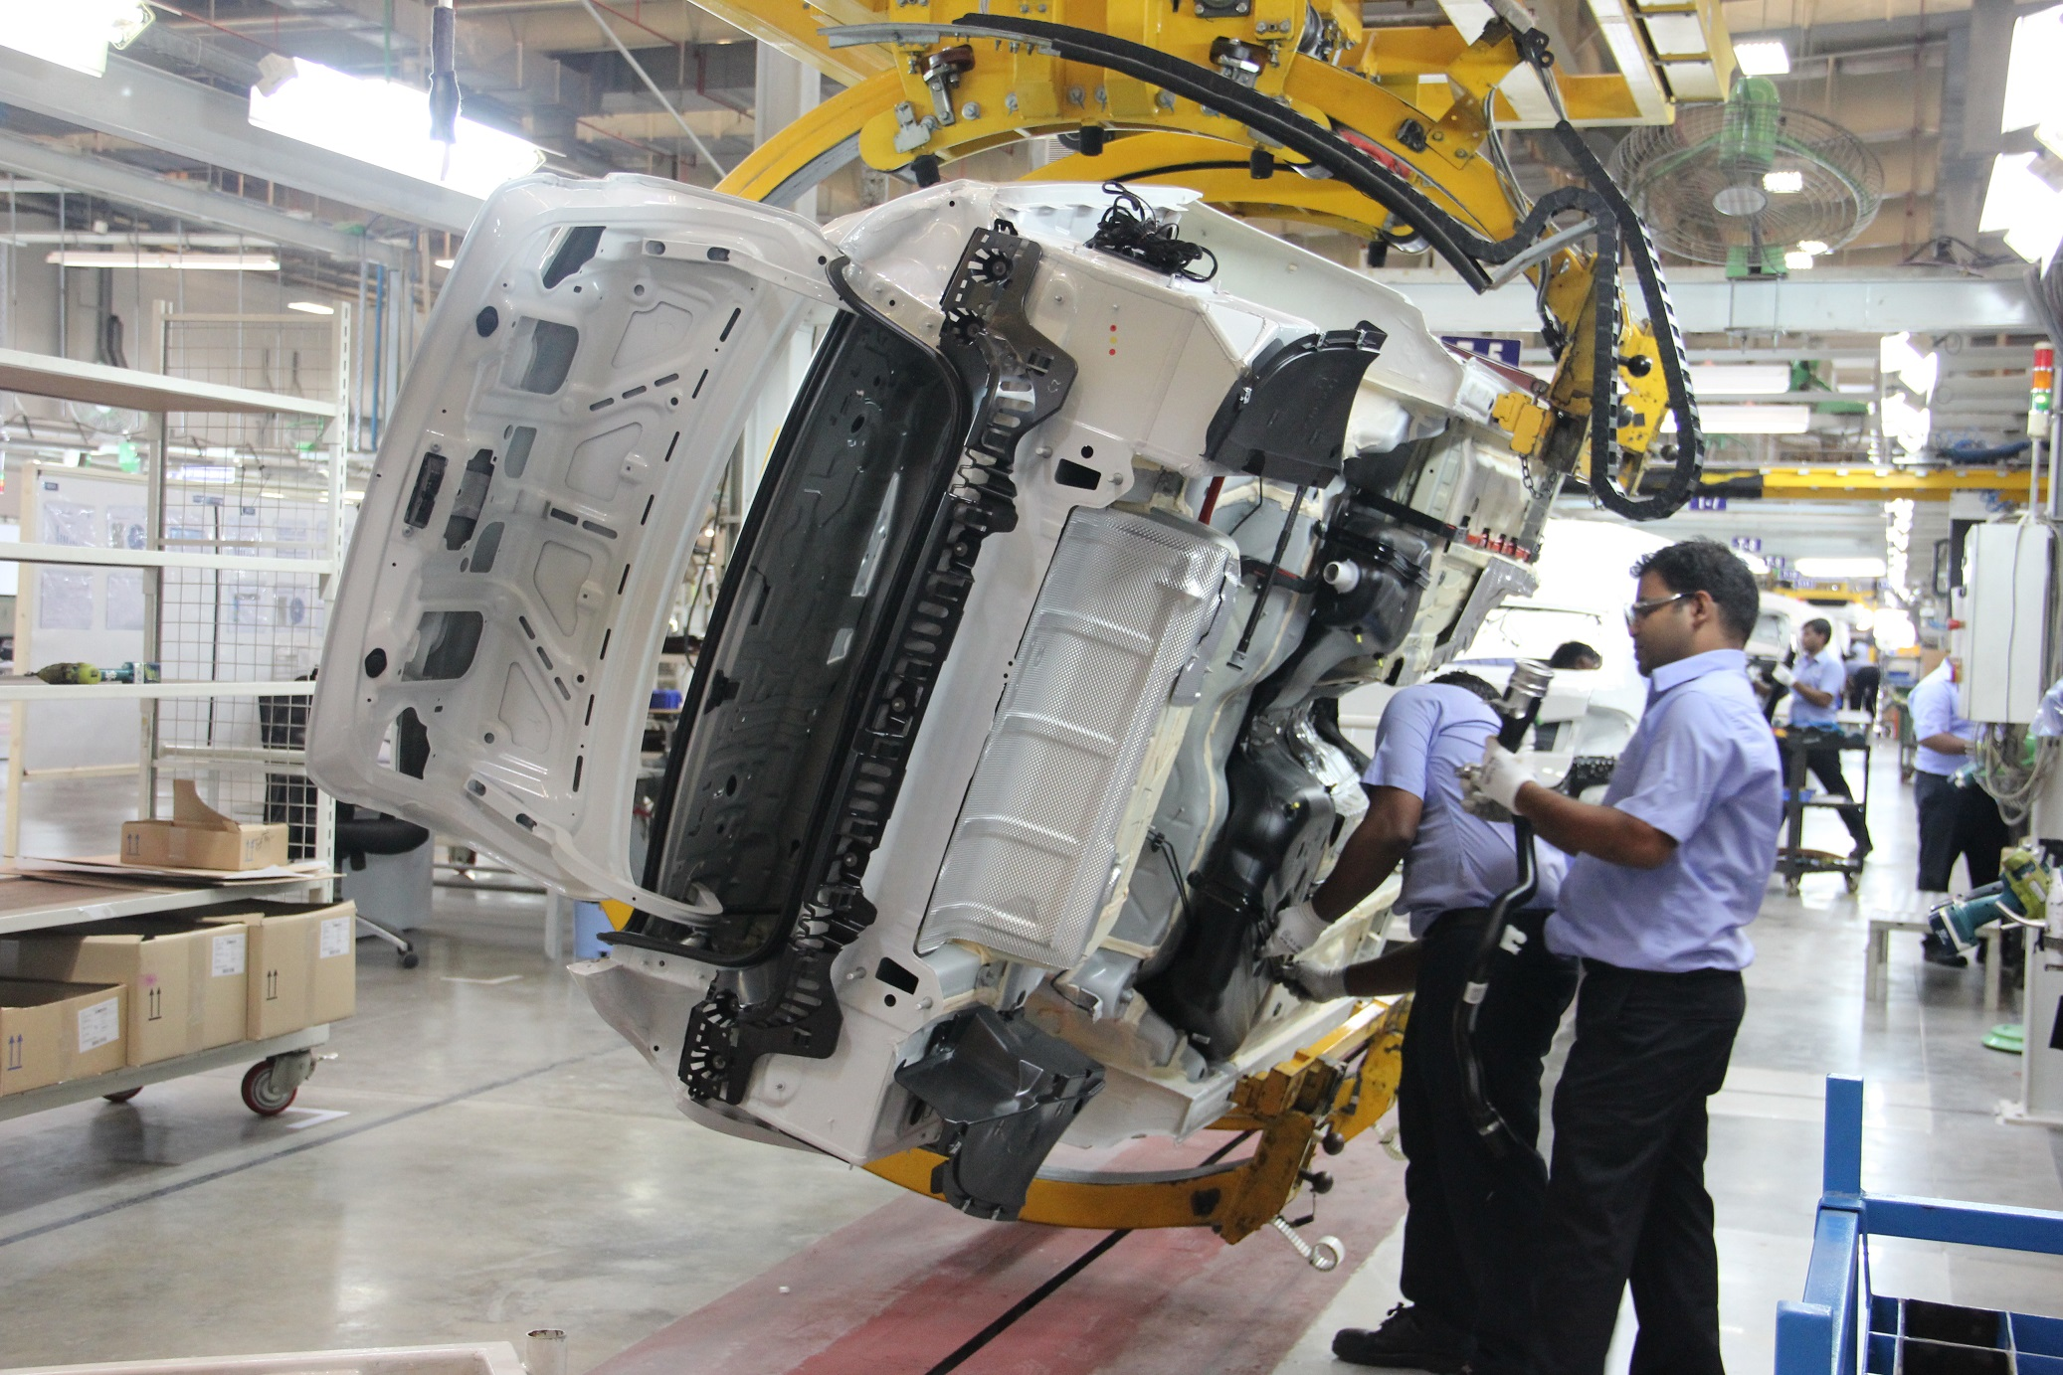
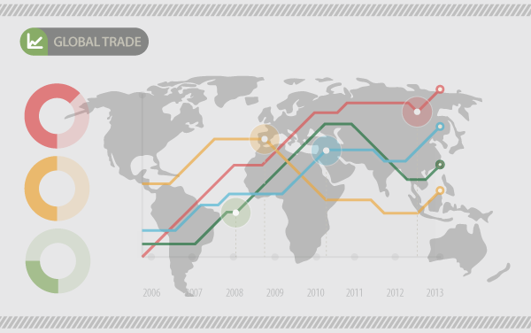
Indian Manufacturing
Overview
Manufacturing contributes…
16 % towards GDP
2% towards Global Trade Share
10% towards Employment Share
Source: Indian brand Equity foundation- Indian Manufacturing overview

Slide 6
Indian Manufacturing
The Indian Manufacturing Sector is NOT growing
Manufacturing has been stagnant
Lack of FDI in the Manufacturing sector
Lack of Skilled Labour
Incentives provided by the Government have been Poor
Source: The world Bank-Manufacturing value added

Slide 7
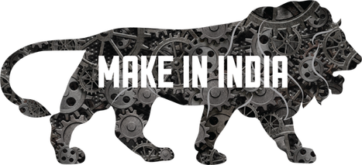
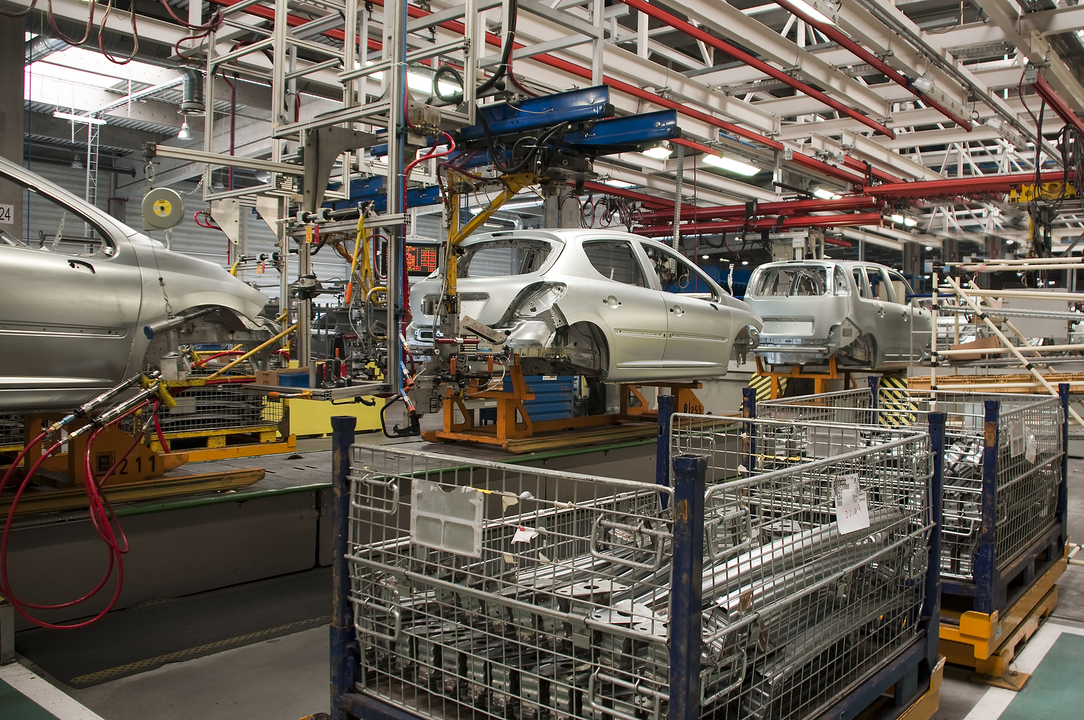
Indian Manufacturing
Areas Addressed
Infrastructure
Skill Development
Technology
Exit Mechanism
Regulation
Others
Availability of Finance
Make in India
In order for the Country’s long term- growth, it is
imperative to raise the global competitiveness of
the Indian Manufacturing sector.
Most significant and comprehensive initiative taken
by the government as of yet.
First of It’s kind for the manufacturing Sector.
Source: Make in India- National Manufacturing

Slide 8
Indian Manufacturing
New Policies developed under “Make in India” and How they benefit the Manufacturing sector
Contribution towards GDP
Increases from 16% to 25% by 2022
Job Creation
Creates 100 million jobs in manufacturing sector alone by 2022
Labour
Creation of appropriate skill sets among rural migrants and the urban poor for inclusive growth
Enhances global competitiveness of the manufacturing sector to ensure sustainability of growth.
Make in India
Goods and Services tax
Construction of New Roads
Solar Power
Finance
Foreign Direct Investments
Labour Laws-Skill India

Slide 9
Indian Manufacturing
Already Witnessing Foreign Investment
Make in India Fair held in India showcasing potential of design, sustainability across India’s manufacturing sector.
The Fair closed with US $ 225.32 billion in investment commitments over the next few years.
Launching £120 Million facility in India.
Biggest Greenfield manufacturing facility in Asia.
Built over 150 acres of Land
Merger between Tata Motors and Cummins Inc.
Launched their third site in India.
Source: Make in India-IBEF, Manufacturing in India, Shine-Industry Manufacturing

Slide 10
Indian Manufacturing
Already Witnessing Foreign Investment

Slide 11
Indian Manufacturing
Bright Future of Indian Manufacturing
2016(Current)
Rank | Country | Index Score (100= High) (10= Low)
1 | China | 100
2 | United States | 99.5
3 | Germany | 93.9
4 | Japan | 80.4
5 | South Korea | 76.7
6 | United Kingdom | 75.8
7 | Taiwan | 72.9
8 | Mexico | 69.5
9 | Canada | 68.7
10 | Singapore | 68.4
11 | India | 67.2
12 | Switzerland | 63.6
13 | Sweden | 62.1
14 | Thailand | 60.4
15 | Poland | 59.1
2020(Projected)
Rank | Country | Index Score (100= High) (10= Low)
1 | United States | 100
2 | China | 99.5
3 | Germany | 93.9
4 | Japan | 80.4
5 | India | 76.7
6 | South Korea | 75.8
7 | Mexico | 72.9
8 | United Kingdom | 69.5
9 | Taiwan | 68.7
10 | Canada | 68.4
11 | Singapore | 67.2
12 | Vietnam | 63.6
13 | Malaysia | 62.1
14 | Thailand | 60.4
15 | Indonesia | 59.1
+6
Source: Deloitte- Global Manufacturing competitive index

Slide 12
Indian Manufacturing
Manufacturing industries that hold the key to the Future-Automobile, Technology and Defence
Automobile Sector
Potential to grow to 6 million + units per annum by 2020.
Demographically and economically-well positioned for growth
It services domestic demand and export potential.
All major car manufacturers investing in the Indian automobile sector.
Soon there will also be a big market for hybrid and electric cars.
Automobile Sector
Automobile Sector | World Ranking
Tractor Manufacturing | 1
Two-wheeler Manufacturing | 2
Bus Manufacturing | 2
Heavy Truck Manufacturing | 5
Car Manufacturing | 6
Commercial Vehicle manufacturing | 8
Source: Make in India- National Manufacturing

Slide 13
Indian Manufacturing
Manufacturing industries that hold the key to the Future-Automobile, Technology and Defence
Defence
Technology
India currently has the third largest armed forces in the world
The Government aims to spend $40 billion on defence manufacturing until 2020.
Majority will be spent on Indian Manufacturers (70%)
Tata
Mahindra
Reliance
Hero
Bharat Forge
Hinduja
49% open to FDI making it a great destination for foreign private companies to invest in the Indian Defence sector.
Recently, The Indian Technology sector has seen a rise.
Investments from major technology based companies within the manufacturing sectors.
India has a great potential to be the hub for technology manufacturing companies.
Source: Make in India- National Manufacturing, Quartz India

Slide 14
Indian Manufacturing
Conclusion
The Manufacturing sector has been stagnant
“Make in India” is a great way to move ahead
Manufacturing sector has already shown improvement
India will be the centre for manufacturing in the upcoming years

