Slide 1
Cranfield University, Dec 2019 Making policies and incentives for the circular economy socially robust Steve Yearley STIS, University of Edinburgh & Institute of Advanced Studies in the Humanities
STIS Edinburgh
Notes:
1

Slide 2
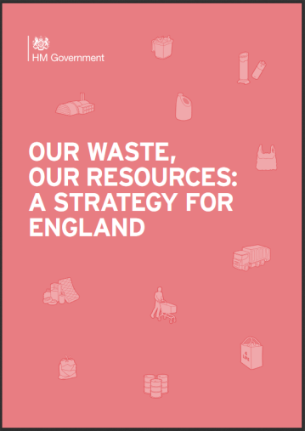
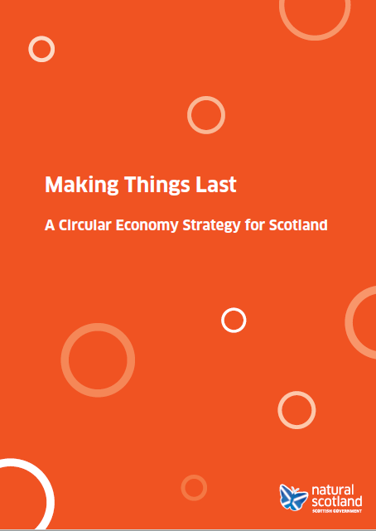
who doesn’t love a Circular Economy?
has the straightforwardness of recycling
… and is a more appealing term than decarbonisation or sustainable development.
2018
2016
STIS Edinburgh
Notes:
2

Slide 3
Naming the goal
Circular Economy
SD decarbonisation
STIS Edinburgh
Notes:
3

Slide 4
Circular Economy
SD decarbonisation
issues of growth
STIS Edinburgh
Notes:
4

Slide 5
Circular Economy
SD decarbonisation
issues of growth
questions of energy & thermodynamics
STIS Edinburgh
Notes:
5

Slide 6
assessing the circularity of the Circular Economy?
comparison with complexity of Life Cycle Analysis (LCA)
transparency and credibility
how does rising prosperity fit with circularity?
STIS Edinburgh
Notes:
6

Slide 7
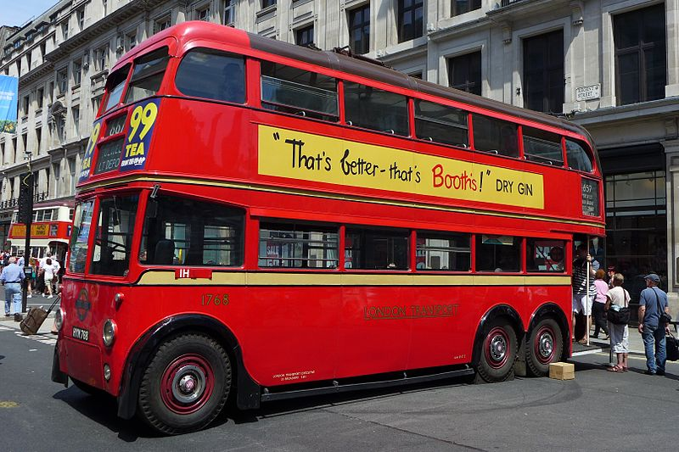
is circularity a good enough goal?
transport and Urry’s
idea of “mobilities”
London Q1 trolleybus 1768 Regent Street, 2014.JPG image by Bahnfrend
STIS Edinburgh
Notes:
7

Slide 8
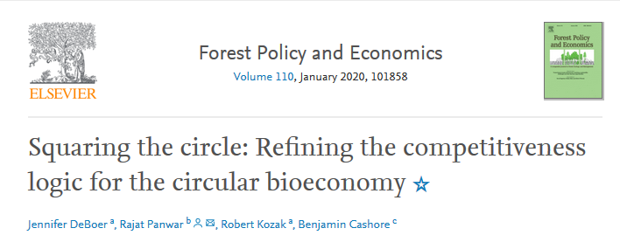
is circularity a good enough goal?
circular bio-economies & genetic modification
STIS Edinburgh
Notes:
8

Slide 9
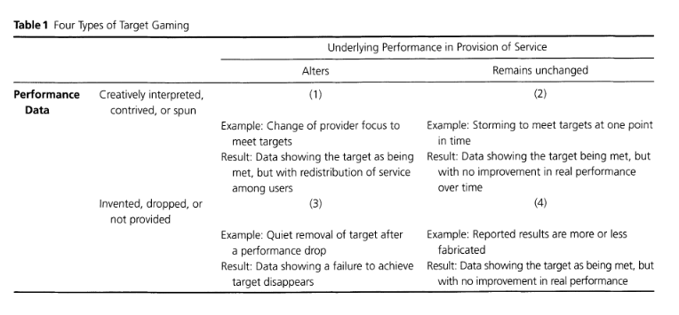
Understanding the policy appeal:
Scotland
European Union
Understanding responses:
“Gaming in Targetworld”
C. Hood (2006)
Public Administration Review 66
STIS Edinburgh
Notes:
9

Slide 10
