Slide 1
Manufacturing 2075-2018
Designing a circular business model from paper mill industrial by-products
Cynthia Adu
Sustainability Consultant, Carbon Smart
4th December 2019

Slide 2

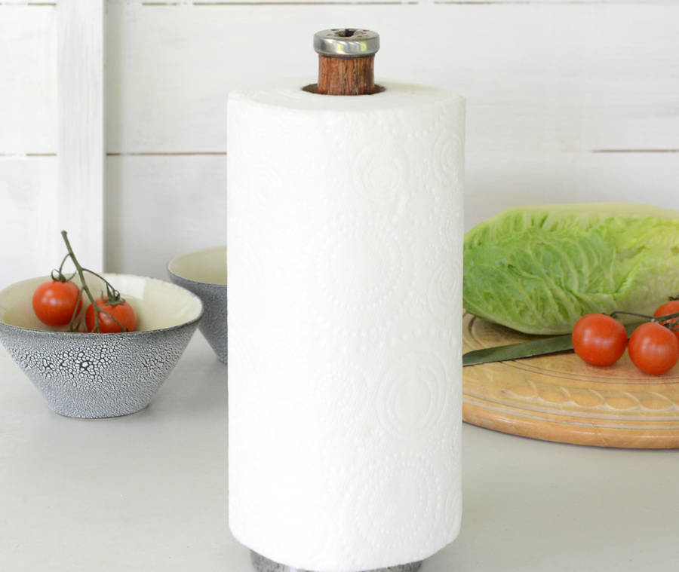



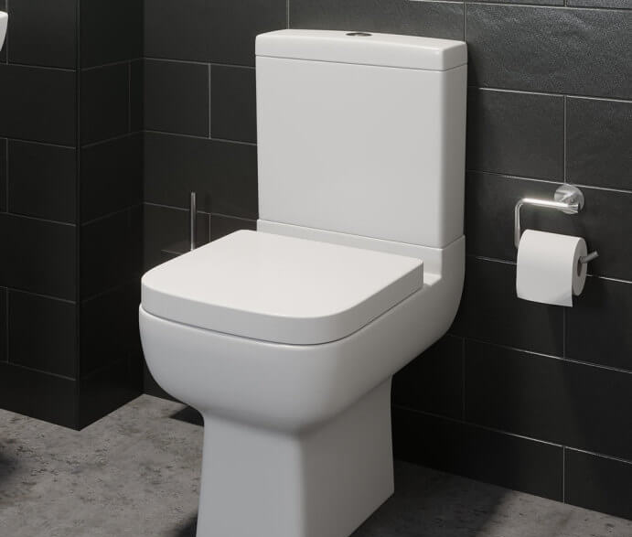
Notes:
People think the consumption of paper is declining heavily because of the computer age, but paper plays a very key part in our lives

Slide 3
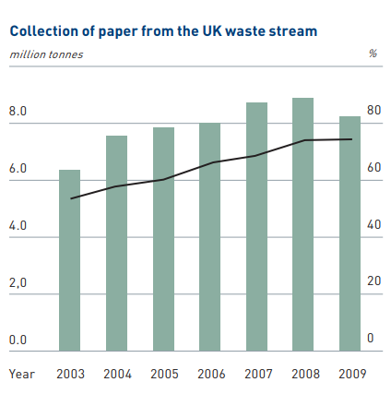
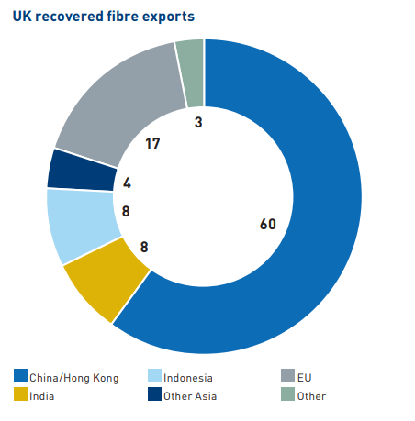
Background

Slide 4
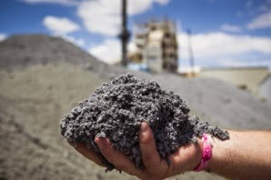
Background
1 million tonnes/year in UK
EU target is 74% paper recycling by 2020
Paper recycling yields more sludge
Landfill cost is £85/ton
2.6 tons of CO2 released per ton of sludge if landfilled.
PMS is used in low value application (agricultural spreading and animal bedding)
Current solution is short term!!
Paper mill sludge (PMS)

Slide 5
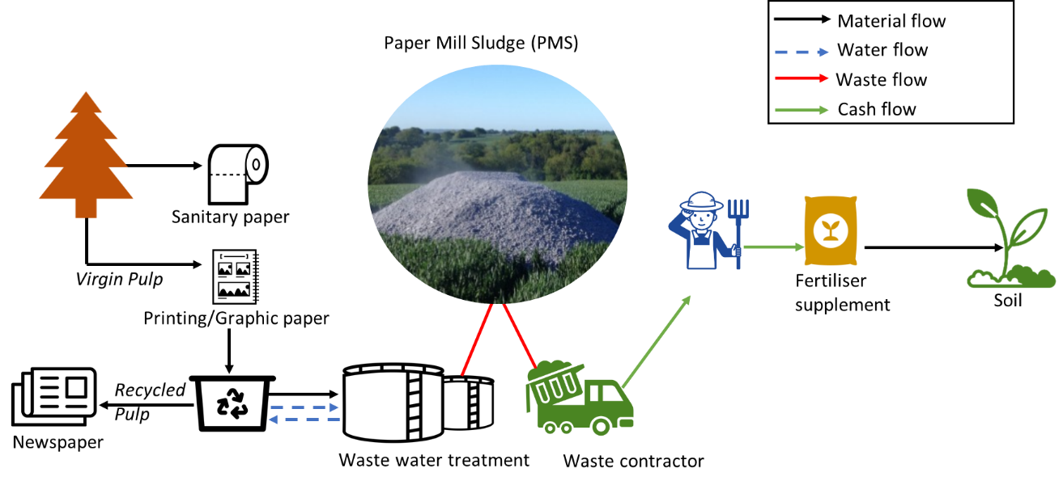
Case study: Ecoganix and UK mills
‘How can waste management businesses uncover value from waste/by-product for the circular economy?’

Slide 6
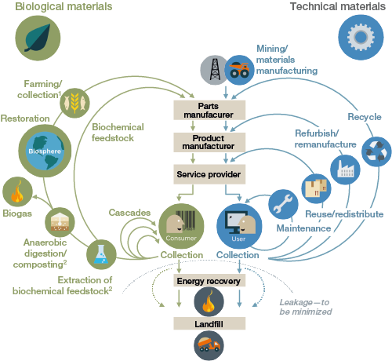
Circular Economy
“A Circular Economy is one that is restorative by design, and aims to keep products, components and materials at their highest utility and value, at all times” (Webster, 2015).

Slide 7
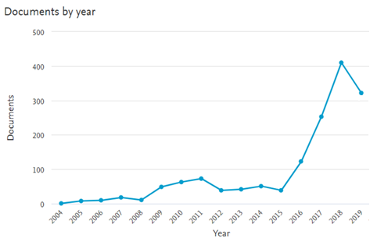
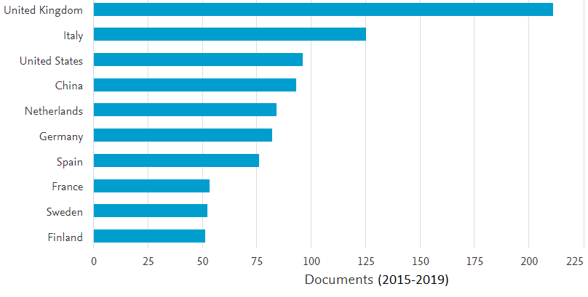
Growth in the circular economy literature
Number of documents
Country
Year
Number of articles

Slide 8
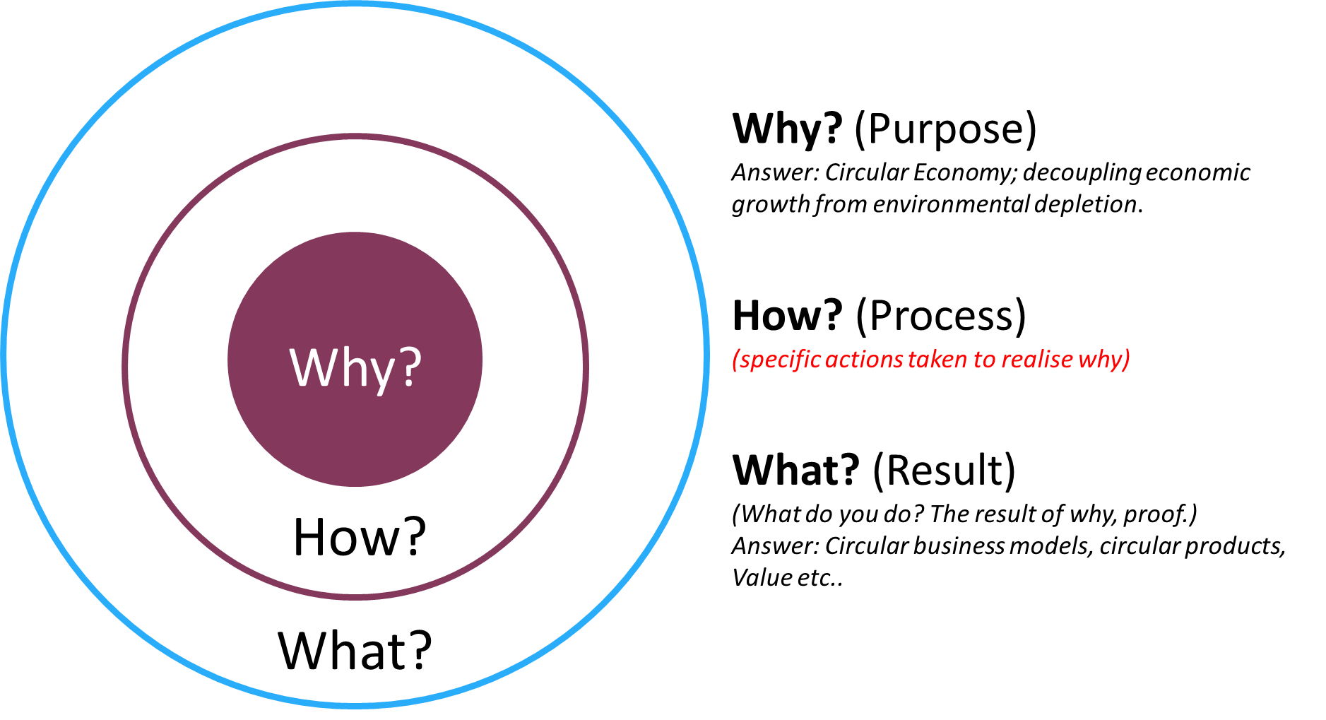
Why, How, What?

Slide 9
Literature gaps and aim
CE is attractive to businesses however the literature focuses on development of business models, product service systems for technical cycles whilst the biological cycles and scientific research content is unexplored.
Design is recognised as a catalyst for the CE however there is a limited evidence on application of design tools to the biological cycle of the CE concept whereby materials are recovered into new feedstock.
Research on PMS in the past years have focused mainly on energy recovery and soil restoration which do not create maximum value i.e contradicts CE concept

Slide 10
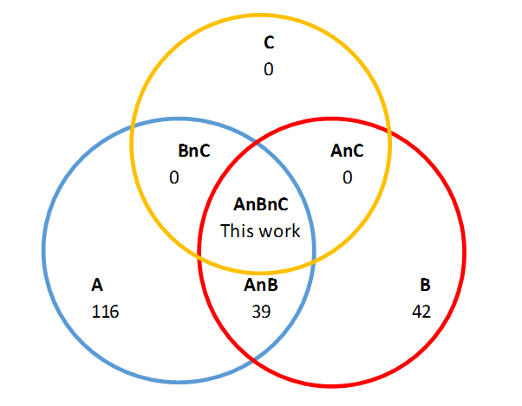
Literature gaps and aim
*A: Articles discussing the CE concept directly/indirectly through various topics.
B: Articles proposing CE business models, design strategies and providing businesses with the tools to apply CE principles.
C: Articles actively applying design thinking or other innovation methodology to guide business innovations and transition towards circular economy.
*TITLE-ABS-KEY (‘circular economy’ AND ‘design’) was used which resulted in 182 articles as of 2016

Slide 11
Design thinking
Problem definition
Divergent thinking
Convergent thinking
Convergent thinking
DEFINE
DELIVER
DISCOVER
DEVELOP
Brainstorming
Stakeholder maps
Rapid prototyping
Field study
Characterisation
Chemical composition
Pain points
Identifying things
Prototyping
Material synthesis
Material testing
Product development
Market research
Life-cycle analysis
Business model canvas
Business case design

Slide 12
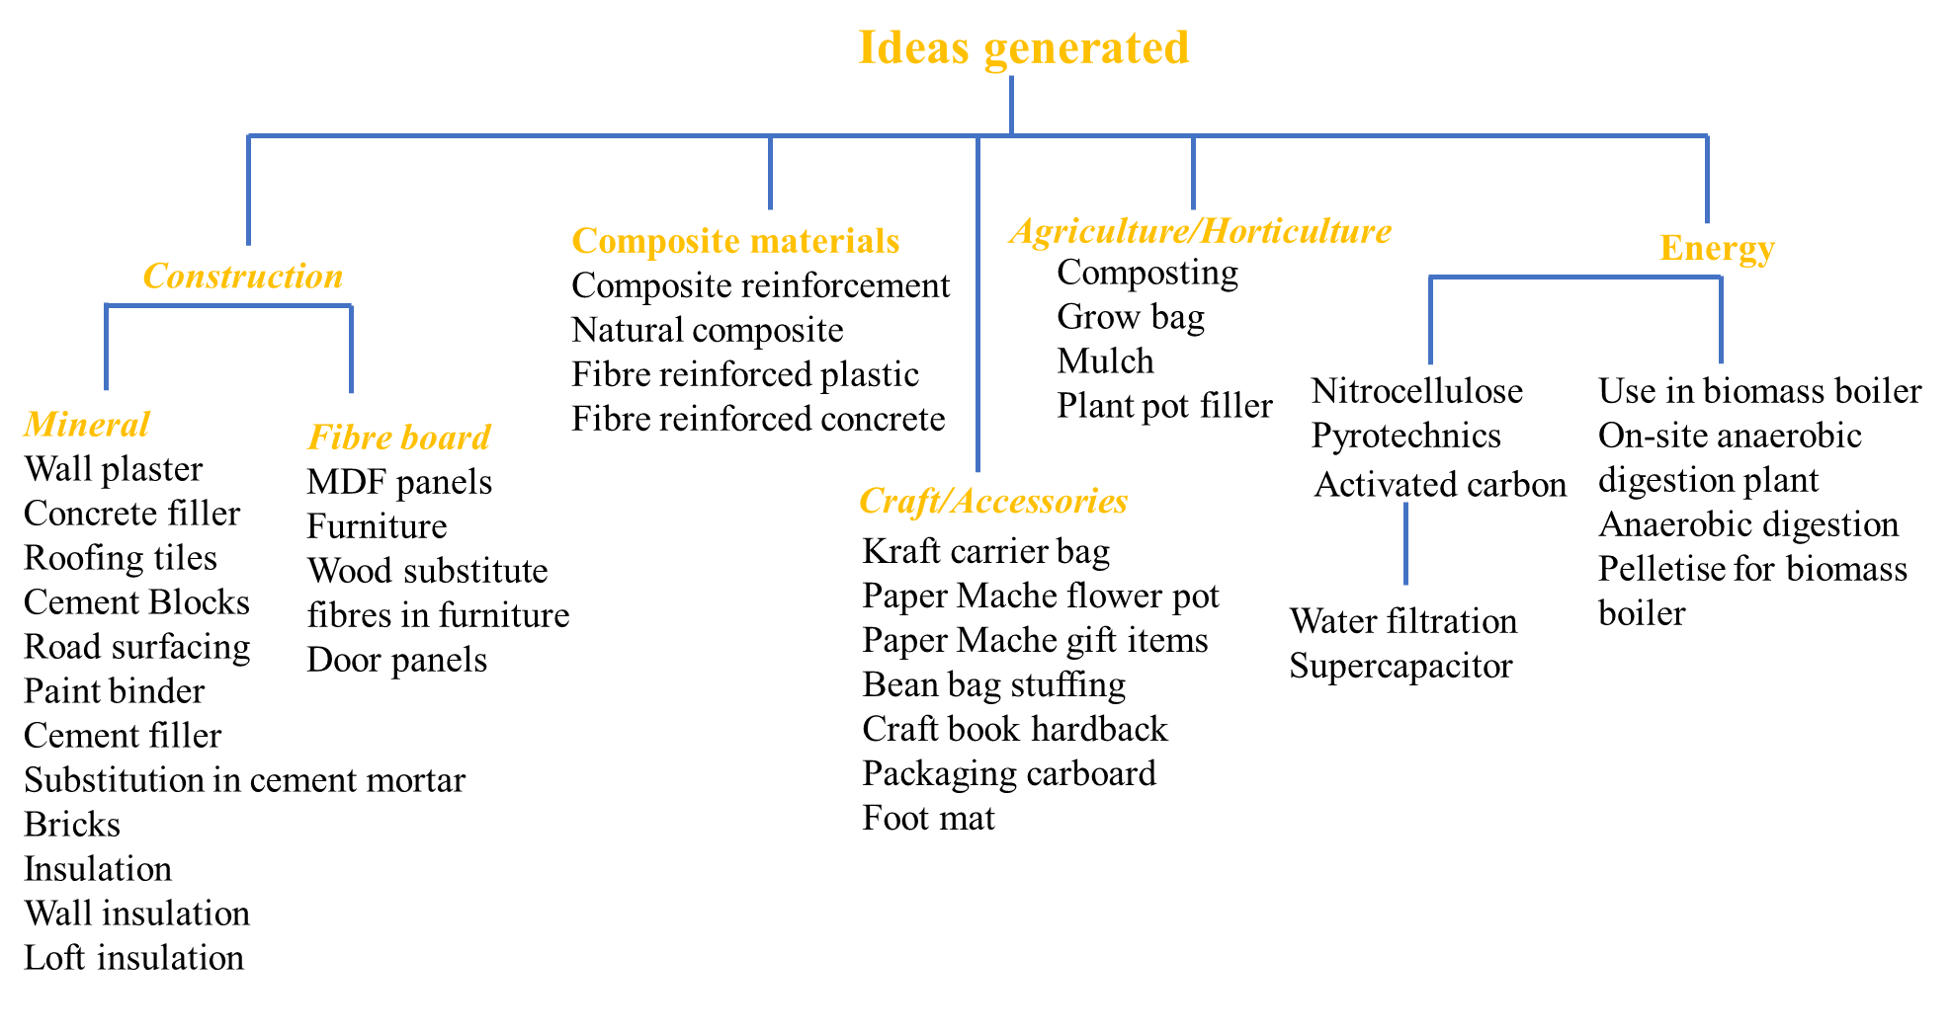
Discover: Brainstorming

Slide 13
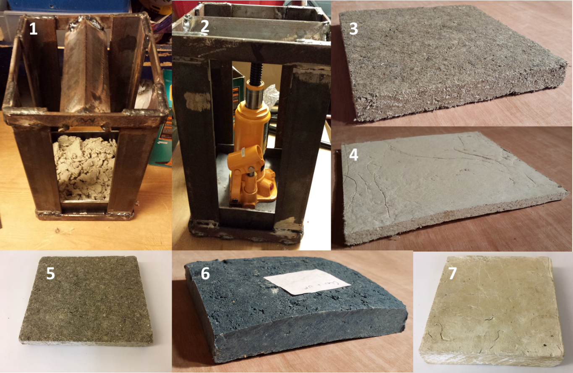
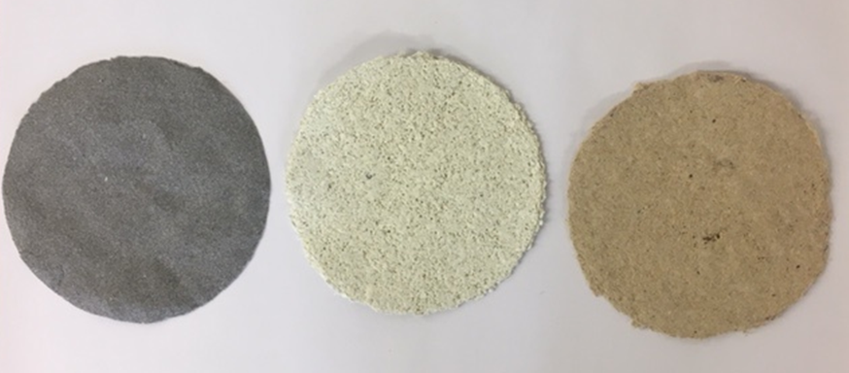
Rapid prototyping

Slide 14
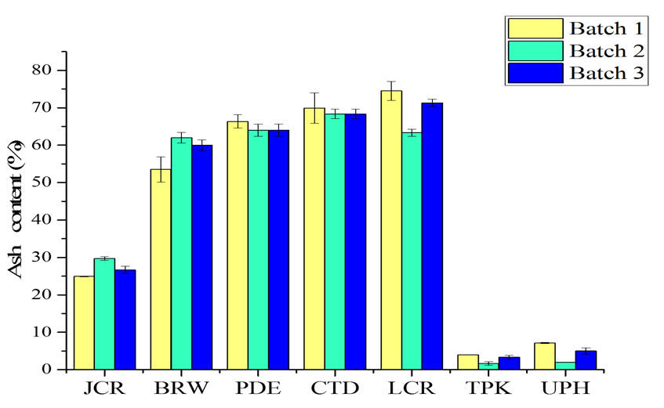
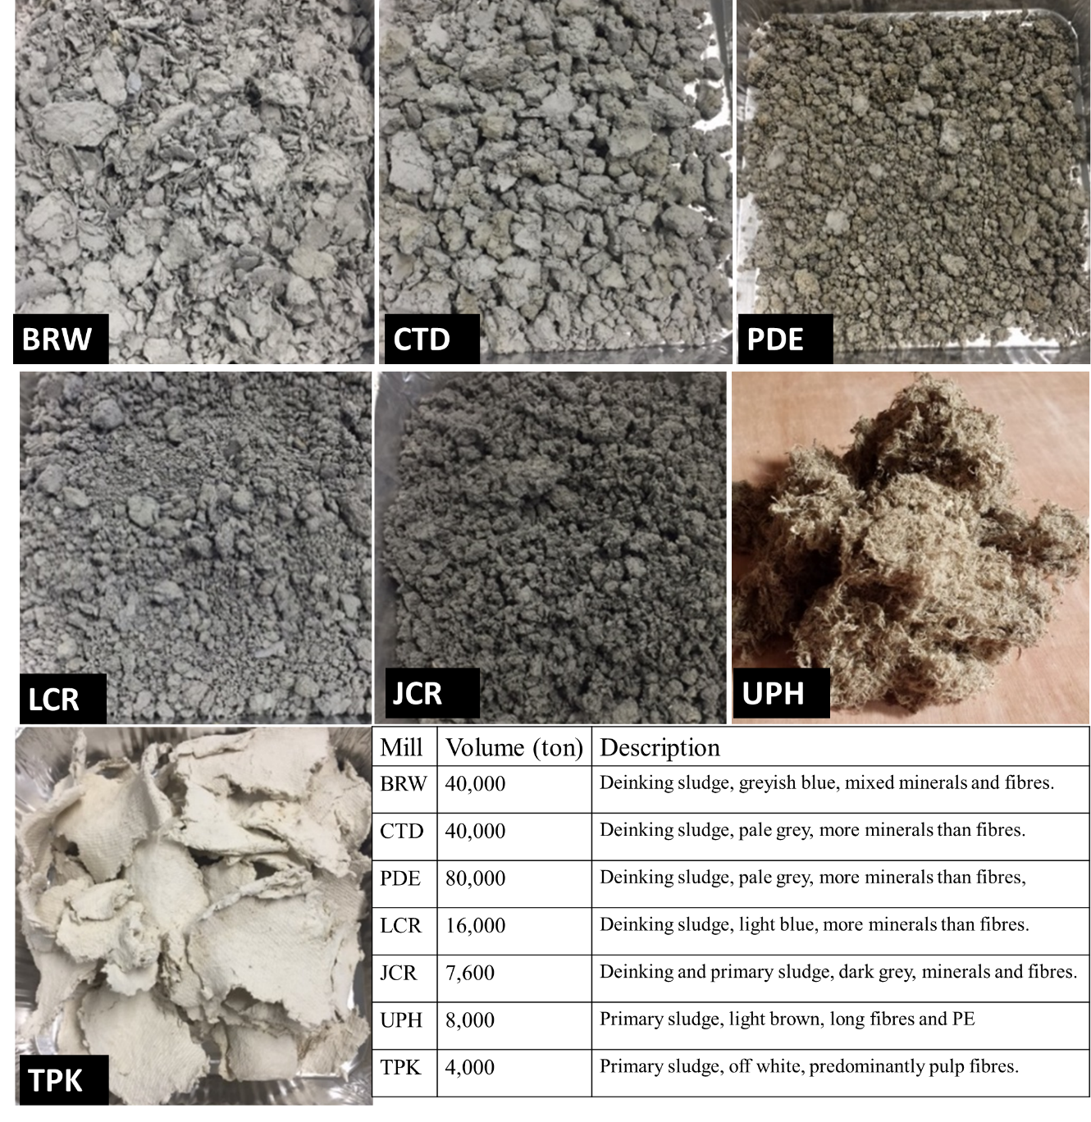
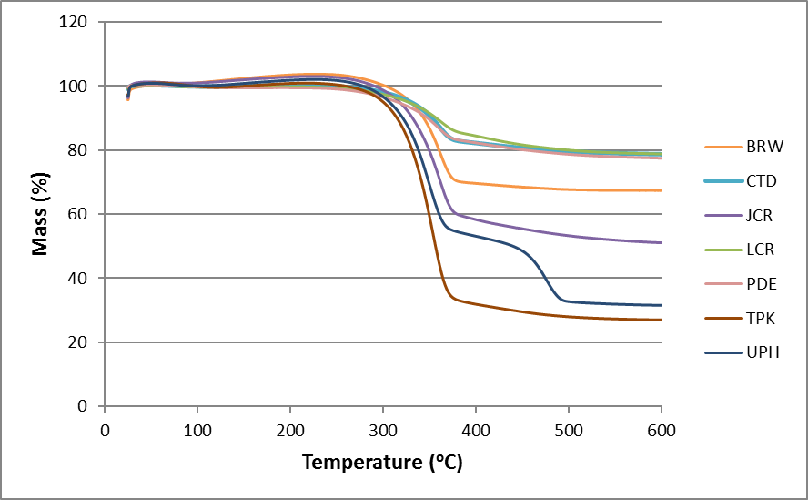
Define: Characterisation
Ash Analysis
Thermogravimetric Analysis (TGA)

Slide 15
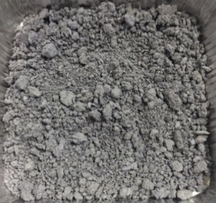
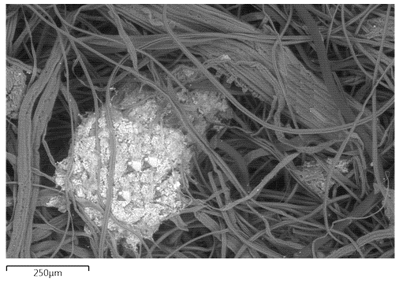
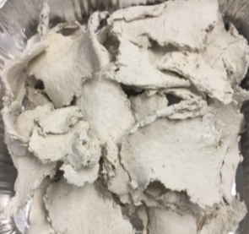
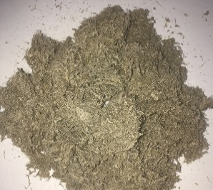
Define
Tissue paper
Cellulose fibres
Natural polymer.
High elastic modulus compared to carbon fiber (150GPa).
Kitchen towel
Mineral fillers
Tea bags
Contains calcium, silicon and aluminum.
Gives it a cementitious nature when wet.

Slide 16
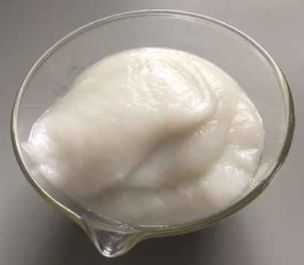
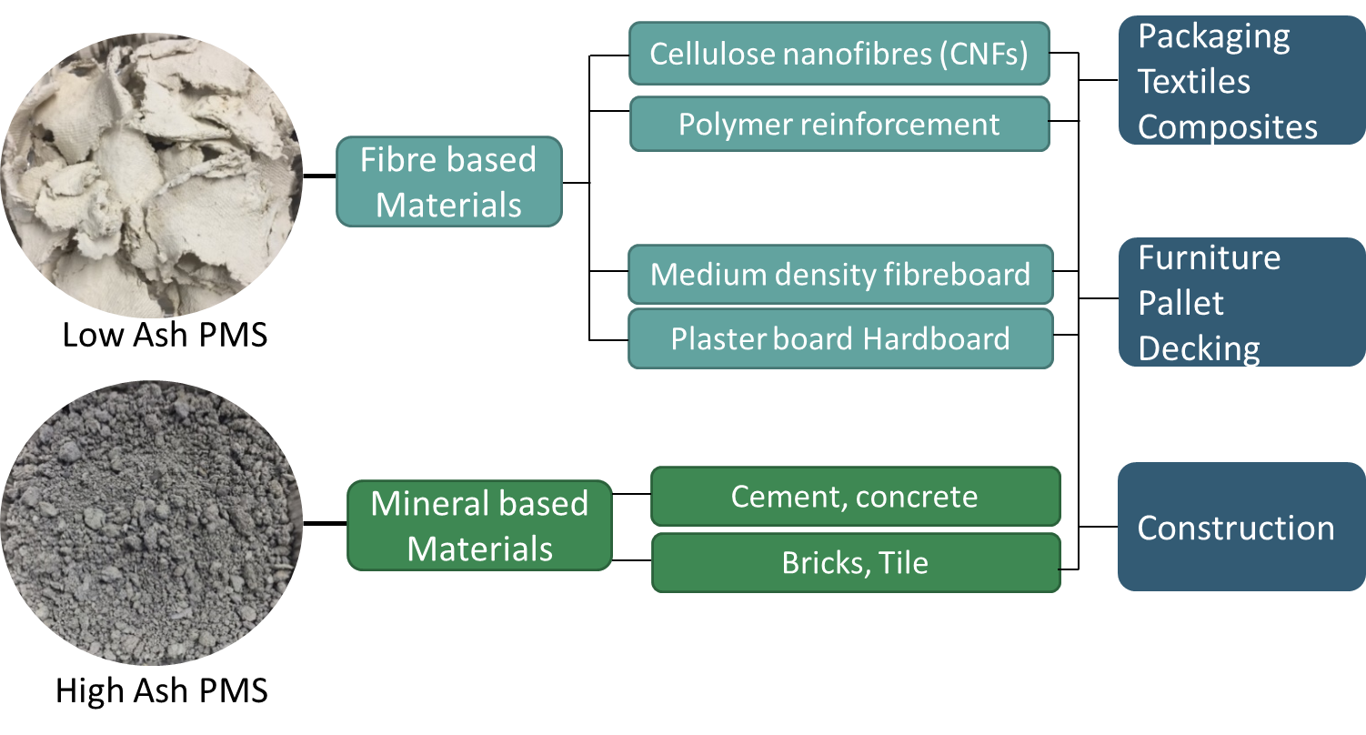
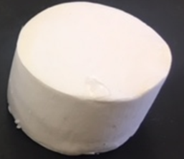
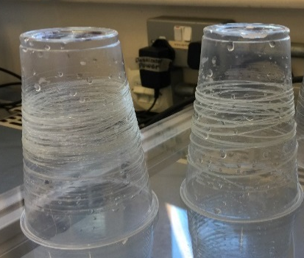
Design thinking
Nanocellulose (Paper sludge nanofibres)
Foam
Filaments
Flooring/cladding

Slide 17

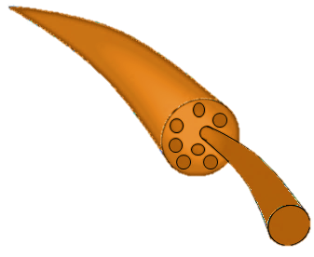

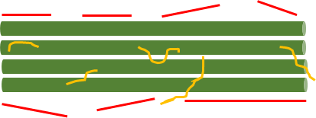
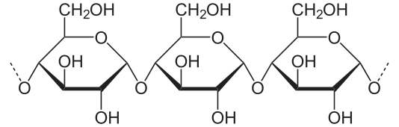
Fibril
Microfibril
Filler
Nanofibres
(100 nm)
Hemicellulose
Paper
Mechanical or chemical treatment
Nanocellulose
Cellulose molecules

Slide 18
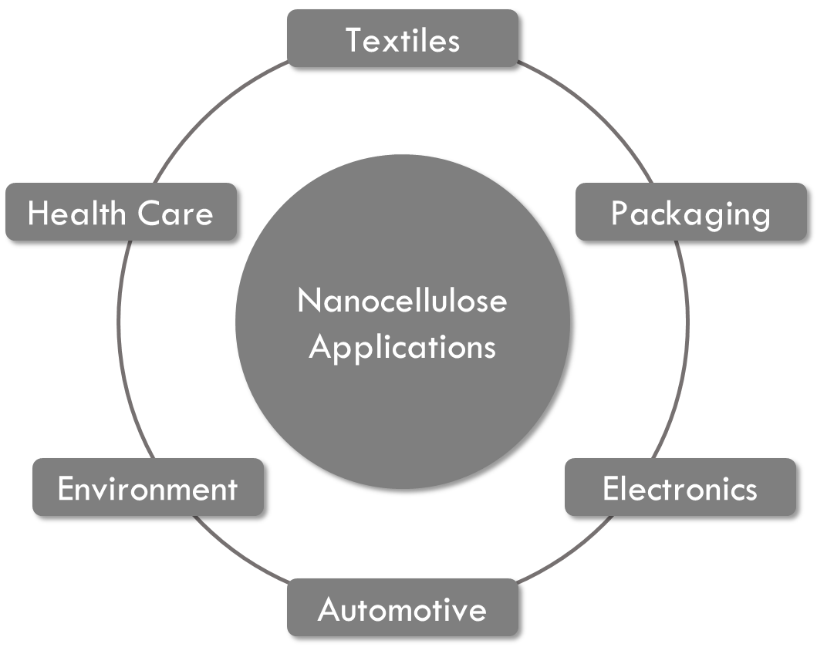
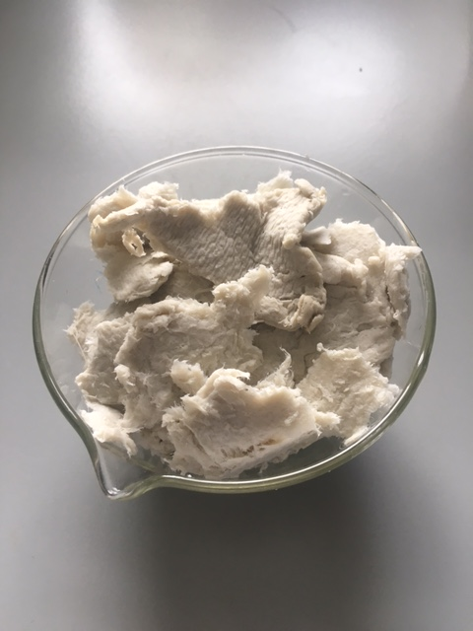
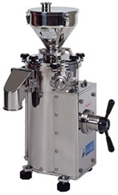
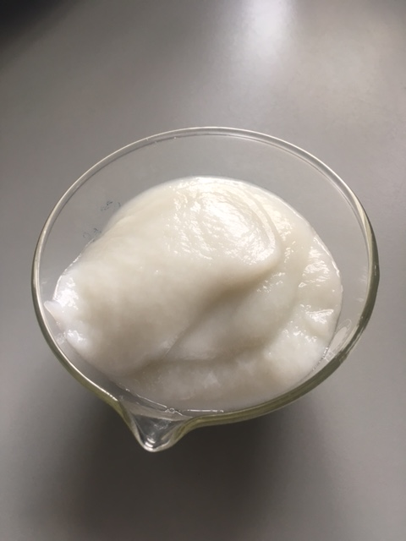
Nanoccellulose production from PMS
Nanocellulose is a psedou-plastic material substance obtained from plant matter by mechanical grinding/chemical treatment.
Paper mill sludge
Mechanical fibrillation
Nanocellulose suspension of PMS
Nanocellulose is made up of hydrogen bonds, it has high mechanical properties, biodegradable and can be used in wide range of application to replace traditional plastic materials.

Slide 19

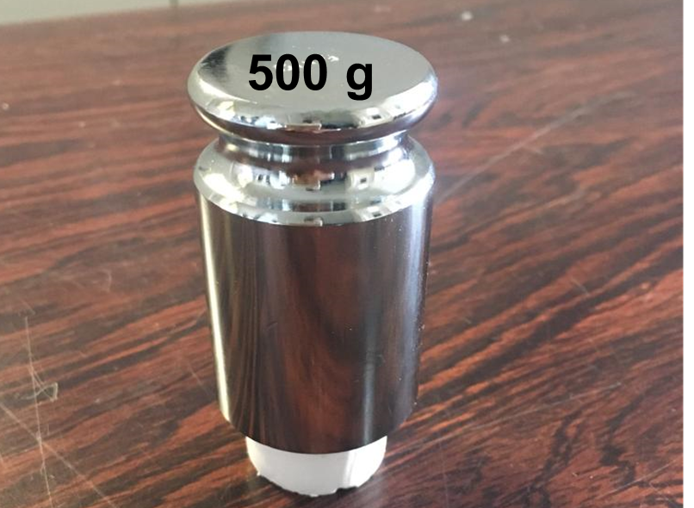

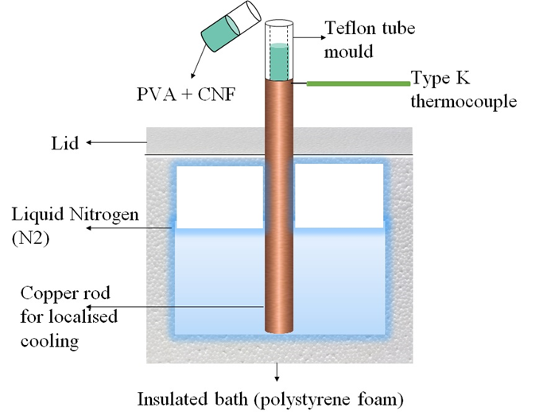
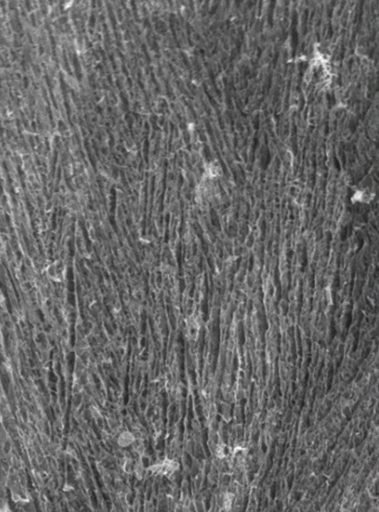
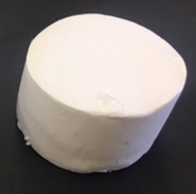
Develop: Foams
Ice crystal growth
Sublimation
Porous structure

Slide 20
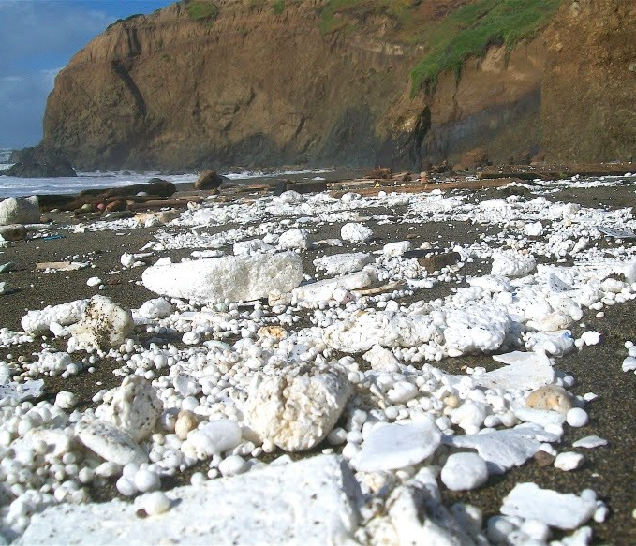
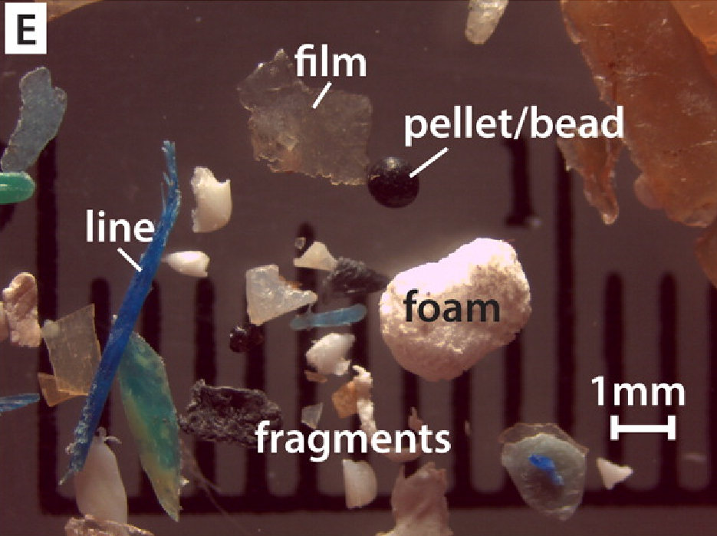
Polyurethane/Polystyrene foams
Remains in the environment, produced using ozone depleting blowing agent (HCFs which are being phased out).

Slide 21
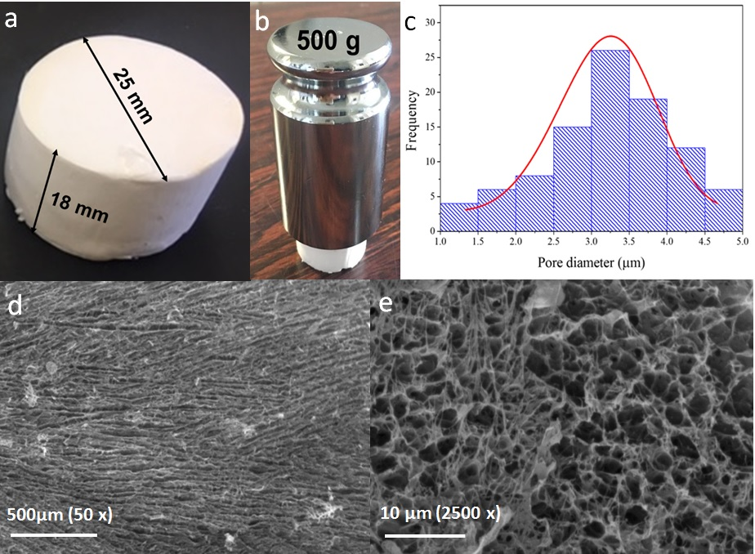
Results from foam
Foam type | Material | Density (kg/m³) | Compressive strength (kPa)
Jablite EPS 100 | Polystyrene | 20 | 100
EthafoamTM | Polyethylene | 29 | 30
This work | PVA-CNF | 28 ± 3 | 82 ± 7
Applications for foams
Packaging foam
Insulation
Cushioning/energy absorption
Scaffolding
Filtration media
Semiconductors

Slide 22
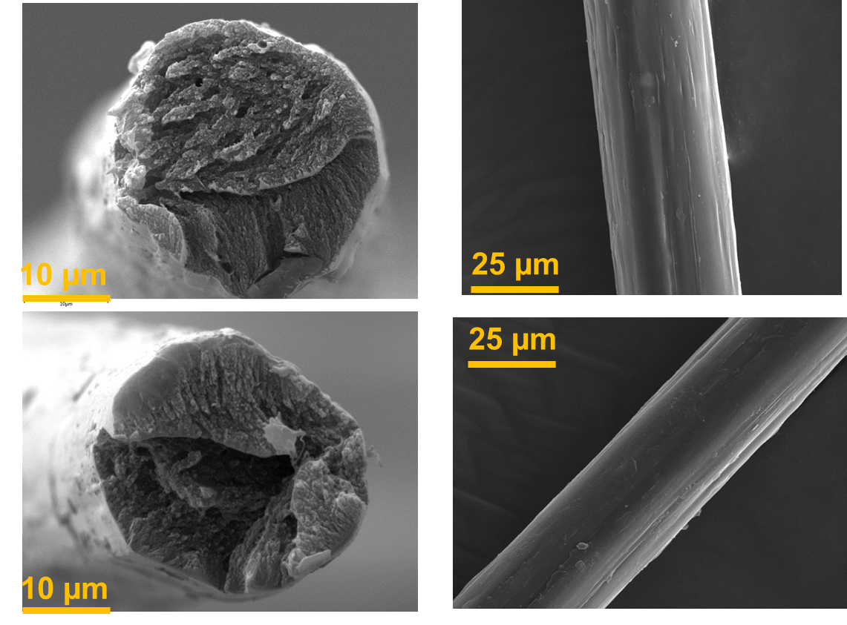
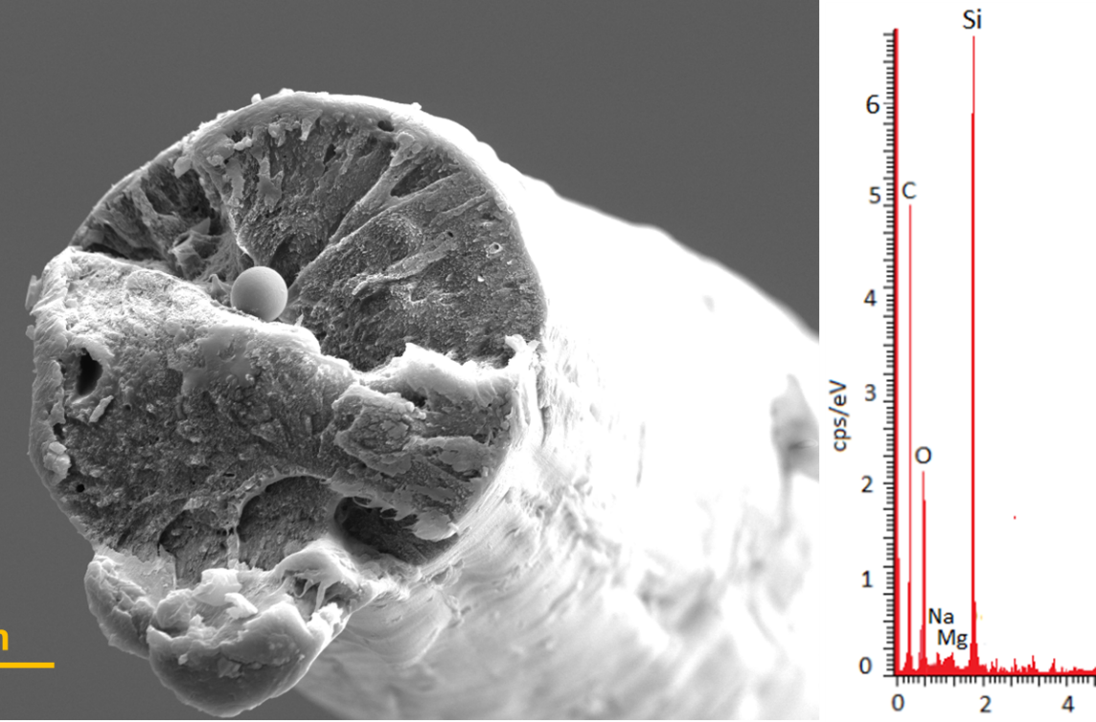
Filament from paper mill sludge
a
b
e
f
c
d
25 μm

Slide 23
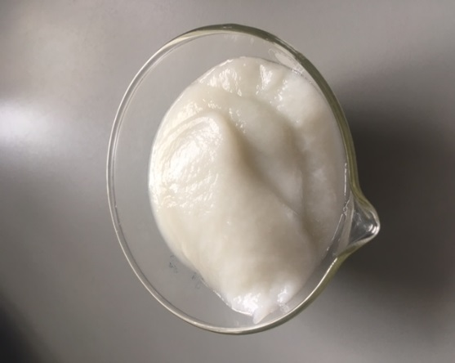
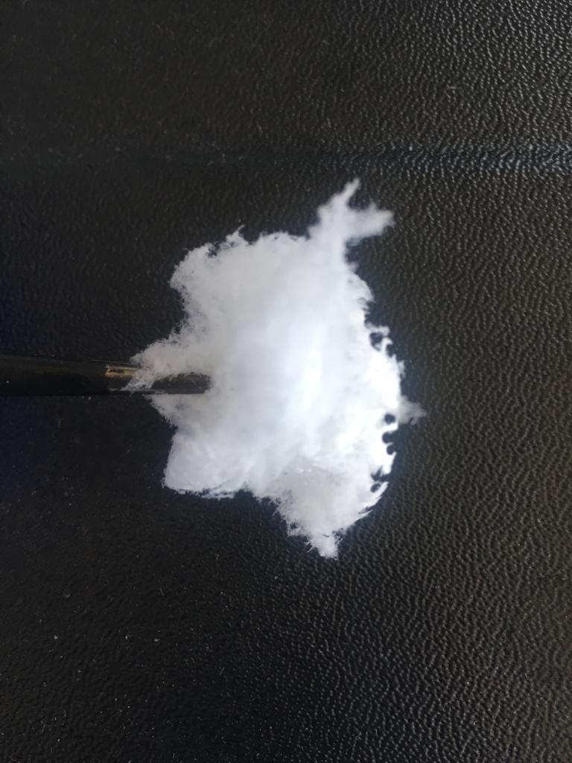
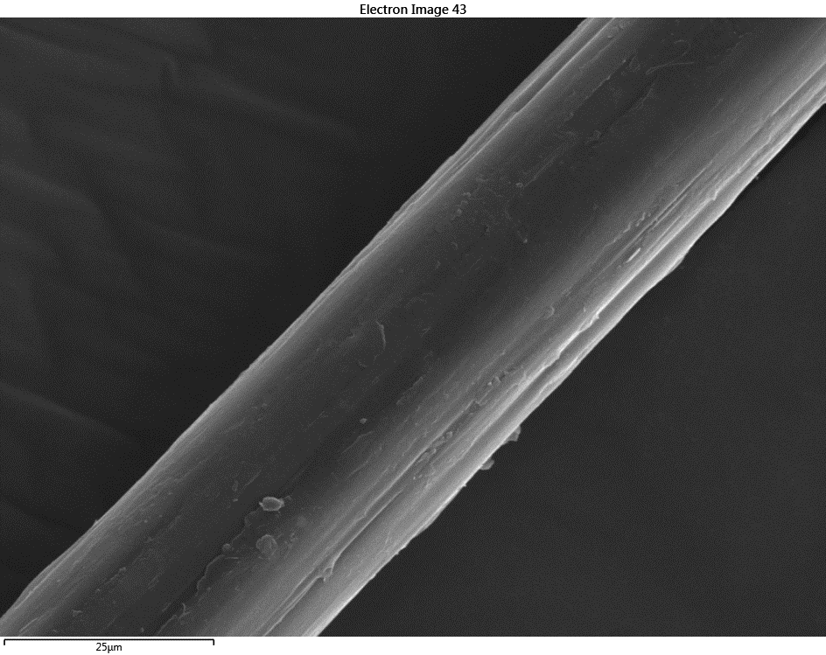
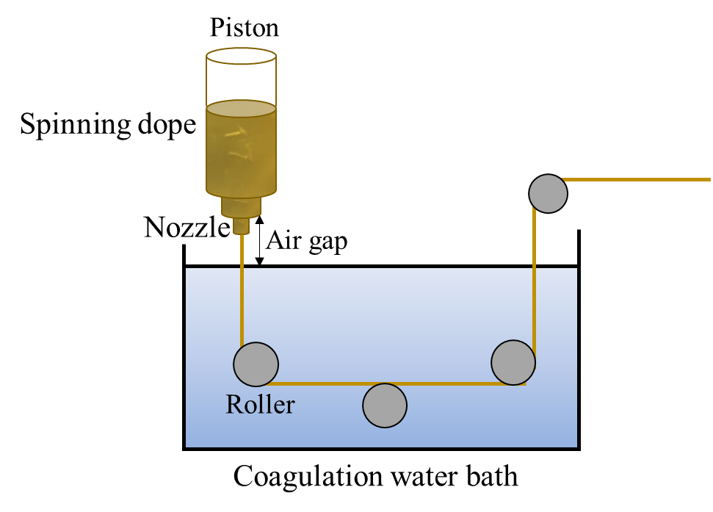
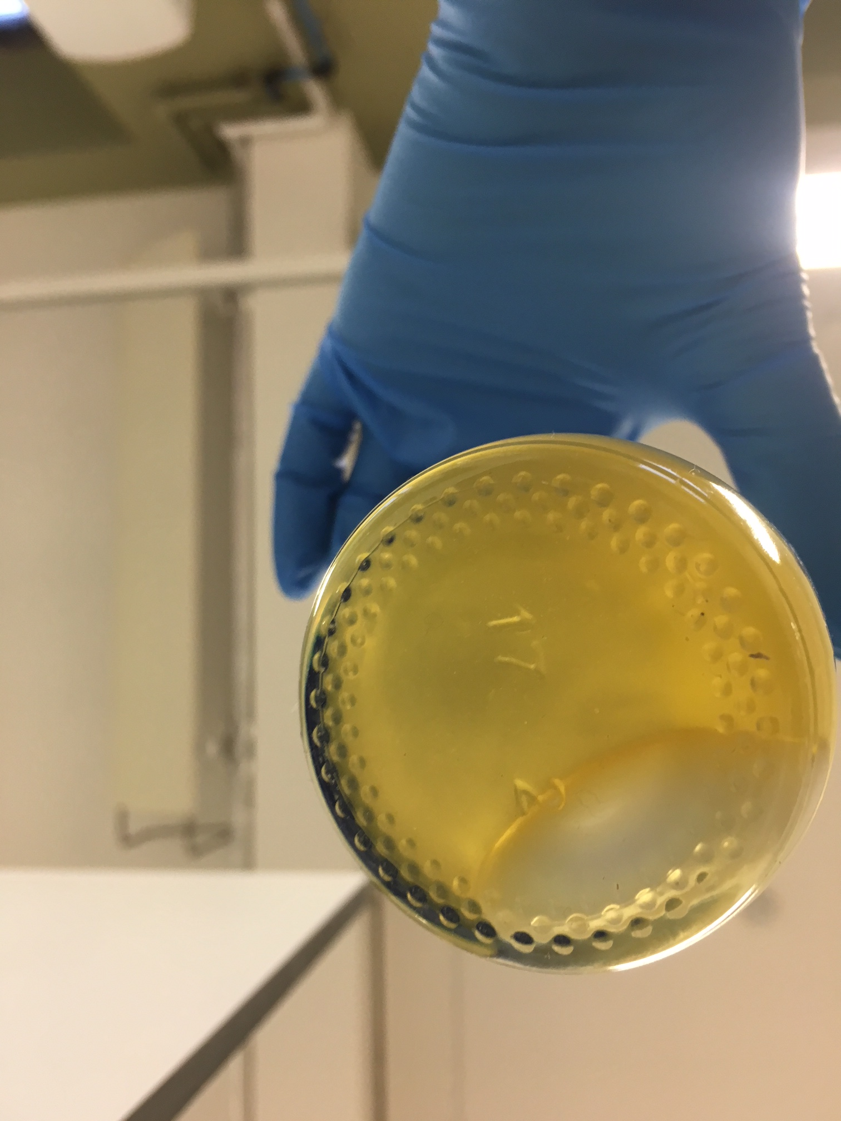
Develop: Filament
Lyophilization
Fibrillation
Freeze dried CNF
Cellulose nanofiber suspension
Paper mill sludge fibres
Dissolution
Dry jet wet spinning
24 μm
Ionic liquid
Cellulose filament

Slide 24
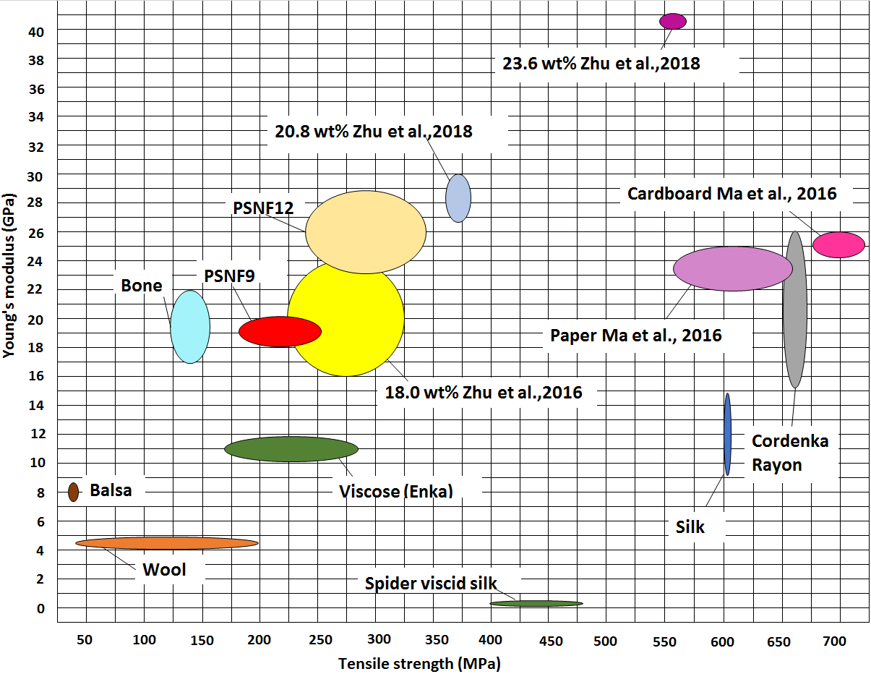

Comparison of mechanical properties

Slide 25
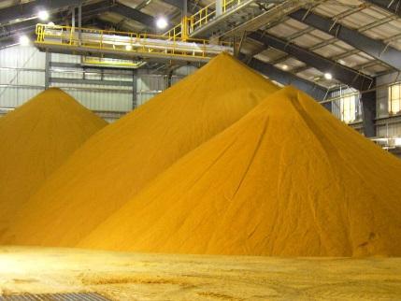
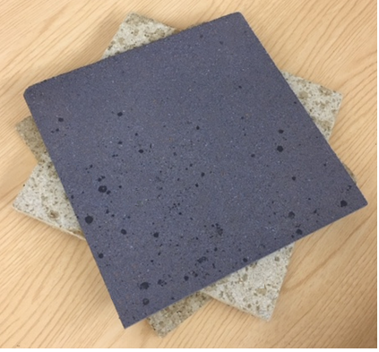
Composite panels
=
+
Paper mill sludge
Bio-resin produced from distillers dry grain and soluble (DDGs) a by-product of ethanol production
Bio-resin derived from distillery by-products (food grade)
Urea formaldehyde free product
High mineral content in sludge for fire retardant application

Slide 26
Mechanical Properties of Composite panels

Slide 27
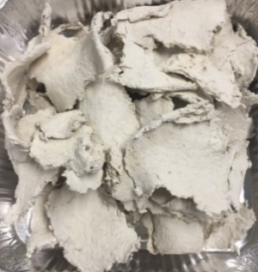








Product portfolio
Paper sludge nanofibres
Foam
Spun filaments
Composite panels
Polymer reinforcement
Packaging
Polymer reinforcement
Furniture
Paint/emulsifier
Insulation
Carbon fibre
Flooring
Films and coatings
Sandwich panel core
Textiles
Construction/wall panel

Slide 28

Ecoganix Business Model Canvas

Slide 29

Ecoprodux Business Model Canvas

Slide 30

Ecoprodux Lean Start-up Canvas

Slide 31

Ecoprodux lean pyramid

Slide 32


Manufacturing 2075-2018
Thank you
Cynthia Adu
Sustainability Consultant, Carbon Smart
4th December 2019

