Slide 1
The Drone Innovation Hub
Offered through a partnership between:
Supporting drone innovations within a shared airspace

Slide 2
The Drone Innovation Hub
About the Hub
Our mission is to offer industry a single point to access multiple resources to plan, prototype, test, certify and then launch at scale solutions that will accelerate the development of uncrewed systems and their integration into a shared airspace.
We can offer start-ups, SMEs, manufacturers, operators and integrators the ability to:
Design, develop, test and operate their solution in a sandbox setup, using a real-life airport environment provided by Cranfield
Connect and partner with suitable stakeholders that can add value, unlock opportunities, and improve their product offering
Transition from TRL 1 through to TRL 9 with particular focus on accelerating the transition from TRL 3 to TRL 7
Gain access to office space, workshops and event facilities to help them grow, market and develop
Benefit from our specialist regulatory, engineering, strategy and research expertise and resources
The Drone Innovation Hub offers industry a single point to access multiple resources to plan, prototype, test, certify and then launch at scale solutions that will accelerate the development of uncrewed systems and their integration into a shared airspace

Slide 3
What we offer: Services & Facilities
Supporting you at the appropriate level in your project and throughout its lifecycle
Facilities & Services
Accelerated Safety/ Airworthiness Process
Accelerated Transition from TRL 3 to 7
Accelerated Transition from Angel Investment to Venture Capital
Simulation
Plan
Eagle Lab
Government Grant
Financial & Business Support: Incubation space,
Bettany Centre, Royal Society Entrepreneur in Residence
AIRC/Indoor Flying Test Areas
1
2
3
4
5
6
7
8
9
Seed/Angel Funding
Technology Readiness Level
Investor Interaction
Develop
AVIATE +
Technical & Regulatory Support:
Global airport research capabilities, regulatory interface
& technical support
Airspace & BVLOS Testing
A Round
Test
B Round
Certify
Cranfield Airport
Launch & Scale

Slide 4
What we offer: Services & Facilities
Supporting you at the appropriate level in your project and throughout its lifecycle
Business Investment
Academic Research and Expertise
Business Management
Financial & Business Support
Support for application to funding, including Cranfield’s investor network
Access to cutting edge research, laboratories, world class expertise and highly skilled graduates
Access to services to support project strategy, marketing and management
Facilities
Air Traffic Services
Testing
Technical & Regulatory Support
Access Cranfield’s Eagle Lab, and AVIATE+ facilities for office, event and workshop space, to help your company develop and grow
Access to and integrate with our cutting edge air traffic services, unmanned traffic management systems, surveillance and more
Benefit from our airport, specialist airspace strategy, and extensive testing facilities

Slide 5
What we offer: Level Access
Supporting you at the appropriate level in your project
Supporting you at the appropriate level in your project and throughout its lifecycle
Levels of Support | Access to facilities, investor partners and business support
Start-up and Planning (A) | Access to Start Up/Seed Investment advice Business Strategy support and access to prototyping labs Access to Academic Research and Feasibility studies
Develop/Simulation (B) | Access to Digital Aviation Research and Technology Centre (DARTeC) Access to Air Traffic Management Laboratory Access to logistics infrastructure/management Access to UTM Digital twin simulation Access to Accelerators (e.g. Connected Places Catapult) Support to engage with CAA Innovation Sandbox (EASA/ICAO interface)
Test and Certify (C) | Access to Cranfield Airport & developing BVLOS Airspace – Aerodrome Traffic Zone (Safely test for integrated solutions within live operational environment) Access to external facilities Access to data collection from other trials (e.g. at volume)
Plan
Develop
Test
Certify
Launch & Scale
Bespoke specifications
Airframe specifications Single versus multiple drones/drone types Multiple conventional operations integration | Surveillance/DAA: UTM and sensors Sensors without UTM UTM without sensors

Slide 6
What we offer: Services
Supporting you at the appropriate level in your project and throughout its lifecycle
Financial & Business Support
Financial Support
Funding Strategy (All levels)
Investment Strategy (All levels)
Business Support
Business Strategy (All levels)
Consultancy (Levels B & C)
Business support (All levels)
Marketing support (Levels B & C)
Technical & Regulatory Support
Research
Academic Research (All levels)
Feasibility studies, e.g. regulatory gap analysis (All levels)
Development Support
Strategy (All levels)
Solutions architecture (Level B)
Software development (Level B)
Simulation (Level B)
Prototyping (All levels)
Assurance
Operational, commercial, technical and environmental assurance (Level C)
Verification (Level C)
Validation (Level C)
Testing (Level C)
Safety and Quality
Safety engineering (Level C)
Ops risk assessments (Level C)
Software assurance (Level C)
Internal audits (Level C)
Proven Process and Checklists
Gate Reviews to maintain progress (All Levels)
Connectivity between simulation, indoor testing and certification (All Levels)
Security Management
Security Threat Analysis (Level B)
Security Vulnerability Assessment (Level B)
Security Technical Risk Assessment & Management (Level B)
Security Architecture (Level B)
Security Operating Procedures (Level B)
Crypto Management Plan (Level B)
Regulatory and Advice
Certification (Level C)
Airworthiness (Level C)
Operational safety cases (Level B and C)
Regulatory advice (All levels)
Airspace change proposals (Level C)

Slide 7
Leading Partners to Support You
About the Hub Partners
Cranfield University is a leading postgraduate university, providing unrivalled research in aviation and other STEM industry sectors.
Cranfield’s is one of the few universities in the world with its own airport and is at the forefront of aerospace technology. With world-class expertise and facilities along with unrivalled industry partnerships, the University has a global reputation for creating leaders in technology and management.
Ebeni is a Safety Consultancy SME whose core business is the assessment & assurance of safety and mission critical operations, applications and products in the aerospace, defence, and ATM markets. We also provide regulatory and airworthiness support, project and risk management services.
We deliver innovative solutions that assure the safety and security of existing and emerging technologies for operators, suppliers and regulators across a range of sectors.
Neuron Innovations provides a trust layer for future mobility, particularly ensuring the safe separation of aircraft.
We apply our software development and integration expertise, in connecting aircraft tracking sensors to drones, airports and unmanned traffic management systems, to help prevent mid-air collisions from taking place.
With a focus on decentralising automation and mobility with partner organisations in their respective ecosystems we ensure a connected future smart transportation systems, we ensure safe, secure, and fair access to data.

Slide 8
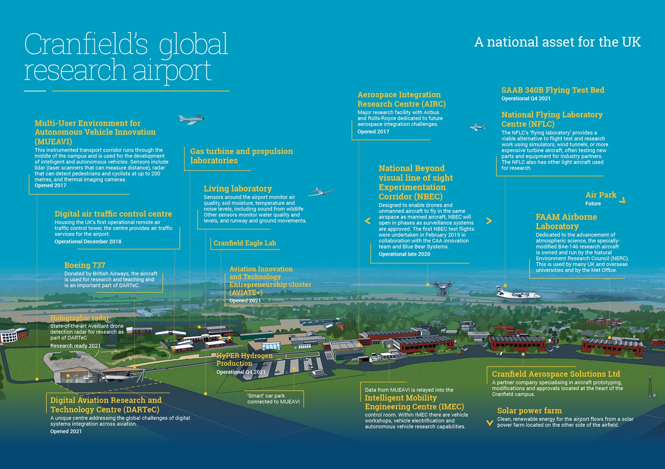

Slide 9
Contact us for a complimentary one-hour review to discuss your business and technical goals
droneinnovationhub@cranfield.ac.uk
https://www.cranfield.ac.uk/themes/aerospace/drone-innovation-hub

