Slide 1
Global Manufacturing: Opportunities for 2015 and Beyond Cranfield University, March 17 2015
Address by Peter Marsh
Author, “The New Industrial Revolution: Consumers, Globalization and the End of Mass Production” www.petermarsh.eu
Twitter @petermarsh307
Notes:
0

Slide 2
(Trumpf laser cutting machine) “There’s a new zeitgeist: I’m seeing a global manufacturing renaissance” : Jeff Immelt, chief executive, General Electric
Global re-industrialisation on the agenda

Slide 3
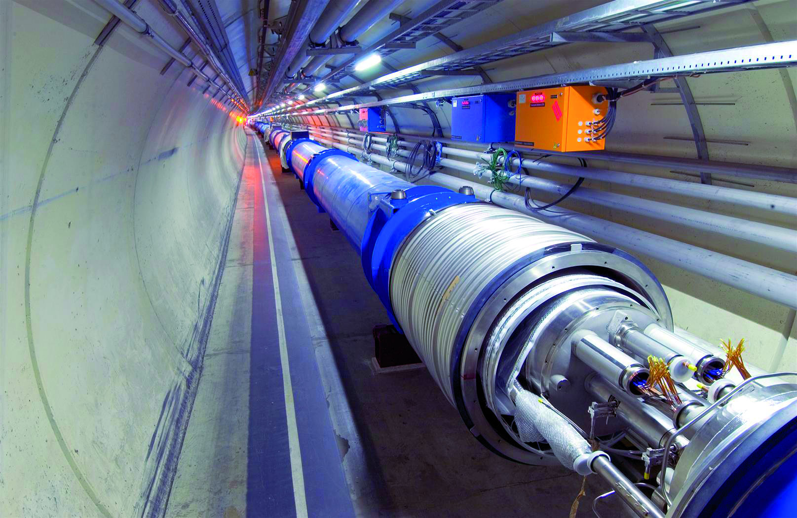
Many “hidden champions” in manufacturing: Fine Tubes (UK) makes 700 sorts of tube
Tubes used inside Cern particle accelerator

Slide 4
Global manufacturing: the opportunities
A. Manufacturing in 2015
B. Key trends
C. What’s changed (the five “C”s)
D. The potential

Slide 5
Global Manufacturing: the Opportunities
A. Manufacturing in 2015

Slide 6
Global economy in 2015
Economic slowdown
Deflation fears
Lower commodity prices
End of emerging market boom
Immense competition outside “niche” areas
Innovation focus

Slide 7
Manufacturing: the key factors
Creative force behind 10bn unique products
About one sixth of world economy
Source of new ideas; stimulates services activity
Employs about 300m people (one third in China) or 1 in 25 of the population

Slide 8
Manufacturing requires four components
MATERIALS
SKILLS
T
ENERGY
CAPITAL

Slide 9
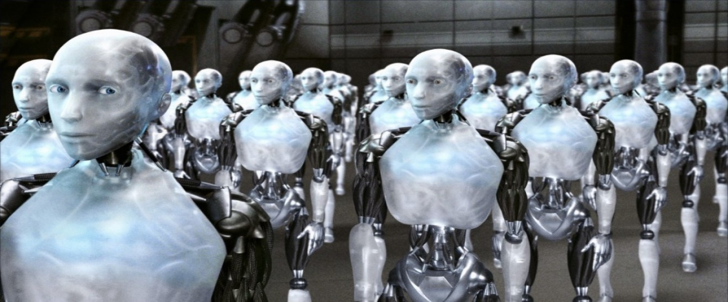
Now a new one has entered the picture
DIGITAL TECHNOLOGY
AIDS MANUFACTURING THROUGH FACILITATING TECHNOLOGY CONVERGENCE AND BOOSTING THE IMPACT OF THE 5Cs: CONNECTIONS, CREATIVITY, CUSTOMISATION, CRAFT AND CHINA

Slide 10
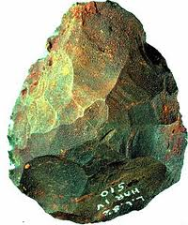
10,000 years of evolution in adding information to materials
Stone age axe : resources needed to make one unit
Manufacturing workers: 1
Sites: 1
Materials: 1
Skills honed by empirical knowledge built up over centuries

Slide 11
The stage we’ve reached now
A 2015-vintage phone: resources needed to make one unit
Manufacturing workers: 5,000
Sites:50
Materials: 50
Skills honed by science and technology advances

Slide 12
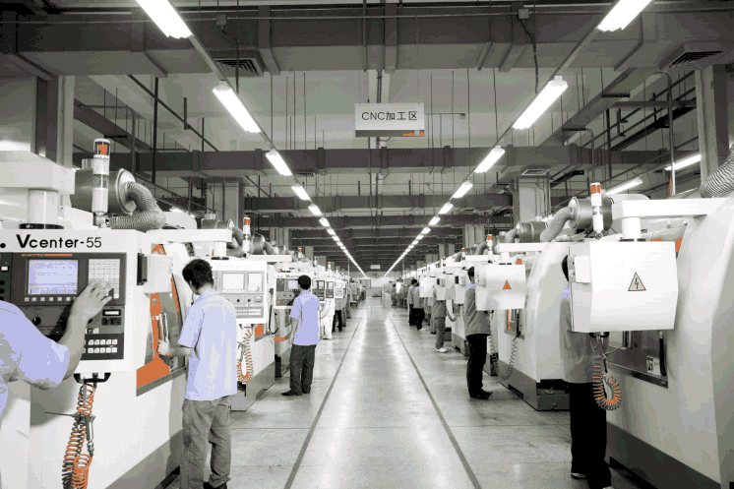
There won’t be a boom in manufacturing jobs
US factory employment fell by 5m between 2000 and 2013 (17.2m to 12.2m) EU lost 7m manufacturing jobs 2000-13 (38m to 31m)
Plant run by Mindray medical equipment group in China

Slide 13
Global Manufacturing: the Opportunities
B. Key trends

Slide 14
How world GDP is divided up
*constant 2005 prices
Source: UN

Slide 15
Manufacturing output: China’s has soared, but so has the US’s Picture since 1970 shows a small rise for the UK and other European nations
Source: UN

Slide 16
Manufacturing league table today: China no. 1, UK no. 10
* Estimate Source: UN, IHS Global Insight

Slide 17
Shift in global manufacturing since 1990
"Golden age" of developed-world manufacturing
Globalisation of manufacturing supply chains
Forecast
Source: Oxford Economics/Haver Analytics

Slide 18
Global Manufacturing: the Opportunities
C. What’s changed (the five “C”s)

Slide 19
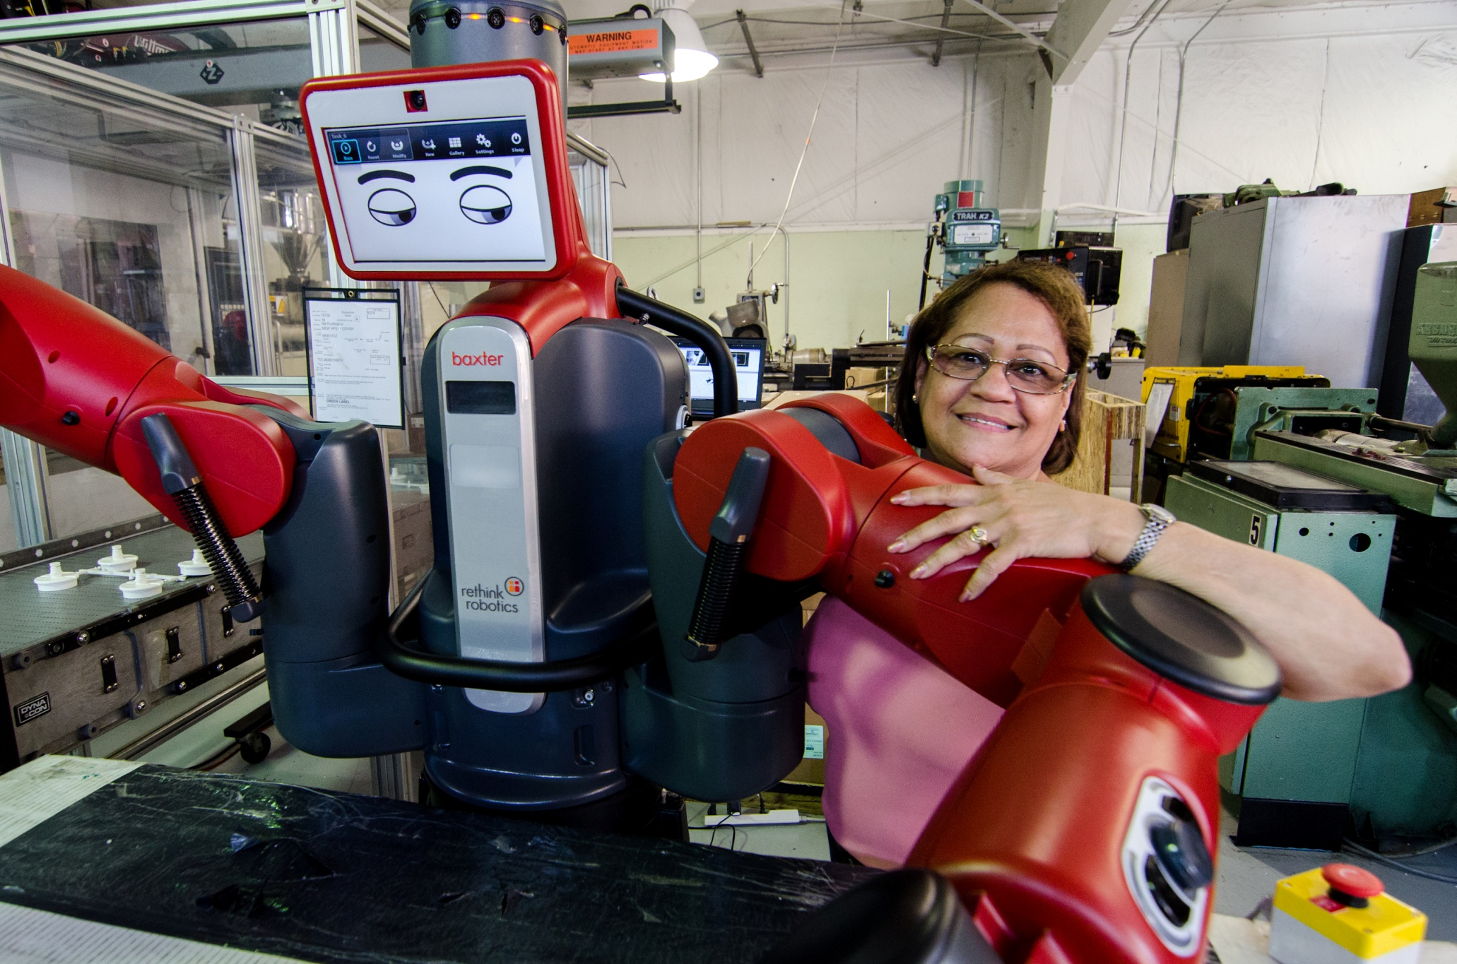
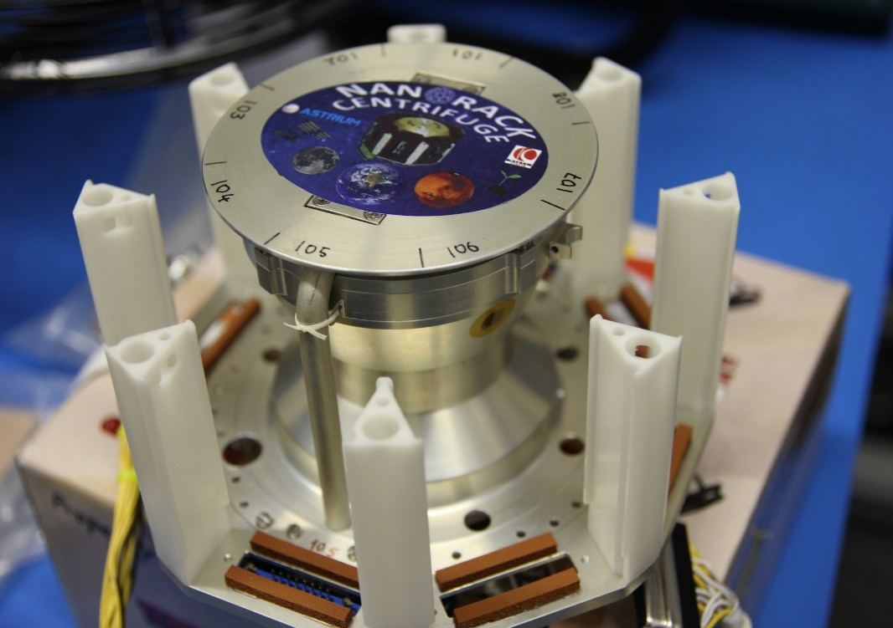
In the new era, the 5 Cs become important
CONNECTIONS
CREATIVITY
CRAFT
CHINA
CUSTOMISATION

Slide 20
CONNECTIONS

Slide 21
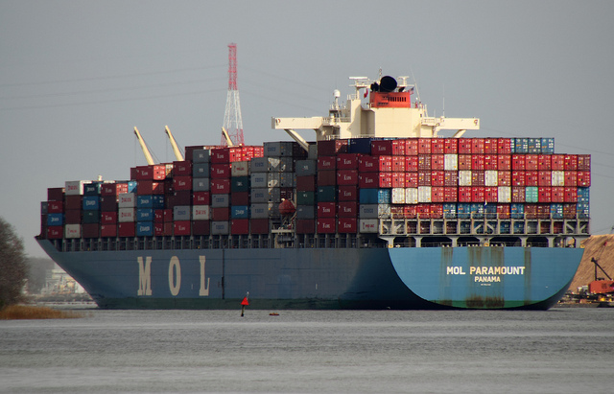
Supply chains are part of the story

Slide 22
…as is telecommunications

Slide 23
As supply/information chains become more complex, dispersed design/manufacturing becomes normal

Slide 24
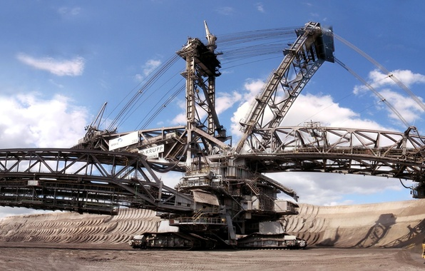
The Internet of Things (one form of connected manufacturing) will influence many sectors
PRODUCTION
TELECOMMS
BUILDING/MINING
AGRICULTURE
Y
ENERGY
TRAFFIC
FLIGHT
HEALTHCARE

Slide 25
CREATIVITY
CREATIVITY

Slide 26
Submarines (and modern aircraft) require huge range of technologies
BAE Systems, Barrow

Slide 27
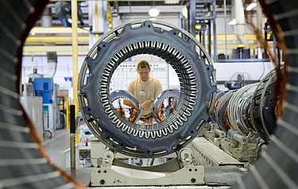
Shigenobu Nagamori of Nidec (Japan): move to reduce energy consumption of electric motors (250bn in the world)

Slide 28
CUSTOMISATION

Slide 29
Manufacturing personalisation: car production

Slide 30
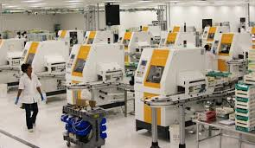
Essilor of France – world leader in customised lenses

Slide 31
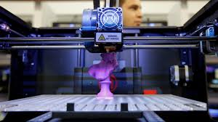
3D printing – adding materials in layers (customisation/making the impossible)

Slide 32
Make your own 16th century cornett (Ricardo Simian of Switzerland)

Slide 33
CRAFT

Slide 34
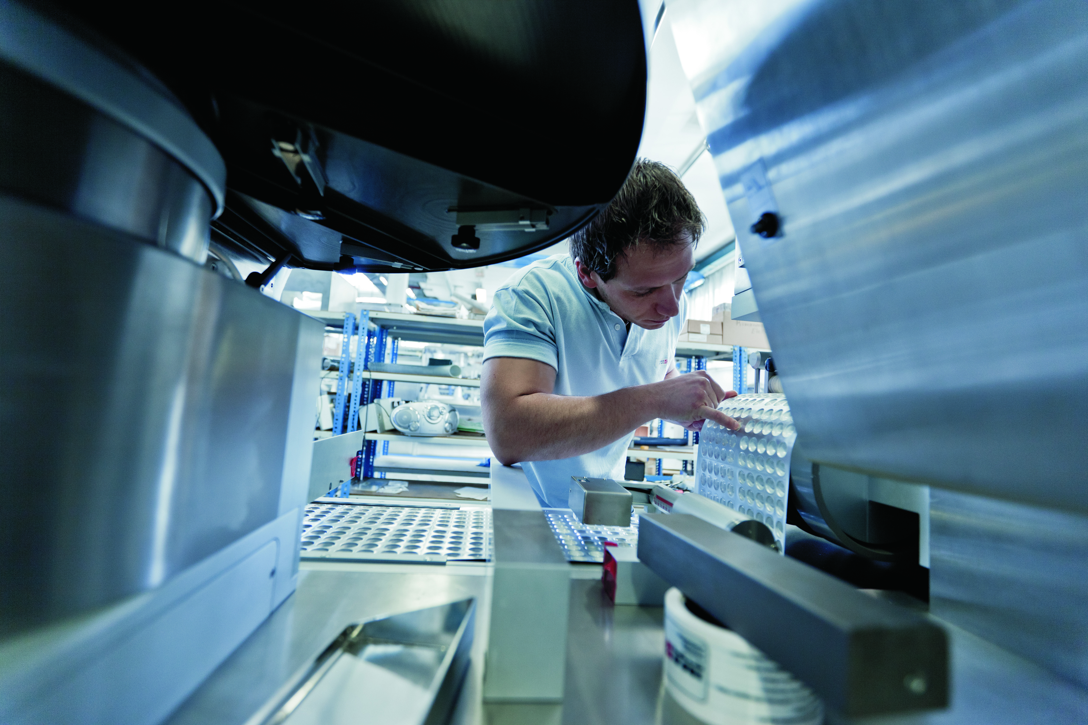
The Italian craft cluster remains important (IMA packaging machine leader, among many small engineering groups in Bologna)

Slide 35
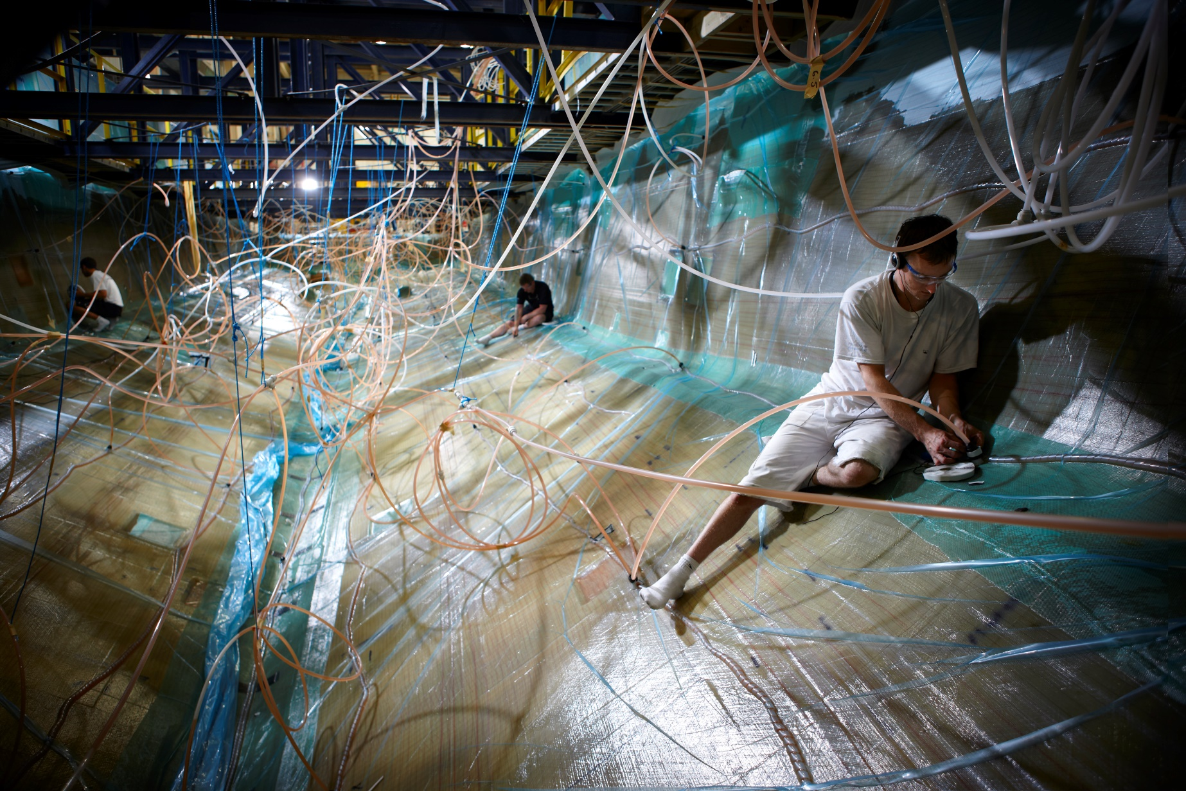
Building an expensive motor yacht is hard to automate (Princess Yachts)

Slide 36
CHINA

Slide 37
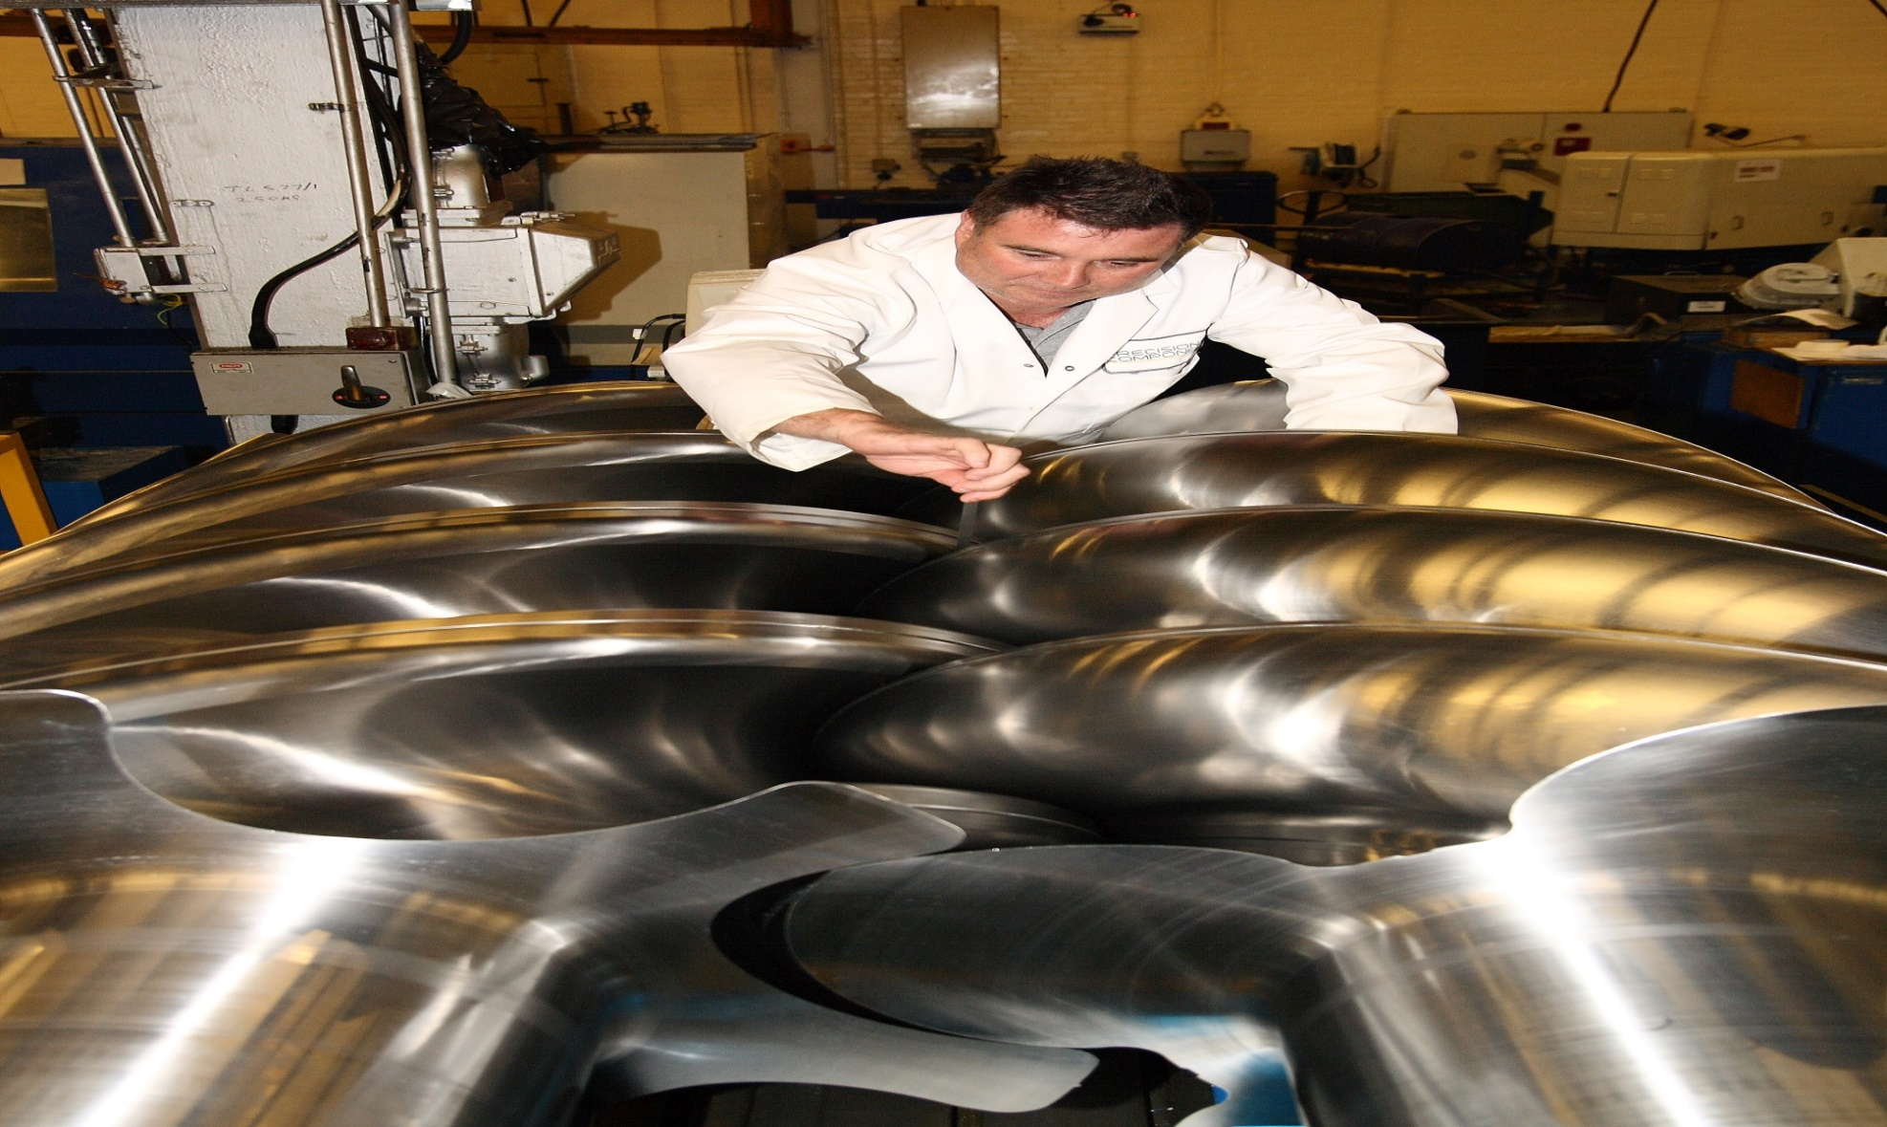
China connection to Made in Britain
Holroyd machine tools – based in Rochdale but owned by Chongqing Machinery and Electric

Slide 38
New materials: carbon fibre composites
New companies– eg in 3D printing
Tao Feng of Beijing Long Yuan 3D printer company in Beijing

Slide 39
Global Manufacturing: the Opportunities
D. The potential

Slide 40
After a decade of change, a levelling off Stripping out Japan and China shows revealing pattern
Source: UN

Slide 41
Focus on products: motorbike maker TVS (India)

Slide 42
Good prospects for the unexpected “champions”: Air Tractor (US) with crop sprayers

Slide 43
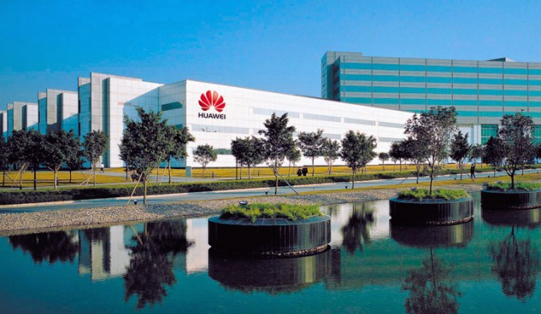
Study the growth companies (Huawei, China)

Slide 44
New breed of networking/smart grid/dispersed design companies (Sigfox of France/Nuri Telecom of S Korea/Libelium of US)

Slide 45
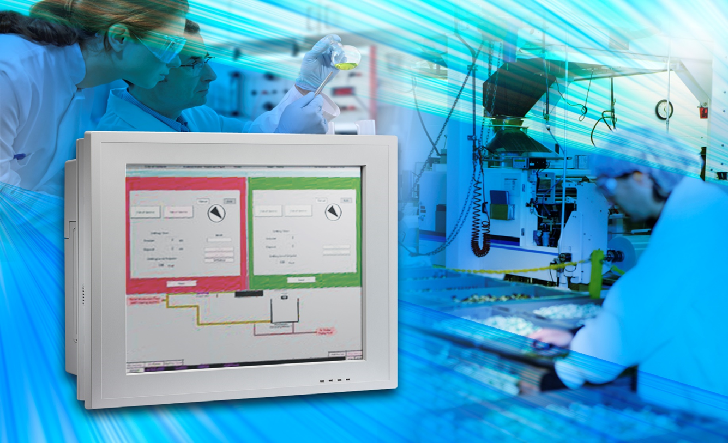
Winners from the new industries: such as smart sensors
Sensor/system makers: from top left, clockwise, Crompton Greaves (India); Zytronic (UK); Sensor
Instruments(Germany); Worldsensing (Spain)

Slide 46
Capitalise on the new opportunities: US company Shinola in Detroit

