Slide 1

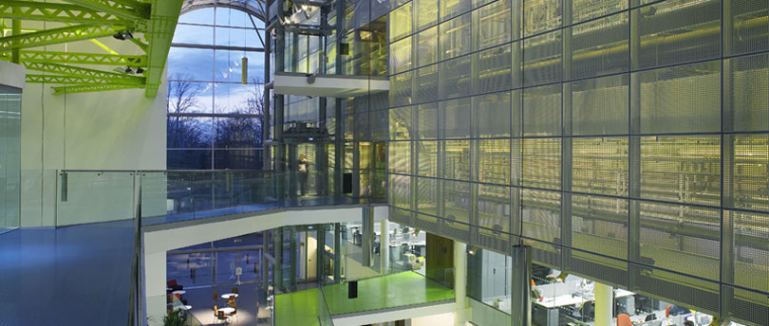

Global Manufacturing Challenges in Bulgaria
Manufacturing Student Think Tank 2015
March 17th 2015
Petar Mitsev

Slide 2
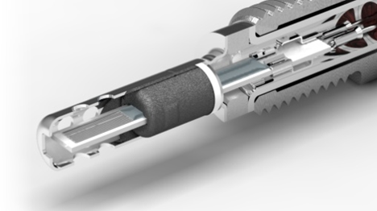
Table of Contents
Bulgaria at a glance
Automotive sensing drivers
Bulgaria manufacturing tailwind and headwind
Talent management
Forward looking
Automotive exhaust gas sensing design (Sensata Technologies)

Slide 3

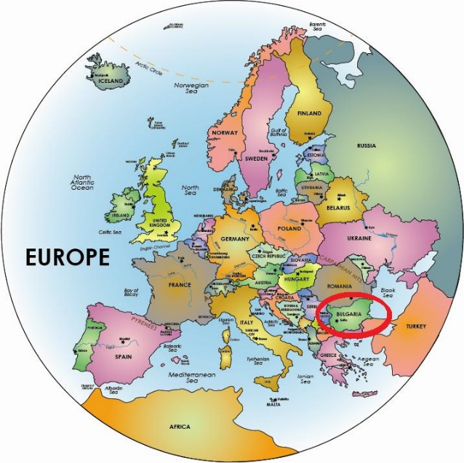
Bulgaria at a glance
Craft heritage
  Cultural fortune
Nature
EU Asia interface
Having fun know how

Slide 4
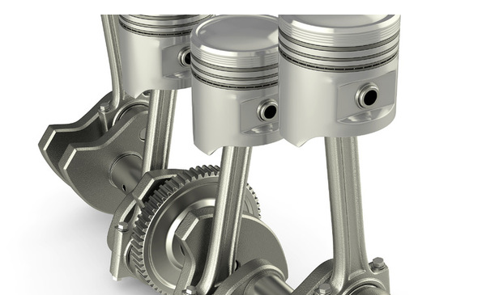
Tailwind. Stability and Cost
Stability
Bulgaria is a member of the European Union, NATO and WTO
Currency pegged to the euro at the level of 1.96
One of the lowest government debts in the EU (18.9 % of GDP as of 2013)
Cost of doing business
Corporate income tax is 10%, the lowest in the EU. Personal income tax is 10% flat rate.
Industries in high-unemployment areas are granted 0% tax
There is a 2-year VAT exemption for imports of equipment for investment projects over €5 million, creating at least 50 jobs
Depreciation time for new manufacturing equipment is 2 years
5% withholding tax on dividends and liquidation quotas (0% for EU tax residents)
Bulgaria has one of the most competitive costs of labor in the world (lowest in the EU)
Favorable construction, rents and utilities cost. Electricity for industrial users is 70% of the European average

Slide 5
Tailwind. Location and Market Access.
Strategic location
Located at the heart of the Balkans, Bulgaria is a strategic logistics hub. Ease of transportation of cargo is provided by
Five Pan-European corridors ( IV, VII, VII, XI, X), which pass through the country
Four major airports: Sofia, Plovdiv, Bourgas and Varna
Two main seaports: Varna and Bourgas, ports on the Danube river.
Access to markets
European Union - zero tariff market with population of 500 million
CIS – still not well penetrated market with a high potential
Turkey - zero tariff market of near 80 million population
Middle East – a market with high purchasing power
North African market

Slide 6
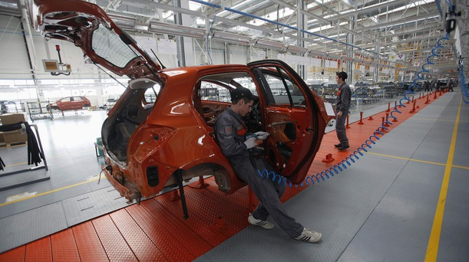
Talent
Great Wall Motors plant in Lovech (Reuters)

Slide 7
Talent. Industry + Academy
Close collaboration is an effective, mutually beneficial development and sourcing route

Slide 8
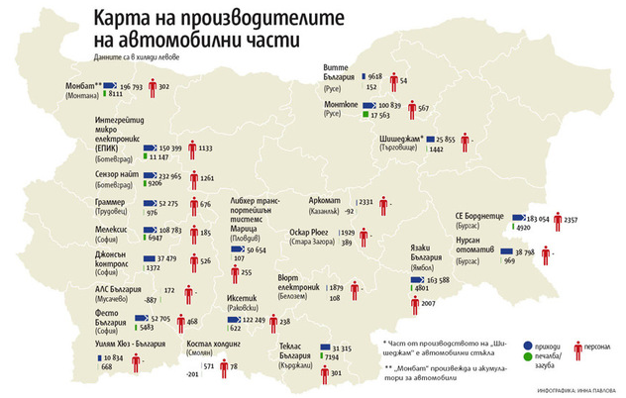
Sensors Business represents 67% percent of Sensata’s business
Our primary focus is the global automotive market and contiguous segments
Organic growth is driven by increased sensor content, emerging market gmature markets
Fundamental rowth, and recovery of long-term trend of government regulations require OEM’s to implement system solutions to reduce tail pipe emissions and improve fuel economy and safety
All system solutions require a mix of sensors to provide input about vehicle environment. Examples: pressure, temperature, speed, position, acceleration, chemical
Automotive manufacture penetration
Over 50 tier 1 and 2 automotive suppliers
Sofia and Plovdiv clusters
Comprehensive OEM customer base

Slide 9


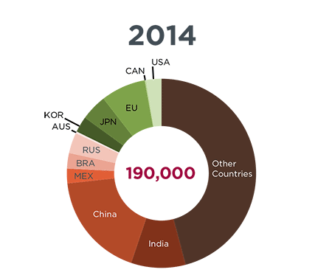

Automotive Sensing
Driven by societal imperatives
CLEAN ENVIRONMENT
Reduce emissions in air and water
EFFICIENCY
increase productivity
Premature deaths
from vehicle exhaust¹
SAFETY
Reduce loss of life, injury, accidents
1 International Council on Clean Transportation

Slide 10
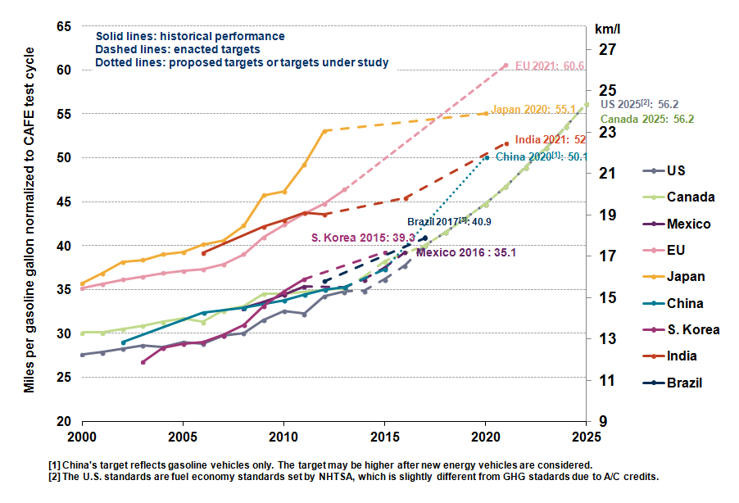
Fuel Economy Expectations Are Rising (MPG)
Source: International Council on Clean Transportation, May 2014 http://www.theicct.org/info-tools/global-passenger-vehicle-standards.

Slide 11
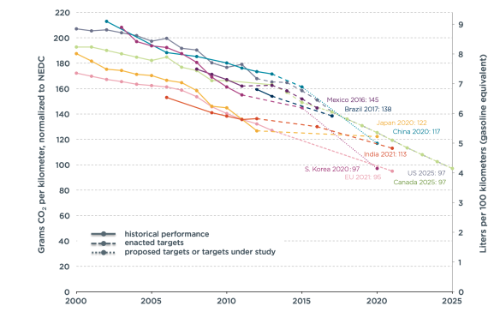
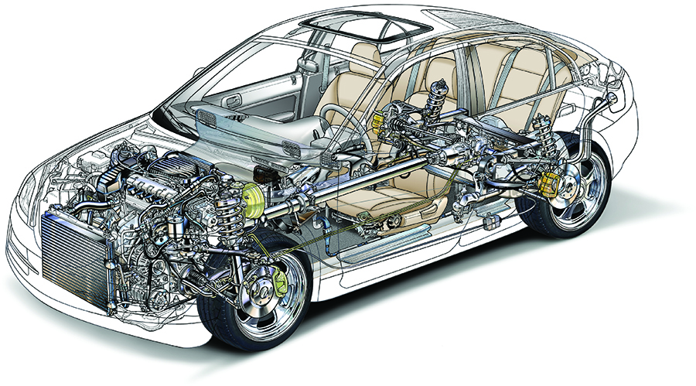
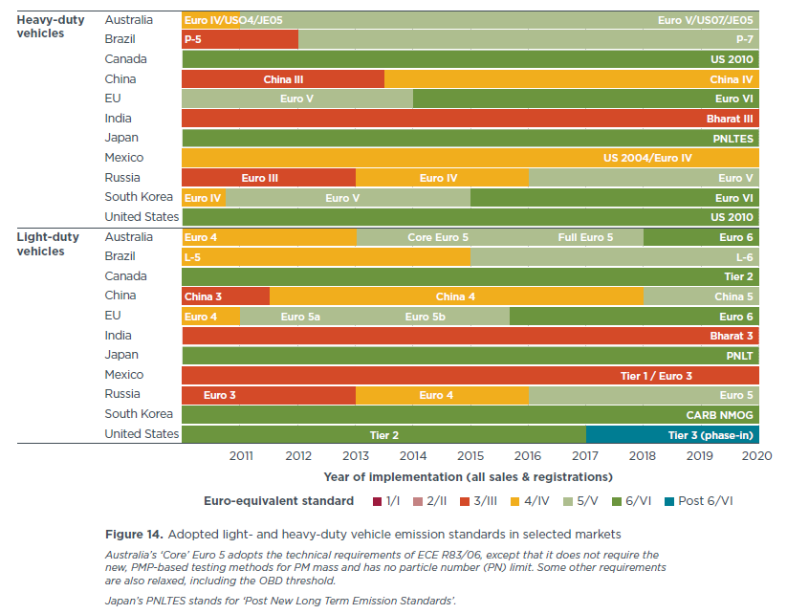
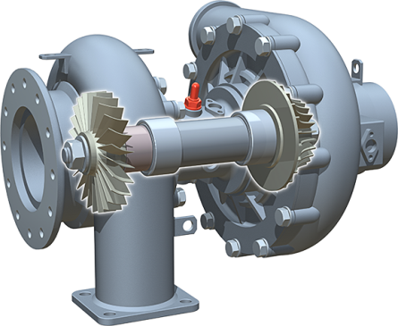
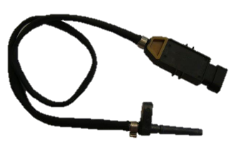
Development of a Sensor
SOCIETAL IMPERATIVES
SYSTEM DEVELOPMENT
PERFORMANCE SENSING
Across Customers
Across Geographies
Across Applications

Slide 12
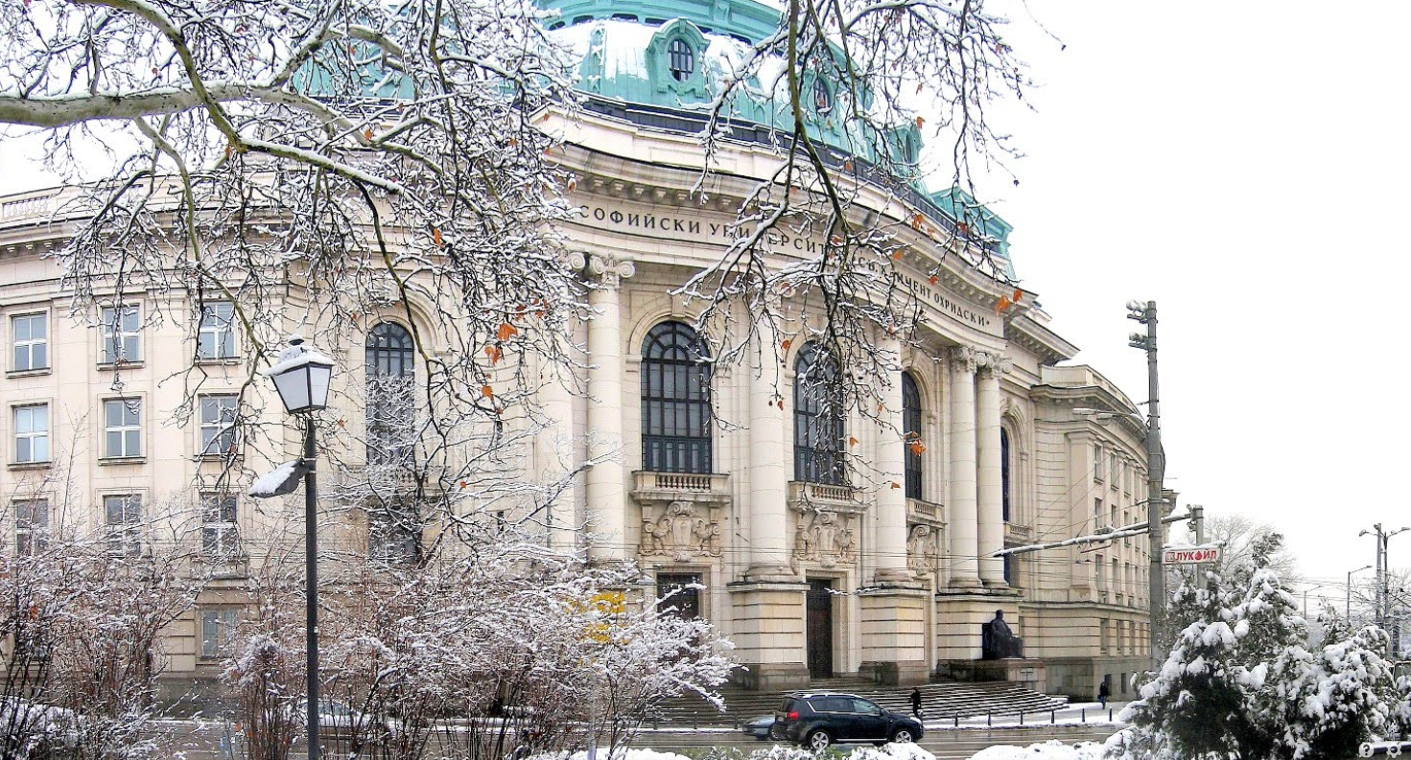
Bulgaria automotive looking forward
Sofia University st. Kliment Ohridski
Strong long-range industry growth drivers - ecology, safety and efficiency
Very favourable overall manufacturing environment
Knowledge-based manufacturing depends on timely talent acquisition

