Slide 1
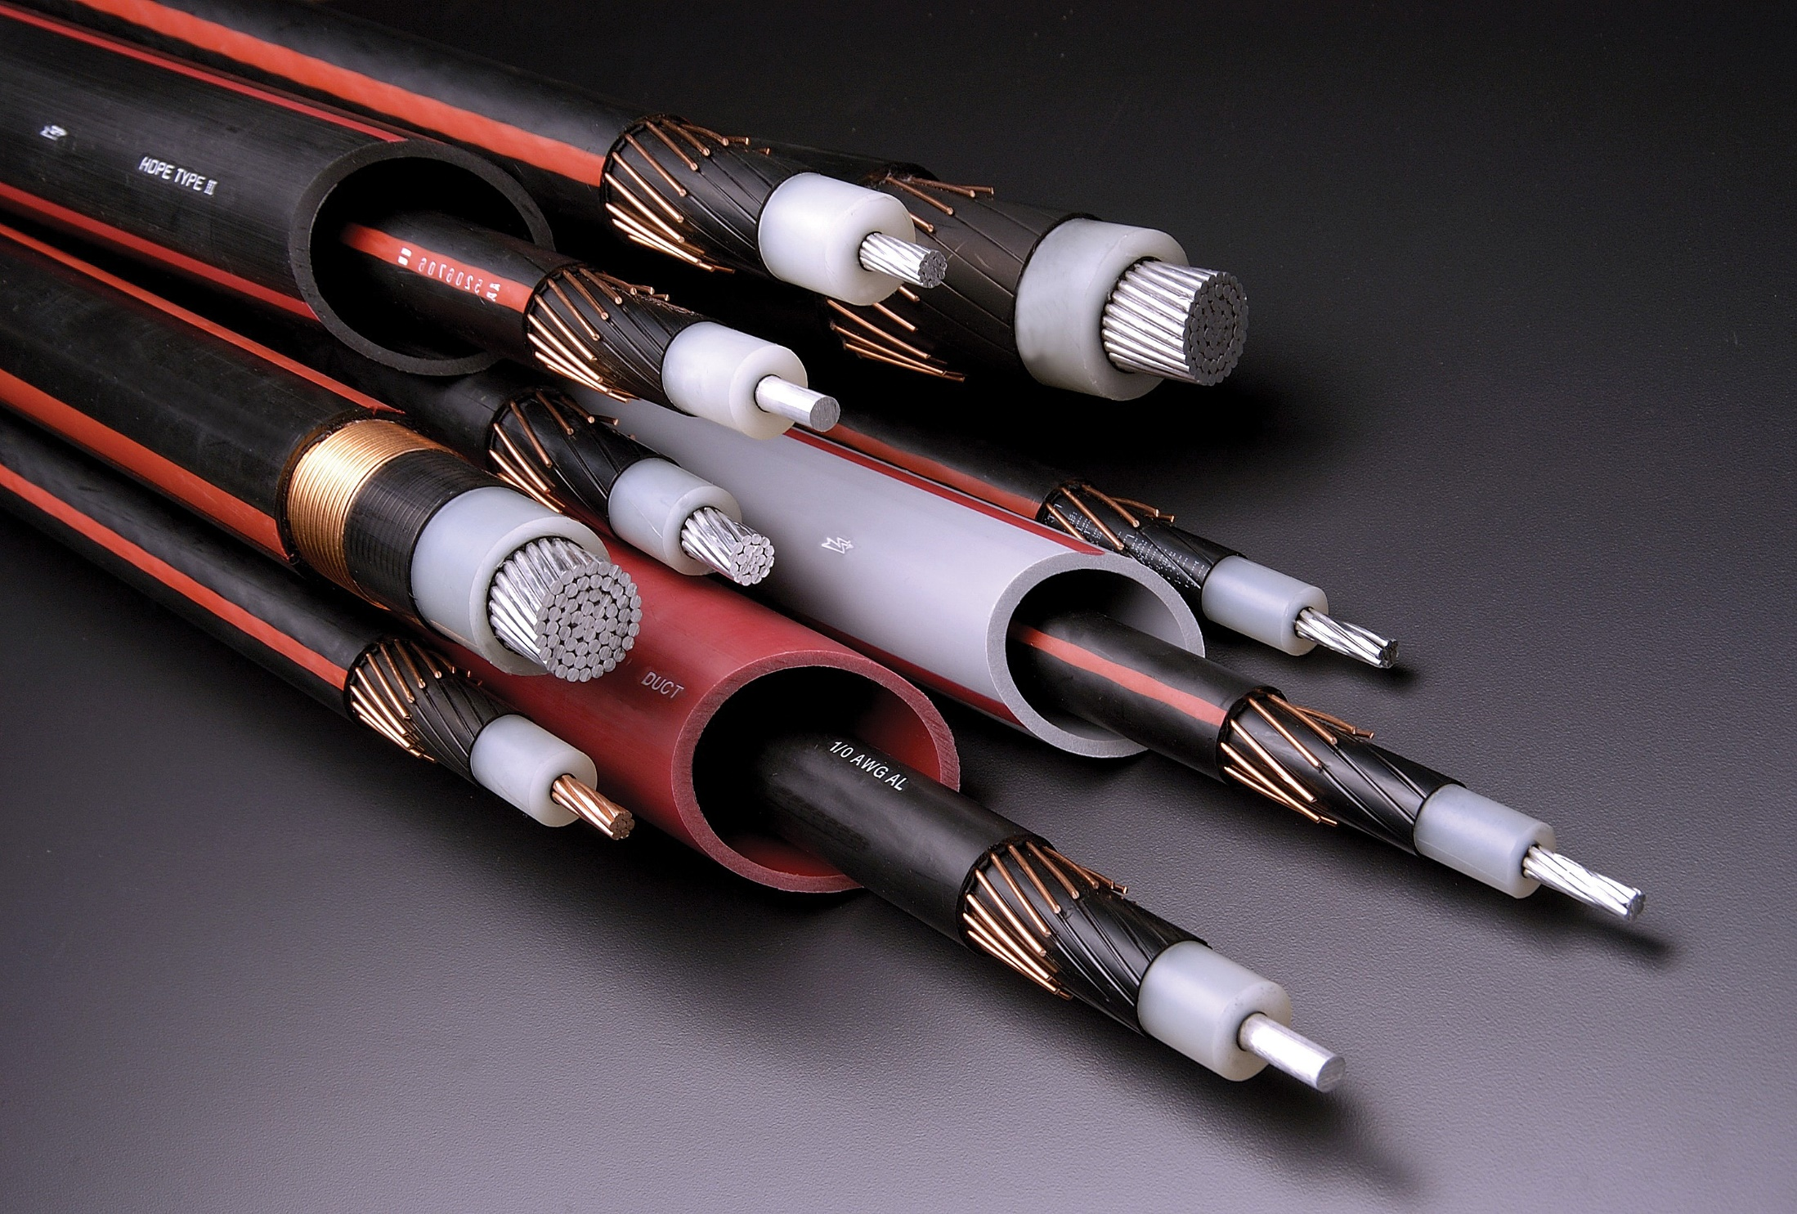
Manufacturing Industry in Nigeria
Oghenefego Okathe School of Aerospace, Transport & Manufacturing 17th March, 2015

Slide 2
Introduction
Overview
Growth
Challenges
Opportunities

Slide 3
General Information
?
Population 2012 (estimated) 173M
Over 300 ethnic groups
400 native languages
A top Oil producing economy
Oil contributes over 90% exports revenue
Largest Economy in Africa & Third fastest growing economy in the world
Notes:
How do I reference different sources for different information? Is it necessary?

Slide 4
GDP Manufacturing Percentage
Manufacturing is the New Driver of Economic Growth in Nigeria
Manufacturing now Contributing up to 9.03% to real GDP
Source: World Bank – World Development Indicators

Slide 5
Manufacturing Annual Growth Rate (%)
Nigerian manufacturing is one of the Top growing industry in the world – 2nd in 2013
From: World Bank – World Development Indicators

Slide 6
Manufacturing Sectors
Others include
Chemicals and Pharmaceuticals
Pulp and paper
Automotive Sector

Slide 7
Developing Auto Industry
Average of 100 thousand new Vehicles are purchased annually
New Automotive Industry Development Plan
Several Manufacturing and Assembly Plants
Strong Collaboration of Indigenous and foreign companies
Notes:
How many auto plant are in Nigeria?

Slide 8
Major Manufacturing Drivers
Policies aimed at diversifying the Economy
Investment in Manpower – Better Education funding
Foreign Investment

Slide 9
Major Challenges
Weak Infrastructure
Power Supply
Transportation
Human Capital
Level of Education
Industrial Skills
Low Patronage ‘Made in Nigeria’ goods
Perceived Poor Product Quality

Slide 10
Opportunities
Huge Local Market
Abundant Raw Materials
Over 70% locally sourced
Cheap Labour
72% of the population are under the of 30 years

Slide 11
Manufacturing Industry in Nigeria
Thank You
Oghenefego Okathe
MSc Engineering and Management of Manufacturing Systems
School of Aerospace, Transport & Manufacturing
o.g.Okathe@cranfield.ac.uk
+447405471192

