Slide 1
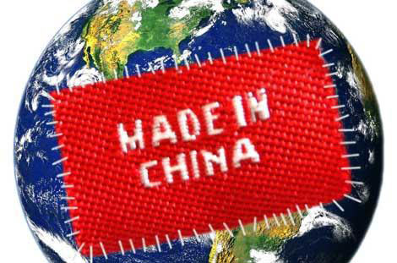
Opportunities and challenges of the manufacture in China
Mu Chen
March 17th 2015

Slide 2
Manufacture in China

Slide 3
Manufacture in China
Exported manufacturing products
Data source:聚焦中国：经验与挑战 © OECD 2012

Slide 4
Manufacture in China
Comparison among export types
Data source:聚焦中国：经验与挑战 © OECD 2012

Slide 5
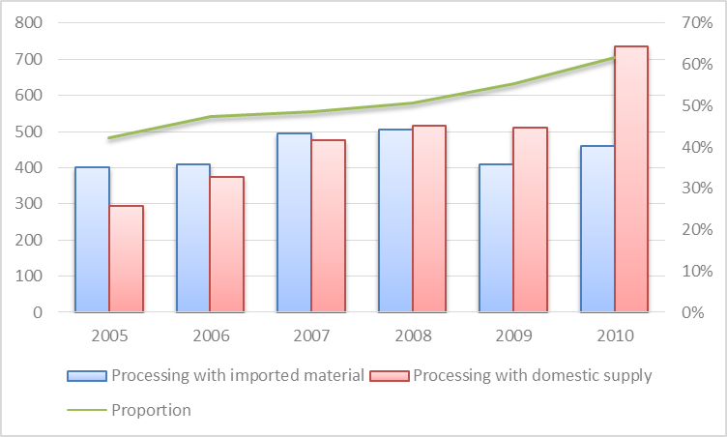
Change happening
More value adding activities in the value chain
Trade export of Chinese local companies (100million US dollars)
sourcing, design and processing
processing
Data source:聚焦中国：经验与挑战 © OECD 2012

Slide 6
Change happening
Chinese manufacturing industry changes way to invest
Data source:聚焦中国：经验与挑战 © OECD 2012

Slide 7
Change happening
Pioneers to win in global market

Slide 8
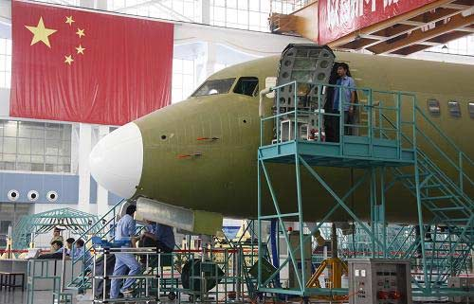
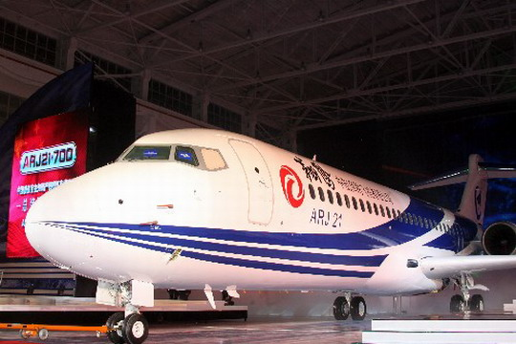
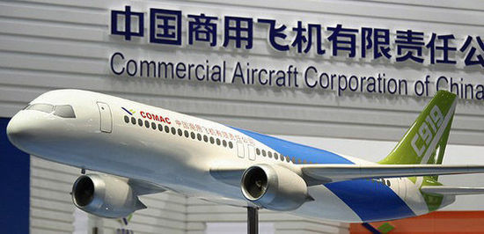
Change happening
Aerospace manufacturing
Data source:
http://finance.people.com.cn/GB/8215/113014/7226080.html
http://info.cm.hc360.com/2009/06/081100122439-2.shtml
http://jiangsu.china.com.cn/html/junshi/rdxw/292803_1.html

Slide 9
More Opportunities
Industrial structure change
Mutual stimulation brought by the development of productive service industry
Productivity improvement caused by technology upgrade
Benefit from the forming of the “Asia Factory”
Demand growth with the developing domestic purchasing power

Slide 10
More Challenges
Increasing labour cost
Competition from South Asia countries
Less developed areas
Immature business ecosystem in the west
Unsustainable development
Imperative pollution control
Pressure from keeping profit and pursuing sustainability

