Slide 1
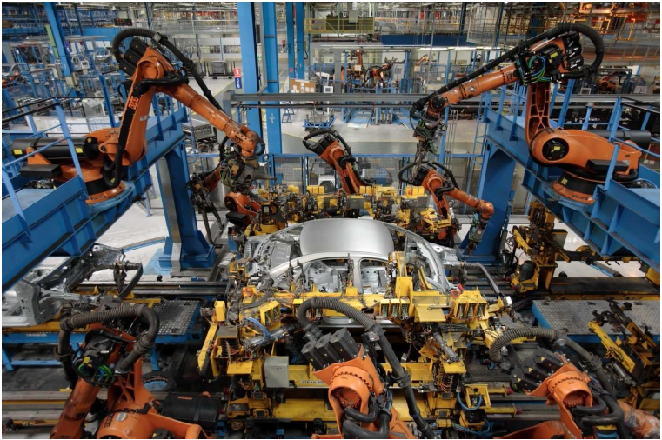
Manufacturing in Spain Current challenges and future trends
Luis Isern Arrom
17/03/2015

Slide 2
Contents
Present
Challenges
Future trends

Slide 3
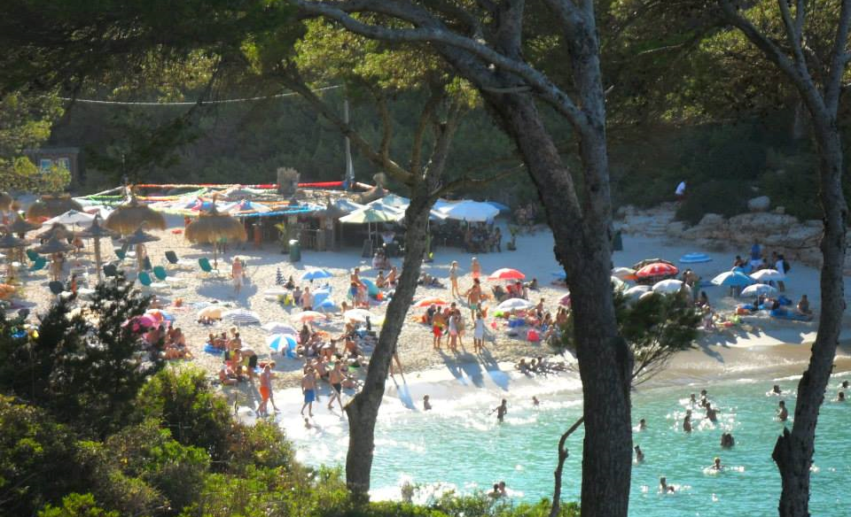
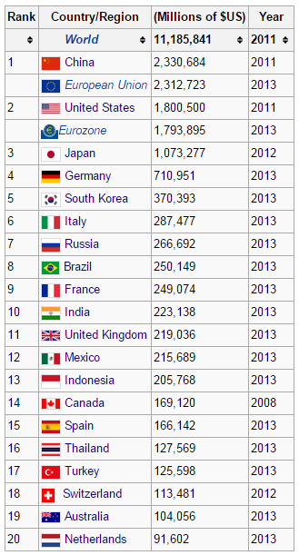
I. Spain
Manufacturing Data
Spain ► 12% GDP (INE)
UK ► 10% GDP (World Data Bank)
28th in population!!!
Notes:
Impression: Manufacturing sun and good weather.
If we go to Wikipedia:
List of manufacturing countries
No Spanish companies in the top100 list of largest European manufacturing companies by revenue (none Spanish) (except ArcelorMittal).
More reliable sources:
Tourism: Services is 74% GDP (world data bank):

Slide 4
I. Spain: manufacturing
Manufacturing (2013 Total turnover: 447,283 M€)
Food 19%
Metallurgy & Metals 12%
Petrol 12%
Vehicles 12%
Chemical 9%
Automotive Industry turnover accounts for 10% of GDP.
…and 18.5% of Exports
Sources: INE (Spanish Statistical Office) – Encuesta industrial de empresas 2013
Ministerio de Industria, Energia y Turismo (Minetur)

Slide 5
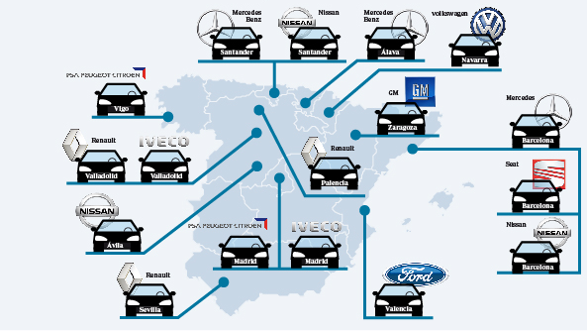
I. Spain: vehicle manufacturing
2nd country in Europe (2.1 million vehicles 2013).
Source: OICA (Organisation Internationale des Constructeurs d’Automobiles). Map: ABC (journal) website

Slide 6
II. Challenges: Unemployment
Source: OECD

Slide 7
II. Challenges: R&D
R&D low in Spain
Percentage from private sector (€ average 64%)
78%
69%
68%
78%
66%
67%
74%
65%
69%
64%
72%
65%
69%
53%
53%
58%
38%
0.2
Source: Minetur (Agenda para el fortalecimiento del sector industrial en España, Sept 2014)

Slide 8
II. Challenges: Energy
Electricity cost for industrial companies: 30% higher than EU average
EU(27) average = 0.09
Source: Eurostat. Prices from 2014 for medium sized industries (500-2000 MWh).

Slide 9
III. Future trends
European Commission: Target of 20% GDP from industry in 2020.
Source of stable and high-quality employment.
Multiplier effect on other economic areas.
Ministry of Industry, Energy and Tourism: Spanish Industry Strengthening Plan:
10 lines of action.
Source: Minetur (Agenda para el fortalecimiento del sector industrial en España, Sept 2014)

Slide 10
III. Future trends
Spanish Industry Strengthening Plan
Unemployment:
Foreign investment: standardization of legislation and simplification (digitalization) of bureaucracy.
SME average size growth:▼ administrative costs, new technologies.
Education reform: closer to labour market.
Energy:
Reform in electric market: ▲ transparency and competition. Smart electric grid.
Update of industrial technologies and processes.
R&D
Spin offs
Financial support
Source: Minetur (Agenda para el fortalecimiento del sector industrial en España, Sept 2014)

Slide 11
III. Future trends
Private sector
How to be competitive? Key factors
International projection
Innovation
Quality
Technological Centres (Private, non-profit, R&D institutions)
1996 FEDIT ► 2014: 36 centres associated
Income
250M€ (x2 in 10 years)
62% from private sector
Low cost: not relevant
Sources: Top management survey by Deloitte (2011)
FEDIT annual report (2013)
Notes:
Se consideran Centros Tecnológicos de ámbito estatal a aquellas entidades sin ánimo de lucro, legalmente constituidas y residentes en España, que sean creadas con el objeto de contribuir al beneficio general de la sociedad y a la mejora de la competitividad de las empresas mediante la generación de conocimiento tecnológico, realizando actividades de I+D+i y desarrollando su aplicación. La actividad de los centros se ha mostrado esencial para el desarrollo tecnológico e industrial de las PYME españolas.

Slide 12
Thank you for your attention!

