Slide 1
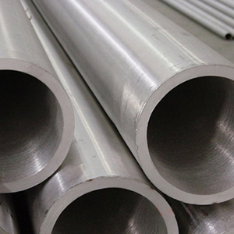
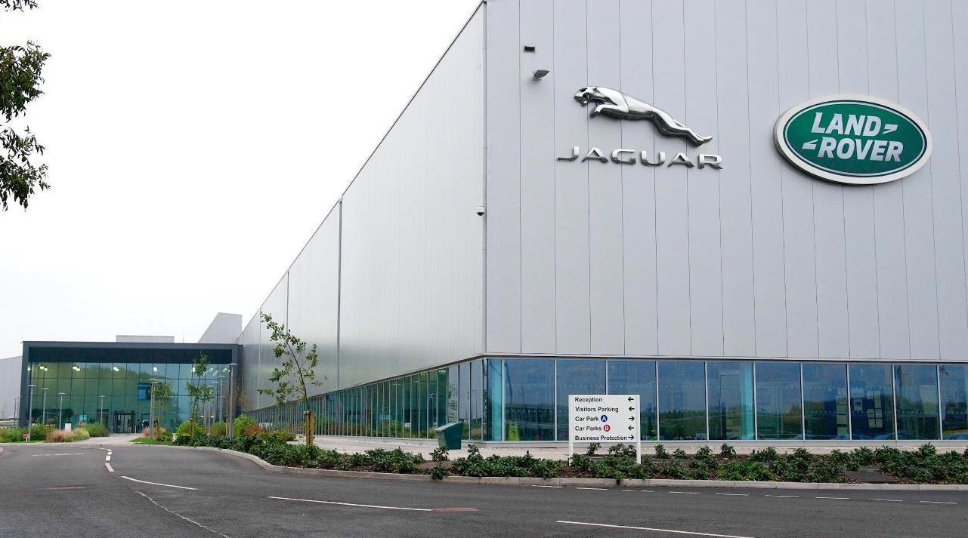
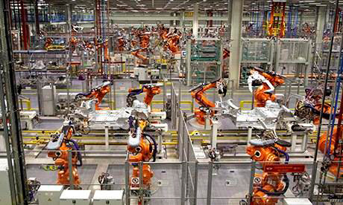
UK Manufacturing in past, present and future
Davood Sabaei
PhD Student, Cranfield University
Think Tank event 2015
Cranfield University

Slide 2
UK Manufacturing - facts
Global market worth £6.3 trillion
2012 total UK manufacturing sell was £347.1 billion
GVA of £130 bn (10.5% UK GVA)
World #2 Aerospace
Resurgent auto industry
54% of UK Exports
2.5 million+ UK jobs
72% of UK R&D is funded by the manufacturing industry.
Manufacturing, value added (% of GDP)
Source: The world Bank database
Notes:
GVA= Gross Value Added
GDP=Gross domestic product

Slide 3
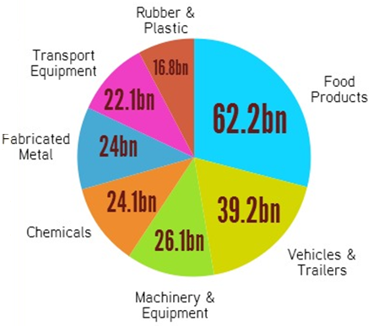
Manufacturing sectors footprints
In 2012, total UK manufacturing sell was near £347.1 billion.

Slide 4
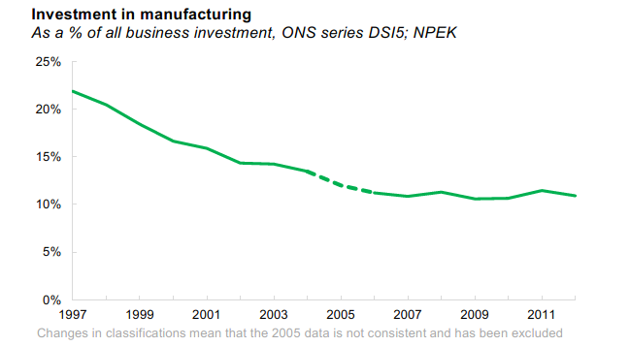
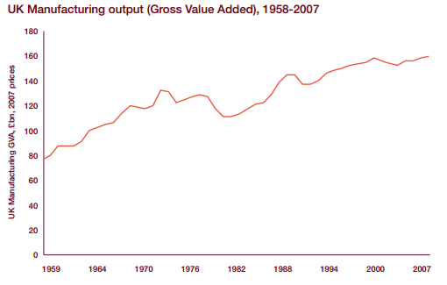
v
Investment and Output
Source: The world Bank database
Notes:
In 1997, investment in manufacturing was worth £21.6 billion, 22% of total investment by businesses. In 2012, it was worth only £13.8 billion, around 11% of total business investment.
Reduction in investment is one reason for reduction in workforce another reason is growing business without employees!
Now that investment has reduction productivity need to be improved to compensate it.

Slide 5
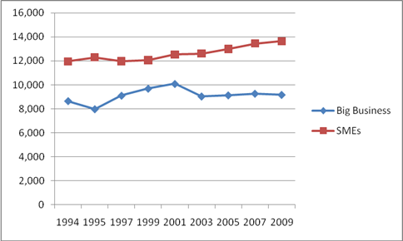
Why UK is one of the best places for manufacturers?
Small and medium scale enterprises (SMEs)
In 2008 there were an estimated 4.8 million SMEs in the UK employing about 13.7 million people with a combined annual turnover of £1,500 billion and growing more each year.
(Source: Department of business and innovation, 2013)

Slide 6
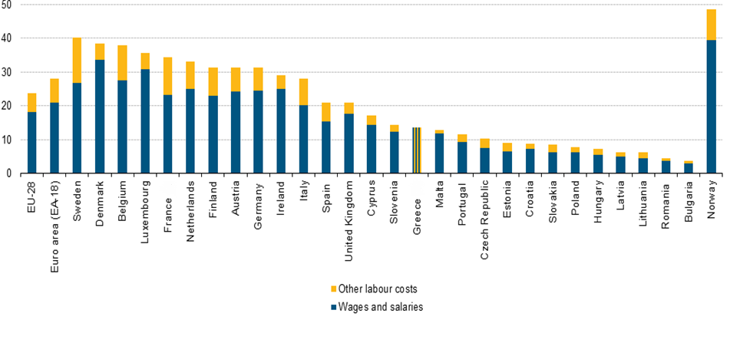
Labour Cost
Source: European Commission

Slide 7
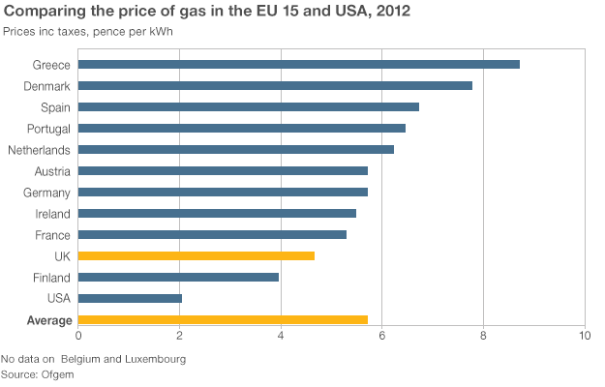
Energy Price and Governmental research investment
Average EU and US Gas Price,2012
Source: ACER, 2013

Slide 8
Governmental research Investment
EPSRC (Engineering and Physical Sciences Research Council): Invests around £800m a year in world class research and training to promote future economic development and improved quality of life. Manufacturing share was £322m in last 4 years.
CATAPULT: Helps companies of all sizes, develop new technologies to
commercial reality and etc.
High Value Manufacturing (HVM) Catapult has 7 centre and £369m capital base.
Innovate UK: is a government-funded body that works closely with UK businesses to promote, invest in and support technology-enabled innovation.

Slide 9
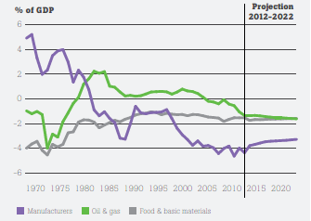
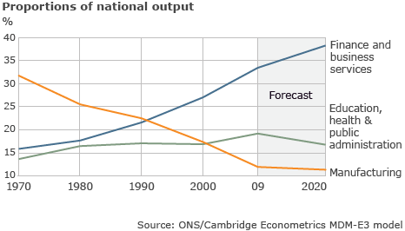
Projection of future
Balance of trades in goods ( %GDP):
Proportion of national output:
Source: (Coutts, k. & Rowthorn, R. , 2013)
Source: ONS/Cambridge Econometrics MDM-E3 Model

Slide 10
Foresight of Task force in UK
There will be around 800,000 jobs to fill in the years up to 2020, as people retire or leave manufacturing
By 2020 there are expected to be an additional 80,000 managerial, professional and associate professional and technical positions in manufacturing.
By 2030, 17% of the UK population will be aged between 60-74.

Slide 11
Thanks any Question?

